Slide 1
SWAN Fiscal Year 2025 Budget
February 6, 2024
Committee of the Whole Meeting

Slide 2
SWAN Budget Overview
Fiscal Year 2025: July 1, 2024 through June 30, 2025

Slide 3
Budget timeline
Finance Committee & Board work Nov, Dec, Jan
Financial audit completed for prior fiscal year 2023
Budget documents posted for membership on January 25, 2024
COW February 6, 2024 presentation & feedback
SWAN board meeting February 16, 2024 final review
Vote for approval March 7, 2024 at Oak Brook Public Library

Slide 4
Your action items (will repeat at end)
Submit bond schedule (if changed) by Friday 2/9
Complete software platform feedback survey by Friday 2/9
Complete EBSCO group-purchase opt-out by Friday 2/23
Schedule in-person attendance at 10:00 a.m. Thursday 3/7 Quarterly meeting for budget approval vote

Slide 5
Budget priorities
Helpdesk platform
Single sign-on (SSO)
Downsizing office space
Membership changes
Preparation & research
SirsiDynix annual subscription
Year-5 of 5-year contract
Removed BLUEcloud Mobile & eResource Central expense $95,130
OCLC annual subscription
Factored 3% increase

Slide 6
Budget Highlights
100 Libraries strong
Addison Public Library full member
Prairie State College exits
Year 2 Aspen Discovery catalog hosting & Support site hosting
Full year security initiative expenses: MDR
SWAN Expo August 2024: 50th anniversary of SWAN (1974-2024)
Revenue
Increase interest income
Small RAILS funding increase from prior years
Membership fees decrease -6%
Expenses
Overall, decrease -3.4%
Added SSO & helpdesk system

Slide 7
FY25 budget: Helpdesk platform
Replacement for OTRS ticketing system and user portal including improved analytics
Customer Relations Manager
Possible additional features
Knowledge Base
Forum integration
Candidates
Zendesk
Zoho Desk
Freshdesk
Budget line #5470 Support Services Subscription
$20,000 annual subscription in FY25 budget
Expense has a small offset with decommission of existing ticketing system

Slide 8
What is Single Sign-On?
Streamlined experience for member library and SWAN staff
Unify all SWAN’s services/accounts under single login
Sign in once and access all services
Leverage existing L2 account
No need to create new account or migrate credentials
Flexible framework – Easy to add new services going forward
Single sign-on is an authentication schema that allows a user to log in with a single ID to any of several related, yet independent, software systems.
Notes:
What is Single Sign-On?
Who does this effect? (SWAN Staff, Member Library Staff, not patrons)

Slide 9
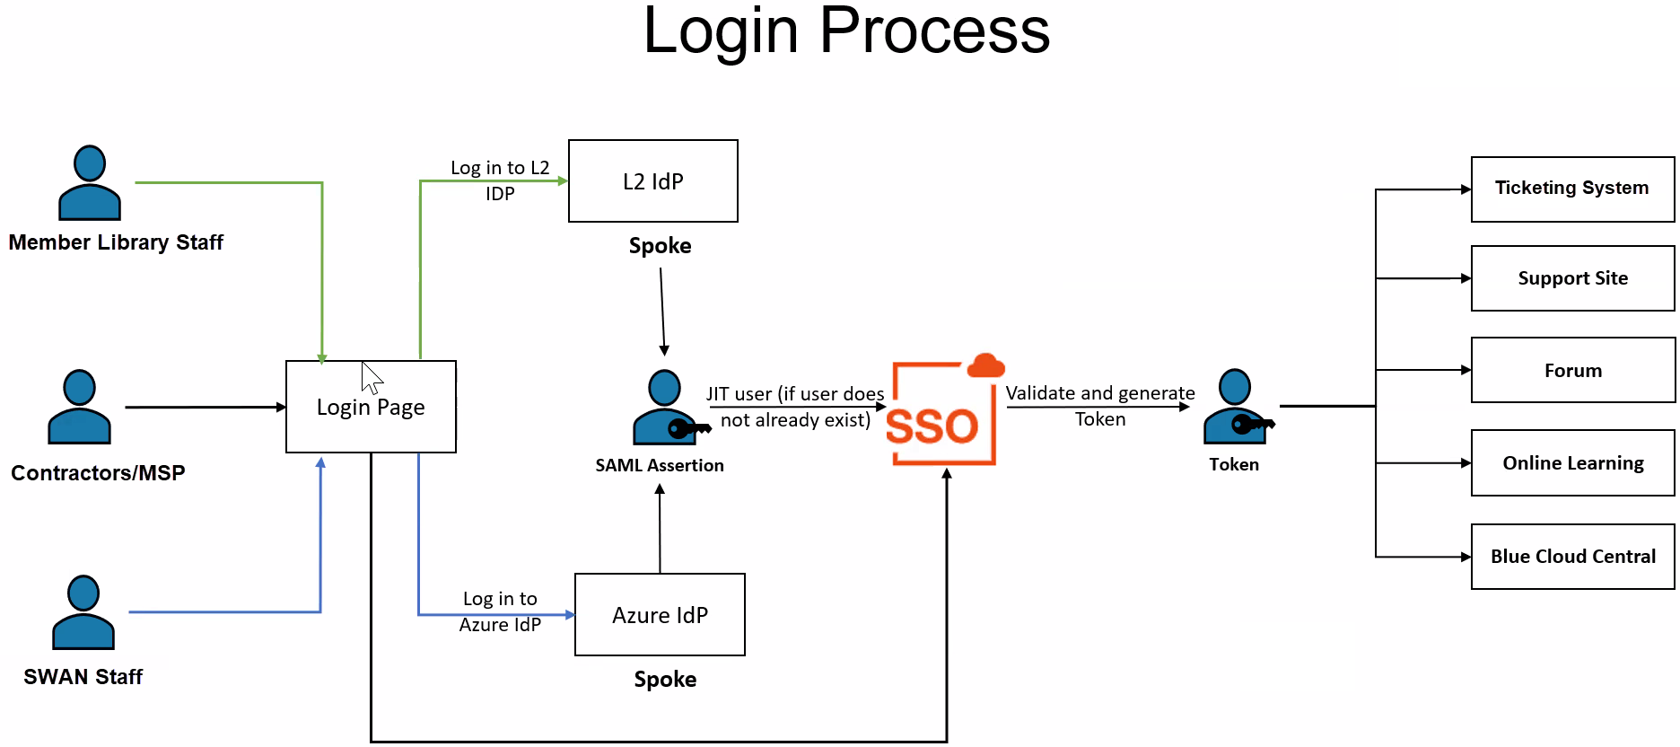
How will SSO work?

Slide 10
FY25: SSO project & budget expense
Subscription based on annual active users
1,000 to 1,200 library staff estimated
SWAN researched in-house, self-maintained, and SaaS options 2022-2023
Ping/HiQuest selected as vendor
Vendors (Okta/Auth.0/etc.) unable to meet our requirements
Ping offers bespoke implementation
Seamless integration with Support Site
Future proof our next library staff client
BLUEcloud Staff
Alternate option requirement
Budget line #5430 Server Infrastructure
$26,890 annual subscription
One-time setup & configuration costs $35,000
Amend existing SWAN budget for FY24 to allow project to begin
Resolution to amend SWAN budget at March 7, 2024 Quarterly membership meeting after budget approval
Notes:
In-house options required significant staff involvement to both implement and maintain.
Ping’s solution is designed to work in conjunction with our existing Drupal Support Site and use L2 as the Identity provider

Slide 11
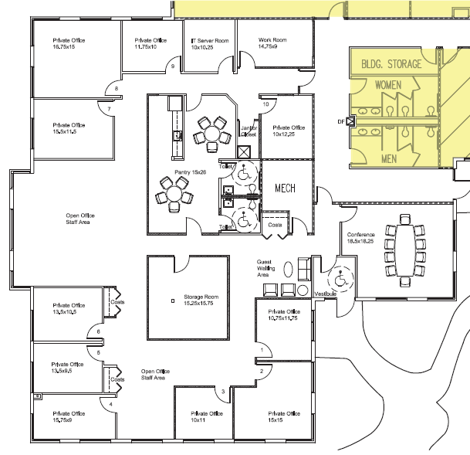
FY25: Office relocation
FY25 budget $32,100 expense reduction
Current space July – Dec 2024
New space Jan – June 2025
Reduction in square footage
Current 5, 621 sq ft
Anticipated 2,800 sq ft
Commercial lease length unknown
Moving November 2024
Current floor plan

Slide 12
Membership changes: Addison Public Library & Prairie State College
Addison Public Library: full year
Revenue - Membership Fee | $70,367
Expenses (licensing add-ons) | -$27,410
 | $42,957
Prairie State College: exit
Revenue - Membership Fee | -$18,333
Net | $24,624

Slide 13
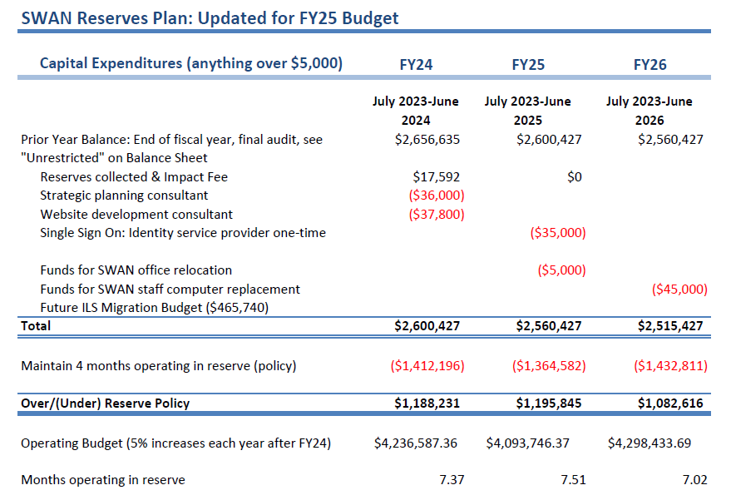
SWAN Reserves
Updated with FY23 audit
Impact fee revenue $17,592 from Addison
One-time expenses:
SSO one-time costs
Office relocation expenses

Slide 14
FY25 Revenue budget

Slide 15
Revenue
Membership Fees, Grant Revenue, Investment & Interest
Pass through: Group-purchase, Reimbursements for Losses,
RAILS LLSAP Support revenue
$500,616 FY25
$2,228 increase
Interest income budget increased from $20,800 to $83,328
Membership fee budget line decreases $196,245
Overall decrease 6% (mileage varies per public library)
Annual conference fees (offset the food & beverage expenses at rental MVCC)
E-commerce transactions budget line (offset by #5940 expense)
EBSCO group purchase fees (offset by #5990 expense)

Slide 16
Expense budget 3.4% decrease FY25

Slide 17
Expenses
Salaries & Wages
Personnel Benefits
2% increase in budget
First increase in 5 years
Held static FY20 – FY24
Positions consolidated via retirement & attrition
2 part-time staff added to Bibliographic Services in December 2022
Increasing complexity with Aspen grouped records
FRBR display of book editions, large type, eBooks, eAudiobooks
FY25 budget benefits for health, dental, & life insurance
Based on open enrollment completed January 1, 2023
Reduction compared to prior year based on usage

Slide 18
Expenses
Buildings & Grounds
Professional Development
Decrease -24.8%
Facility lease ends November 2024
New location with planned reduction in square footage
Utilities expense unchanged
Reduced expenses based on actual end of June 30, 2023
Conference travel budget $6,000 reduction from pre-pandemic $11,000 budget

Slide 19
Expenses
Membership Development
Information & Technology Services
Supports SWAN Expo
SWAN 50th anniversary
Reduced staff travel budget to libraries
Expenses for SWAN Learning Management System is the #5330 Library Professional Development budget line
Full year transition of SWAN websites hosted by in SWAN infrastructure to vendor solutions
Decrease for Azure expense #5430
SirsiDynix decrease (BLUEcloud Mobile & eResource Central service replaced by LiDA)
OCLC increase 3% (anticipated)
EBSCO increase 3% (anticipated)

Slide 20
Expenses
General Office, Hardware & Equipment, Insurance
Contractual Services
Budget for office supplies includes one-time $10,000 for office relocation needs
Business, D&O, crime, cyber insurance budget increase based on 2023 renewal
Continuing legal, HR Source membership, & accounting services
Addison joining = contractual expenses RAILS Catalog Grant
SWAN Expo MVCC facility expense
Increase to Notification & Collection due to MessageBee expense
Consulting expenses for FY25
LiDA software development $5,000

Slide 21
Expenses
Library Materials & Content
Interest & Fees
EBSCO database package group-purchase year-5 renewal 3% increase
Budget line #5940 E-commerce payment transactions added with revenue offset
Bank fees, merchant account ProPay fees reduction
Annual conference merchant account fees no longer needed

Slide 22
Revenue: Membership Fees
Separate formula for academic, school, special, and public libraries
Public library formula based on county tax data (Cook, DuPage, Kane, Will)
Self-reported bond payments, debt service obligations deducted from total tax data
Completion of debt service payments may increase fees (ex: Downers Grove)
Details on how SWAN membership fees are calculated https://support.swanlibraries.net/about/budget
State funding via RAILS LLSAP is applied as a reduction in membership fees for 96 public libraries

Slide 23
FY25 Revenue
Public library fee formula incorporates tax data
Bond or debit service arrangement will be deducted from tax data
FY25 budget is using 2021 tax & bond data
Why not current?
Disbursement completed end of 2022
Tax reports collected in September 2023
FY25 SWAN budget work begins October 2023
Bond schedule & SWAN: set it & forget it!
Submit bond schedule by Friday 2/9

Slide 24
EBSCO database subscription year-5 renewal group-purchase

Slide 25
EBSCO database group-purchase
Year-5 renewal with 85 participating libraries
Pricing posted & in Committee of the Whole meeting packet
Opt-out period ends Friday, February 23rd 11:59 p.m.
Libraries opted out will remain out of the year-5 deal
Go to Support > Help > Request Forms > Opt-out EBSCO database group purchase
https://support.swanlibraries.net/forms/80756

Slide 26
Membership Meeting
Feedback from you today
Board meeting February 16th
Final budget packet February 26th
March 7, 2024 Directors’ & Administrators’ Quarterly meeting
In-person vote at meeting
Thursday,March 7, 2024 10:00 a.m.
Oak Brook Public Library

Slide 27
Feedback

Slide 28
Feedback & Board contact info
Aaron Skog | aaron@swanlibraries.net | SWAN
Anna Wassenaar | awassenaar@blueislandlibrary.org | Blue Island Public Library
Colleen Waltman | colleenw@homewoodlibrary.org | Homewood Public Library District
Dorothy Koll | dkoll@acornlibrary.org | Acorn Public Library District
Jennifer Cottrill | jcottrill@midlothianlibrary.org | Midlothian Public Library
Jesse Blazek | jblazek@phlibrary.org | Palos Heights Public Library
Samantha Johnson | sjohnson@rosellepld.org | Roselle Public Library District
Tim Jarzemsky | tjarzemsky@mybpl.org | Bloomingdale Public Library

Slide 29
Platform Survey
60 libraries completed the satisfaction survey to-date
Rate the satisfaction of products
WorkFlows by SirsiDynix
BLUECloud Analytics by SirsiDynix
MobileCirc/MobileStaff by SirsiDynix
Aspen Discovery
MessageBee by Unique Management
OCLC WorldShare
One submission per library
Closing Friday, February 9th!

Slide 30
Your action items
Submit bond schedule (if changed) by Friday 2/9
Complete software platform feedback survey by Friday 2/9
Complete EBSCO group-purchase opt-out by Friday 2/23
Schedule in-person attendance at 10:00 a.m. Thursday 3/7 Quarterly meeting for budget approval vote(s)

Slide 31
Links!
Library Bond Submission form due 2/9
https://support.swanlibraries.net/form/94546
Membership satisfaction with SWAN platform due 2/9
https://support.swanlibraries.net/form/94482
EBSCO opt-out year 5 due 2/23
https://support.swanlibraries.net/forms/80756
Quarterly meeting on 3/7 10:00 a.m. – 12 p.m.
https://support.swanlibraries.net/meeting/94441

Slide 32
Questions & Answers

