Slide 1
SWAN Quarterly Meeting
March 1, 2018
Notes:
SWAN 2017 Q4 Meeting: December 7, 2017 at RAILS Burr Ridge

Slide 2
March 1, 2018 Agenda
Call to Order and Welcome
Public Comment
Introduction of New Library Directors
Approval of the December Quarterly Meeting Minutes – Action Item (Exhibit pgs. 3-5)
Approve FY19 Budget & Fee Schedule – Action Item (Exhibit pgs. 6-47)
SWAN Library roll call vote performed by Tiffany Verzani, SWAN Board Secretary
2018 SWAN Board Election Process – Information Item (Exhibit pg. 48)
Strategic Planning Process – Discussion Item

Slide 3
March 1, 2018 Agenda
Enterprise 5.0 Upgrade Announcement & Projects for March - May – Information Item (Exhibit pgs. 49-54)
New 19 Go-Live May 1, 2018 & Consortia Impact – Information Item

Slide 4
Enterprise Changes
Preparation for 5.0 Upgrade
Scheduled for Wednesday, March 21, 2018
Theme changes
Incorporating Enterprise Usability Study, DUX, and Enterprise Task Force feedback
Detailed display
Footer
Header

Slide 5
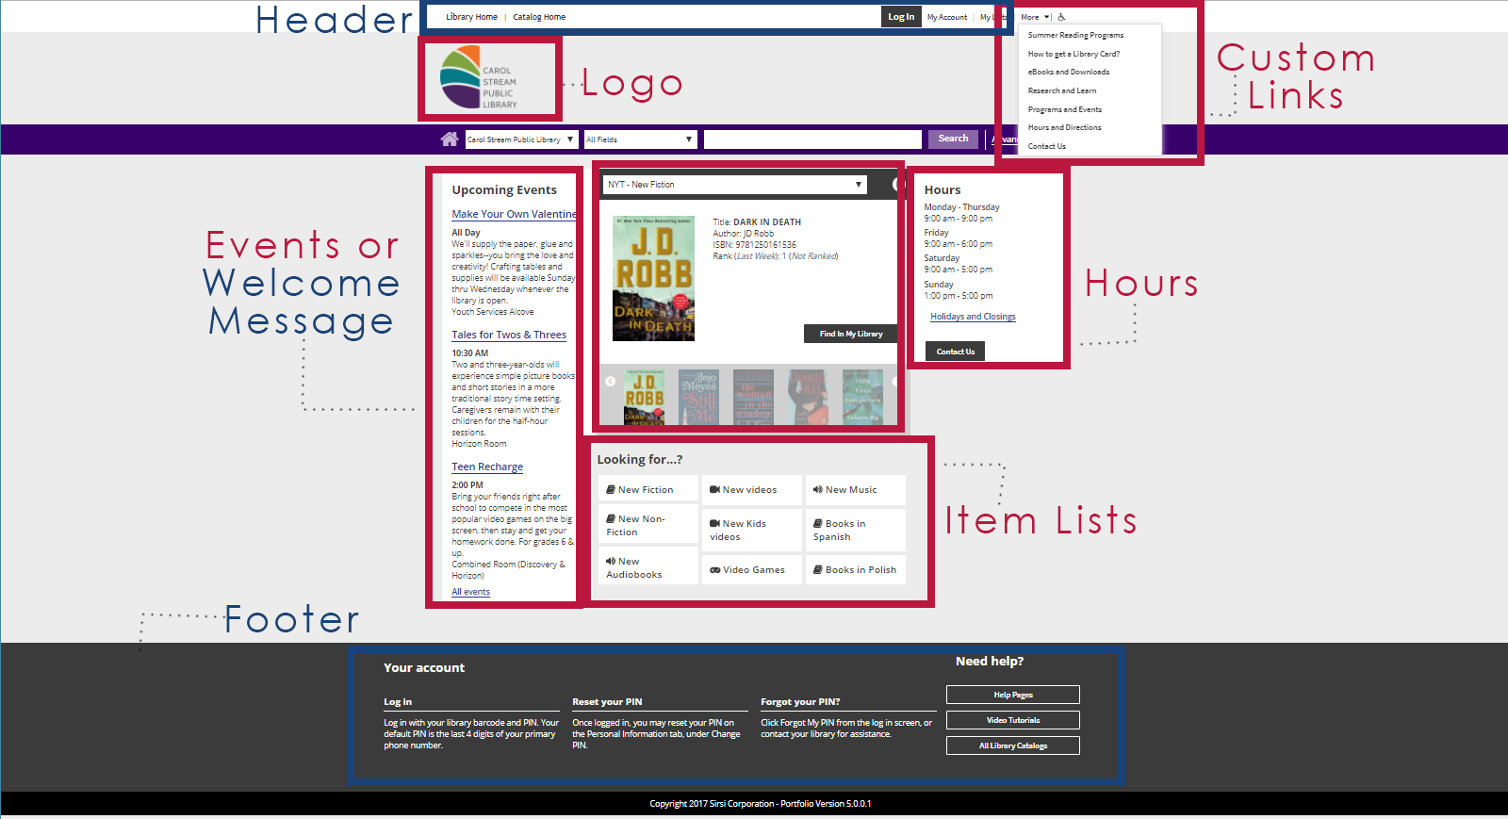
Open Your Menus!

Slide 6
Changes in Enterprise
Getting to Responsive Design
Enterprise 5.0 upgrade March 21, 2018
FLAT THEME
Enterprise 5.0.1 not ready
FLAT THEME for MOBILE PAGES
Long Term: no release version specified
Search Improvements: “Improved handling of misspellings and alternate spellings; improved handling of recent or popular titles”

Slide 7
Enterprise 5.0.1 Release with Mobile Pages
No release date announced
Slated Q2 2018 in SirsiDynix’s January 2018 product roadmap
Possible July 2018

Slide 8
SWAN Planned Downtime
Mon. Apr. 30 2017
Consortia-wide downtime of Symphony, Offline Circulation required
Step in data load process, requires Symphony indexing, and this is a lot of data
Tue. May 1 2017
New 19 Go-Live
Sun. May 27
Monday, May 28, possibly Tuesday May, 29: Memorial Day plans for Symphony indexing post-de-duplication of 1.5 million bibliographic records
Wed. Mar. 21 2017
Enterprise Upgrade 4am – 6am

Slide 9
Growing by the numbers
Libraries Served: from 78 to 97
Population Served (Patrons served by public libraries in the consortium): Current SWAN (1,436,829) + LINC (222,104) + MAGIC (128,346) = 1,787,279
Library Items in the Catalog: Current SWAN (7,924,458) + LINC (1,187,200) + MAGIC (730,941) = 9,842,599
Annual Circulation: Current SWAN (13,456,399) + LINC (4,350,000) + MAGIC (1,532,926) = 19,339,325
Post-migration, the SWAN consortium will have a combined catalog of nearly 10 million items, serving a population of 1.8 million patrons. And, annual circulation is expected to top 20 million.

Slide 10
New 19 ILL During Migration Timeline
Deflect SWAN Requests through OCLC
March 1
Add “XYZILL” prefix to ILL item id
April 1 – April 28
Consider Creating temp ILL items prior to Tech Freeze April 1-April 16
Continue Holds Processing until April 28
Consider OCLC Non-Supplier Status April 16-~May 5
SWAN Libs Continue Holds Processing
Thru migration
Create OCLC Custom Holdings Group NOW
Update OCLC Supplier Status
When ready after migration
SWAN Normal Operations – Deflect SWAN Requests in OCLC
Update OCLC Custom Holding Group for SWAN to include all libraries
STOP!
N19
N19
N19
N19

Slide 11
New 19 Technical Services Timeline
Rebuild Indexes April 30
Go Live
May 1
SWAN Bib Srv – 590 setting on N19 records ~May 3
Pre-Dedup Reports ~May 14-18
MARCIVE Authority Control Clean-up ~June
Apply Authority Changes & Rebuild Indexes ~July 3-4
SWAN Bib Srv – Split N19 Weeklies ~May 4-6
Dedup (no deletes, no control # change, no merges)
~May 23-25
Rebuild Indexes May 27
SWAN Bib Srv Review
~May 21-22
N19 Suspend Tech Services March 14
OCLC Holdings Clean-up Summer
SWAN Normal Operations ~August
STOP!
Data review/edits – (e.g. VPD Call Number based updates)
N19

Slide 12
March – May Projects
Enterprise 5.0: major release
Cloud Infrastructure
BLUEcloud Analytics: Acquisitions Data (Likely delayed by SD)
New 19 Data Testing
Reports Group: time saving tasks, “de-newing” automation
New 19: PR Advisory Group
New 19 Q&A Sessions: March 7 & April 4
COSUGI in Atlanta Apr 16-18
SWAN Classes: available for all libraries & New 19
New 19 Go-Live!
May 1, 2018

Slide 13
Questions, Discussion

