Slide 1
SWAN Quarterly Meeting
September 5, 2019

Slide 2
Call to Order & Welcome
Stacy Wittmann, Eisenhower Public Library District
SWAN Vice-President

Slide 3
SWAN Quarterly Meeting Agenda
Call to Order and Welcome
Public Comment
Introduction of New Library Directors
Action Item-- Approval of the June 5, 2019 Quarterly Meeting Minutes (pgs. 3-7)
Discussion Item – SWAN Demand Management: Configuration Changes to Holds & Testing Underway (pgs. 8-10)
Discussion Item – Overview of the New SirsiDynix BLUEcloud Circulation, Cataloging, & Acquisitions (pgs. 11-25)
Discussion Item—BLUEcloud Mobile App Feedback & Questions
Discussion Item – SWAN Board Recommended Change in Accounting Service (pgs. 26-28)
Action Item – Amend the Fiscal Year 2020 Budget
Information Item – 2019 SWAN Expo (pgs. 57-66)
Announcements and Questions
Next meeting: December 5, 2019

Slide 4
Demand Management: Configuration Changes to Holds & Testing Underway
Dawne Tortorella, SWAN Assistant Director

Slide 5
Our Challenges and Opportunities
Minimize unnecessary transits
Get items into the hands of our patrons faster
Enhancing staff tools for managing holds
Hold Map restrictions and impact on placing/filling holds
Impact on collection development
Neighborly practice

Slide 6
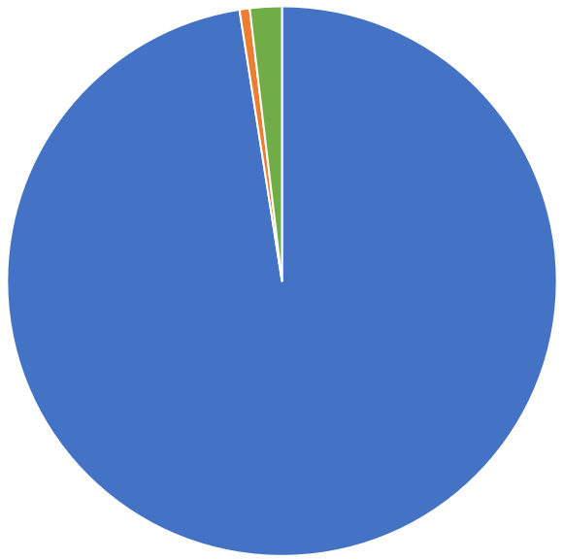
FY19 3,078,944 transits
Within SWAN 3,000,954 (97.5%)
Borrow outside of SWAN 20,304 (0.6%)
Lend outside of SWAN 57,686 (1.9%)
Missing in Transit 1,518 (<0.05%) or less than 1 in every 2,000 items

Slide 7
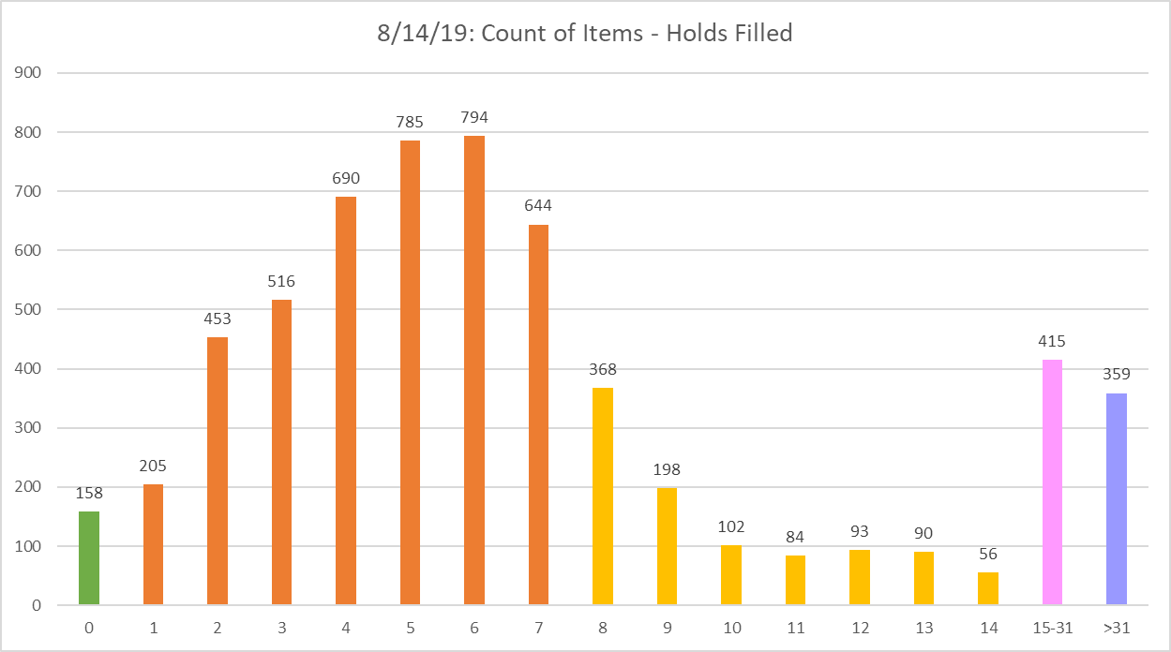
Typical Day: Days to Fill Hold
84% of holds placed, filled within 1 week
93% of holds placed, filled within 2 weeks

Slide 8
Process & Timeline
Jan-June, 2019
Research
Modify config
Compare
Gather data
Post data gathering
Oct, 2019
July-Aug, 2019
And then…
Rinse & Repeat
Sept-Oct, 2019
Sept, 2019

Slide 9
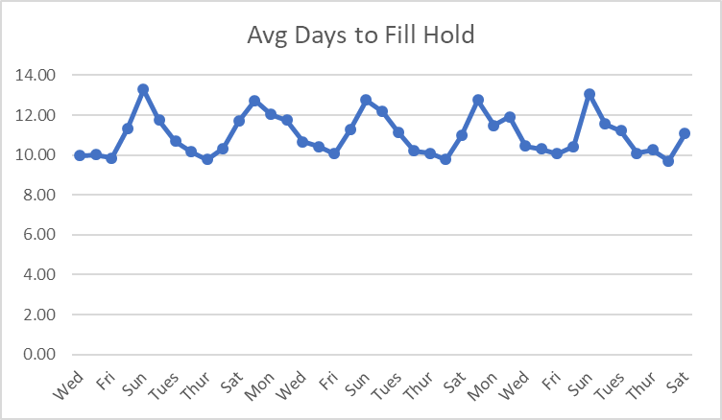
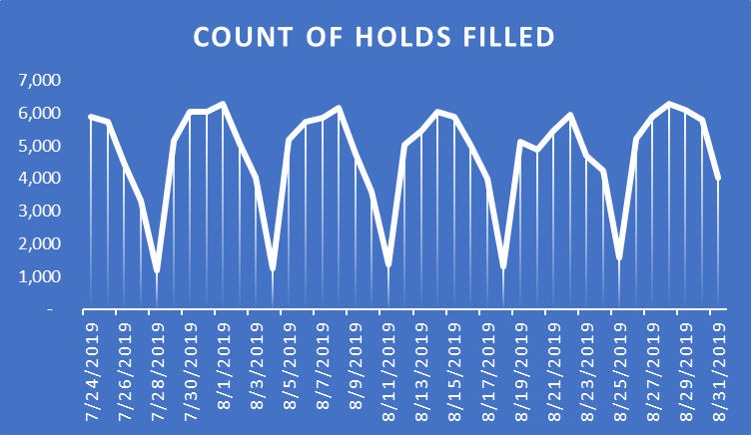
Data Insights: 7/24/19-8/31/19
Avg Daily Holds Filled | Average Total Days to Fill | Avg Days to Fill per Hold | Median Days to Fill
4,748 | 51,125 | 11.01 | 6

Slide 10
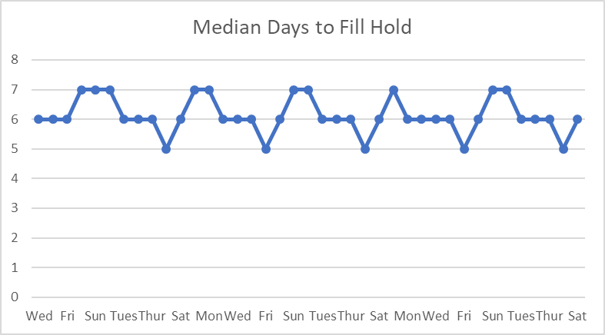
How Will We Know It is Working? Maintain a healthy heartbeat
Any configuration change will be evaluated on median days to fill.
Rather than look at individual titles and items, the overall health of the system will be evaluated.

Slide 11
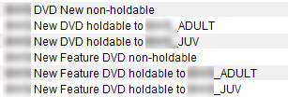
Balancing Demand & Philosophy
XYZ shares
ABC restricts
XYZ restricts
Some libraries restrict to their patrons only
Some libraries share everything

Slide 12
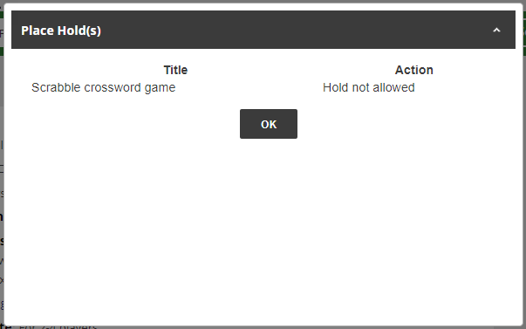
What Obstacles Do Patrons & Staff Encounter?
Hold not allowed
Potentially misleading holds/copies ratio based
Trying to understand patterns of what can and can’t be held

Slide 13
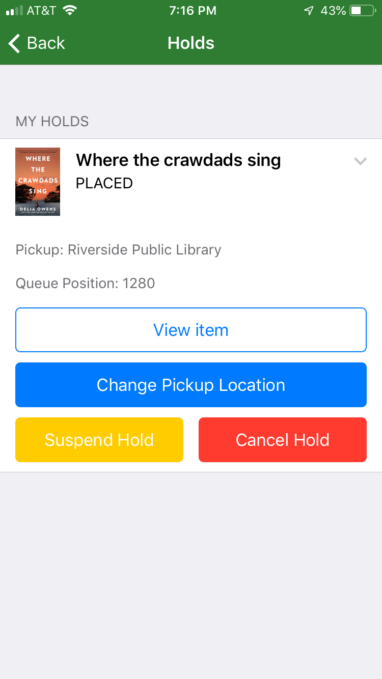
Where Am I in the Queue?
“We never tell patrons where they are in the queue because we really can’t calculate what order holds will be filled.”
But…

Slide 14
What is BLUEcloud? Overview of the New SirsiDynix BLUEcloud Circulation, Cataloging, & Acquisitions
Aaron Skog, SWAN Executive Director
Dawne Tortorella, SWAN Assistant Director

Slide 15
BLUEcloud Library Services Platform
Acquisitions
Circulation
Cataloging
Electronic Resource Mgmt
eRM
BLUEcloud
Central
Resource
Central
Mobile App
Search
Commerce
Analytics

Slide 16
What is Symphony? What is BLUEcloud?
Symphony
BLUEcloud
Integrated Library System (ILS)
Application, Oracle database
Staff interface is WorkFlows
Searching, Circulation, Cataloging, Acquisitions, Managing Holds, User Management
Java based client
Can be sited locally or hosted by SirsiDynix Software-as-a-Service (SaaS)
Library Services Platform (LSP)
Can work with either Symphony ILS or Horizon ILS, but does not replace either ILS
BLUEcloud Central allows managing and launching applications through a user-specific login
BLUEcloud Circulation, Cataloging, Acquisitions
Sited in geographical regions
Accessed through web-browser

Slide 17
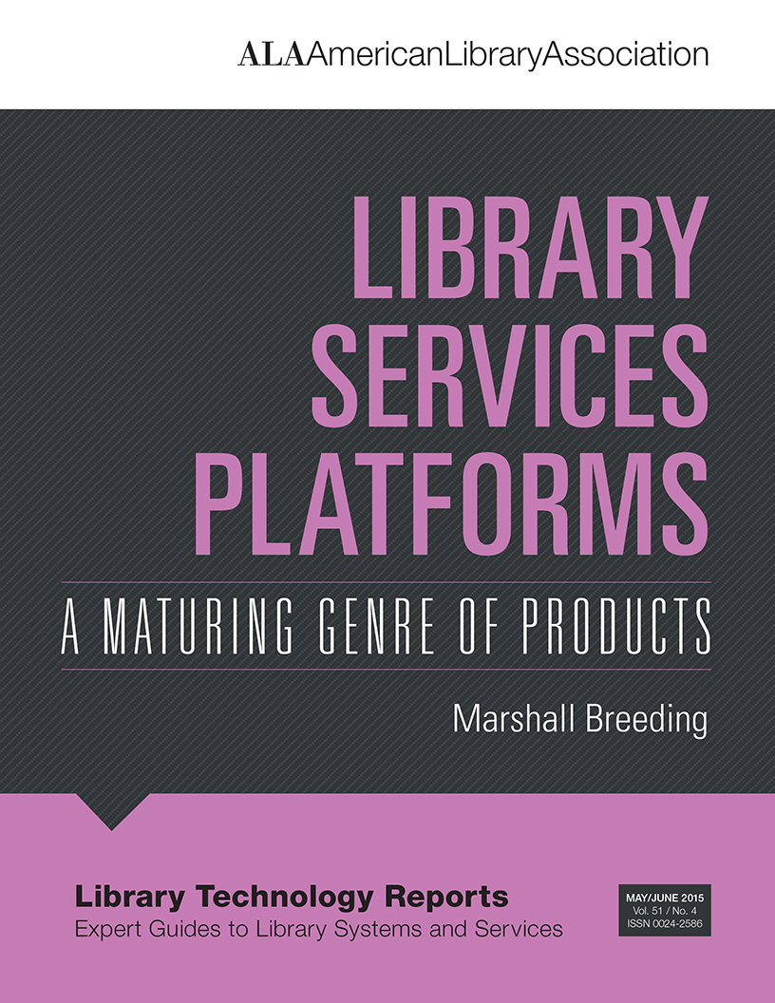
American Library Association Library Technology Reports
May/June 2015 Issue
Good concepts
Issue is now 4 years old, so keep that in mind

Slide 18
SWAN
Library
Services
Platform
SirsiDynix
EBSCO
OpenAthens
OCLC
Azure
SendGrid

Slide 19
BLUEcloud Regions & Upgrades
Multi-tenancy: global, data centers in different continents
Users in a region access nearest data center
Shift our access to another should failure occur
Version naming: 19.06.0 = June 2019
“Agile” Software Development
BLUEcloud Global regions
North America (three regions):NA1, NA2, NA3
Europe: EMEA
Asia-Pacific: APAC
SWAN is NA2

Slide 20
BLUEcloud: Now
What is SWAN already using?
Aaron Skog, SWAN Executive Director

Slide 21
What does BLUEcloud do
for us and our patrons?

Slide 22
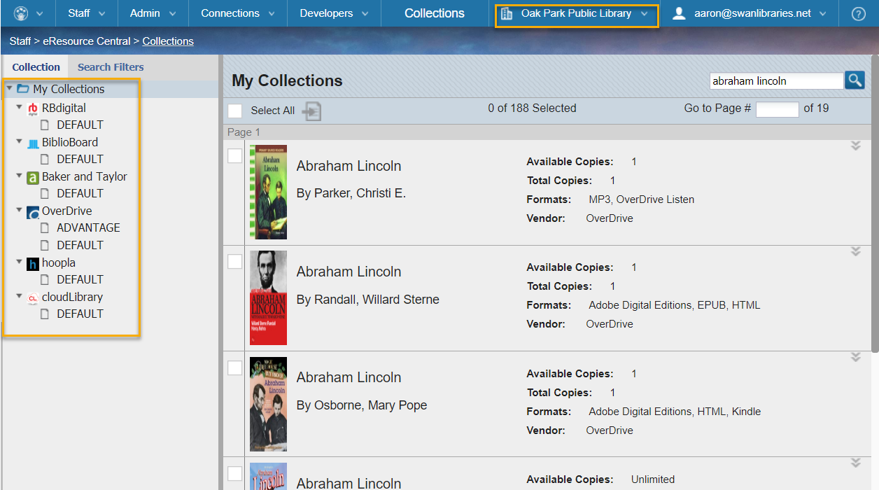
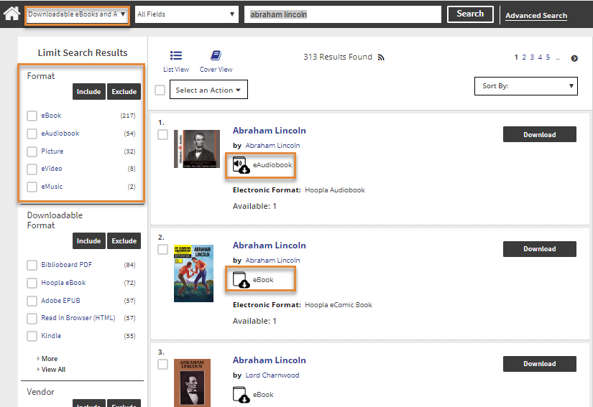
E-Content Integration with Enterprise
eResources subscriptions are managed in BLUEcloud Central
Enabling access to eResources in Enterprise

Slide 23
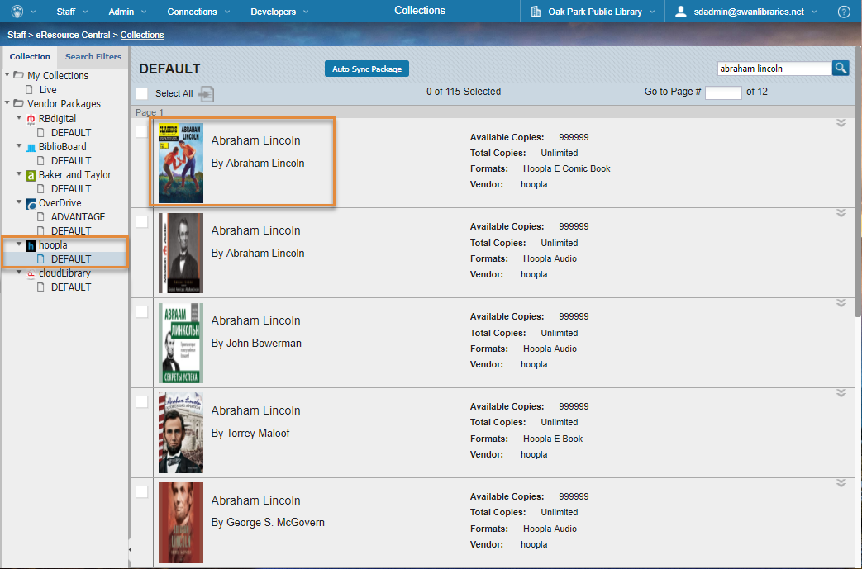
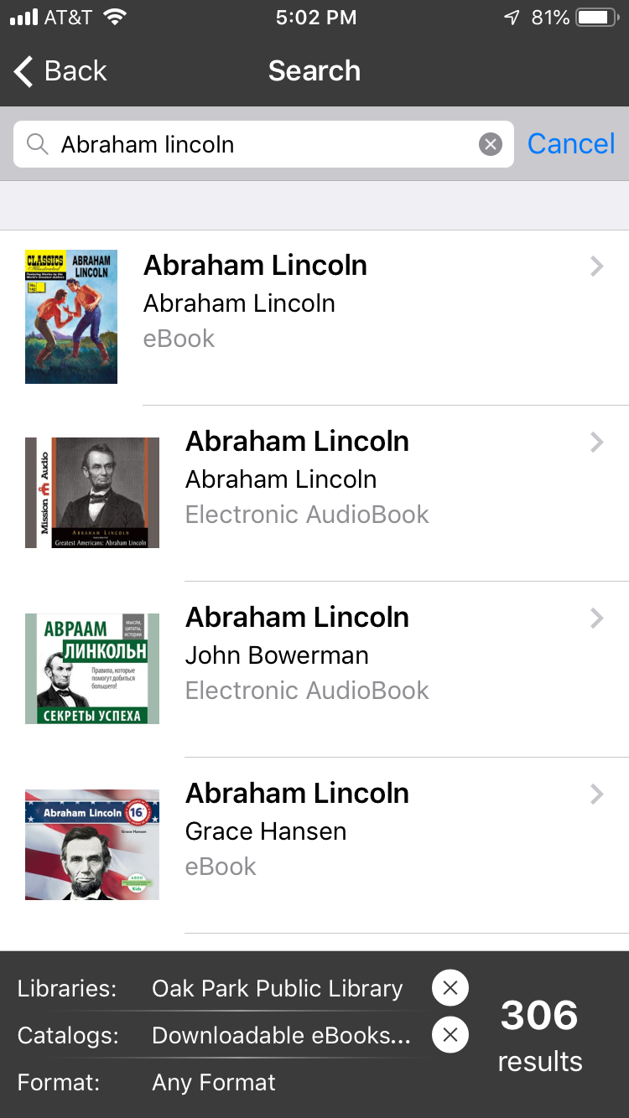
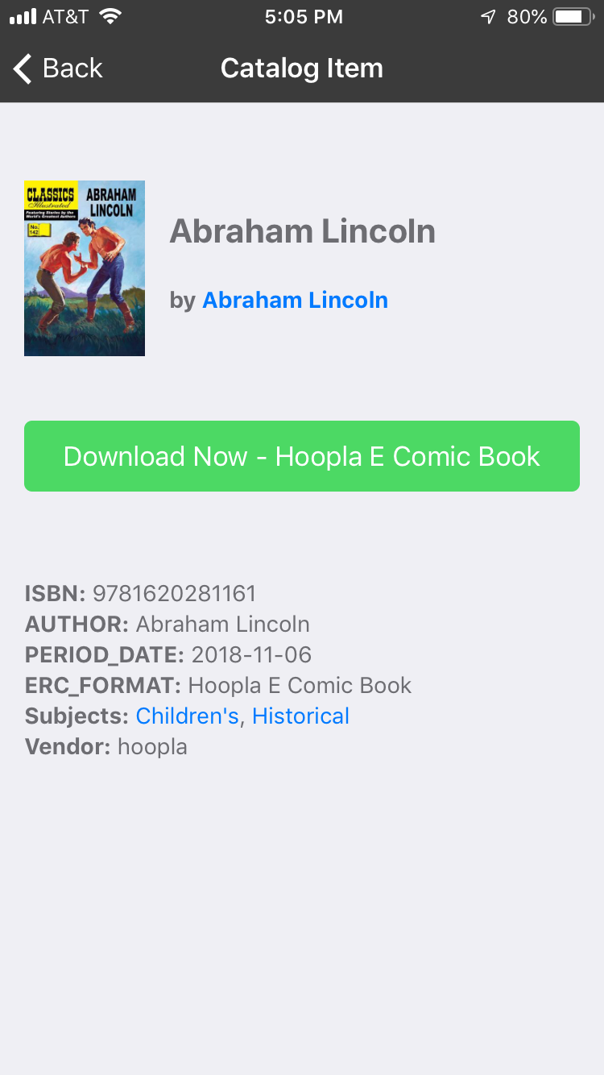
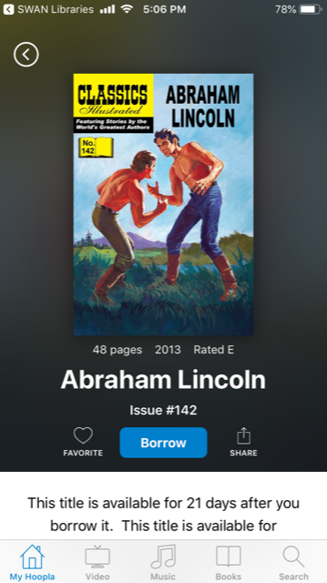
E-Content Integration with and BLUEcloud Mobile
eResources subscriptions are managed in BLUEcloud Central
Enabling access to eResources in BLUEcloud Mobile

Slide 24
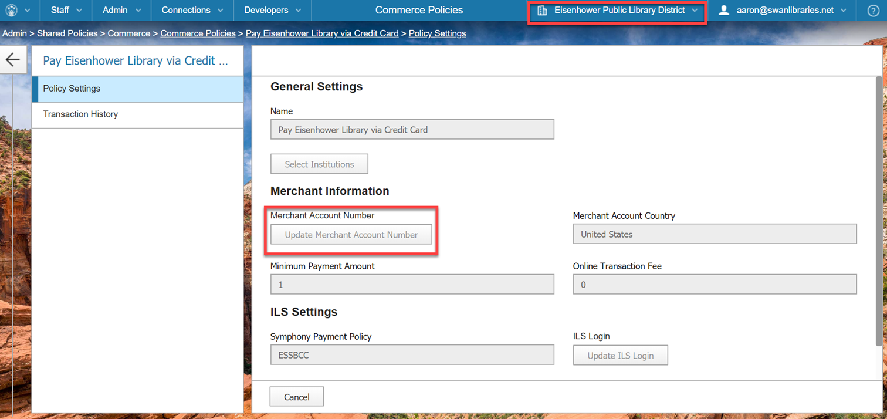
BLUEcloud Commerce
BLUEcloud Central used to configure Commerce Policies
Patrons can pay fines online

Slide 25
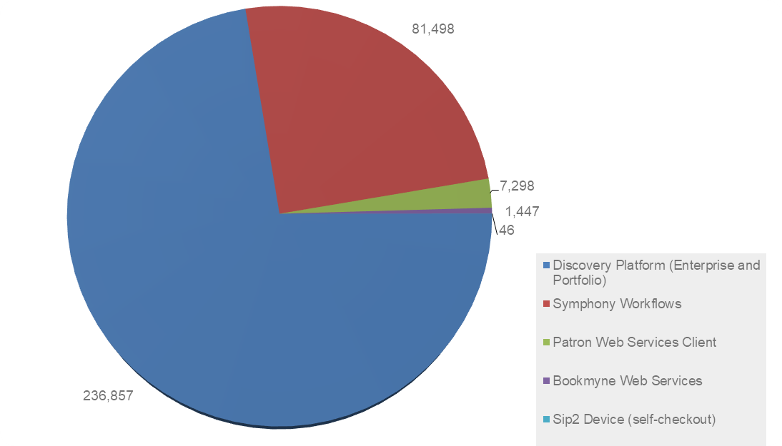
BLUEcloud Analytics, formerly known as BCA
BLUEcloud Analytics can report on transactions within BLUEcloud applications.
From 7/16-9/4:
8.1% of patron-initiated holds came through BLUEcloud Mobile.
Trans Stat Client Type | Count (Trans Stat Id) | % of Patron Initiated
Discovery Platform (Enterprise and Portfolio) | 236,857
Symphony Workflows | 81,498 | 90.26%
Patron Web Services Client | 7,298 | 8.08%
Bookmyne Web Services | 1,447
Sip2 Device (self-checkout) | 46
Patron-initiated Holds Total | 90,289

Slide 26
BLUEcloud: Research & Development in SWAN
Dawne Tortorella, SWAN Assistant Director

Slide 27
What is research & development?
Work directed towards the innovation, introduction, and improvement of products and processes.

Slide 28
What are SirsiDynix SPP, Beta, and Pilots?
SPP: Strategic Partnership Program
Exists to create customer participation in new feature discussions, user centered design and product direction
Providing feedback on features earlier in development cycle while there is still time to incorporate feedback into product
Beta Testing
Customer Testing of Newly Developed Software releases prior to General Release
An opportunity to seek firsthand customer input
An opportunity to find unanticipated issues
Pilot: Projects
Pilot programs are offered when SirsiDynix is developing brand new product offerings
Similar to beta testing, but distinction is that product has not been in live release previously
An opportunity to test early development and provide feedback, iterative testing process
See SirsiDynix article: https://support.sirsidynix.com/article/40

Slide 29
BLUEcloud Central: SWAN Research Teams
BLUEcloud Circulation
Crystal Vela, SWAN
Tara Wood, SWAN
Ridgeway Burns, HDS
Bonni Ellis, SCD
Peggy Tomzik, ESS
BLUEcloud Cataloging
Scott Brandwein, SWAN
Samantha Dietel, SWAN
Diane Nickolaou, SWAN
Claudia Nickson, SWAN
Joy Anhalt, TPS
Rebecca Bartlett, LGS
Amanda Kaiser, SCD
Julie Tegtmeier, SCD
BLUEcloud Acq Pilot ​
​Scott Brandwein, SWAN ​
Samantha Dietel, SWAN
Claudia Nickson, SWAN ​
Vickie Totton, SWAN ​
Rebecca Bartlett, LGS ​
Linda Ertler, LGS ​
Amanda Kaiser, SCD ​
Julie Tegtmeier, SCD

Slide 30
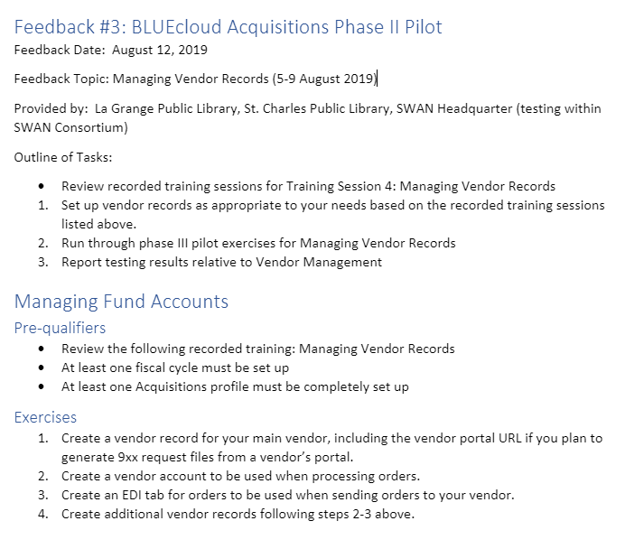
Research Teams SWAN Online Portal

Slide 31
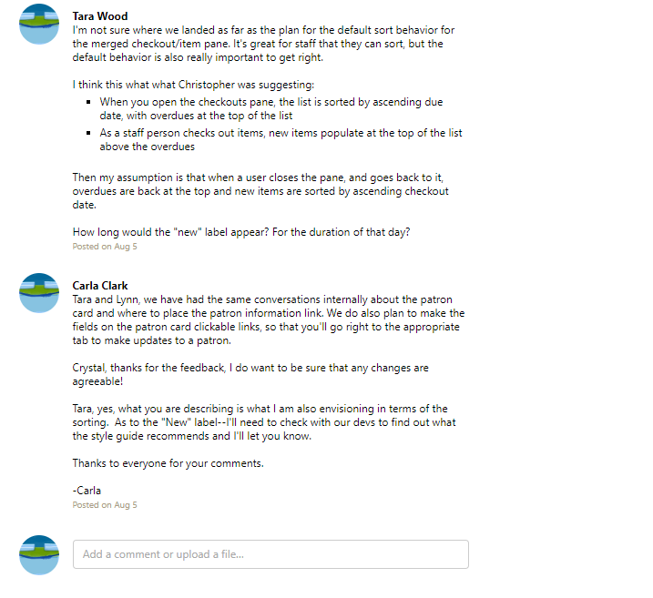

Slide 32
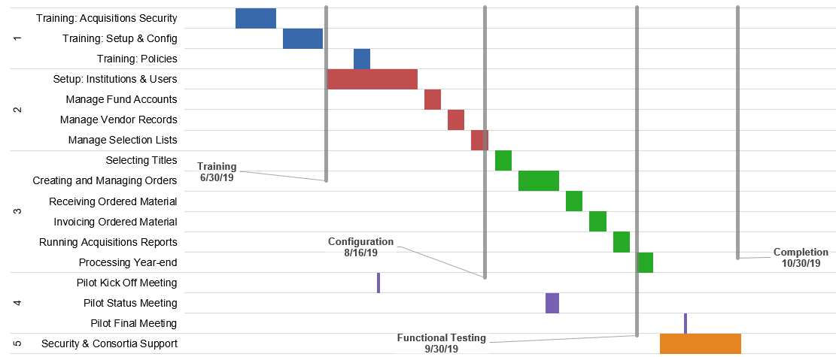
BLUEcloud Acquisitions Phase III Pilot

Slide 33
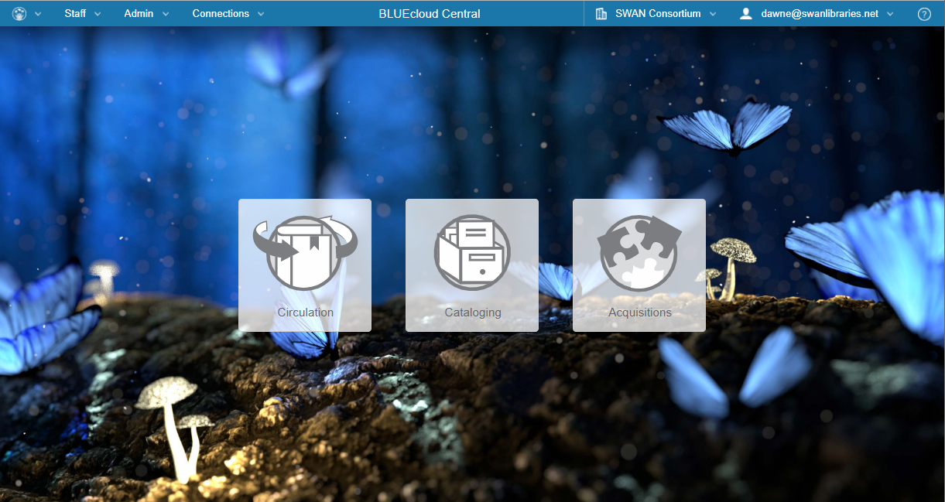

Slide 34
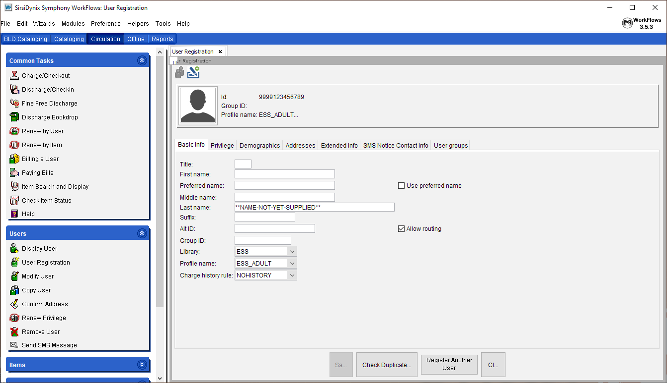
WorkFlows Circulation

Slide 35
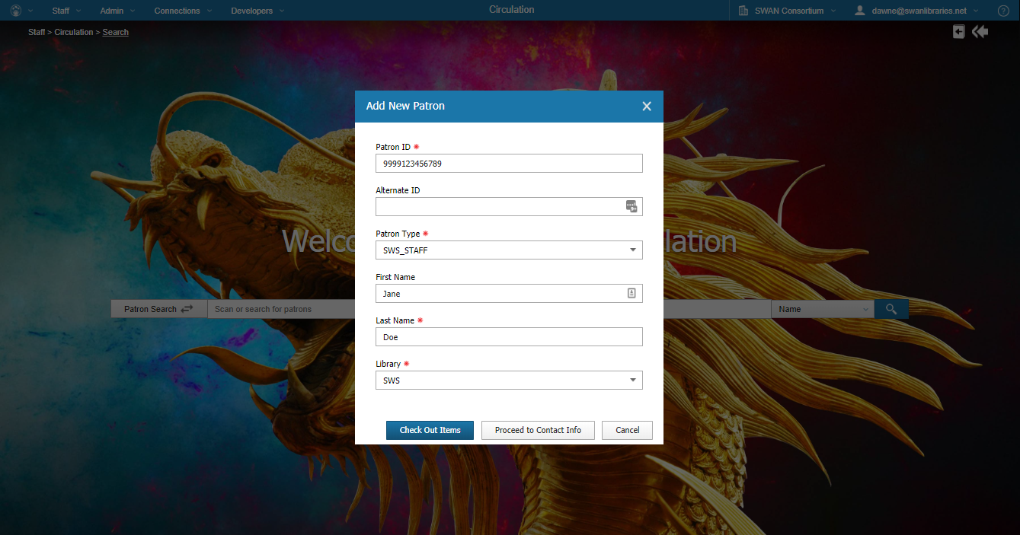
BLUEcloud Circulation

Slide 36
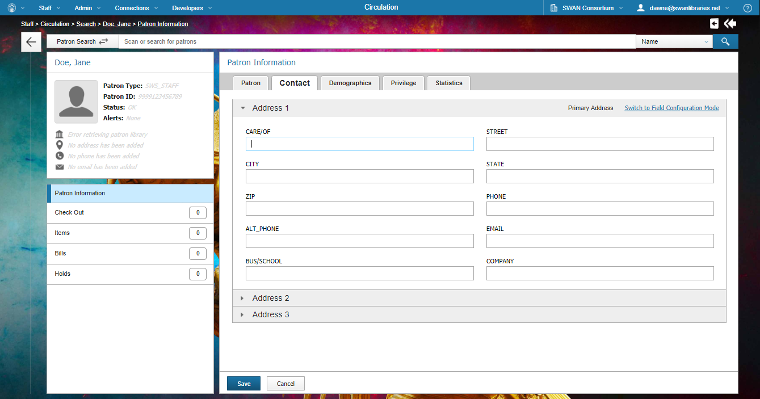
BLUEcloud Circulation

Slide 37
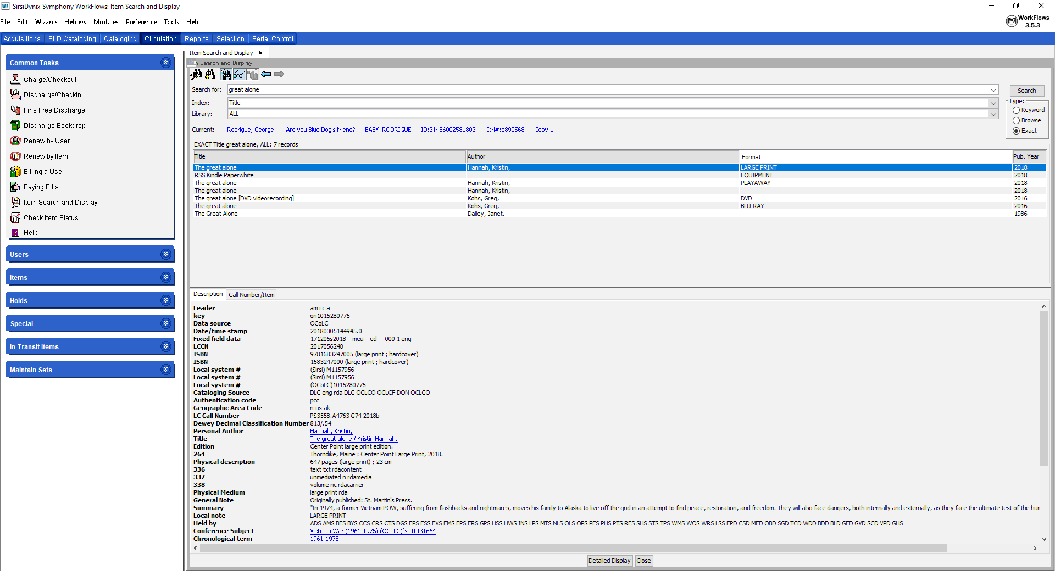
WorkFlows Item Search & Display

Slide 38
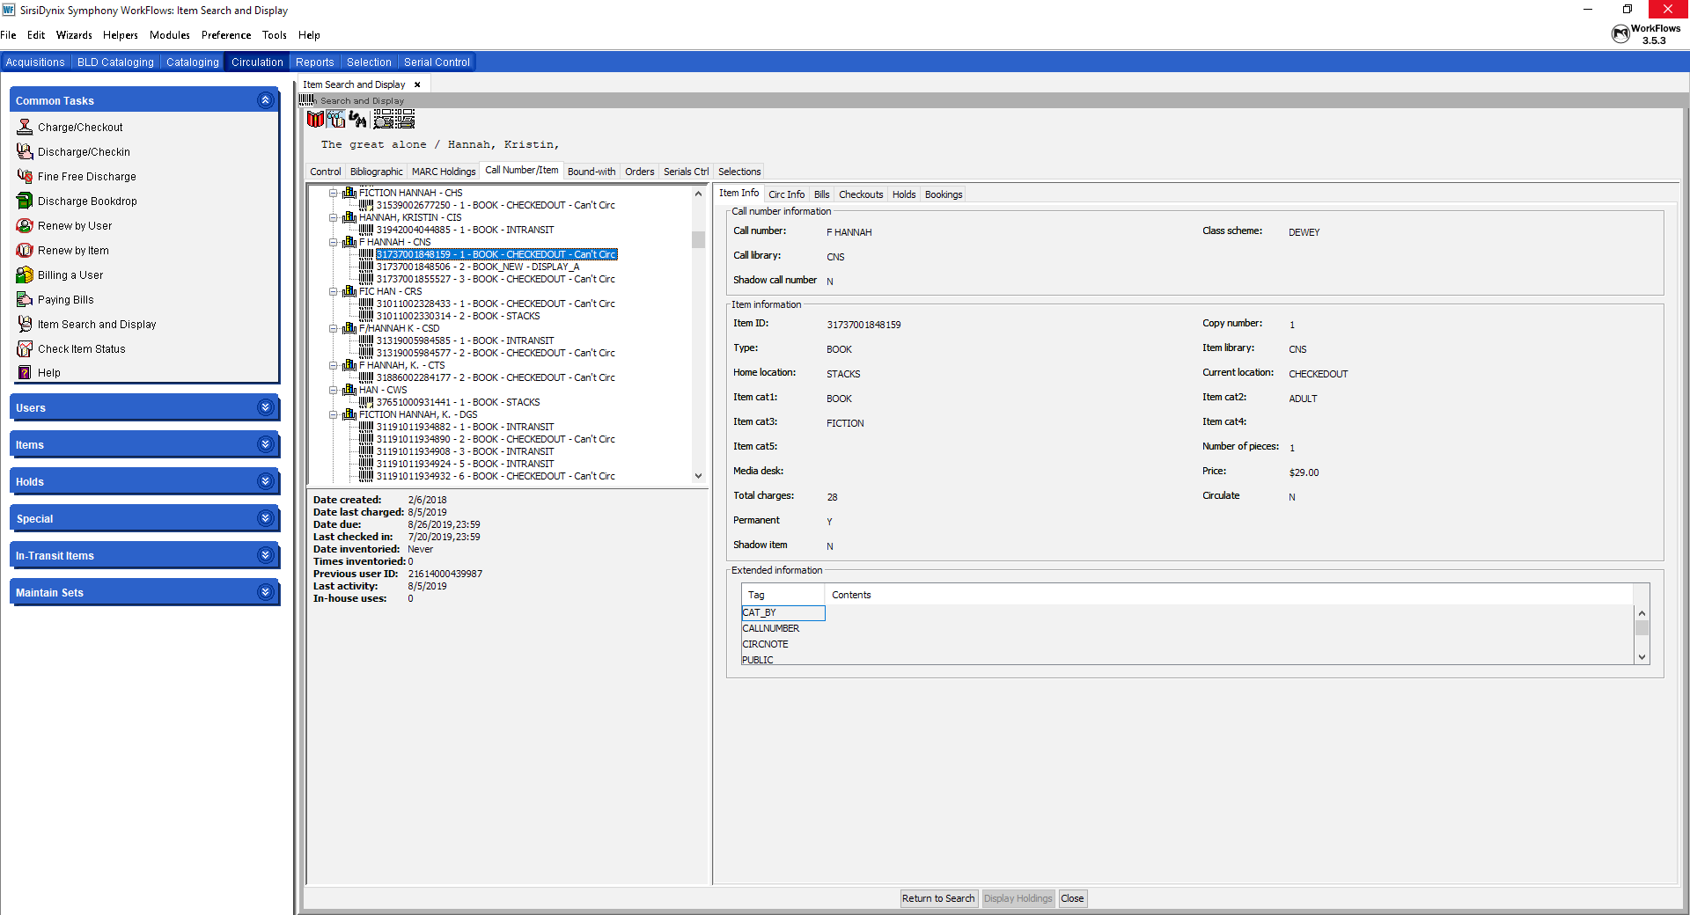
WorkFlows Item Search & Display

Slide 39
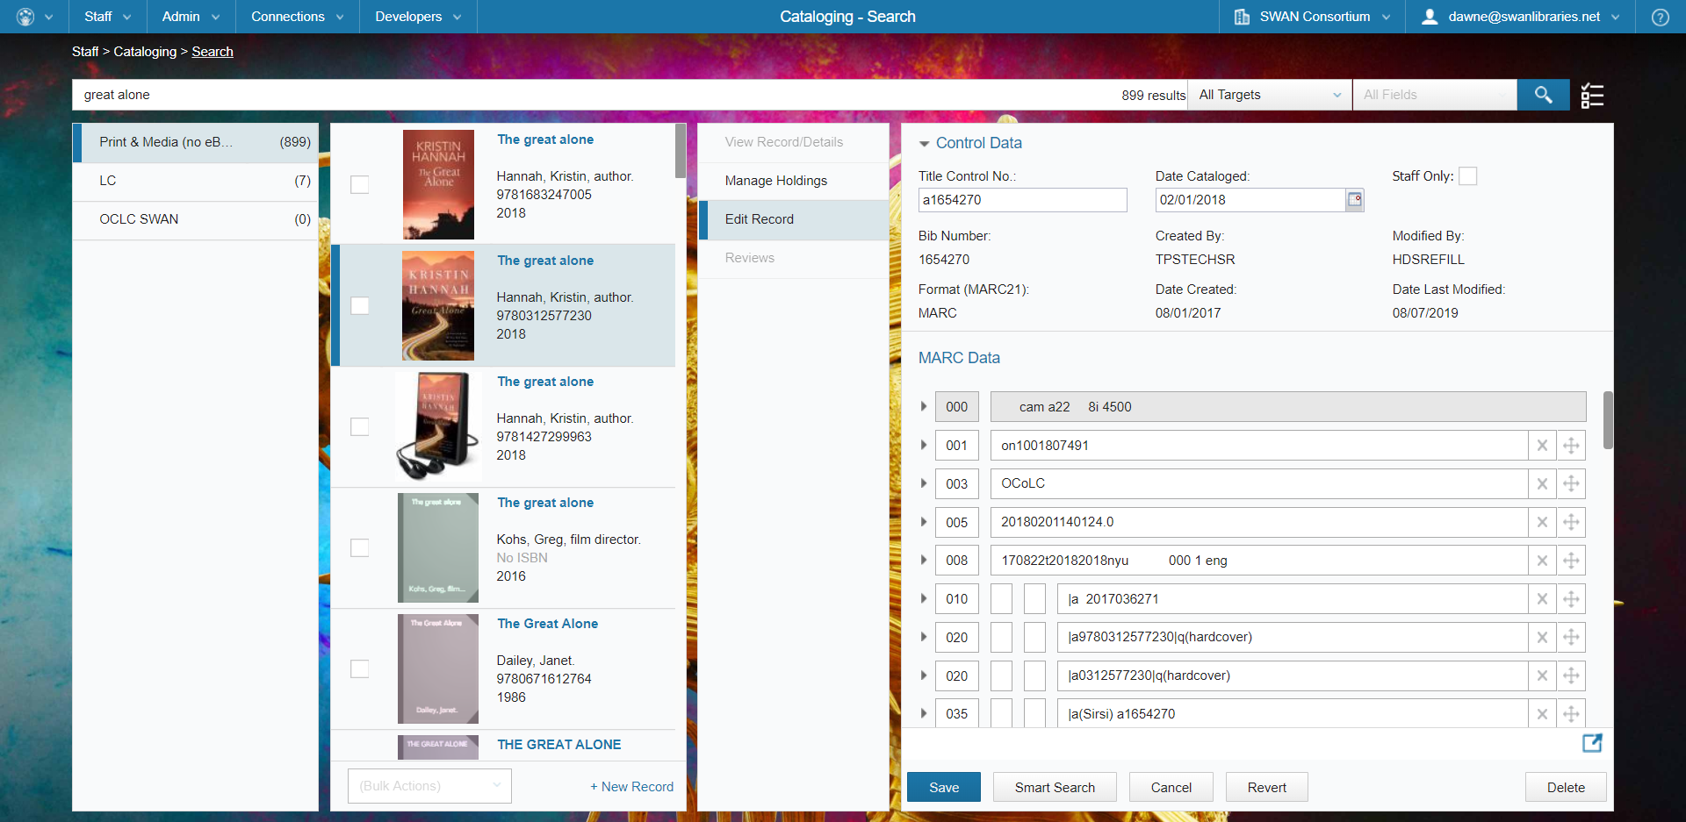
BLUEcloud Cataloging

Slide 40
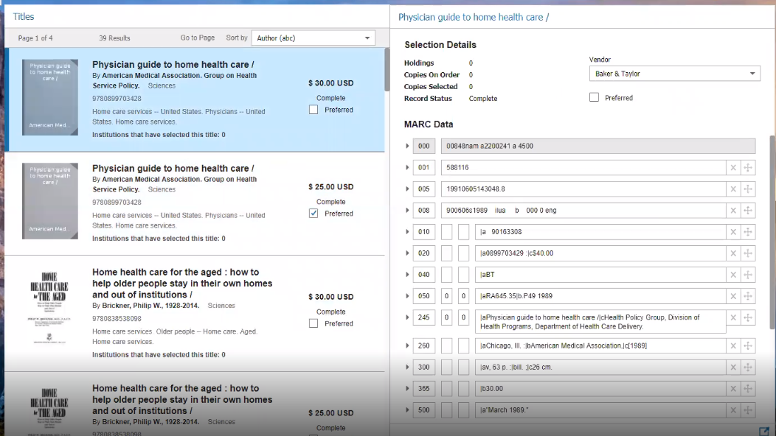
BLUEcloud Acquisitions – Selection Lists

Slide 41
BLUEcloud Weather Forecast
No shared logins
Increased need for secure policies and practice
Shared interfaces
Frequent updates
Opportunities for new consortium models (e.g. shared fund circles)
Sunny but with a chance of scattered clouds

Slide 42
and a final note…
≠
≠
BLUEcloud Circulation | MobileCirc | BLUEcloud Mobile
Staff tool running in a web browser Runs within the BLUEcloud staff interface, BLUEcloud Central Cloud-based application Live and limited The future | Staff tool that supports a subset of staff functions Application runs on a tablet, preferably Apple iOS Requires a licensed installation on the device, managed by SWAN IT Not part of the BLUEcloud suite Used for inventory, on-shelf item processing Not a great Circ tool | Patron tool for searching the catalog and managing library account Mobile app that runs in both iOS and Android operating systems Uses search and electronic resource indexes managed in BLUEcloud central Available now for all SWAN patrons

Slide 43
BLUEcloud Overview: Questions?

Slide 44
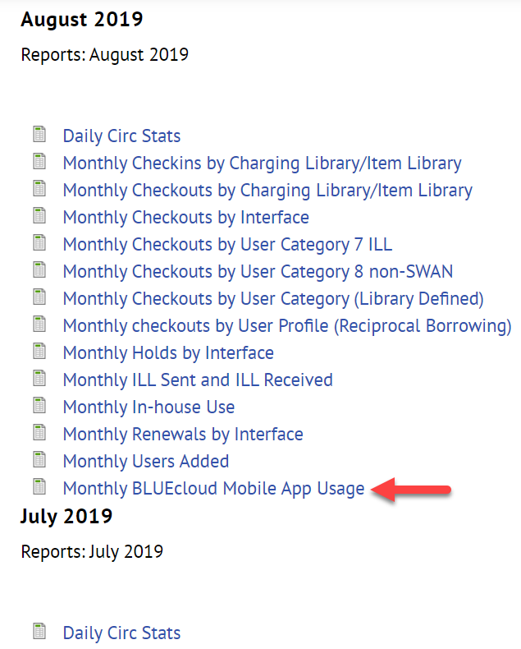
Discussion Item—BLUEcloud Mobile App Feedback & Questions
Training Recording: BLUEcloud Mobile App Administration
SWAN-Wide Monthly Statistics
Mobile App: Getting Started Video

Slide 45
SWAN Board Recommended Change in Accounting Service
Discussion Item – SWAN Board Recommended Change in Accounting Service (pgs. 26-28)
Advantages with change
Proposals reviewed
Timeline
Memo in packet
Budget Change

Slide 46
SWAN Board Recommended Change in Accounting Service
Action Item – Amend the Fiscal Year 2020 Budget
Resolved, the SWAN fiscal year 2020 budget line #5420 Accounting will be increased from $8,445 to $21,555 for 10 months of accounting services plus one-time setup fees.
Library roll call performed by Dawn Bussey, SWAN Board Secretary, Director of Glen Ellyn Public Library
Article IX Section 6 Voting: The following items require membership vote to pass: Budget & Revisions (In-person affirmative vote of 2/3 of all members present is required)

Slide 47
2019 SWAN Expo Feedback
Information Item – 2019 SWAN Expo (pgs. 57-66)
The Purpose and Vision of SWAN Expo
To create a gathering for the SWAN Membership and friends sharing expertise and big ideas, striving to bring best practices back to our colleagues.
Post Event Feedback

Slide 48
Wrapping Up
Lynda.com Authentication Changes (Steven Schlewitt, SWAN IT & System Support Manager)
Executive Director Report- Questions? (Aaron Skog, SWAN ED)
Operations Report – Questions?

Slide 49
SWAN Quarterly Meeting End
Announcements and Questions
Next meeting: December 5, 2019

