Slide 1
March 5, 2020
SWAN Quarterly Meeting

Slide 2
Agenda
Welcome & Business
Approval of Revised SWAN ByLaws
Approval of EBSCO Group-Purchase for SWAN Public Libraries
Approval of FY21 Budget & Fee Schedule
2020 SWAN Board Election Process
What Does a Fine Free Library Look Like? (recap of 2/19 Panel discussion)
SWAN Patron Help Site Launch
Next meeting: June 4, 2020

Slide 3
SWAN ByLaws Revision Overview, Q&A
The revisions to the ByLaws encompass three main areas. The ByLaws define “Membership” and “Board” as distinct, with separate roles for approving specific activities.
Online Membership voting for SWAN Board: a January 2020 legal opinion requested by the ByLaws Committee determined that Board elections should either be made in-person at a Membership meeting, or have the online election be an advisory poll which the sitting Board members would endorse as the successors to the seats. The SWAN Board is recommending in-person elections.
Budget approval can have an online advisory poll to obtain Membership feedback, but the actual approval of the budget would become a Board approval.
Revision of the ByLaws would retain the requirement of Membership approval. Revising the SWAN Intergovernmental Agreement would also retain the requirement of Membership approval.
These changes allow expanded membership input to take place online. The Open Meetings Act however forbids official decision-making taking place online, so in order to allow SWAN to allow expanded online participation the compromise is to shift some Membership approval authority to the SWAN Board.

Slide 4
ByLaws Revision Approval: Roll-Call
Article XII - Amendment of ByLaws
The Bylaws may be amended, altered, added to or repealed upon the affirmative vote of two-thirds (2/3) of all the Member Libraries present at any regular or special meeting of the membership of SWAN, provided that notice of the proposed amendment, alteration, addition or repeal is given in writing to the Member Libraries thirty (30) days prior to such meeting.

Slide 5
EBSCO Group-Purchase Overview
This EBSCO deal will serve all 1.8 million public library patrons in the SWAN service area while providing huge savings to current EBSCO subscriptions.
All 92 public libraries in SWAN will need to participate. To achieve this goal, SWAN has put together progressive pricing (see packet p. 36)
The EBSCO deal is based on RAILS EBSCO “Package B” comprised of thirteen core databases and a choice of four additional databases (see packet p. 34)
We also have ensured libraries have some choice within the EBSCO Package B optional databases.
A library can keep the databases they prefer, and SWAN will continue to support those e-sources alongside the proposed EBSCO package.

Slide 6
EBSCO Group-Purchase Benefits
SWAN staff will manage and configure access to this content through OpenAthens authentication and from the catalog Article Search interface
SWAN libraries will share a common “baseline” of electronic content
Content is surfaced through Enterprise – Article Search, clearly identified as library resources
Shared subject guides and resources for patrons through the SWAN patron help, linked from Enterprise catalogs

Slide 7
EBSCO Group-Purchase: SWAN Staff Responsibilities
Centralized management and configuration of databases, including links for remote access use
Centralized point-of-contact for sales and contract renewal
Centralized support and troubleshooting – through SWAN help/ticket system. SWAN works with EBSCO.
Instructional support through library subject guides and online tutorials, accessible from the SWAN patron website
Online training for library staff in use of resources, including targeted resources to assist library staff in collection development, reference, and readers advisory (working in collaboration with SWAN member library experts)
Training and support in reporting statistics; consortium-wide statistical analysis
Continued collaboration with RAILS and the Illinois State Library to expand access to electronic resources with significant cost savings

Slide 8
SWAN Pricing for Group-Purchase
Based on COW feedback & Board discussion
Willingness to forgo some of the full discount to get others in deal
All 92 libraries should pay something
Final pricing based on tax data– same metrics used to create SWAN membership fees
Sorted by Package B 2020 price as high % of tax revenue
Higher % of package price compared to tax revenue, i.e. smaller library budget = greater discount
Four discount levels: 38%, 44%, 48%, 73%
Each group divided evenly into 23 (92 divided by 4)

Slide 9
Approval of Group-Purchase
Depending on SWAN ByLaws changes!
Roll-call vote
Online poll

Slide 10
SWAN Budget
New Budget Structure!
4000 | Membership Fees
4100 | Membership Reimbursements
4200 | Reimbursement for Losses
4300 | Grant Revenue
4400 | Registration & Event Receipts
4500 | Investment & Interest
4600 | Reserve Fund Transfer
Highlights
Anticipates Three Libraries Joining
Glenside Public Library District
Roselle Public Library District
Warrenville Public Library District
One-time Reserves Funding Laptops, Training Lab, EMV
BLUEcloud Mobile
5000 | Salaries & Wages
5020 | Personnel Benefits
5100 | Building & Grounds
5200 | Professional Development
5300 | Membership Development
5400 | Information & Technology Services
5500 | General Office
5600 | Hardware & Equipment
5700 | Insurance
5800 | Contractual Services
5900 | Library Materials & Content
6000 | Interest & Fees

Slide 11
SWAN Budget: Revenue Highlights
4010 Membership Fees
includes 6 mos 3 new libraries $52,565 (Jan-June 2021)
4310 RAILS LLSAP Support
increase of $37,339 to $562,018 total
4600 Reserve Fund Transfer
$14,000 to purchase replacement credit card swipes for EMV/chip & PIN
1 swipe/library = 1 EMV free from SWAN (SWAN pledge in 2015)
No device released yet, no indication of a date from ProPay

Slide 12
SWAN Budget: Expense Highlights
5000 Salaries & Wages
no increase
5020 Personnel Benefits
anticipates 10% increase in 2021 (2nd half of FY21 budget)
5200 Professional Development
5300 Membership Development
has SWAN Expo speaker fees, travel to libraries, meeting hosting
5440 Library Services Platform $43,800 increase to $927,200
Added licensing for 3 new libraries for SirsiDynix, EBSCO, & OCLC
SirsiDynix add-on $7,944
OCLC add-on cost $21,571
EBSCO now 3-year agreement locked in 1% escalation (was 5%)

Slide 13
SWAN Budget: Expense Highlights
5620 Hardware $62,200 increase
one-time staff laptop refresh $44K (offset by Reserve Fund Transfer)
group purchase pass-thru of $14K for EMV devices (offset by revenue invoicing libraries replacing swipes)
Contractual Agreements
includes the one-time expenses for adding 3 new libraries, which is offset by 4320 Other Grant Revenue $56,500 (RAILS Catalog Grant)
5910 Library Materials & Content
$5,000 from reserves to test purchase of popular book titles to help with new item demand & hold queues
5990 Group Purchases Content
This is where the $420K EBSCO group-purchase expense would be recorded
Revenue offset would be 4190 Member Group Purchase Receipts

Slide 14
Budget Question & Answer Time
Budget Approval
Depending on SWAN ByLaws changes!
Roll-call vote
Online poll
Article V - Financial matters
Section 1. Budget
The proposed budget and Annual Fees Schedule shall be approved by a vote of two-thirds (2/3) of all of the Members present at the March Quarterly meeting. The Member Libraries that are not present at the March meeting shall be deemed to have approved said budget.

Slide 15
Board Election
Election Process Announced | March 5 (Quarterly)
Self-Nominations Accepted | March 5 - 22
Names of Candidates Released | April 6
In Person Ballot at June Quarterly Meeting | June 6 (Quarterly)
Results Announced | June 6 (Quarterly)
Elected Candidates invited to June SWAN Board Meeting | June 19
Candidates’ Terms Begin | July 1
July Board Meeting | July 17

Slide 16
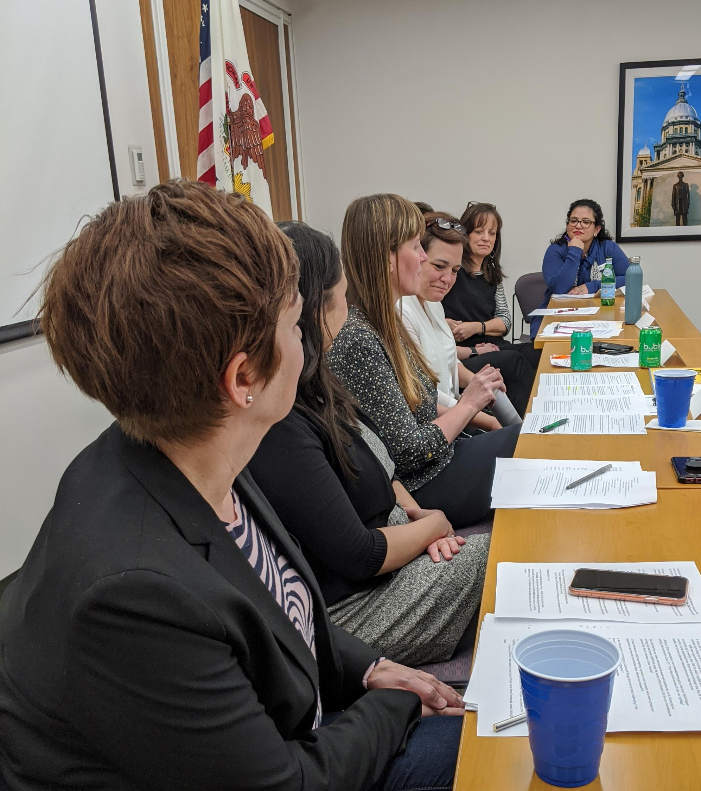
Fine Free Panel Notes
Overdue fines represented a regressive tax on people who can least afford them
Staff morale and efficiency improved – better able to have quality engagements with patrons
Juvenile card registration went up
Material returns went up
General patron behavior did not change – elimination of overdue fines did not cause increase in days overdue on average
Thank you to a great panel!

Slide 17
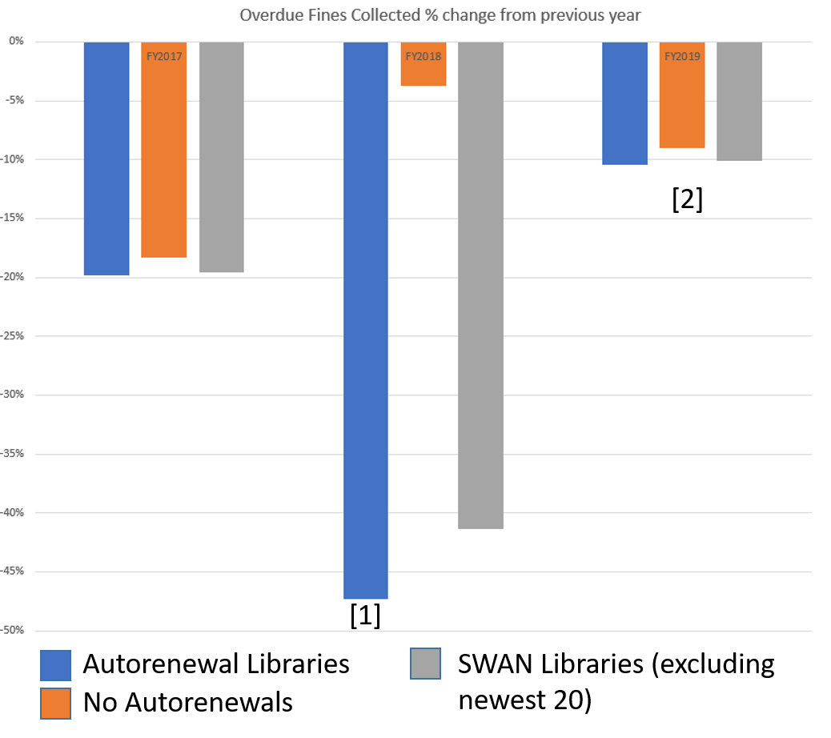
Auto-renewals
Introduced June 2017
Libraries participating
80 public libraries
1 academic library
2 special libraries
Initial year after introduction, overdue fees collected fell [1], then leveled off [2]

Slide 18
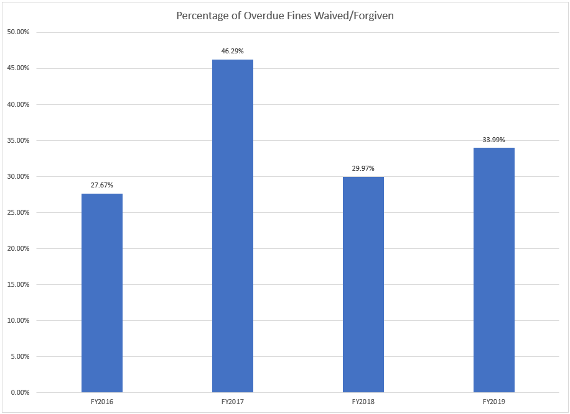
Libraries Waive Fines (a lot!)
Approximately 1/3 of all overdue fines throughout the system are waived
How do libraries determine which fines to waive? Food 4 Fines, Fine Free Friday
2017 showed a bump as more libraries waived fines as part of auto-renewal deployment

Slide 19
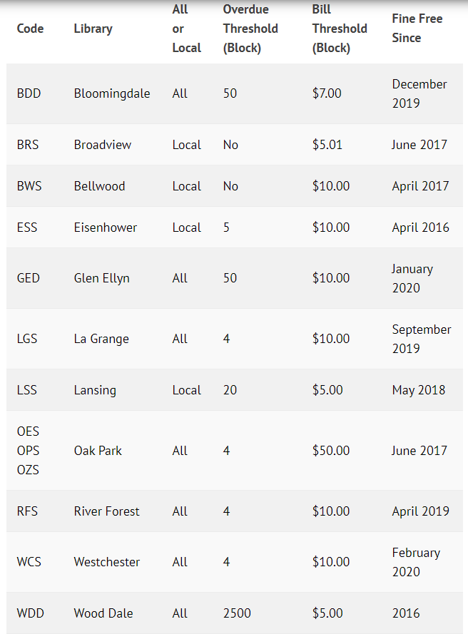
If you want to go Fine Free
Talk to your neighbors
Ask other libraries about their experience
Listen to panel discussion https://support.swanlibraries.net/tutorial/67434
Analyze data (we can help)
Review SWAN Support Site on configuration https://support.swanlibraries.net/documentation/67324
Schedule a consultation with SWAN
Continue conversation on SWAN options to select from (menu of choices)

Slide 20
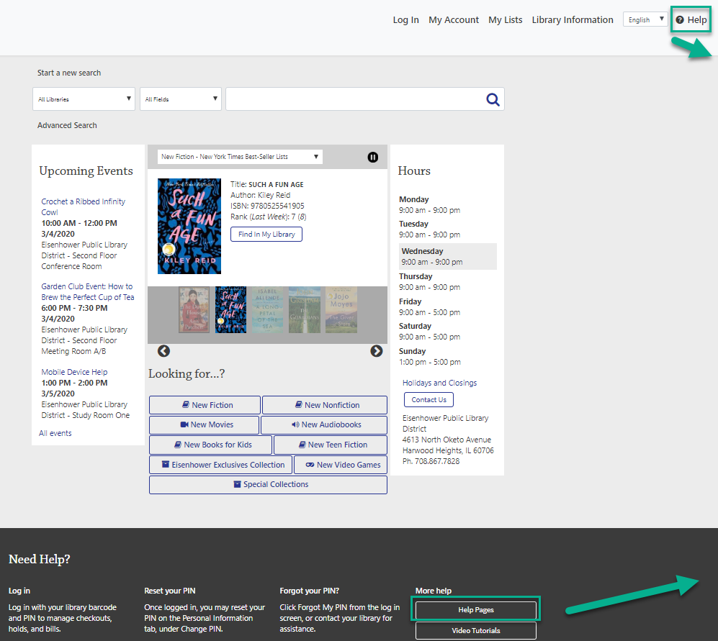
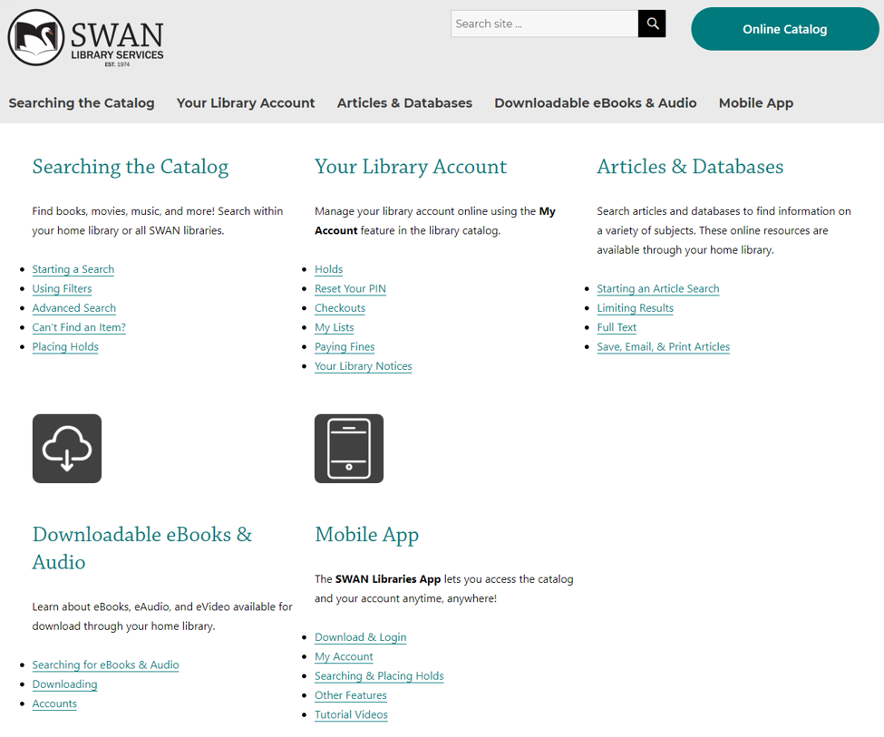
SWAN Patron Help Site (linked from catalog)

Slide 21
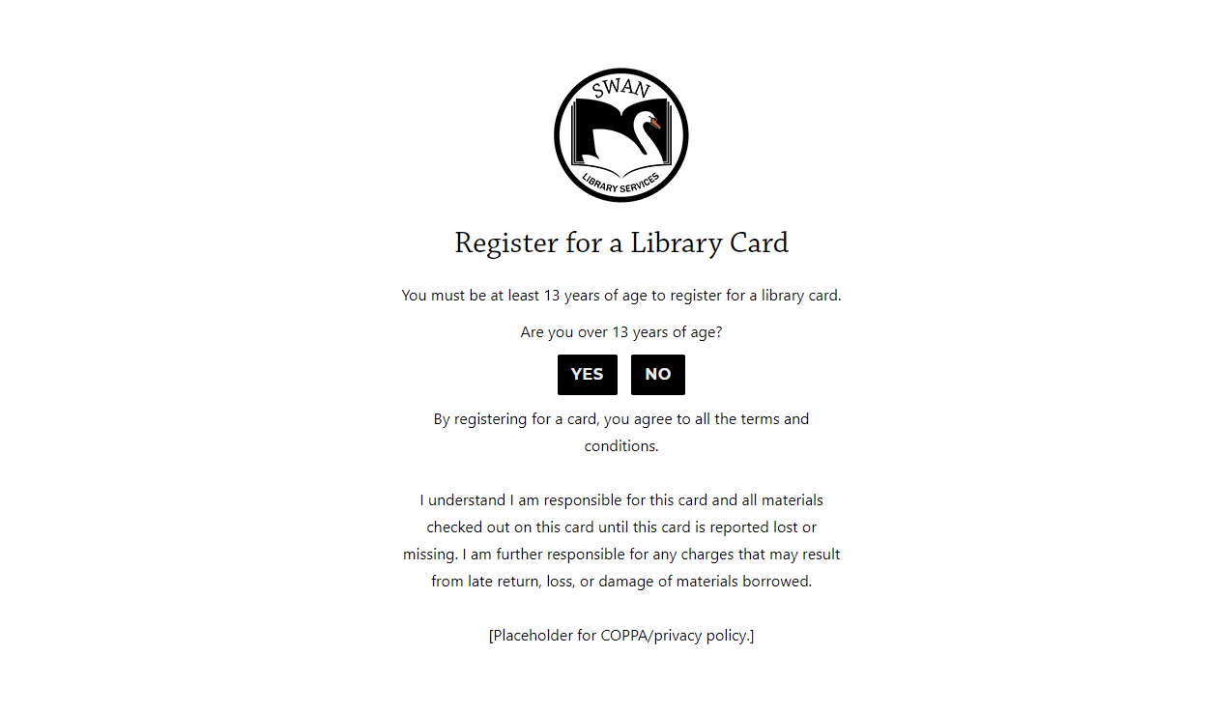
Patron Online Registration (Oak Park Pilot)

Slide 22
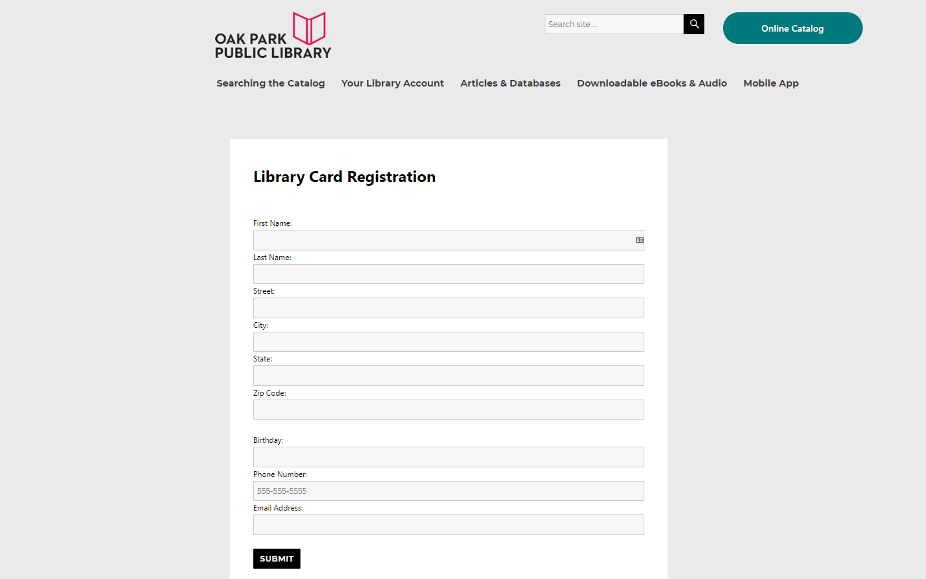
Online Registration
Creates digital library card with limited privileges
Library reviews reports of new registrations
Library verifies card and updates to full patron card
Patron visits library to pick up card or receives card via mail

Slide 23
Announcements & Questions
BLUEcloud Central 20.03.0 Release
Notes:
Starting with these releases, SWAN will be conducting member updates to share added features/functionality, and timeline/impact with the membership. We will announce these sessions via SWANcom, News posts, and on L2.

