Slide 1
SWAN Fireside Chat
April 14, 2020

Slide 2
Topics
Action Update
What does reopening look like?
Fine Free discussions
eResources Update
SWAN eXpo 2020 Web Series

Slide 3
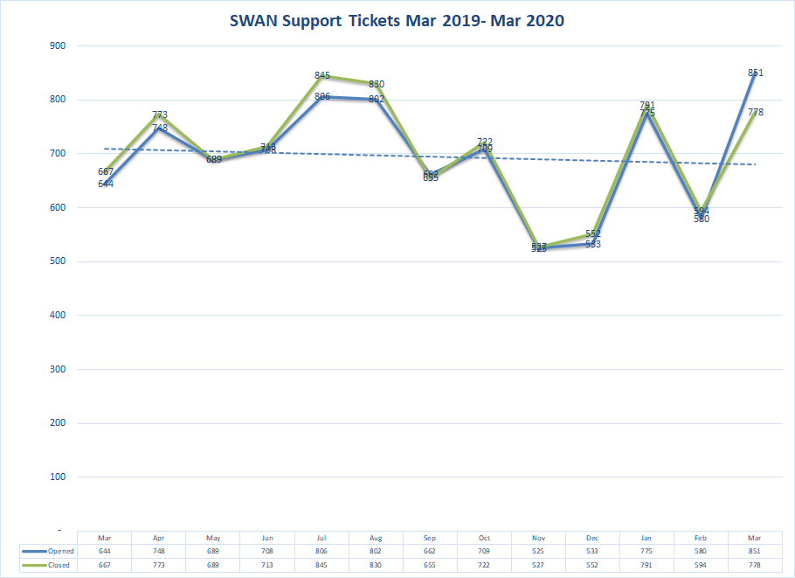
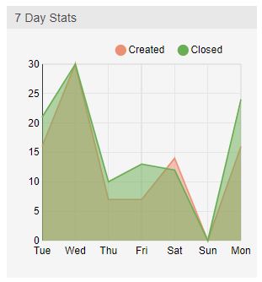
Help ticket tracking
Yes, it does feel like a roller coaster
As of April 13th, 61 tickets remain open

Slide 4
Due Dates updated to 6/3/2020 (some exceptions apply)
Patron expiration dates updated to 7/4/2020 for those who would have expired 1/1/2020 – 6/30/2020
Consider updating expiration date to NEVER – submit a help ticket for consultation
Holds suspended until 5/1/2020 – need to make a decision soon on how long to extend these suspensions.
This Photo by Unknown Author is licensed under CC BY-SA

Slide 5
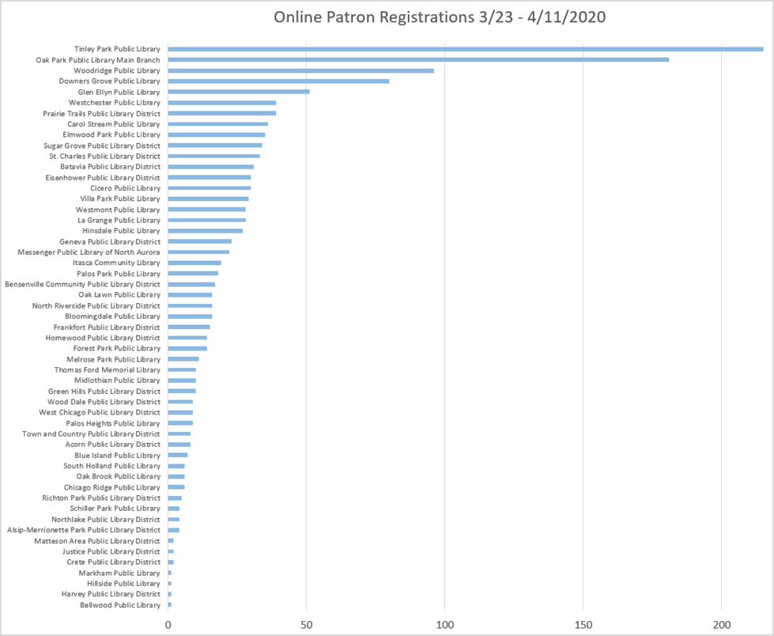
Online Patron Registrations as of 4/11
60 Libraries participating
1,368 patron accounts created

Slide 6
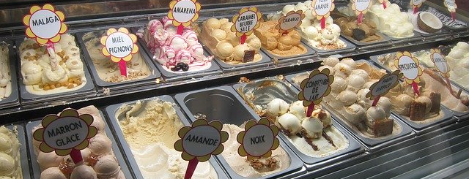
The answer to decision FATIGUE?
Limit Decisions – Let’s make them together
In a crisis like this, burnout can emerge because of something different – what experts call ‘decision fatigue’
BBC - https://www.bbc.com/worklife/article/20200330-covid-19-how-to-learn-a-new-skill-in-coronavirus-quarantine

Slide 7
Reopening Plans & Discussion
Visit the SWAN Community Forums to discuss these topics with our community.
Working on unified plan across SWAN (by end of April, extend as necessary)
Considerations & Concerns:
Health recommendations drive decisions – where are we getting those directives?
What does reopening mean? How will libraries prep spaces, materials, staff?
Gradual movement toward “normal” resource sharing (e.g. allow current items on hold shelf to be picked up, resume local holds after x days, process incoming material (delivery only), restart ILL/pick-up)
What are recommendations for material processing and how will that impact staffing and procedures?
Are libraries considering home delivery or curbside pick-up – what does that mean in terms of system support?
Notes:
We will be working to have a standard procedure across SWAN. Questions and considerations:
1. Date libraries are expected to reopen (we will probably give libraries at least 5 days to reopen, process items currently on hold shelf, ready for patron access) 2. RAILS delivery will likely be delivery only - no pick-ups for the first few days to a week to catch up on backlog 3. We will likely put into place hold rule for all libraries of only filling holds for their patrons (we can't make that pickup since our global configuration is set to prioritize local patrons, not pick-up choice). And items going out will be put in bins (but not picked up), then rescanned prior to pick-up resumption. 4. All of this is also dependent on recommendation for material processing and contamination. So, we are working on a unified plan and will have that developed by the end of April, and can adjust as the stay-at-home order is extended.

Slide 8
Draft Plan of Reopening Timeline/Holds Processing – for discussion
Soft Opening
Sort items on hold shelf by expiration date
Local Holds Filled
Hold map restricts holds to be filled outside local patrons or leave as is?
OnShelf Items wizard displays Pickup Library (fill for own library pick-up)
Prep for Pickup
As items are checked in, if they do indicate to put in transit, temporarily box
Return to New Normal Operations
Process existing hold shelf (check-in or manually retain)
Keep boxes in FIFO (first in, first out) order when delivery resumes
Review/modify staff procedures, incorporate transit label use at time of prepping for blue bin/pickup by RAILS delivery
Evaluate curbside or home delivery service options
Update Pickup preferences of patrons using these services
Update hold wrappers to indicate pickup preferences
Process OnShelf Items for own library continuous, or as able
Process OnShelf Items for transit/pickup at another library as close to delivery pickup time as possible to minimize unnecessary travel
Use In Transit delivery labels which can be scanned and traced in the future, if necessary
Review hold pick-up preference on hold slip/wrapper – patrons may want curbside or home delivery. Process internally, as appropriate
Unsuspend holds
Notices resume ~Day 3?
Note – material processing guidelines for safety need to be incorporated into this plan, but guidelines are pending as of 4/14/2020
Day 1-7
Daily checkout of items to QUARANTINE – non-holdable, as returned (store and date for checkin)
Day 8-30
~ +1-3 Months?
1
Items currently in storage at RAILS are delivered for processing (no pickup of new materials at libraries). Libraries process incoming materials [1]
After quarantine, either reshelve, place on hold shelf, or set aside for future delivery
Your patron but delivery at another library? Segregate and contact? Pickup faster if patron comes to home lib. Or set aside until delivery resumes and it is routed to desired pickup location.
2

Slide 9
What should we be asking?
Considering curbside service? Will you be offering this at the library and/or elsewhere in the community?
Anticipated hours of operation?
Number of staff on site vs remote?
Do you have a plan to share?
Should we research a texting service?
What supplies will be needed? How will you procure those? Should SWAN help procure face shields, paper bags & other supplies?
How are decisions make on reopening and potential closings in the future?
We will compile a survey to collect member concerns and thoughts related to reopening.

Slide 10
Curbside Service: What Does This Mean?
SWAN role with supplies, bulk purchaser: paper bags, face shields, etc.
SWAN researching texting service for library curbside service
RAILS role in recommendations on disinfecting materials
SWAN considering hiding/shadowing some collections within the catalog, e.g. puppets, board games, etc. present real issues for disinfecting
https://www.mprnews.org/story/2020/04/12/minnesota-libraries-offer-contactless-curbside-pickup-to-serve-readers

Slide 11
Burgers, beer, books – keep the process familiar
Communicate service (Website, newsletter, Facebook, etc)
Order (shopping cart, hold queue, phone)
Wait to hear when order is ready or select a preferred pick-up time
I’m here – text or phone
Runner preps order
Pop your trunk - ENJOY

Slide 12
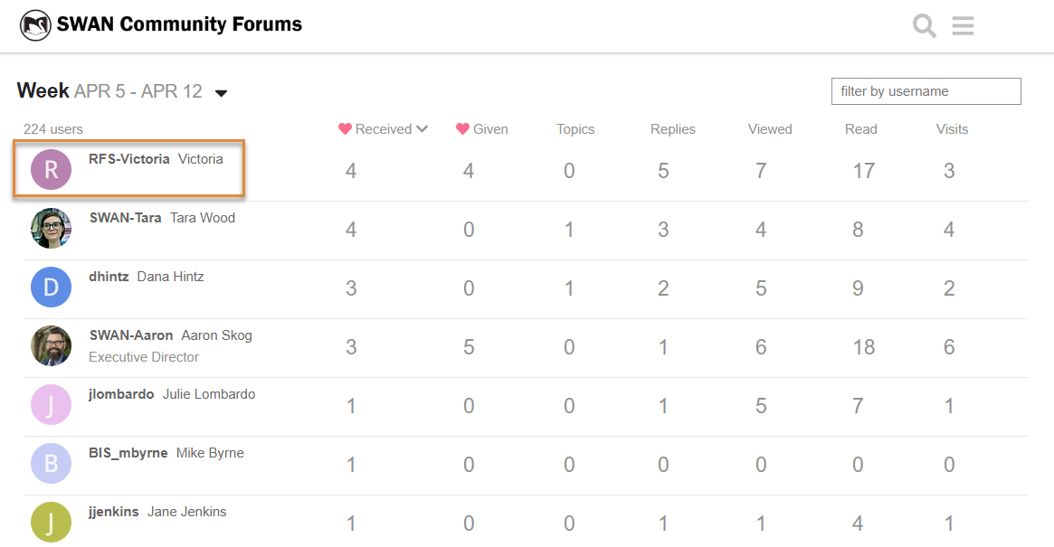
SWAN Community Forums
96 users added since we opened up the forums to all
Check your Spam for invites
Victoria is our conversation-starter of the week. Emoji prize coming!

Slide 13
Fine Free Discussions
SWAN's Fine Free Strategy is an opt-in program. If your library chooses to opt-in:
No fines are charged for any material that is checked out at your library.
Library cards will be blocked when an item checked out at your library becomes 14 days overdue. When items are checked in, that block is immediately removed.
All overdue material is automatically billed at 42 days overdue.
Resources:
https://support.swanlibraries.net/documentation/67324
Fine Free Panel Discussion (February 19, 2020) https://support.swanlibraries.net/tutorial/67434

Slide 14
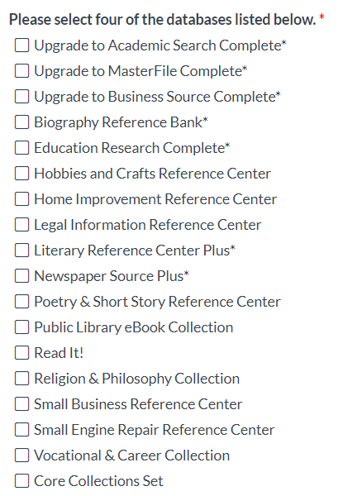
EBSCO Group Purchase – Public Libraries
Select your optional databases by April 30th
Additional information on databases available from EBSCO flyer, linked in the webform for database selection.
SWAN Article Search and EBSCO Discovery Service for Reference Support (April 22 9:30-11) Register on L2 https://www.librarylearning.info/events/?eventID=30592
As of April 13th, 24 libraries have completed their selections.

Slide 15
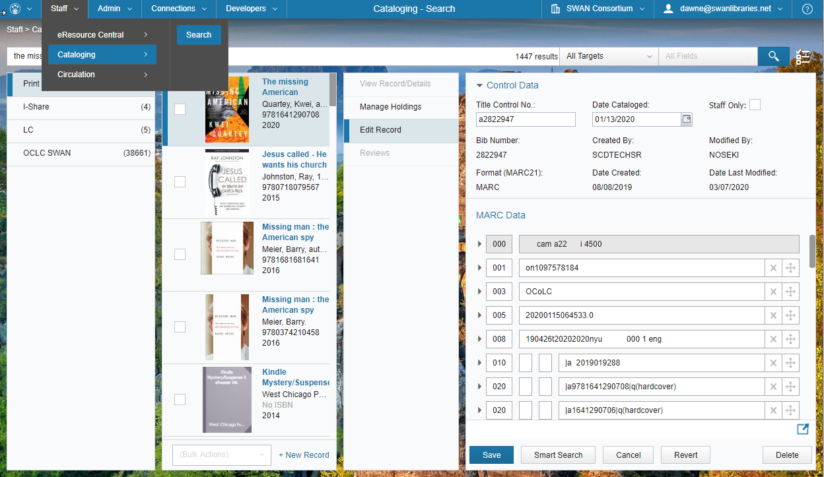
Cataloging Call to Action
Reviewing cleanup lists for Cataloging Libraries to assist
Automating daily processing to maintain catalog
Expanding targeted use of BLUEcloud Cataloging

Slide 16
Introducing….
SWAN eXpo 2020 Web Series
Submit a presentation idea -
https://fs8.formsite.com/SWANServices/swanx2020webseries
Notes:
While SWAN eXpo 2020 is cancelled, we will be providing a series of ongoing 45 minute sessions including a presentation and Q&A. These presentations will be on topics of interest to our membership, and many from speakers we had lined up for SWANx.
If you are interested in presenting a topic,

Slide 17
Fine Free Planning & Discussion
Agenda
Join Dawne, Vickie, and Crystal in a review of the SWAN configuration to facilitate a unified approach to implementing fine free in SWAN. We will review configuration and circulation rules, statistics, and fine forgiveness when implementing. Many libraries were interested in pursuing fine free policies earlier this year; COVID-19 has only added to this interest level and now is a great time to prepare and implement.

Slide 18
Security & Patron Privacy Tips
Agenda
Join Steven Schlewitt and Rudy Host of SWAN as they moderate a discussion on security and patron privacy in our changing service model. They will suggest strategies for ensuring patron information is securely transferred, as well as provide tips of heightening awareness related to scams and security vulnerabilities.

Slide 19
Coping with Compassion Fatigue
Agenda
Libraries are increasingly adding social services to their workload, but many library workers do not have the training or support that is expected for social workers or mental health experts. If you ever feel worn out at work, overwhelmed, or preoccupied with someone you're trying to help, come to this workshop to assess your own personal level of compassion fatigue and learn self-care methods to help you cope.
Amy Franco, Adult Department Assistant Director Glen Ellyn Public Library

Slide 20
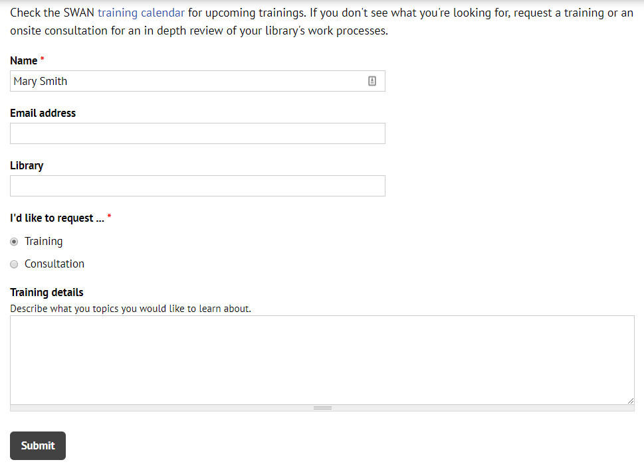
Questions & Follow-up
Send questions to our online ticketing system at help@swanlibraries.net
Visit the SWAN Support Site for access to recorded sessions. https://support.swanlibraries.net
Submit a request for additional training topics. Help > Request Forms > Request Training or Consultation
Notes:
If you have questions, please contact SWAN via our online ticketing system. Also, SWAN training sessions, documentation, and resources are available from the SWAN Support Site.
You can submit a request for additional training through our online form.

