Slide 1
SWAN Fireside Chat
April 21, 2020

Slide 2
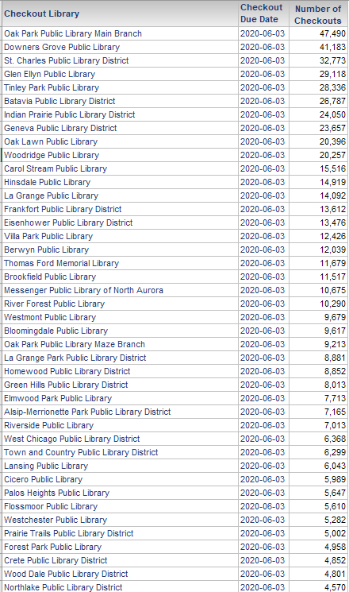
Topics
Snapshot:
Items due 6/3/2020
Action Recap
Fine Free for Now FF4NOW option
Cataloging update
Non-resident discussion
Library consortia meeting recap
Library plans
Library staff PPE
eResources Update
SWAN eXpo 2020 Web Series
Notes:
Aaron speaking:

Slide 3
Action Recap
[NEW] Holds with an expiration date of March 16 – September 6, updated to September 7, 2020.
[NEW] OCLC Supplier Status (No) Updated, through 7/1/2020
Due Dates extended to 6/3/2020 (Public Libraries)
Patron record expiration dates updated to 7/4/2020 (for any user accounts expiring between 1/1/2020-6/30/2020)
Days Closed through April 30, 2020
Notices, billing, collection – all suspended
Notes:
Aaron speaking:

Slide 4
Important Decisions Pending
Holds currently suspended until 5/1/2020 – when to extend and for how long?
If service becomes local only, changes will need to be made to:
Remove Pick-up anywhere option from Enterprise
Consider changing all pick-up locations to patron’s home library
Restrict holds to home library only
Notes:
Aaron speaking:

Slide 5
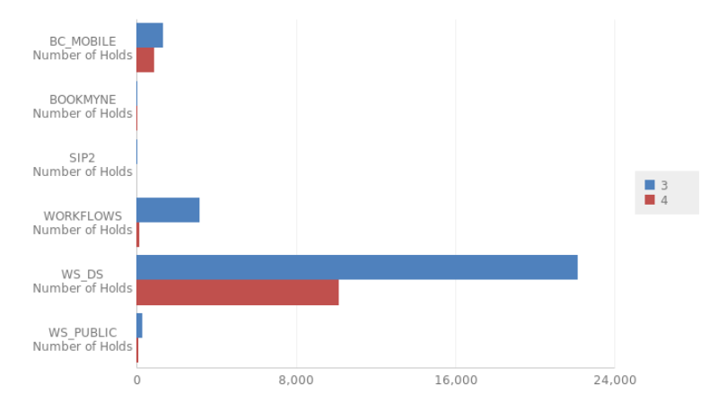
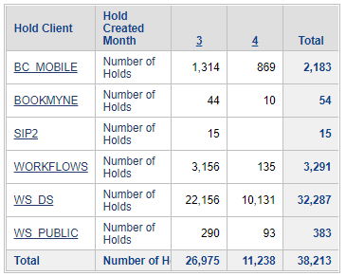
Are people still placing holds?
Yep!
Notes:
Dawne

Slide 6
Fine Free for Now – “FF4NOW”
Libraries have expressed a temporary fine free rule during phased reopening.
Existing Fine Free libraries could continue their existing practice and loan rules.
Temporary rule for libraries:
Same circulation rule regardless of item checked out (library staff will be selecting/processing all items during limited service)
3 weeks, 0 fines, 0 grace period, 0 renewals (3W0F0G0R)
Any requests for renewal can be handled via phone call and library staff assistance, no automatic renewals
Notes:
Dawne speaking:

Slide 7
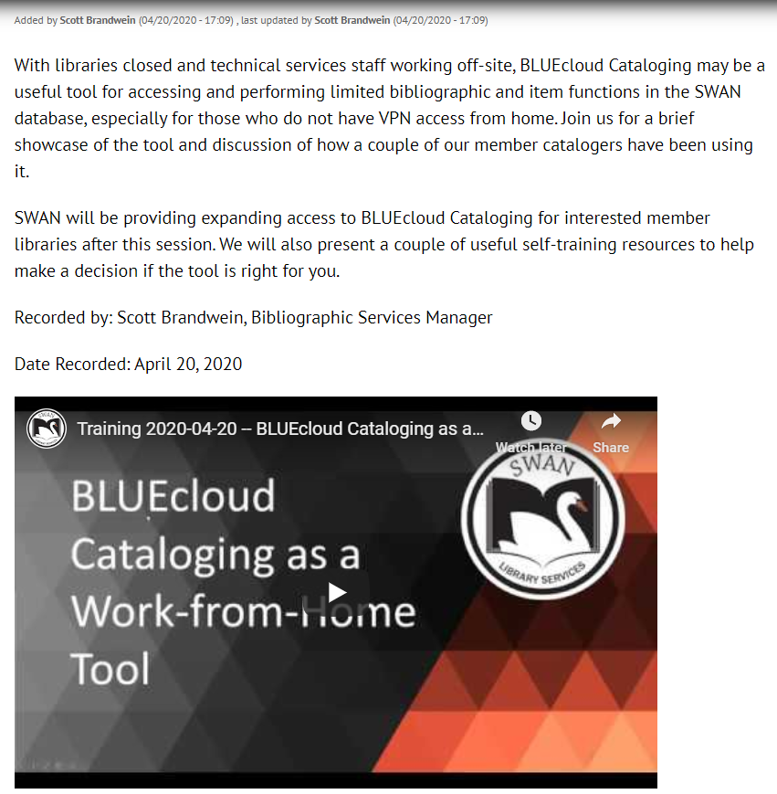
BLUEcloud Cataloging
View recording – https://support.swanlibraries.net/tutorial/70842
Recommendations:
Review training resources
Determine your ideal use case(s)
Evaluate whether these can be accomplished in BLUEcloud Cataloging in full or in part
Send a ticket to SWAN for login access
Hot off the press
Notes:
Scott speaking:
Scott notes: The session yesterday focused on the abilities of the tool. Mention a couple of possible applications for non-cataloging libraries – item type/location/call# agreement, Discard workaround

Slide 8
Non-Resident Discussion
4/10 – RAILS received email from Illinois State Library legal stating “counsel has advised that given the current situation and measures to address the pandemic, a flexible interpretation of the nonresident rules should be applied.”
SWAN Online Patron Registration tool:
Adheres to COPPA legal requirements
Verifies ZIP codes within library service area
Libraries are responsible for reviewing their vendor agreements in terms of legal access to content/resources.
Online Patron Registration continue to grow. 1,951 since March 23rd. Averaging about 70/day for the past week.
See BLUEcloud Analytics > Users > Count Users Reports > Count Online Cards Created by Date
Notes:
Aaron speaking

Slide 9
Library Consortia Meeting Recap
Common themes and solutions – in concert with our colleagues’ thinking
Decisions made at the consortium level & planning together
Resources shared:
A Phase Reopening Plan for Libraries, John Thill
Public Health Principles for a Phased Reopening: Guidance for Governors, John Hopkins Bloomberg School of Public Health
Mitigating COVID-19 When Managing Paper-Based, Circulating, and Other Types of Collections, IMLS
Participants: Alaska, Arizona, Florida, Illinois, Massachusetts, Minnesota, New Jersey, New York, Ohio, Wisconsin Australia (SAPLN), SirsiDynix
Notes:
Aaron Speaking:
Make sure to note SAPLN calling it “Click & Pick” instead of curbside pickup and “Drop & Wave” for delivery

Slide 10
In the News…
Directors of the Park Ridge, Niles-Maine, Morton Grove, Skokie and Lincolnwood Libraries said the plans they are developing include such measures as:
Outside pick-ups and drop-offs of requested materials
Limits on the number of patrons allowed inside libraries at any one time
Fewer pieces of furniture
New screening between patrons and staff
Cancellation of on-site programs
“It may not be the same way that it was for a long time, if ever,” said Heidi Smith, director of the Park Ridge Public Library
Notes:
Aaron

Slide 11
Waiting for Illinois Update…
The State of Wisconsin has extended the "stay at home" order until May 26, 2020
The new order includes minor changes allowing certain activities to start up again:
public libraries can provide curbside pickup of books
golf courses can open with more spread out tee times
non-essential businesses will be allowed to do deliveries, mailings and curbside pick-up
arts and crafts stores can do curb-side pick-up for materials used to make masks or PPE
aesthetic lawn care or construction is allowed as long as it's done by one person
Source, Emergency Order #28 updated 4/16/20 https://www.wisconsinlibraries.org/assets/2020-04-16%20Safer%20at%20Home%20extension%20FAQ.pdf
Notes:
Aaron

Slide 12
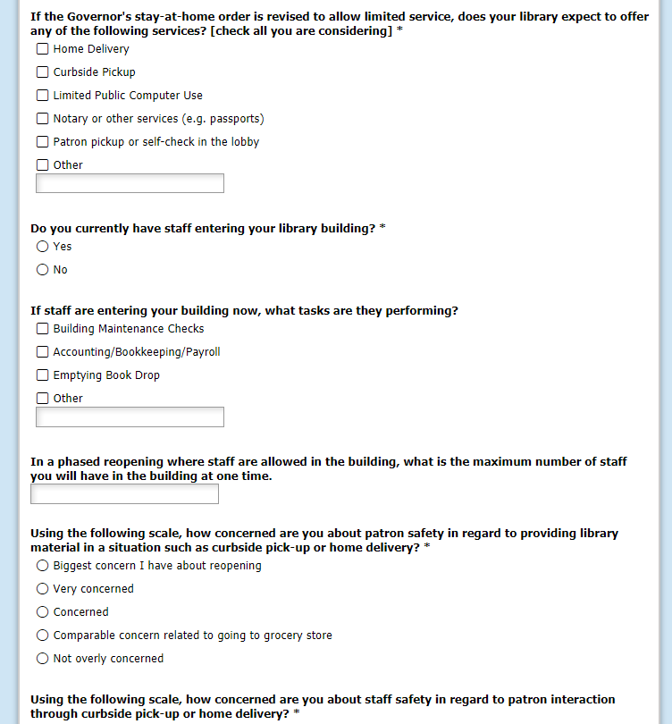
Library Plans
We don’t know what reopening looks like – what do you think?
Complete our online survey - https://fs8.formsite.com/SWANServices/covid-19-reopening
Share your plans. We will post your plans for colleagues.
Join the SWAN Community Forums!
Notes:
Aaron Speaking:

Slide 13
Recommendations from NEDCC COVID-19 and Collection Care, RAILS webinar - https://www.railslibraries.info/events/181331
72-hour quarantine
Separate quarantine space
Store in bags or bins – date for quarantining – don’t touch between start and end of quarantine
Co-locate on carts or shelving away from staff areas is acceptable
Quarantine receiving orders – keep in box, store for 3 days
Staff handling quarantine materials should use gloves
Dispose immediately
Other staff processes should use hand washing, not gloves
Don’t clean material, recommended cleaning products will damage items; time is the best safety product
Clean with disinfectant/wipes hard surfaces, work surfaces, door handles
Notes:
Dawne speaking:

Slide 14
Staff PPE
Likely all staff will need to wear masks to protect colleagues
Wash clothing after each shift; virus is not easily passed through soft porous surfaces
Continuous surface cleaning – create checklist and responsibility chart
Gloves only for those working in quarantine process
Face guards, workstation shields when dealing directly with public
ORGANIZATION – don’t handle until date stamp
Notes:
Dawne speaking:

Slide 15
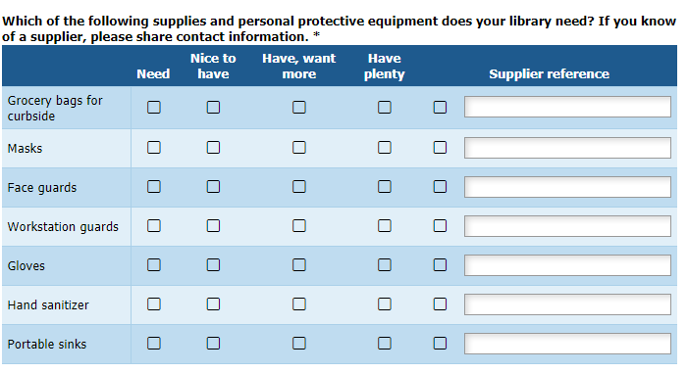
Procurement of PPE and Supplies
SWAN Board supports facilitating procurement and distribution for our libraries
Supplies & PPE being researched:
Grocery bags for curbside/delivery
Face Shields – for staff working curbside, providing safe patron interaction
Masks
Gloves – for staff processing book drop, moving items into quarantine; regular staff functions rely on hand washing
Hand sanitizer
Portable sinks?
Service point/station protective shields
If you have a supplier reference, please share that information in the survey.
Notes:
Aaron speaking:

Slide 16
SWAN Community Forums
67 users added in the past week
Check your Spam for invites
Aaron and Jesse both get emjois – most hearts given and received
Notes:
Aaron speaking:

Slide 17
Last week reminder – patron experience
Communicate service (Website, newsletter, Facebook, etc)
Order (shopping cart, hold queue, phone)
Wait to hear when order is ready or select a preferred pick-up time
I’m here – text or phone
Runner preps order
Pop your trunk - ENJOY
Notes:
Aaron speaking:

Slide 18
Handling Material - staff experience
Quarantine
Ends
Quarantine
Reshelve/
process
Empty
Bookdrop
Prepare
Pick-up
Wear gloves
Date/Segregate
Wash hands
Curbside service
Receive
Book orders
Prepare storage for housing material for 3 days in quarantine before processing.
Notes:
Dawne

Slide 19
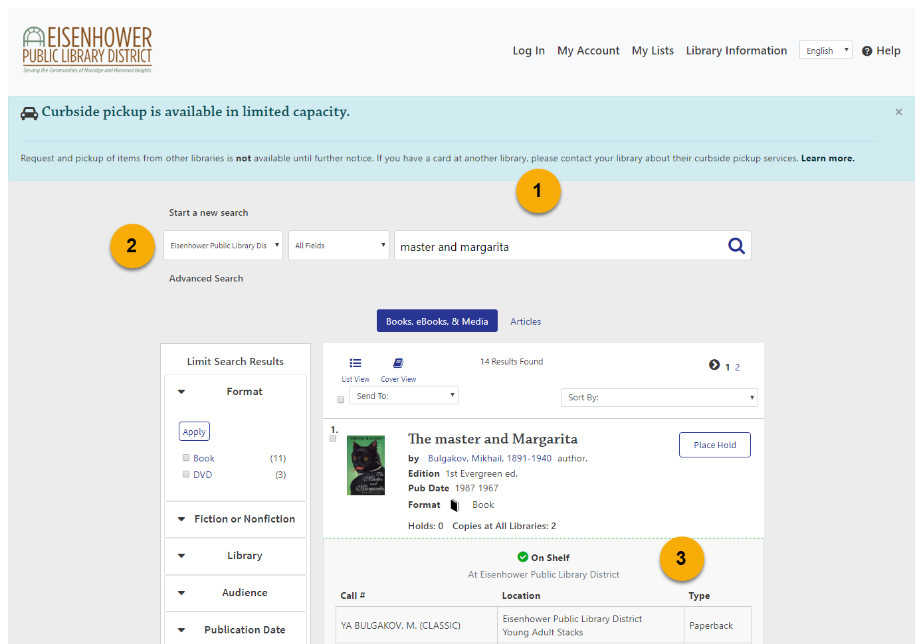
Enterprise – local service model
Considerations for limited access to collections/curbside support
Messaging and link to local instructions
Scope search local
Encourage patrons to look for on shelf items
Notes:
Tara speaking:

Slide 20
eResources Update
Ancestry online access extended through May 31st
Notes:
Robin speaking:

Slide 21
eResources Update
Acorn Public Library District
Batavia Public Library District
Bedford Park Public Library District
Bellwood Public Library
Berkeley Public Library
Bloomingdale Public Library
Bridgeview Public Library
Broadview Public Library District
Calumet City Public Library
Clarendon Hills Public Library
Crestwood Public Library District
Crete Public Library District
Downers Grove Public Library
Evergreen Park Public Library
Flossmoor Public Library
Frankfort Public Library District
Franklin Park Public Library District
Geneva Public Library District
Green Hills Public Library District
Indian Prairie Public Library District
Justice Public Library District
LaGrange Park Public Library District
Lansing Public Library
Markham Public Library
North Riverside Public Library District
Northlake Public Library District
Oak Park Public Library
Palos Heights Public Library
Palos Park Public Library
River Forest Public Library
River Grove Public Library District
Riverside Public Library
Schiller Park Public Library
South Holland Public Library
Steger-South Chicago Heights Public Library District
Tinley Park Public Library
Town and Country Public Library District
Westchester Public Library
Westmont Public Library
Database selections are due April 30th
See your options and complete the form on the SWAN Support Site: https://support.swanlibraries.net/news/2020-04/69763
Thanks to these 39 libraries who have responded as of April 20th
Notes:
Robin speaking:

Slide 22
Introducing….
SWAN eXpo 2020 Web Series
Submit a presentation idea -
https://fs8.formsite.com/SWANServices/swanx2020webseries/index.html
Notes:
Aaron speaking: While SWAN eXpo 2020 is cancelled, we will be providing a series of ongoing 45 minute sessions including a presentation and Q&A. These presentations will be on topics of interest to our membership, and many from speakers we had lined up for SWANx.
If you are interested in presenting a topic,

Slide 23
Security & Patron Privacy Tips
Agenda
Join Steven Schlewitt and Rudy Host of SWAN as they moderate a discussion on security and patron privacy in our changing service model. They will suggest strategies for ensuring patron information is securely transferred, as well as provide tips of heightening awareness related to scams and security vulnerabilities.
Notes:
Aaron speaking:

Slide 24
Coping with Compassion Fatigue
Agenda
Libraries are increasingly adding social services to their workload, but many library workers do not have the training or support that is expected for social workers or mental health experts. If you ever feel worn out at work, overwhelmed, or preoccupied with someone you're trying to help, come to this workshop to assess your own personal level of compassion fatigue and learn self-care methods to help you cope.
Amy Franco, Adult Department Assistant Director Glen Ellyn Public Library
Notes:
Aaron speaking:

Slide 25
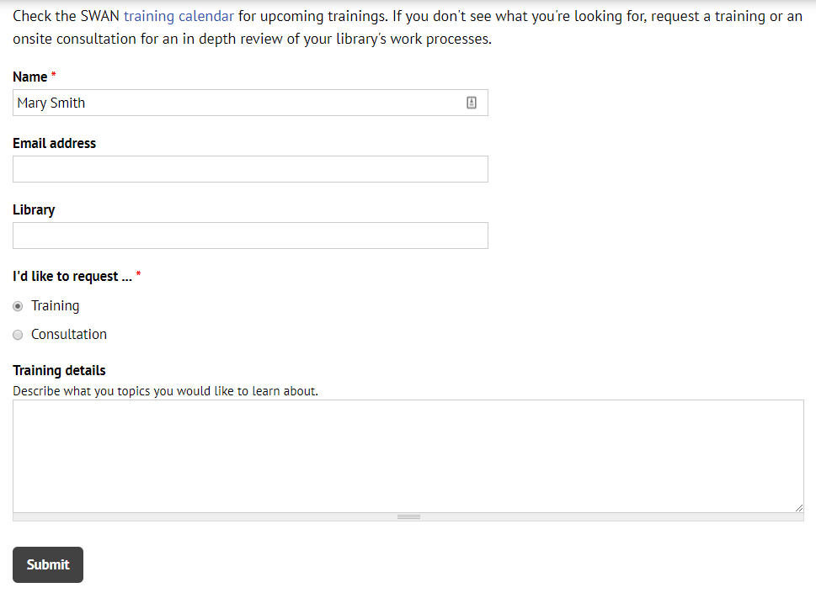
Questions & Follow-up
Send questions to our online ticketing system at help@swanlibraries.net
Visit the SWAN Support Site for access to recorded sessions. https://support.swanlibraries.net
Submit a request for additional training topics. Help > Request Forms > Request Training or Consultation
Notes:
Aaron speaking:
If you have questions, please contact SWAN via our online ticketing system. Also, SWAN training sessions, documentation, and resources are available from the SWAN Support Site.
You can submit a request for additional training through our online form.

