Slide 1

SWAN Fireside Poolside Chat
June 23, 2020

Slide 2


SWAN Poolside Chat
June 23, 2020
This Photo by Unknown Author is licensed under CC BY-SA
Notes:
Aaron speaking

Slide 3
Topics
Action Recap:
  Timeline for restarting reports
PPE
Notices & Notifications
Online Patron Registration
Managing Holds
Optional workflows
  QUARANTINE in-house user (check-in before quarantine)
  CURBSIDE in-house user (checkout after quarantine)
Curbside Update
L2 Update
Resuming Resource Sharing
REALM Study – Phase 1 Results
RAILS Delivery Resumes
Illinois Phase 4 - Reopening
  PPE Needs?
EBSCO Update
By the numbers
SWAN eXpo 2020 Web Series
Notes:
Aaron speaking

Slide 4
Action Recap & Reminders
[ALERT] Local Holds Only (phased resumption starting 7/7)
  Holds placed by CHICAGO_P & NONSWAN_RB profiles will no longer be automatically suspended after 7/7 (local decision on whether to fill)
[NEW] Patron records with expiration dates between 1/1/2020-9/7/2020 extended to 9/8/2020 (some libraries excluded specific profiles)
[NEW] 1st Overdue notices now sent at 14-days overdue instead of 7
Overdue notices started June 9
Courtesy, autorenewal notices started June 1
Suspended holds now active (previously extended to June 8)
Online-only cards extended to August 31, 2020
Unfilled holds with an expiration date of March 16 – September 6, updated to 9/7/2020
Notes:
Steven speaking

Slide 5
Notices & Notifications
For Fine Free libraries who are blocking patrons based on number of items immediately overdue, review impact of quarantine. If desired, limits can be modified.
https://support.swanlibraries.net/documentation/64674
1st Overdue (send at 14 days instead of 7 days overdue)
Text Notice:
  You have overdue library item(s). Please disregard this notice if you returned your material in the past week; items are quarantined before checkin.
Email Notice:
  **1ST OVERDUE NOTICE**
  Please disregard this notice if you returned your material in the past week. All material is held in quarantine before being checked in.
  The following item(s) are now overdue. Please return the item(s) below to avoid potential fines.
  Thank you!
  **Do not reply to this email**
Print Notice (will not be printed/mailed until at least August):
  Please disregard this notice if you returned your material in the past week. all material is held in quarantine before being checked in.
  The following item(s) are now overdue. Please return the item(s) below to avoid potential fines.
  Thank you!
  Did you know that you can opt in to receive notices like these via email or text? Contact your library for additional information, or to change your preferences.
Notes:
Steven speaking

Slide 6



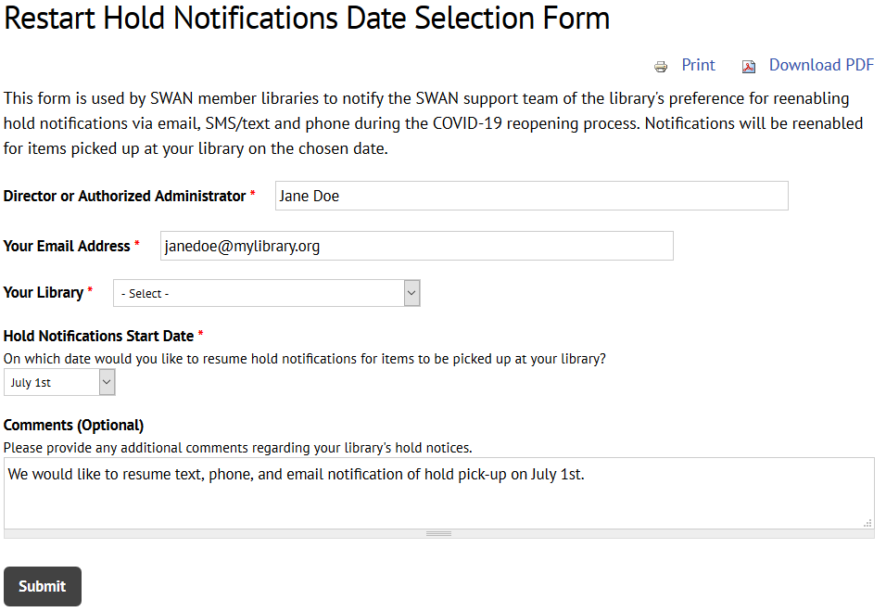
Restarting Hold Pick-Up Notices
2 PM - Yes
https://support.swanlibraries.net/forms/75250
10 AM - No
6 PM - No
Opt-in to restart your hold pick-up notices
Hold pick-up notices can resume on Wednesdays starting 7/1
Hold pick-up notices will run once a day at 2:00 PM (plan your processes to either take advantage or avoid notifications)
Notes:
Steven speaking

Slide 7
Managing Holds – “We are swamped”
Strategies for managing long hold queues.
Process hold queue daily; but consider a rotation on patron last name range to process per day, reducing the number of patron pick-up days/bags.
Consider reasonable number of items patron can use within check-out period.
Reduce number of holds patron can place. While this will not impact the backlog, it will slow hold placement a bit moving forward.
Notes:
Vickie speaking

Slide 8

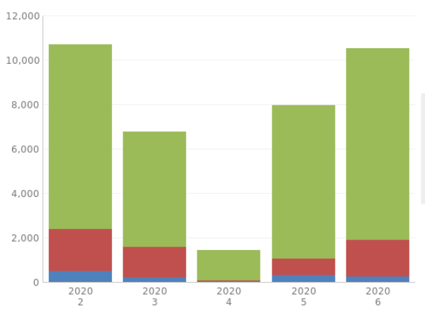
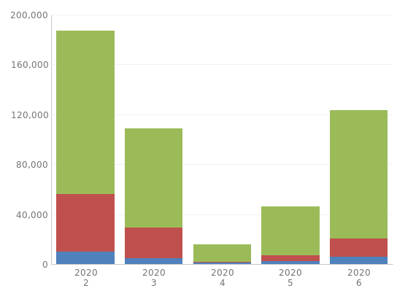
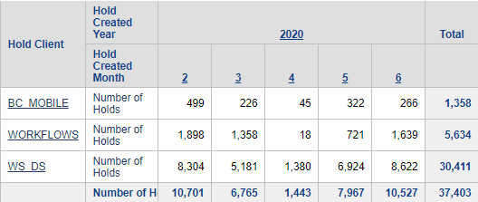
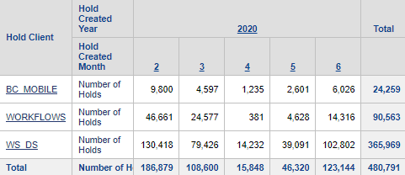
Holds Backlog Examples – Holds Placed
Notes:
Vickie speaking
These charts illustrate how holds placement is returning to pe-COVID trends, add to that the backlog and the reduced capacity to check out materials, it is clear to see why keeping up with the Pull List is challenging.
The graph on the left shows one library (DGS) – others are showing similar trends. Considering we have a full week left in June, those holds placement numbers are going to surpass Feb 2020 holds in many libraries.

Slide 9
Optional Workflows
If your library wants to use either of these in-house users, please submit a help ticket and a unique user for your library will be created
QUARANTINE in-house user
Use to clear items off patron records
Checkout to user when emptying book drops
Quarantine items
Check-in items post-quarantine
QUARANTINE items do not appear on holds list
CURBSIDE in-house user
Use to remove hold pickup status
Checkout to user when hold is trapped to remove My Account messaging that hold is ready for pickup
Either reshelve or put in temporary location to wait for holds list
CURBSIDE items appear on holds list
Notes:
Vickie speaking

Slide 10
Updating Online Patron User Records
Fun Fact: 52 ONLINE accounts created yesterday
https://support.swanlibraries.net/documentation/68769
Online User Only Card
Do not update barcode or create a new record
Update privilege expiration date in the existing record to match normal library policy, (ex. 3 years, NEVER)
Do not issue a physical card
Full Access Library Card
Check for duplicate record - duplicate accounts are not permitted unless they are a child with dual residency or a student with an academic card
Modify existing record
  Update patron profile
  Update privilege expiration date
  Fill in all fields required by local library practice
Create a physical card - Do NOT mail card prior to contacting the patron
Online records (Profile = ONLINE) will be removed 60 days after the privilege expiration date.
Notes:
Michael speaking

Slide 11

Curbside https://support.swanlibraries.net/members/curbside-information
56 libraries currently configured for Curbside Communicator
19 libraries using another method of communication
If you initially opted in to use Curbside Communication, but have implemented another solution, please let us know if we can cancel Curbside Communicator for your library to save on costs.
Notes:
Michael speaking

Slide 12
L2 – RAILS Relaunch in mid-August
All SWAN events through end of December have been moved to virtual spaces
GoToWebinar will handle registrations – be sure to register in advance for personal link to event and receive reminders
Library staff and directory information must be reviewed/updated by July 31st (we recommend by July 15th)
  Request removal of erroneous/duplicate staff accounts if you are not able to update
  If you have maintained learning logs, those must be saved as a print or PDF (My Events)
SWAN events will still be visible on the SWAN Support Site
Notes:
Steven speaking

Slide 13
6/23 - Timeline for restart of ILL/RBP
Resume Hold Notifications 7/1, 7/8, 7/15, 7/29, 8/5, 8/12, 8/19, 8/26, 9/2
Overdue, Courtesy, Autorenewal Notices
Custom Long Overdue (removes lost items > 365 overdue)
Billing Notices
ILL in SWAN starts for some
Collection Reports
ILL in SWAN for some
RBP Resumes & full ILL
June 1
July 6
July 27
Sept 9
June 26
July 7 for some
Aug 12
6/22 Reports sent and News Post Reminder for final Shelf Check
Notes:
Aaron speaking
To clarify: the webform only has the Wednesdays listed to have your Hold Notifications restart. No Mondays, no Tuesdays, no Thursdays, Friday, Saturdays, or Sundays. ONLY WEDNESDAY

Slide 14
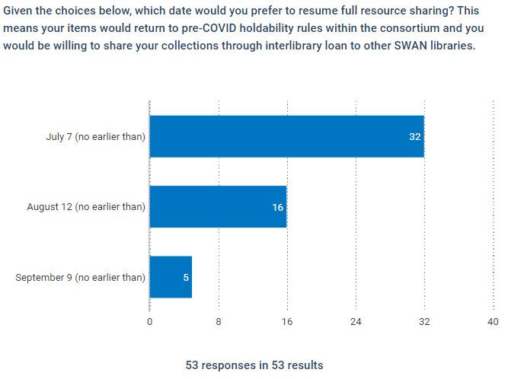
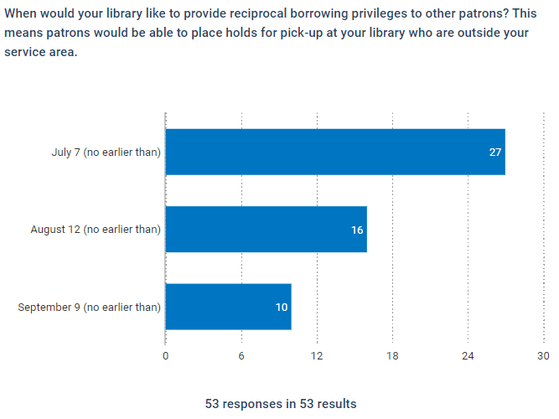
Resuming Resource Sharing
NOTE: 39 libraries did not respond
Interlibrary Loan
Reciprocal Borrowing
Notes:
Aaron speaking

Slide 15
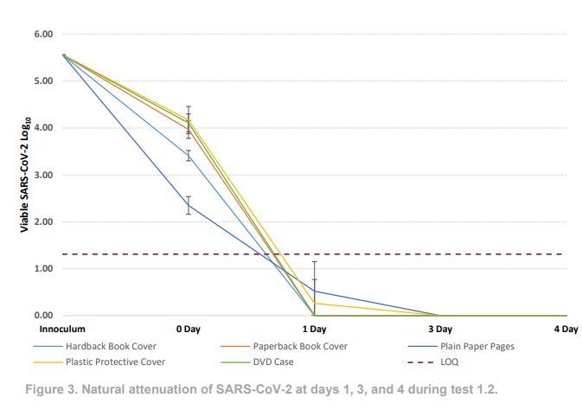
REALM Study – Phase 1 Results
Phase 1 research tested:
Hardback book cover (buckram cloth)
Softback book cover
Plain paper pages inside a closed book
Plastic book covering (biaxially oriented polyester film)
DVD case
Results show that the SARS-CoV-2 virus was not detectable on the materials after three days of quarantine.
https://www.webjunction.org/news/webjunction/test1-results.html
Notes:
Aaron speaking

Slide 16
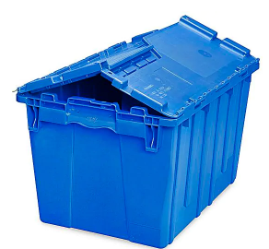
RAILS Resumes Delivery Schedule June 29
Blue bins only (request additional, if needed)
Every item labeled
Contactless delivery (not within staff areas)
Items quarantined before pick-up (look for RAILS announcement) – staff wearing PPE to handle items is considered “clean” and does not require additional quarantine time.
Empty bins immediately upon receipt, follow local practice.
Wipe down bin before returning to delivery.
Notes:
Aaron speaking

Slide 17
Illinois – Phase 4, June 26th
Notes:
Aaron speaking
SWAN is moving towards Phase 4 once the resource sharing is turned on for all libraries.

Slide 18

Libraries Reopening
Let us know! Submit a help ticket to indicate date opening for patrons.
Questions we will ask:
Are you continuing curbside?
Do we need to adjust FF4NOW rules?
Special Enterprise banner changes?
Did you shadow collections that you want to unshadow?
Did you open up browsing collections for holds that now should be restricted?
If your doors are open, you can circulate anything to anyone you allow into your building. The system is ready now to support reopening when your doors open.
We will turn on resource sharing in groups on set dates.
This Photo by Unknown Author is licensed under CC BY
Notes:
Aaron speaking

Slide 19
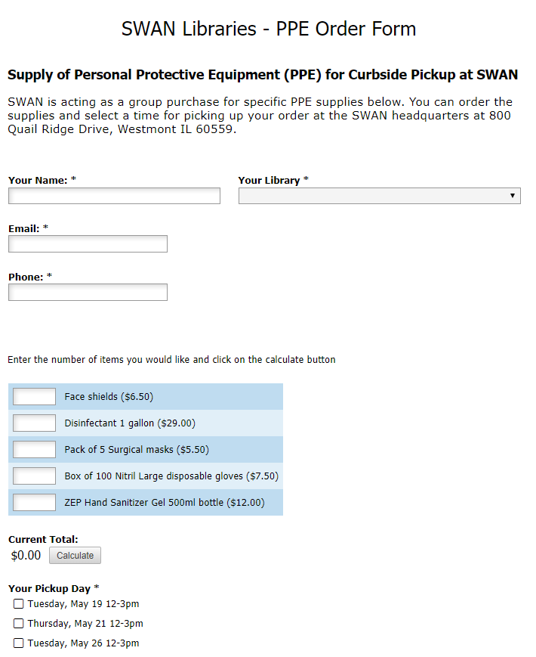
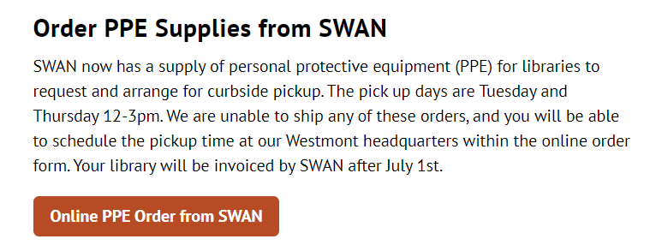
SWAN PPE Curbside
https://support.swanlibraries.net/documentation/71395
Complete supply order form
Supply preferred date for pick-up & time
Wait for confirmation from Ginny
Notes:
Aaron speaking

Slide 20
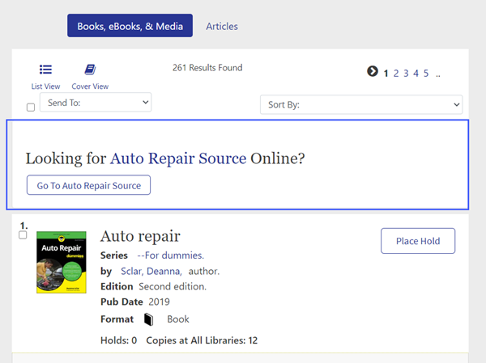
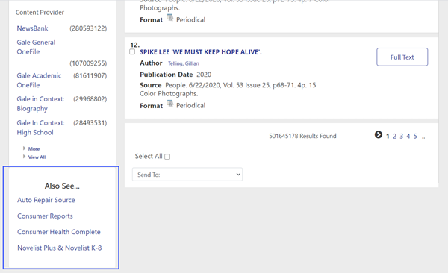
EBSCO Group Purchase Go Live July 8th
https://support.swanlibraries.net/news/2020-06/75030
Search Article Search for most of your databases.
Consumer Reports, Consumer Health, Novelist, and Auto Repair are not integrated into Article Search, but will be shown as “Also See…” references in Enterprise.
Standard SWAN-wide database will also be included as search recommendations.
Notes:
Robin speaking

Slide 21



EBSCO Databases SWAN Group Purchase Update
Sign up on L2
https://www.librarylearning.info/events/?eventID=31583
Don’t miss the buzz….
Notes:
Robin speaking

Slide 22
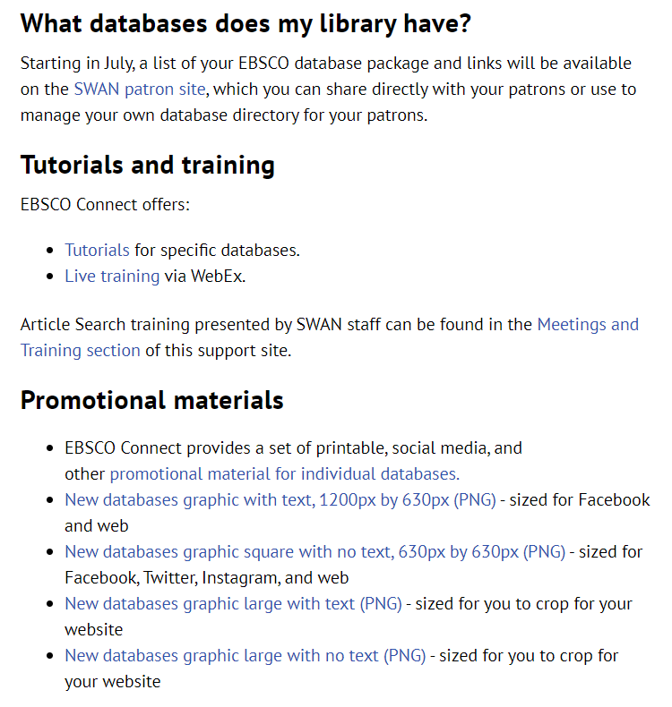

EBSCO Resources on the SWAN Support Site
Documentation > E-Resources > SWAN EBSCO Databases
https://support.swanlibraries.net/documentation/70949
Tutorials and training from EBSCO Connect listed by interface
Notes:
Robin speaking

Slide 23


Promotional Graphics Available
EBSCO provides graphics on EBSCO Connect and you can find a link to those on the SWAN EBSCO Databases page of the Support Site
SWAN created graphics can be found there as well.
Sized for Facebook, Twitter, Instagram
Sized for social media banners
Notes:
Robin speaking

Slide 24
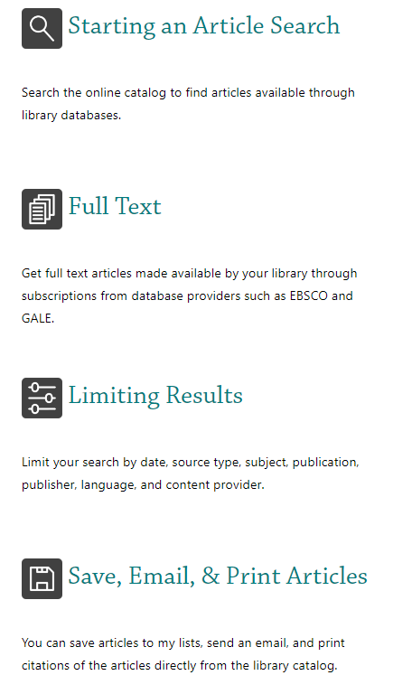
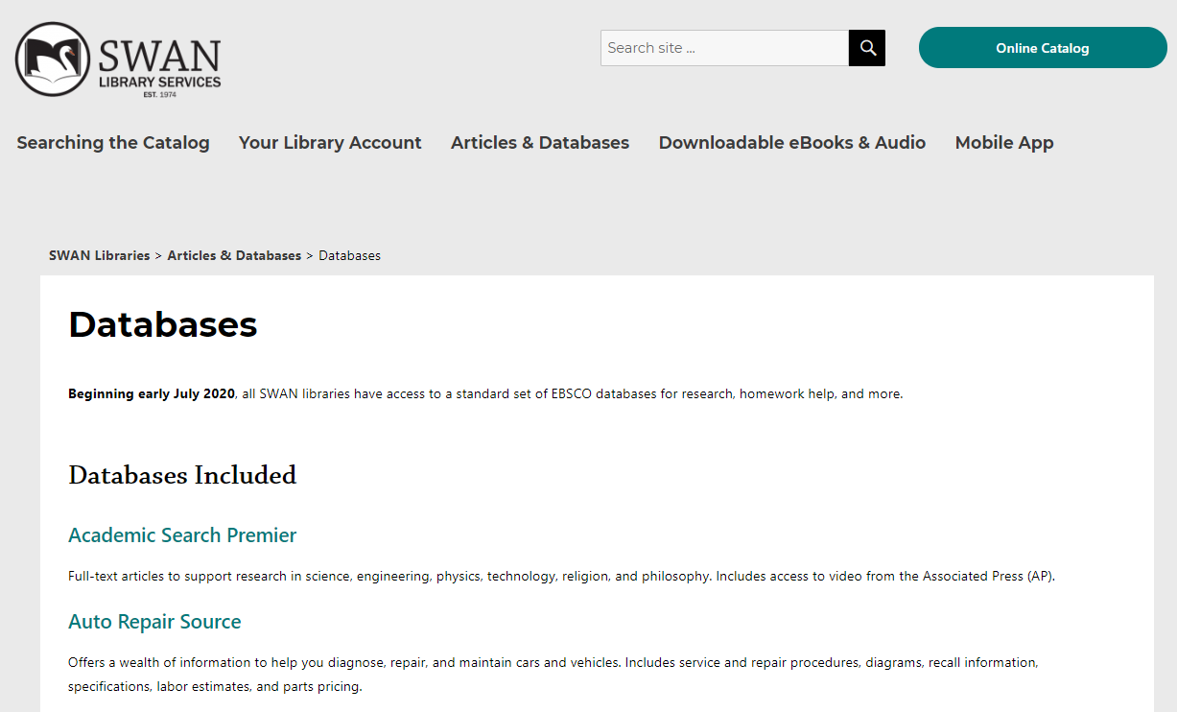
Patron Resources & Access to Databases
https://swanlibraries.net/articles-databases/
https://swanlibraries.net/articles-databases/databases/
Notes:
Robin speaking

Slide 25
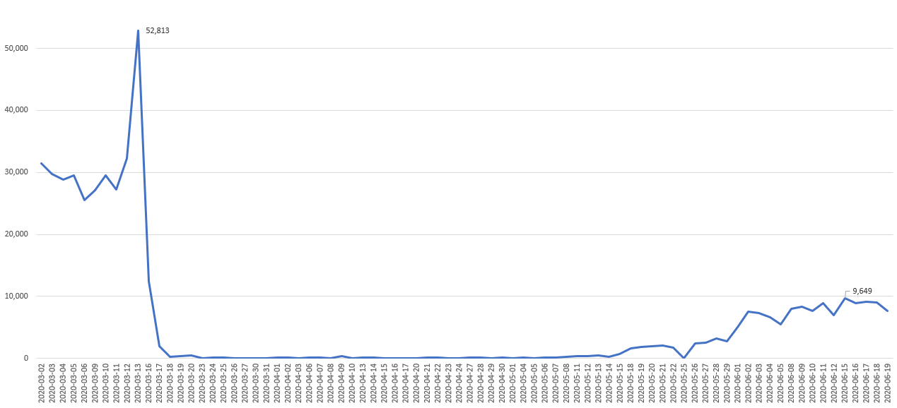
Checkouts March 1-June 21 (excluding weekends)
Since last Fireside Chat
Notes:
Aaron speaking

Slide 26
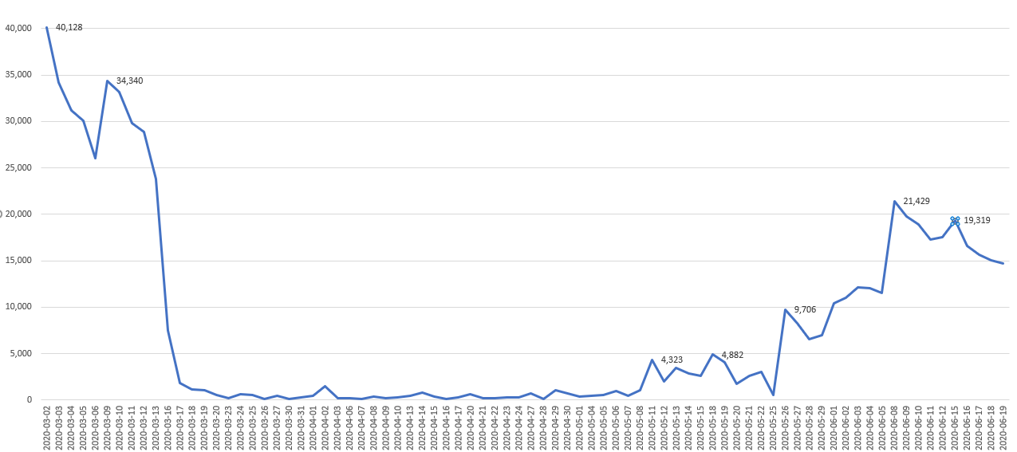
Check-ins – March 1- June 21 (excluding weekends)
Since last Fireside Chat
Notes:
Aaron speaking

Slide 27
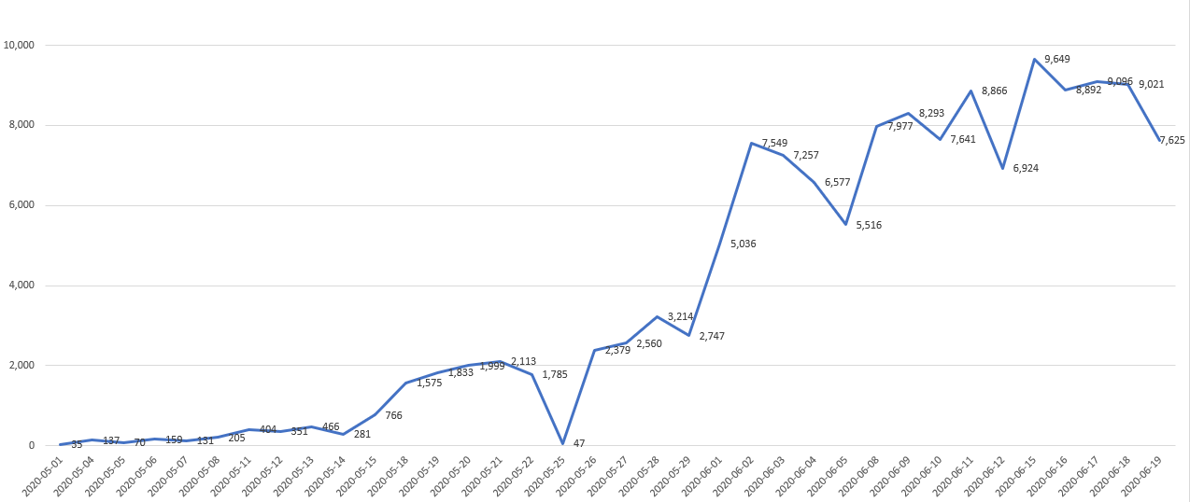
Checkouts May 1-June 22 (weekends excluded)
Notes:
Aaron speaking

Slide 28
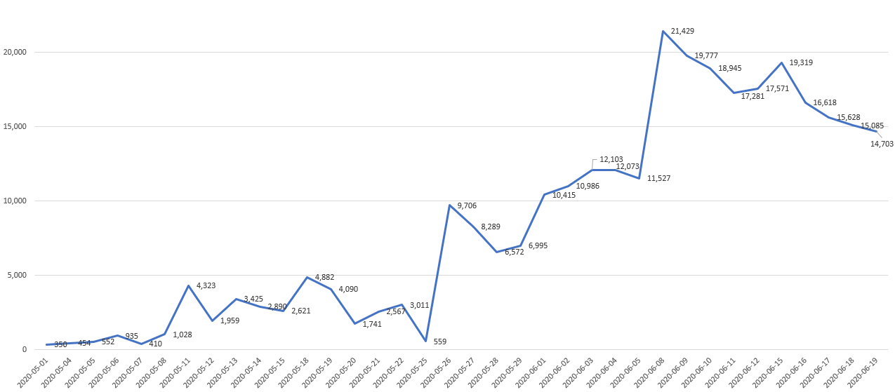
Check-ins – May 1-June 21 (weekends excluded)
Notes:
Aaron speaking

Slide 29
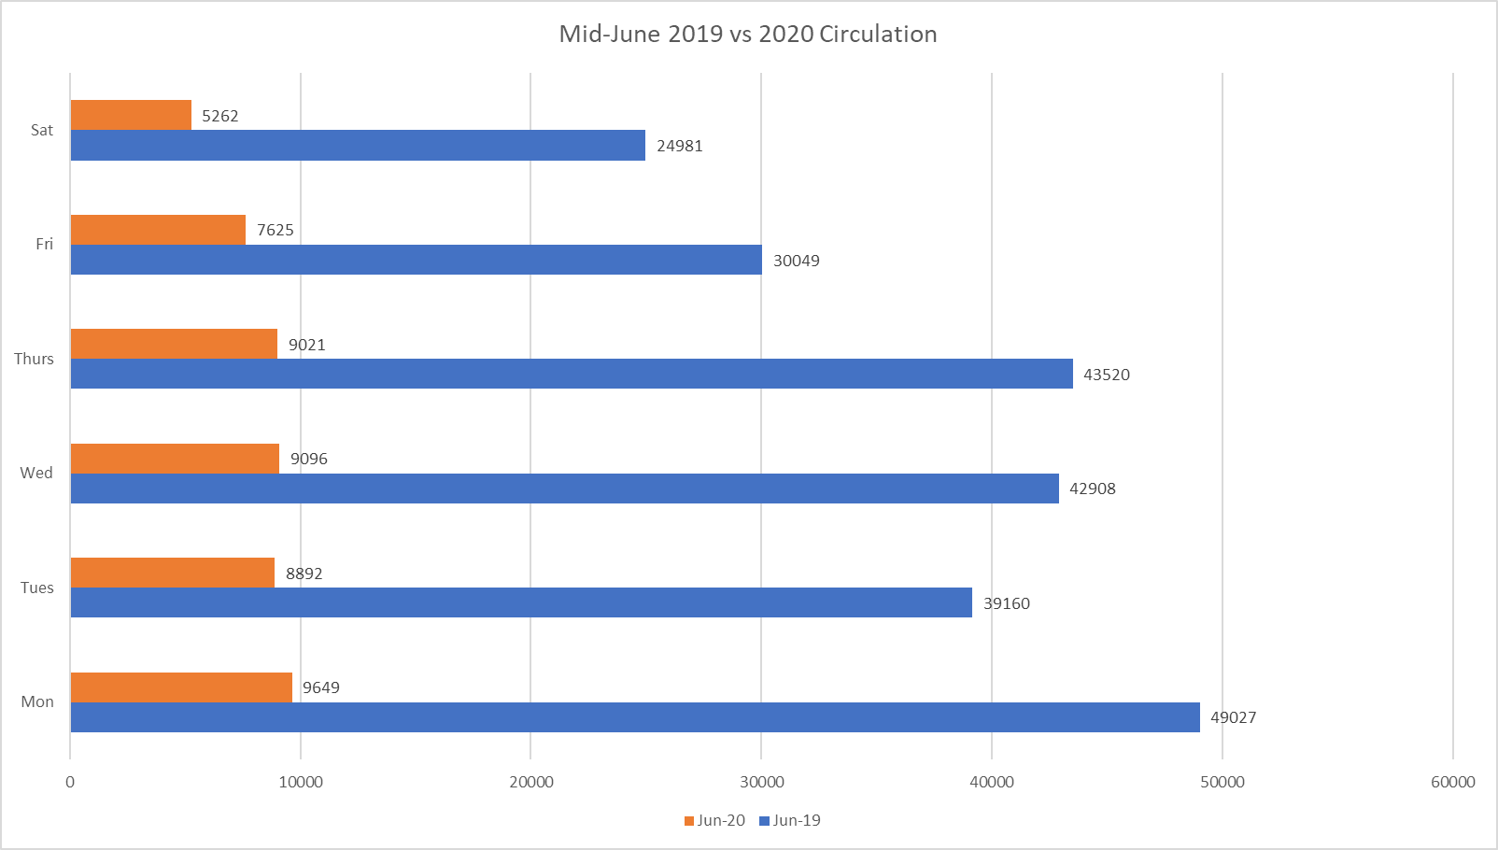
Circulation Comparison 2019 vs 2020 (~20%)
Notes:
Aaron speaking

Slide 30
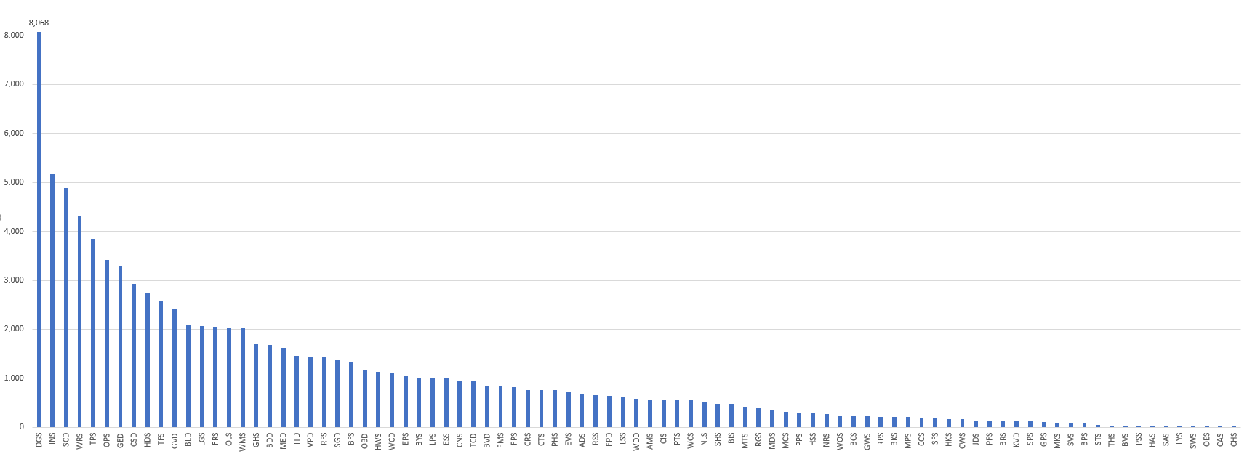
Checkouts in last 14 days
2 libraries > 5,000 checkouts
30 libraries > 1,000 checkouts
50 libraries > 500 checkouts
75 libraries > 100 checkouts

Slide 31


Facilitating Virtual Book Clubs
SWAN eXpo 2020 Web Series
These days we’re all learning on the fly. Pioneering new ways to meet our patrons where they are and in ways that were unimagined six months ago. This isn’t always comfortable or easy but it’s turning out that ingenuity and enthusiasm can, in many ways, make up for lack of experience. With that in mind, we need to get past the idea that we can’t be authorities on a subject just because the format is suddenly so very different. Join colleagues for a discussion on facilitating and joining online book clubs. From selection to facilitation to technology, we will share their experiences and encourage others to discuss how they are working in a virtual world to keep book clubs thriving.
Notes:
Aaron speaking

Slide 32
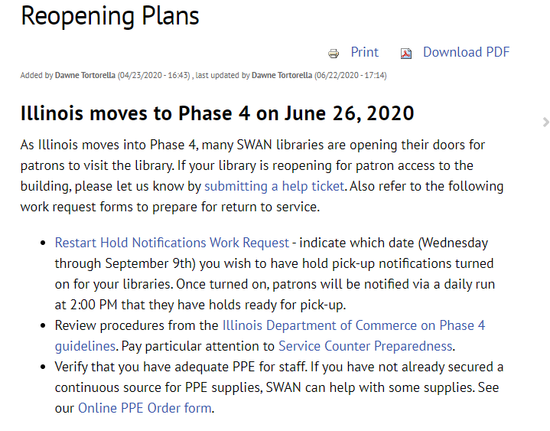
Library Check List https://support.swanlibraries.net/documentation/71031
Submit help ticket – Let us know you are reopening for patrons in the building.
Restart Hold Notifications - Hold Notifications will restart on Wednesdays. Select your date for requesting restart.
Check IL Dept of Commerce Guidelines
Online PPE Order Form - SWAN can help with some supplies required for readiness in offering services.
Notes:
Aaron speaking

Slide 33
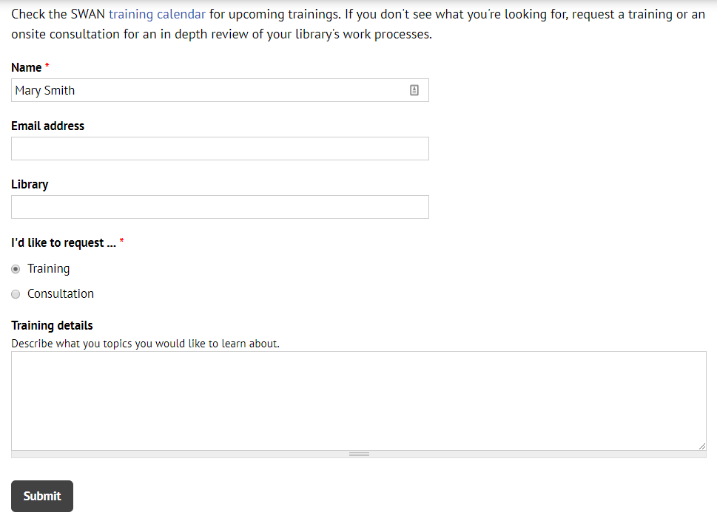
Questions & Follow-up
Send questions to our online ticketing system at help@swanlibraries.net
Visit the SWAN Support Site for access to recorded sessions.
https://support.swanlibraries.net
Submit a request for additional training topics.
Help > Request Forms > Request Training or Consultation
Notes:
Aaron speaking:
If you have questions, please contact SWAN via our online ticketing system. Also, SWAN training sessions, documentation, and resources are available from the SWAN Support Site.
You can submit a request for additional training through our online form.

