Slide 1
SWAN Fireside Poolside Chat
July 7, 2020

Slide 2
SWAN Poolside Chat
July 7, 2020
Notes:
Aaron speaking

Slide 3
We sprung a leak! Turning on the resource sharing hose…
Pull items for your patrons, pick-up at your library first.
Do not pull other libraries unless they are participating in resource sharing, and then only at end of day when a local copy may have come in to satisfy the hold.
If item not pulled today, it will either on your list tomorrow, or someone else’s if a local copy becomes available.
This Photo by Unknown Author is licensed under CC BY-SA

Slide 4
Topics
Action Recap:
Timeline for restarting reports
Notices & Notifications
Poll (1st Overdue)
Managing Holds
Poll (Resource Sharing Restart)
Optional workflows
QUARANTINE in-house user (check-in before quarantine)
CURBSIDE in-house user (checkout after quarantine)
Online Patron Registration – Reminder on updating patron records
L2 Update
EBSCO Update
By the numbers

Slide 5
Action Recap & Reminders
[NEW] Local Holds Only (phased resumption starting 7/7)
Holds placed by CHICAGO_P & NONSWAN_RB profiles will no longer be automatically suspended after 7/7 (local decision on whether to fill)
[DISCUSS] 1st Overdue notices now sent at 14-days overdue instead of 7
[DISCUSS] Clean Hold Shelf processing will resume 7/7 (nightly processing)
Patron records with expiration dates between 1/1/2020-9/7/2020 extended to 9/8/2020 (some libraries excluded specific profiles)
Overdue notices started June 9
Courtesy, autorenewal notices started June 1
Suspended holds now active (previously extended to June 8)
Online-only cards extended to August 31, 2020
Unfilled holds with an expiration date of March 16 – September 6, updated to 9/7/2020

Slide 6
Libraries Reopening
Let us know! Submit a help ticket to indicate date opening for patrons.
Questions we will ask:
Are you continuing curbside?
Do we need to adjust FF4NOW rules?
Special Enterprise banner changes?
Did you shadow collections that you want to unshadow?
Did you open up browsing collections for holds that now should be restricted?
If your doors are open, you can circulate anything to anyone you allow into your building. The system is ready now to support reopening when your doors open.
We will turn on resource sharing in groups on set dates.
This Photo by Unknown Author is licensed under CC BY

Slide 7
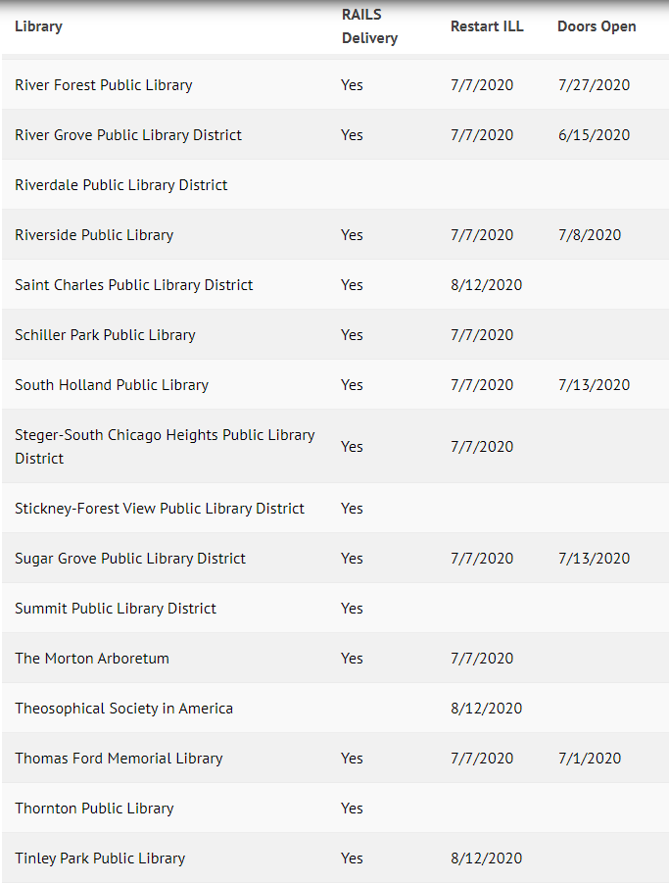
Library Services Recap https://support.swanlibraries.net/node/75665
50 SWAN Libraries resuming resource sharing 7/7/2020
38 SWAN Libraries have building open to the public in some capacity
88 SWAN Libraries resumed delivery service
If the data on your library is incomplete or incorrect, please submit a support ticket – help@swanlibraries.net

Slide 8
6/23 - Timeline for restart of ILL/RBP
Resume Hold Notifications 7/1, 7/8, 7/15, 7/29, 8/5, 8/12, 8/19, 8/26, 9/2
Overdue, Courtesy, Autorenewal Notices
Custom Long Overdue (removes lost items > 365 overdue)
Billing Notices
ILL in SWAN starts for some
Collection Reports
ILL in SWAN for some
RBP Resumes & full ILL
June 1
July 7
July 27
Sept 9
June 26
July 7 for some
Aug 12
6/22 Reports sent and News Post Reminder for final Shelf Check
Notes:
Aaron speaking
To clarify: the webform only has the Wednesdays listed to have your Hold Notifications restart. No Mondays, no Tuesdays, no Thursdays, Friday, Saturdays, or Sundays. ONLY WEDNESDAY

Slide 9
Notices & Notifications
For Fine Free libraries who are blocking patrons based on number of items immediately overdue, review impact of quarantine. If desired, limits can be modified.
https://support.swanlibraries.net/documentation/64674
With libraries reopening, do we want to move back to 7 days?
1st Overdue (send at 14 days instead of 7 days overdue)
Text Notice:
You have overdue library item(s). Please disregard this notice if you returned your material in the past week; items are quarantined before checkin.
Email Notice:
**1ST OVERDUE NOTICE**
Please disregard this notice if you returned your material in the past week. All material is held in quarantine before being checked in.
The following item(s) are now overdue. Please return the item(s) below to avoid potential fines.
Thank you! **Do not reply to this email**
Print Notice (will not be printed/mailed until at least August):
Please disregard this notice if you returned your material in the past week. all material is held in quarantine before being checked in.
The following item(s) are now overdue. Please return the item(s) below to avoid potential fines. Thank you!
Did you know that you can opt in to receive notices like these via email or text? Contact your library for additional information, or to change your preferences.

Slide 10
1st Overdue Poll – what is your preference?
1st overdue back to 7 days.
Use Quarantine user to check in items prior to quarantine so eliminate patron miscommunication.
1st overdue at 14 days until COVID quarantining is no longer required.

Slide 11
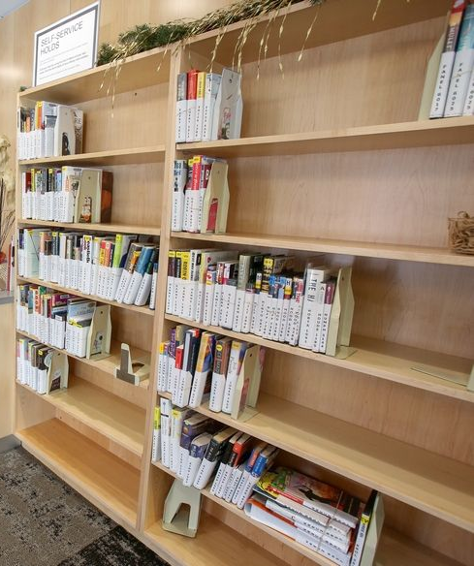
Clean Hold Shelf
The Clean Holdshelf report will update the current location to a new location, HOLD_PROC - Holds Processing, when it runs.
The report will no longer put the item in transit.
All items removed from the hold shelf must be scanned manually.
This will eliminate problems with items missing on the holdshelf being put in transit automatically.
Notes:
We added HOLD_PROC, Holdshelf Processing, as a new location. The Clean Holdshelf report will update the current location to HOLD_PROC when it runs and will no longer put the item in transit. One of the reasons we made this adjustment is to ensure an item is not put in transit without being scanned manually. This will eliminate items being put in transit if the library does not find them on the holdshelf.

Slide 12
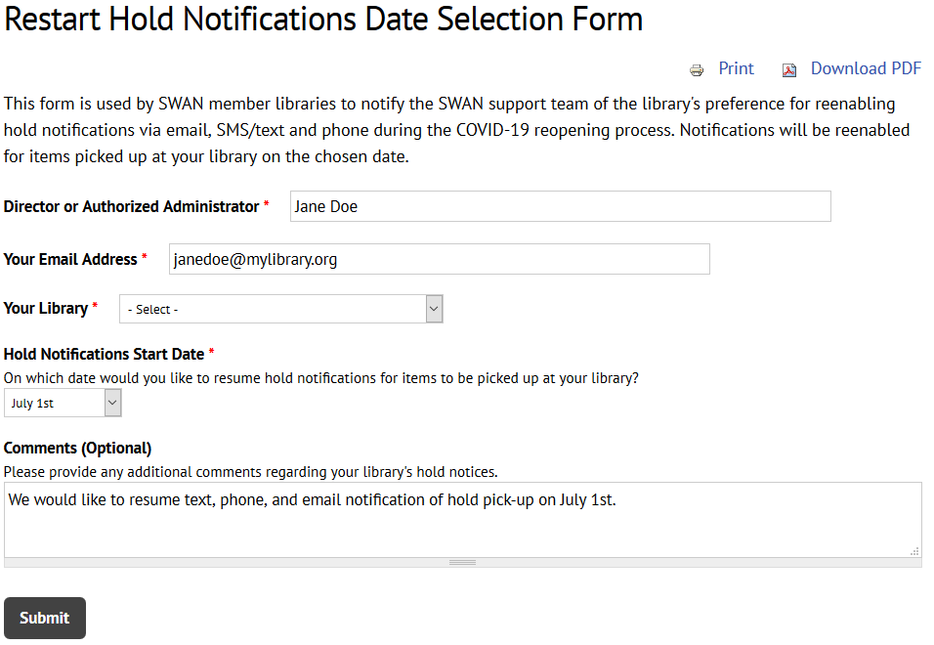
Restarting Hold Pick-Up Notices
2 PM - Yes
https://support.swanlibraries.net/forms/75250
10 AM - No
6 PM - No
Opt-in to restart – Wednesdays
27 libraries 7/1
13 libraries 7/7
Hold pick-up notices will run once a day at 2:00 PM (plan your processes to either take advantage or avoid notifications)

Slide 13
Managing Holds – progress is being made
Strategies for managing long hold queues.
Process hold queue daily; but consider a rotation on patron last name range to process per day, reducing the number of patron pick-up days/bags.
Consider reasonable number of items patron can use within check-out period.
Reduce number of holds patron can place. While this will not impact the backlog, it will slow hold placement a bit moving forward.

Slide 14
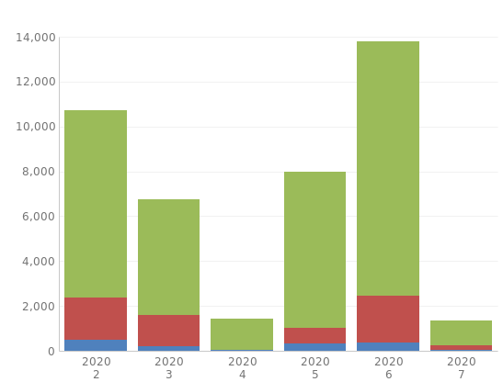
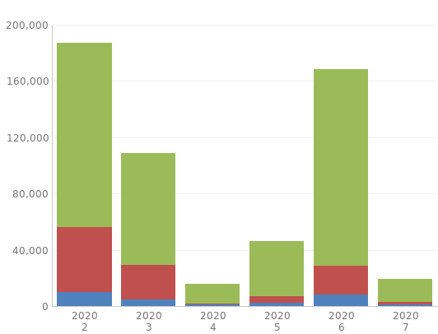
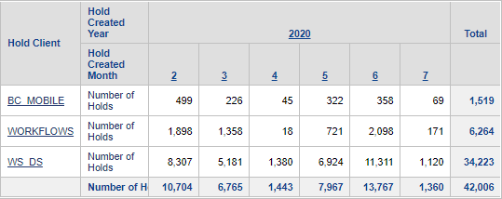
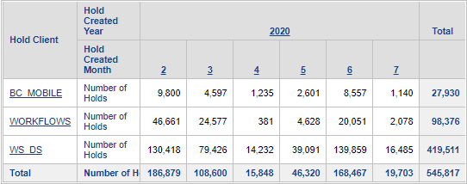
Holds Placed (Sample Library & All SWAN)
+29%
-10%
Notes:
Now that we have the full month of June to compare, we can see that consortium-wide our holds placed is just about back to normal. However, individual libraries may be experiencing a much different impact. Downers Grove is shown on the left. They experienced nearly a 30% increase in holds placed in June vs February.

Slide 15
Resource Sharing Poll – do you want an option before August 12 or Sept 9?
Please add some additional dates between current opt-in dates.
OK with choosing date of Aug 12th or Sept 9th.
Only respond if you have not yet restarted resource sharing.

Slide 16
Optional Workflows Tools for Quality Control
If your library wants to use either of these in-house users, please submit a help ticket and a unique user for your library will be created
Q - QUARANTINE in-house user
Use to clear items off patron records
Checkout to user when emptying book drops
Quarantine items
Check-in items post-quarantine
QUARANTINE items do not appear on holds list
C - CURBSIDE in-house user
Use to remove hold pickup status
Checkout to user when hold is trapped to remove My Account messaging that hold is ready for pickup
Either reshelve or put in temporary location to wait for holds list
CURBSIDE items appear on holds list (maybe? – working with SirsiDynix)

Slide 17
Reminder - Handling Material - staff experience
Quarantine
Ends
Quarantine
Reshelve/
process
Empty
Bookdrop
Prepare
Pick-up
Wear gloves
Q
Date/Segregate
C
Wash hands
Curbside service
Receive
Book orders
Prepare storage for housing material for 3 days in quarantine before processing.
Checkout to QUARANTINE User
Checkout to CURBSIDE User
Notes:
Dawne speaking:

Slide 18
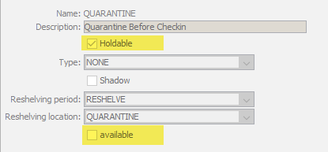
QUARANTINE User
Checkout to QUARANTINE User BEFORE quarantine
QUARANTINE items do not appear on holds list
Empty
Bookdrop
Quarantine
Ends
Quarantine
Wear gloves
Checkout to QUARANTINE User
Date/Segregate
Benefit: Immediately clears checkout from patron record.

Slide 19
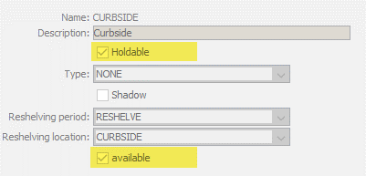
CURBSIDE User
Checkout to CURBSIDE User AFTER quarantine
Segregate those CURBSIDE items for processing
Schedule around hold pick-up notifications (2 pm)
Quarantine
Ends
Quarantine
Date/Segregate
Wash hands
Benefit: Removes hold available status from patron record, allowing staff time to prep curbside.
Checkout to CURBSIDE User

Slide 20
Curbside checkout processing – staff experience
2
Pull items from shelves
Order Pick-up
5
1
Check Onshelf Items List
Sort by Patron Last Name
Move to holding area
Items checked out to CURBSIDE should appear on list – we are working with SirsiDynix on this
6
Items not picked up are checked back in
3
4
Print receipt
Staple to bag
Checkout to Patron
Email Receipt
Contact Patron

Slide 21
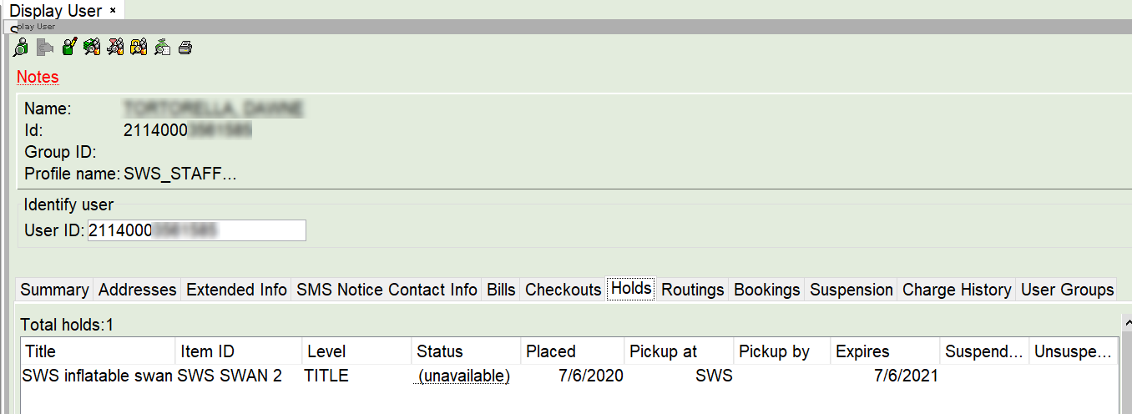
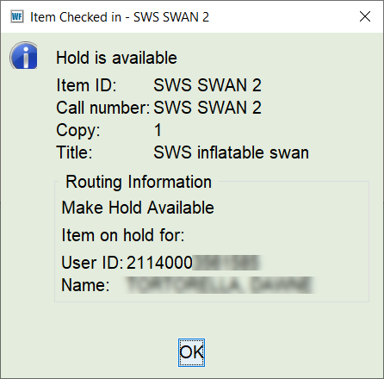
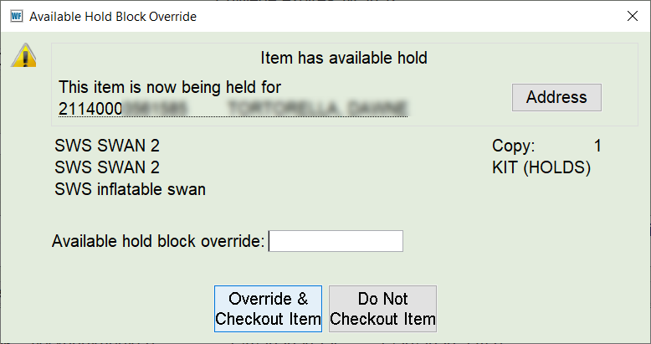
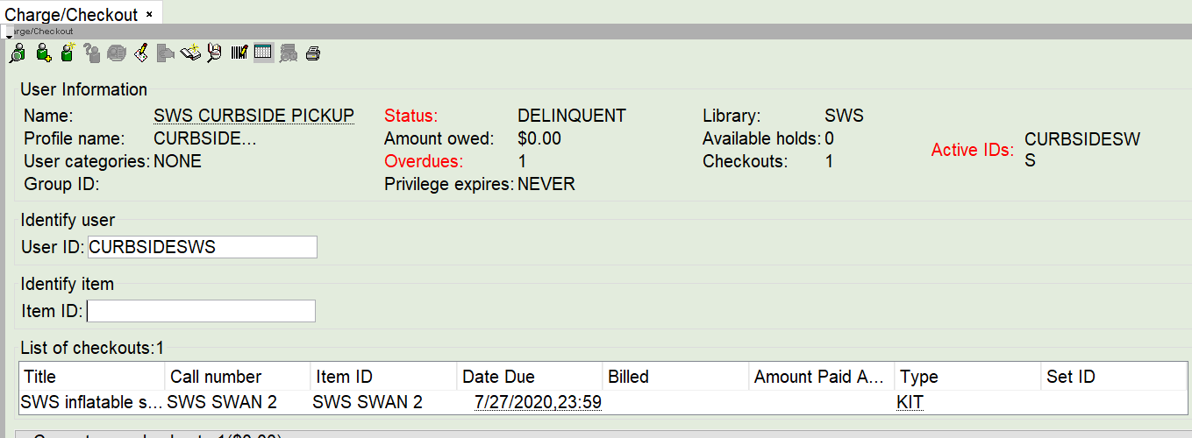
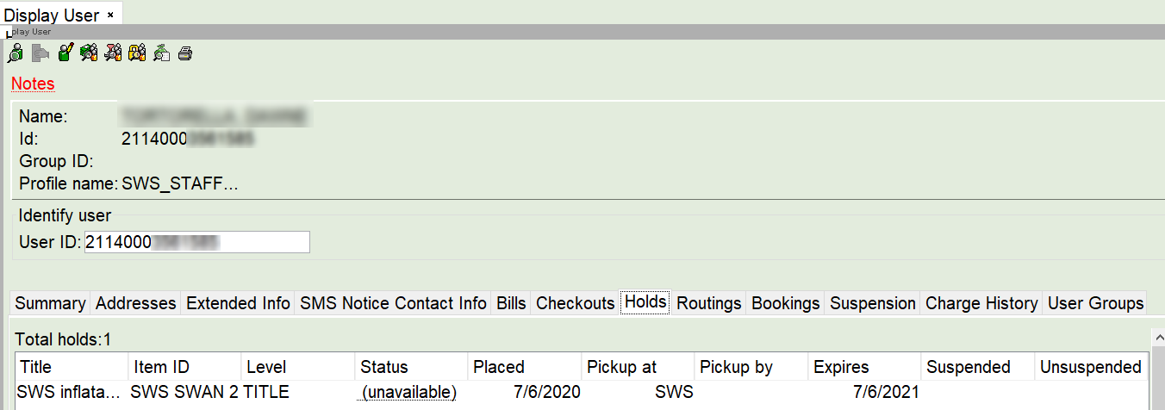
Example: CURBSIDE Checkout Process
1. Patron has hold for item
2. Check-in, traps hold
3. Checkout to CURBSIDE, override
4. Shows checkout to CURBSIDE User
5. Hold shows unavailable for patron

Slide 22
Updating Online Patron User Records
Still popular! 47 new accounts created on 7/6/20
https://support.swanlibraries.net/documentation/68769
Online User Only Card
Do not update barcode or create a new record
Update privilege expiration date in the existing record to match normal library policy, (ex. 3 years, NEVER)
Do not issue a physical card
Full Access Library Card
Check for duplicate record - duplicate accounts are not permitted unless they are a child with dual residency or a student with an academic card
Modify existing record
Update patron profile
Update privilege expiration date
Fill in all fields required by local library practice
Create a physical card - Do NOT mail card prior to contacting the patron
Online records (Profile = ONLINE) will be removed 60 days after the privilege expiration date.

Slide 23
L2 – RAILS Relaunch in mid-August
All SWAN events through end of December have been moved to virtual spaces
GoToWebinar will handle registrations – be sure to register in advance for personal link to event and receive reminders
Library staff and directory information must be reviewed/updated by July 31st (we recommend by July 15th)
Request removal of erroneous/duplicate staff accounts if you are not able to update
If you have maintained learning logs, those must be saved as a print or PDF (My Events)
SWAN events will still be visible on the SWAN Support Site

Slide 24
EBSCO Databases SWAN Group Purchase Update
Sign up on L2 https://www.librarylearning.info/events/?eventID=31583
Don’t miss the buzz….

Slide 25
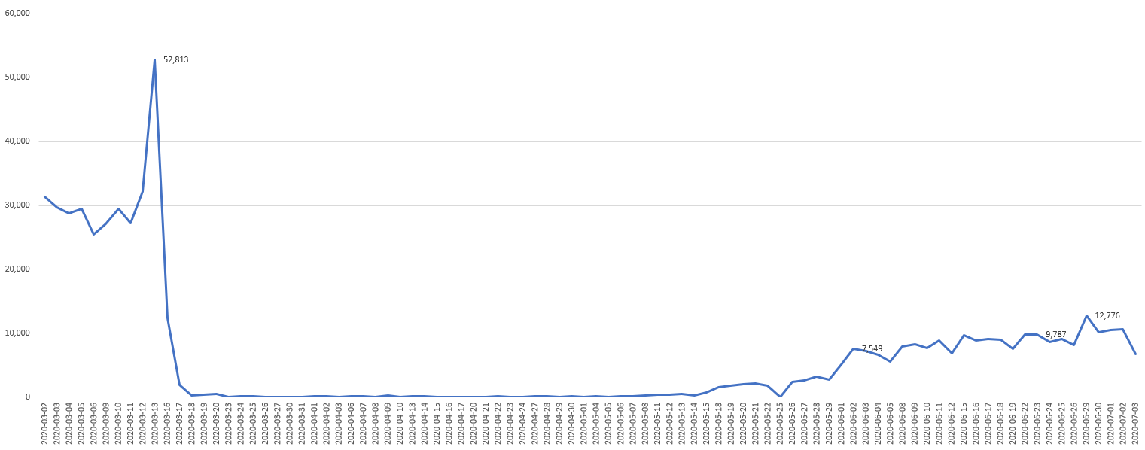
Checkouts March 1-July 3 (excluding weekends)
Since last Fireside Chat

Slide 26
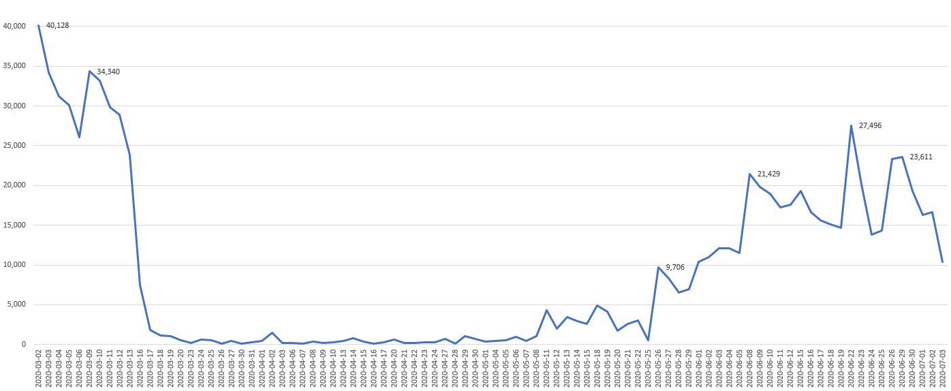
Check-ins – March 1- July 3 (excluding weekends)
Since last Fireside Chat

Slide 27
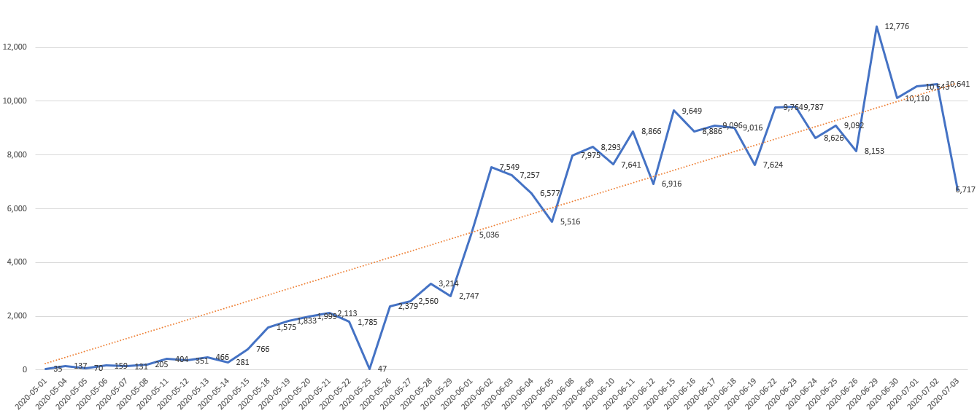
Checkouts May 1-July 3(excluding weekends)

Slide 28
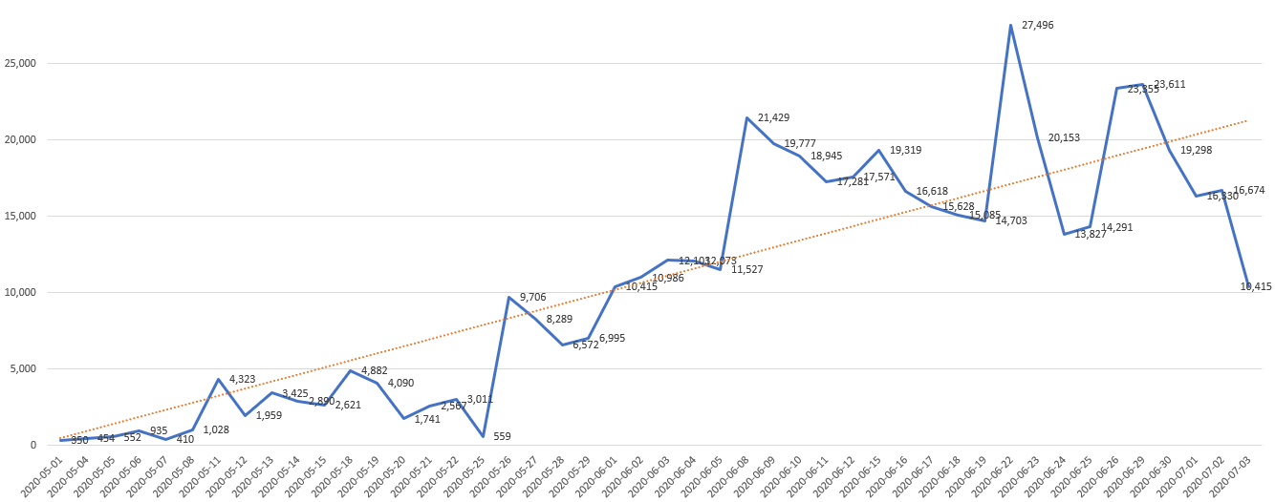
Check-ins – May 1 – July 3 (excluding weekends)

Slide 29
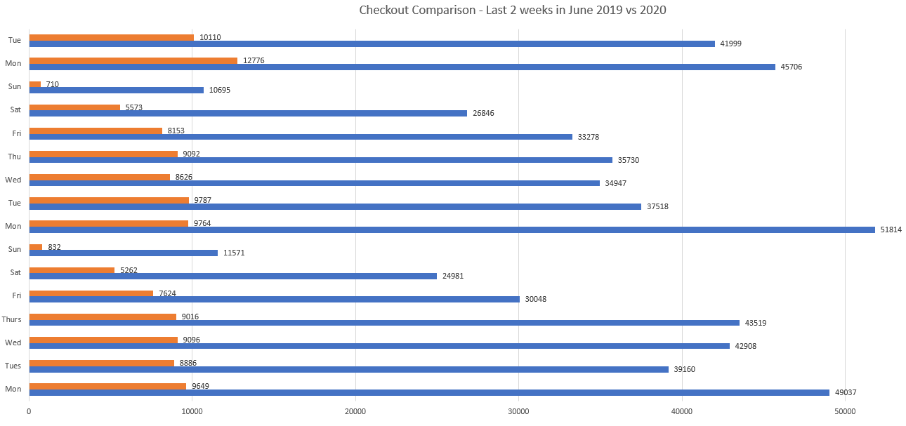
Circulation Comparison – Last 2 weeks in June 2019 vs 2020
26% of 2019
22% of 2019
21% of 2019

Slide 30
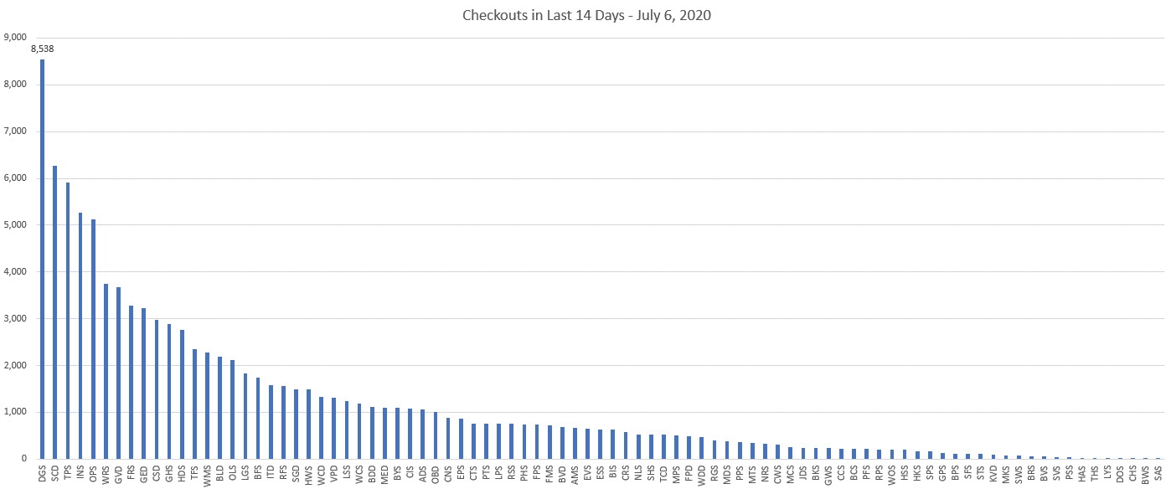
Checkouts in last 14 days – Snapshot 7/6
5 libraries > 5,000 checkouts
32 libraries > 1,000 checkouts
51 libraries > 500 checkouts
76 libraries > 100 checkouts

Slide 31
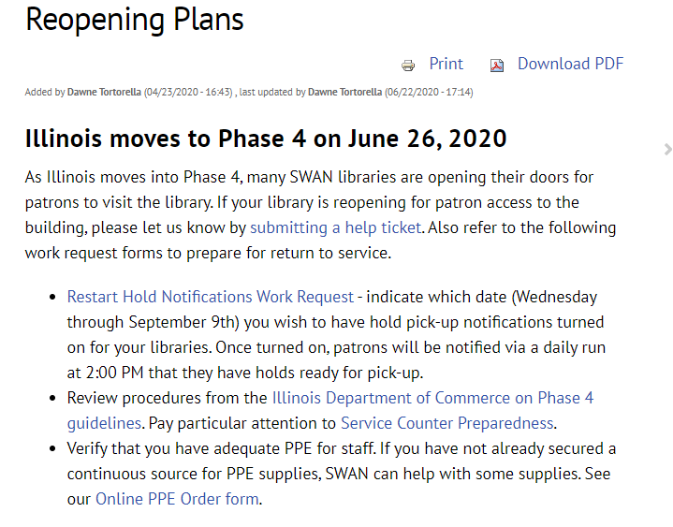
Library Check List https://support.swanlibraries.net/documentation/71031
Submit help ticket – Let us know you are reopening for patrons in the building.
Restart Hold Notifications - Hold Notifications will restart on Wednesdays. Select your date for requesting restart.
Check IL Dept of Commerce Guidelines
Online PPE Order Form - SWAN can help with some supplies required for readiness in offering services.

Slide 32
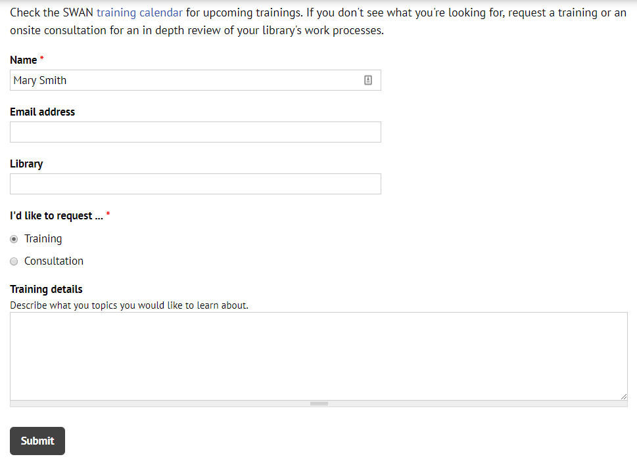
Questions & Follow-up
Send questions to our online ticketing system at help@swanlibraries.net
Visit the SWAN Support Site for access to recorded sessions. https://support.swanlibraries.net
Submit a request for additional training topics. Help > Request Forms > Request Training or Consultation
Notes:
Aaron speaking:
If you have questions, please contact SWAN via our online ticketing system. Also, SWAN training sessions, documentation, and resources are available from the SWAN Support Site.
You can submit a request for additional training through our online form.

