Slide 1
SWAN Poolside Chat
August 28, 2020
Notes:
Aaron speaking

Slide 2
Discussion Questions
How do you quarantine?
And what do you consider “clean” vs “dirty”
When do you quarantine
Do patrons have access to stacks? Has that impacted your practice.
How RFID and materials handlers impact practice
Looking at “In Transit” and how holds trap
Pull items as close to delivery pick-up as possible to minimize unnecessary transit
Overdues, blocks, fines – how quarantine impacts messaging to patrons

Slide 3
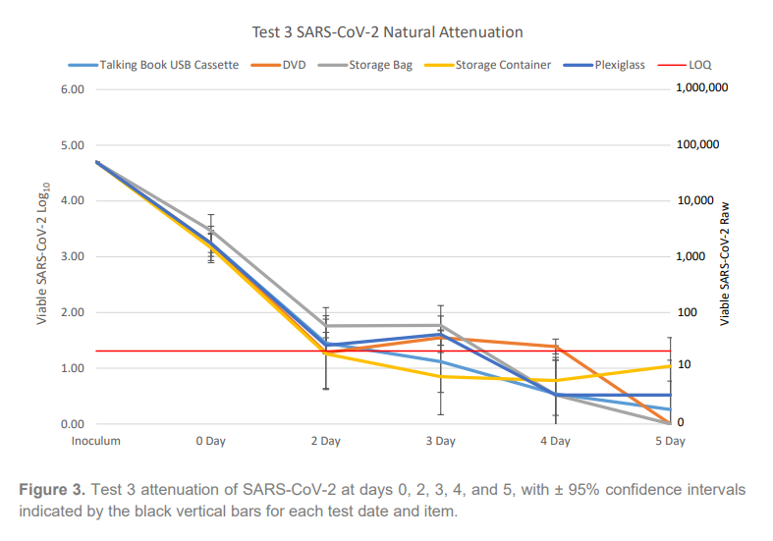
Late Breaking News – REALM Test 3 Results
https://www.webjunction.org/content/dam/WebJunction/Documents/webJunction/realm/test3-report.pdf
Results show that after five days of quarantine in an unstacked configuration, the SARS-CoV-2 virus was not detected on the storage bag (flexible plastic) or the DVD. The storage container (rigid plastic), plexiglass, and the USB cassette all showed detectable virus at five days. Day five was the final timepoint tested.
Compared to the results of Test 1 and 2, this data suggests that a slightly longer quarantine time for these types of plastic-based materials may be required to render SARS-CoV-2 undetectable through natural attenuation alone. Alternatively, based on the materials’ nonporous nature, suitable liquid disinfection methods may promote a more rapid decontamination than the quarantine method.

Slide 4
Discussion Links
RAILS memo, 8/26 – Extension of Quarantine for items in RAILS delivery
SWAN Online Forums – Library Material Quarantine discussion
Curbside and Quarantine Users documentation – we realize this may not be a preferred approach for most, but there may be some libraries with lower volume or RFID check-in stations that can read stacks of items.

Slide 5
Quarantining/Delivery
Open stacks?
How does that impact quarantine decisions
Quarantine
Ends
Quarantine
Empty
Bookdrop
Reshelve/
process
OK
?
Date/Segregate
To delivery
For pick-up
Prepare storage for housing material for quarantine before processing.
From delivery
How do you define “clean” and “dirty” materials?
7 days quarantine required since patron use
Notes:
Dawne speaking:

Slide 6
Fine Free Blocking
8/26 – based on feedback in online forums, we changed Fine Free overdue block to 21 days overdue.
If you want 14 days, send request to help.
Library cards will be blocked when an item checked out at your library becomes 14 21 days overdue. When items are checked in, that block is immediately removed.
This block may affect access to digital resources.
Staff may unblock the patron [change status to MAILRETD, save - change status to BLOCKED, save – status will update to DELINQUENT]
but if material is not checked in that day, the block will be reapplied with the evening maintenance.
If block is due to other patron profile limits (e.g. bills, number of items overdue) the block will immediately be reapplied when accessing the patron record.

Slide 7
Not Fine Free or block with other criteria?
Review user profile settings, we can adjust those, as desired
Investigating grace periods being applied across the board – working to test. Idea is to:
Change 0 Grace to 7 Grace
Change 3 Grace to 8 Grace
Preserve ability to return when out of quarantine requirements

Slide 8
Hard question, but have to ask…
Does a 7-day quarantine requirement prior to delivery pick-up create a situation where libraries will need to opt-out of resource sharing again?
If you are open to the public, how does this impact ability to follow a mandatory 7-day quarantine for delivery pick-up?

Slide 9
September Quarterly Membership Meeting
September 3rd 10 AM - Noon
Register on GoToWebinar
See SWAN Support Site > Meetings & Trainings > Meetings & Documents
Topics will include:
Aspen Discovery Exploratory Research
SWAN100 Migration
EBSCO
Update on projects/Tactical Plan
https://attendee.gotowebinar.com/register/7953200119477753099

