Slide 1
SWAN Cataloging Users
October 1st, 2020

Slide 2
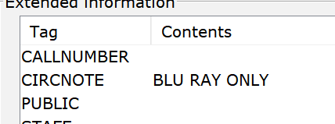
Combo Packs with standalone items
Move items to correct records upon receiving
Example of note that MUST not be added to Combo Pack records:

Slide 3
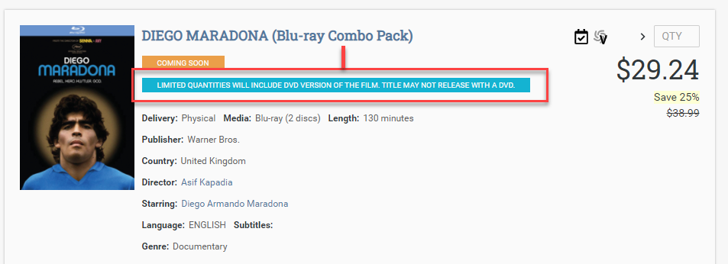
Combo Packs on MWT with this notation:

Slide 4
Binge Boxes – best practices
In-house created binge boxes
|zISBN and |zUPC
Library three-letter code + title. Example: 245 00 XYZ Sports Binge Box.
List titles in the 505 tag
Note : If you are copying another library’s binge box record, make sure not to delete or edit anything on their record.
Documentation on support site: https://support.swanlibraries.net/documentation/66931

Slide 5
VOX Books
Specific tags
300 1 audio-enabled book
500 VOX Books.
590 OTHER AUDIO
* Do you create pre-cats for each title or use the file sent by Library Ideas to create MARC records?

Slide 6
Graphic Novels and books in series
Add as much information as possible to the pre-cat.
Search for the series to see how it has been previously entered.
Send in tickets with series inconsistencies for SWAN to update all records associated with the series title.

Slide 7
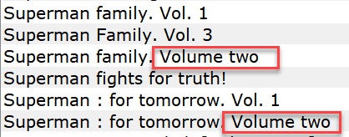

Slide 8
946 Signature tag
New standardized format :
XYZ/CN/YYYYMMDD

Slide 9
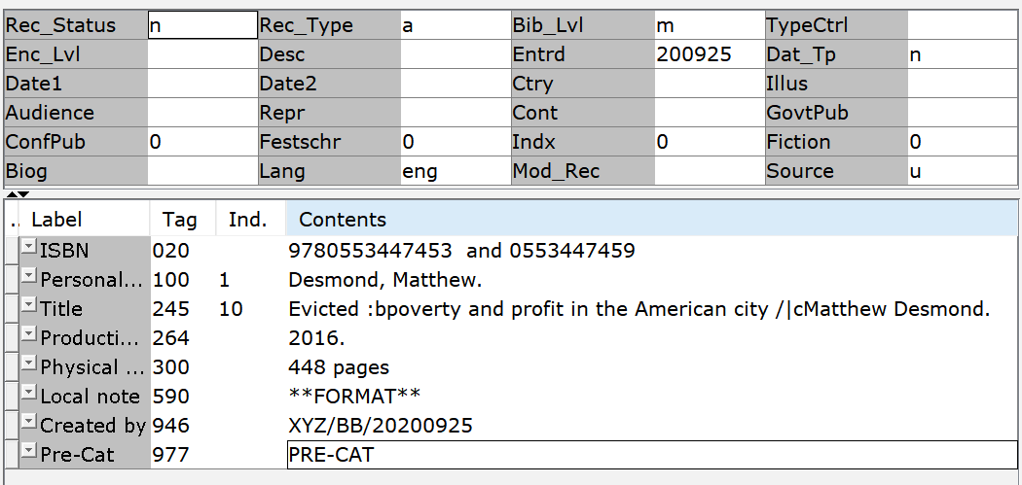
Detecting errors in the following pre-cats

Slide 11
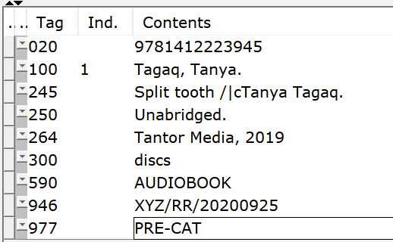

Slide 12
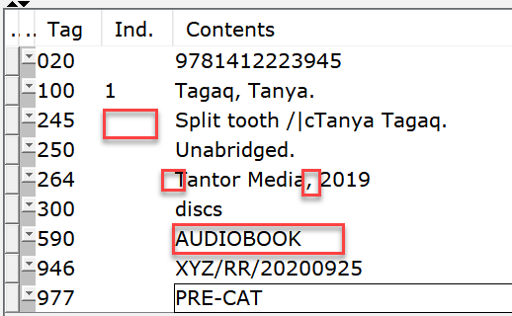
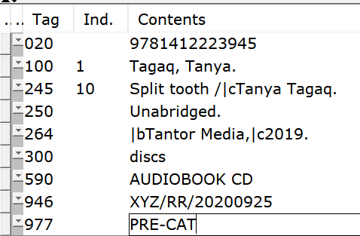

Slide 13
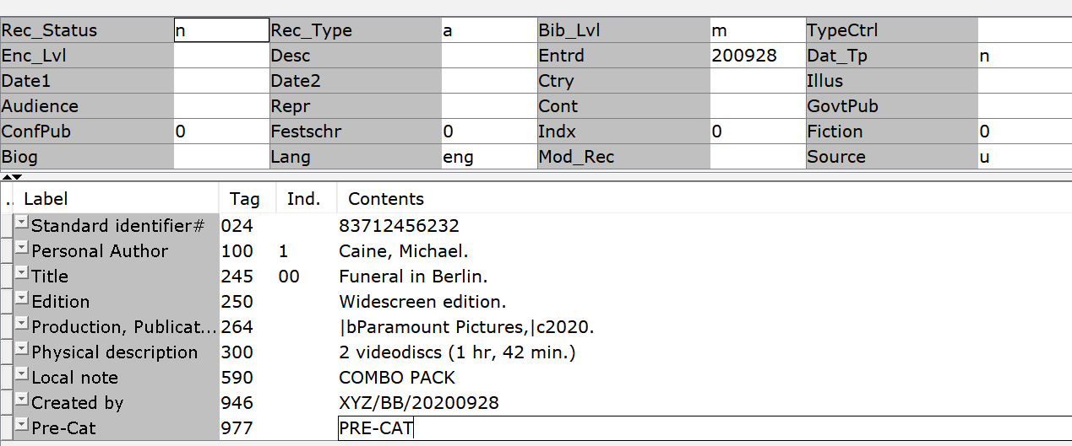

Slide 14
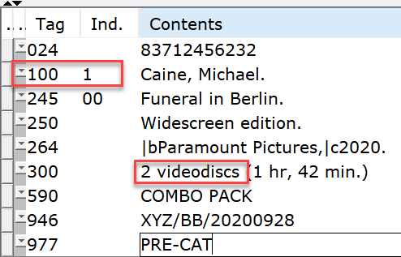
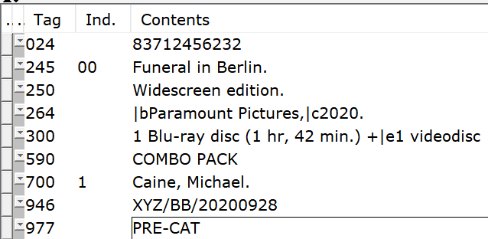

Slide 15
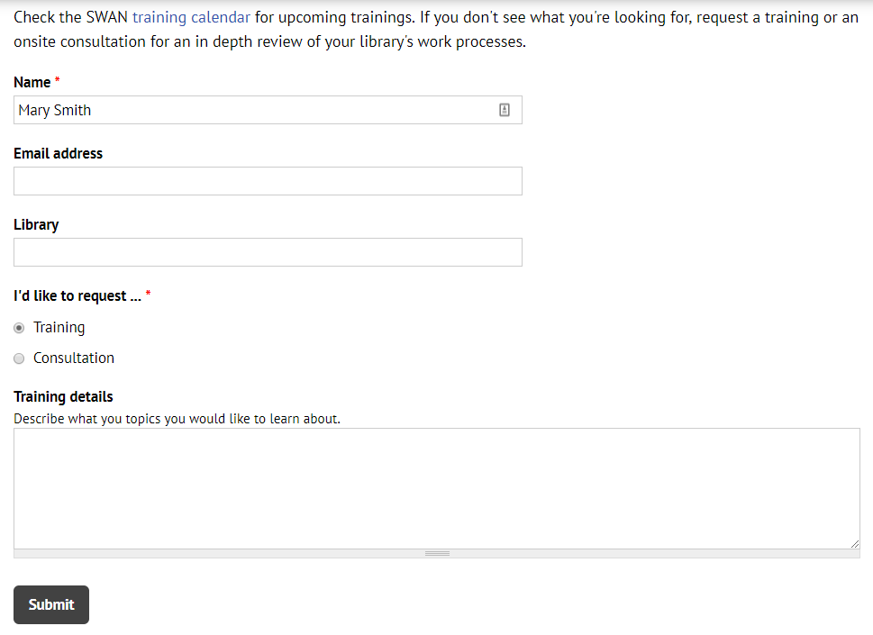
Questions & Follow-up
Send questions to our online ticketing system at help@swanlibraries.net
Visit the SWAN Support Site for access to recorded sessions. https://support.swanlibraries.net
Submit a request for additional training topics. Help > Request Forms > Request Training or Consultation
Notes:
If you have questions, please contact SWAN via our online ticketing system. Also, SWAN training sessions, documentation, and resources are available from the SWAN Support Site.
You can submit a request for additional training through our online form.

