Slide 1
SWAN Fireside Chat
April 27, 2021

Slide 2
Agenda
Quarantine & grace period reset
Fine Free decisions and numbers
Processing fee
URLs in notices
Locker & drive-up pickup options (pseudo libraries)
Patron record purge & NCOA
Explore More Illinois
Dialer pilot
Support site & OTRS migration
Interactive trainings for staff
E-resources updates
Statistics
Upcoming Events & Meetings

Slide 3
RAILS Quarantine Timeline
May 2020 (3-7 days)
June 29, 2020 (7 days)
July 2020 (3-7 days)
August 31, 2020 (7 days)
October 27, 2020 (3 days)
February 24, 2021 (24 hrs)
April 12, 2021 (0 days)
https://www.cdc.gov/coronavirus/2019-ncov/more/science-and-research/surface-transmission.html
Notes:
Vickie

Slide 4
Grace Period
June 1, 2021
Modified in October, 2020 to match quarantine periods
Fine accrual delayed for 7 days
0 day grace, delayed 7 days
3 day grace, delayed 8 days
System-wide global change will be reset to pre-covid 0 days/3 days grace on June 1st
Return to normal grace period and fine accrual
This Photo by Unknown Author is licensed under CC BY-NC
Notes:
Vickie

Slide 5
Polls – Quarantine, Library Hours, Curbside
What’s happening at your library? Get ready for some polling questions.
As of May 1, how long does your library quarantine?
Has your library made permanent shifts in hours of operation?
When does your library plan to return to pre-covid hours?
How have you transitioned curbside service?
Notes:
Dawne

Slide 6
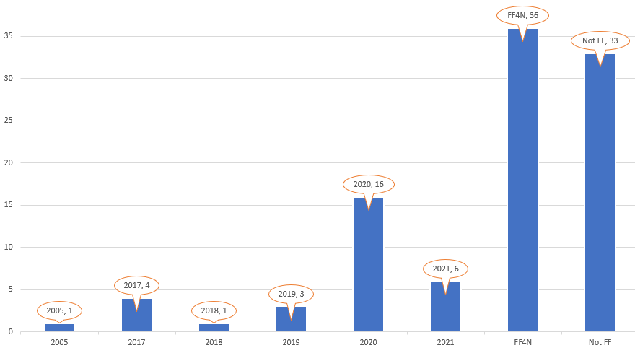
Fine Free Decisions & Numbers
31 libraries Fine Free
36 libraries Fine Free for Now
September 1, 2021
Return to pre-covid circ rules, or fine free permanently
This Photo by Unknown Author is licensed under CC BY-NC
Notes:
Dawne

Slide 7
Fine Free Observations
When libraries move to a fine free circulation policy, the following has been noted:
General behavior on returning items does not change; people return items when they have finished reading/viewing.
Return of long overdue items without assessing fines, does result in more items returned when patron is not responsible for overdue fines.
Patrons may decide to use a neighboring library due to that library’s fine free policy, but these numbers are low. Most patrons continue to use the library which is most convenient and for reasons other than fines.
Reciprocal borrowers are no more likely in accumulating overdue items than home patrons.
Notes:
Dawne

Slide 8
Fine Free – Working with neighbors
Fine free libraries are concerned about the incentive (or disincentive) to return items:
Block patrons if they reach an overdue item threshold -AND/OR-
Block patrons when they have any item overdue for more than 14 days
Libraries are conscientious and concerned about being good stewards of other libraries’ material.
Our neighboring consortium/system (CCS/CPL) block at much lower thresholds and across the board. Both treat items 7-days overdue as lost, with replacement cost billed to patron. Upon return, that replacement cost is removed.
Notes:
Dawne

Slide 9
 | Patron Profile Limits | Nightly Overdue Time Period Block
Parameters | Billing threshold – items overdue 42 days are considered lost and added to bills Items Overdue – number of items that can be overdue (1 day) before record is blocked | Nightly job reviews any patrons with overdue items > 14 days checked out at your library; updates patron status to blocked
Patron Experience | Patron limit determines when account is blocked, regardless of which library they use If home library does not have overdue limits, the patron will not be blocked until meeting a bill threshold | Home library patron profile is checked for blocking, so other blocks may occur if profile has limits If home library does not block for overdues, patrons will not be blocked until 1 item becomes overdue for 14 days
Benefits | Home library patrons know limits and when to expect blocks to be applied Patrons can balance return of material to manage blocks | Assuming no limits are reached, patrons are given 2-weeks before account is blocked Only items > 14 days overdue are considered in nightly block update
Challenges | When limit is reached, patron is immediately blocked Block is not cleared until number of overdue items falls beneath the limit | Block is applied via a report run nightly, which may be updated to OK when the patron record is opened in WorkFlows. WorkFlows recalculates status when patron record is opened. This leads to staff confusion. Staff have to pay attention to Alerts and overdue dates/items.
Recommendation | Allow libraries to set bill threshold Move to a universal limit on overdue items allowed for patron account (not applied to in-house accounts) – 11 items | Use in addition to a universal overdue limit if library wishes to block even with 1 item overdue for more than 14 days.
Notes:
Dawne

Slide 10
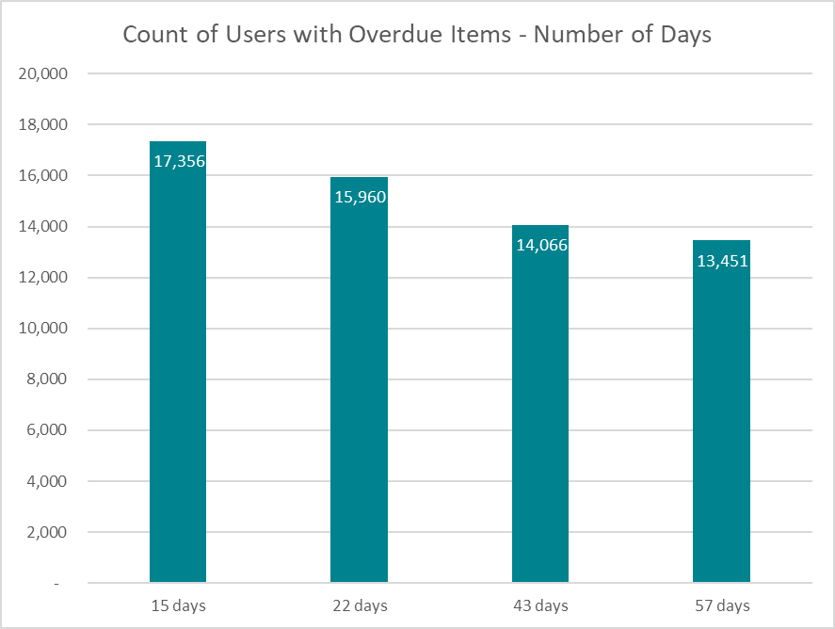
How many patrons have overdue items?
Very little statistical difference in number of patrons with items 14 days overdue vs 21
So, do we even need to go back to the 14 day block?
1.65%
1.52%
1.34%
1.28%
Work with e-content vendors to remove blocks based on patron status to avoid disruptions to patrons blocked when accessing e-content.
Notes:
Dawne

Slide 11
Processing Fees
July 1, 2021
Processing fee is assessed by checkout library for lost items
Default Price Policy is set by each library; if none, SWAN default is applied
Item price should be set for each item. BcAnalytics report – List items with no item price
See Support Site: Documentation > ILS Configuration > Item Configuration > Default Price
Default processing fee will be $0
This Photo by Unknown Author is licensed under CC BY-NC
Notes:
Dawne

Slide 12
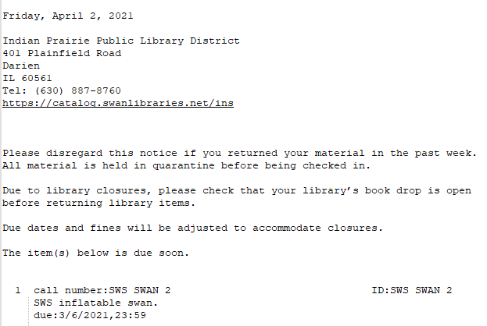
URLs in notices
An additional field with your library's Enterprise URL
Notice text will be removed,
“Contact the library listed above or visit http://catalog.swanlibraries.net to view a list of libraries with links to their catalog. To see if the item(s) can be renewed, log into "My Account" in your library catalog and click on the Checkouts tab. Thank you."
No changes needed by you!
Aspen pilot libraries – No link until Aspen go-live launch
Notes:
Vickie

Slide 13
Pseudo-libraries
Used as a patron pick-up point for holds
Selected by patron when placing a hold
Patron can modify pick-up point preference before hold is filled
No patrons are associated with the pick-up point
No items are held by the pick-up point
Used to facilitate “transit” between main library and special hold shelf
Once item is ready to process for special hold shelf, item is checked in, hold slip generated, processed for patron pick-up
Checkout must be completed by Pseudo Library to properly remove title from hold shelf
Notes:
Dawne

Slide 14
Drive-up window processing – staff experience
2
Checkout to patron
at drive-up window
1
Pull items from shelves
2
Check Onshelf Items
a
Print hold slip/wrapper
Place on hold shelf
1
3
b
From
XXX
Check in item
TO
XXX_D
Check in item
Print hold slip/wrapper
Place on drive-up hold shelf
c
Notes:
Dawne speaking:

Slide 15
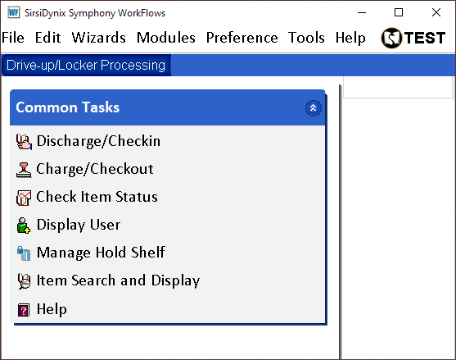
XXXCIRCDRV
Limited access to WorkFlows functions – only use to process holds for pick-up at the pseudo library (Drive-up Window or Lockers)
Notes:
Dawne

Slide 16
Patron Record Purge
Purge criteria
Last Activity Date (LAD) prior to 1/1/2018
Patron records flagged in the 2018 NCOA that have not been verified/updated
Bills paid via SWANPURGE
Bills associated with bad address/mail returned
LAD before 1/1/2018; bills <=$10
LAD before 1/1/2011; bills $10.01-$200
LAD before 1/1/2011 and Status = Collection
Notes:
Dawne

Slide 17
Patron Record Purge Timeline
May 1, 2021
Instructions posted
May 15, 2021
May 22,2021
Pay bills with SWANPURGE, based on criteria
May 29, 2021
Reports for review
Review reports
Update records, if necessary
Remove inactive patron records
Notes:
Dawne

Slide 18
National Change of Address (NCOA)
Who submitted?
Public library patrons only
First address in patron record, if using PO box, indicate as secondary address and mark as primary contact
Geo-location
Patrons active after 1/1/2020 will receive geo-location longitude/latitude
Record update actions
Replace first address in patron record
Add a note NCOA 2021 – Previous address
Report changed report for review and outreach
No change in patron status
90-day post update, remaining with NCOA 2021 notes, status updated to BADADDRESS
Notes:
Dawne

Slide 19
Weekly processing of inactive accounts
Starting July 2021 perform weekly patron maintenance/record removal of inactive accounts 3+ years.
Move from annual process to ongoing patron management of inactive accounts.
Provide reports and assistance in automating notification of patrons turning 18.
Benefits:
Eliminate dramatic patron record count changes – keep consistent counts.
Reduce personal information stored on inactive users.
Focus on proactive communication, outreach, and resolution of billing.
Notes:
Dawne

Slide 20
NCOA Timeline
Jul 1, 2021
1st and 2nd address reports
Jul 15, 2021
Sep 1, 2021
Submit records to Unique
Oct 15, 2021
Instructions for updating PO Box
Review reports
Update records, if necessary
Update patron record address changes
Add NCOA 2021 note field, geo-location
Feb 1, 2022
Update status to BADADDRESS with remaining NCOA 2021 notes
Notes:
Dawne

Slide 21
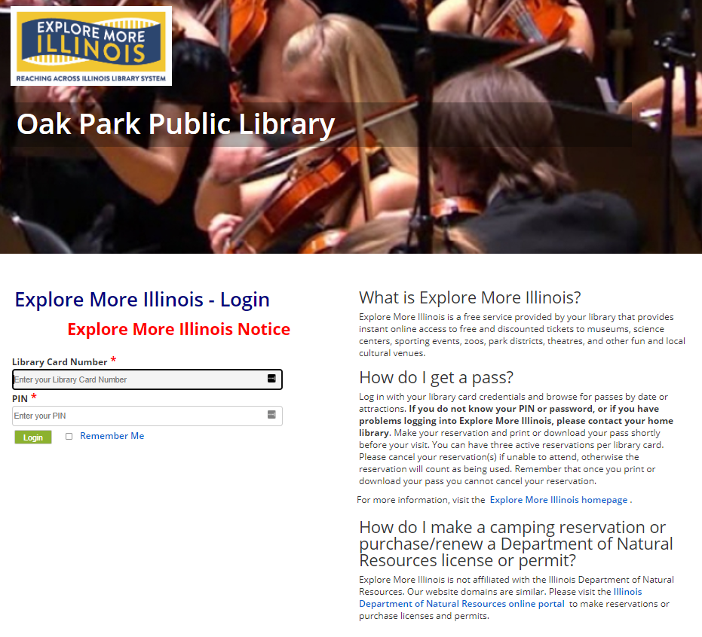
Explore More Illinois
All SWAN libraries are configured for patron verification.
If your library would like to participate, contact RAILS at info@exploremoreillinois.org; please copy help@swanlibraries.net
SWAN will work with RAILS to help test setup.
Currently 69 of 95 SWAN public libraries participate.
Example: https://exploremore.quipugroup.net/?OakPark
Notes:
Dawne

Slide 22
SWAN Notice Dialer Pilot
Currently piloting with Elmwood Park, Eisenhower patrons
2-3 week pilot period
Priorities
Caller ID
(Optional) can now include library's phone AND name
End of Day call analytics emailed report
Currently includes only failed calls
Attempting to include successful calls
Notice script tweaks
Some names are spelled out awkwardly
Other identified issues
Occasional voicemail issues
Notes:
Steven

Slide 23
Support Site & OTRS Migration
Wed, April 28th
7PM
Services unavailable during 7PM outage:
SWAN Support Site
Access to documentation, training, and SWAN events
SWAN Ticketing System
Access to submit/review/comment on tickets
Automatic processing of tickets submitted to help@swanlibraries.net
Please call 844-SWAN-LIB (844-792-6542) for urgent issues during this time
Support Site & OTRS migration to Microsoft Azure cloud
This Photo by Unknown Author is licensed under CC BY-NC
Notes:
Steven

Slide 24
Interactive Staff Trainings
Meetings & Trainings>Tutorials & Training Resources
Look Online Training in results.
Currently there are four online self-paced courses with more in the works!
Notes:
Crystal

Slide 25
EBSCO Database Selections
The databases are the same as last year.
https://support.swanlibraries.net/documentation/70949
May 3-16 selection form available sent via SWANcom
We ask that everyone fill it out even if you are not making changes.
By July 1 start of the subscription we will send out another SWANcom with all the links, updated patron site, and EDS updated
Notes:
Tara

Slide 26
Poll - Group Purchases
We’re exploring opt-in group purchase opportunities.
Is your library interested in:
Kanopy
Reference Solutions (formerly Ref USA)
Notes:
Tara

Slide 27
EBook & Streaming Borrowing Rules
We recommend allowing patrons to borrow without restriction
Fine Free library patrons will be blocked from borrowing eBooks and streaming if the print material is overdue
Contact your sales representative at OverDrive and Hoopla to make those changes
Notes:
Vickie

Slide 28
Statistics
Note: These statistics and a few more are reported in the Monthly Operations Report, available online in the monthly Board packet, publicly available.
Notes:
Dawne

Slide 29
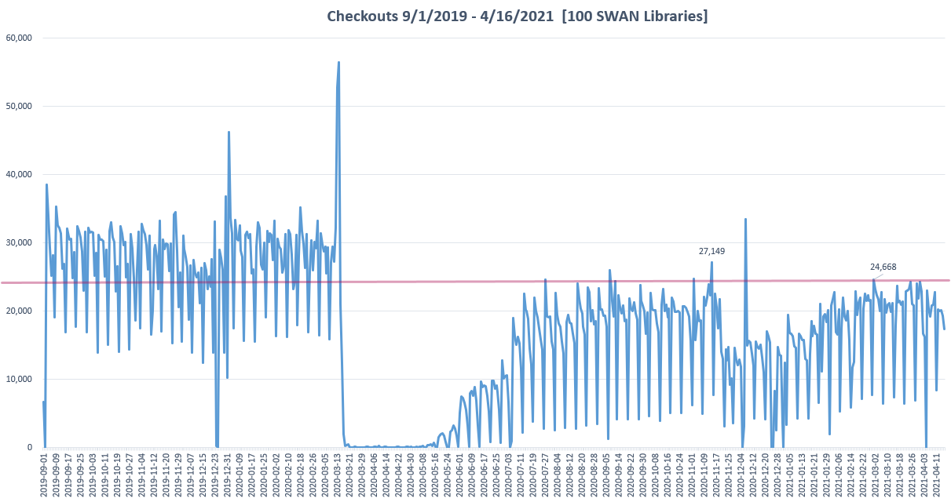
Notes:
Dawne

Slide 30
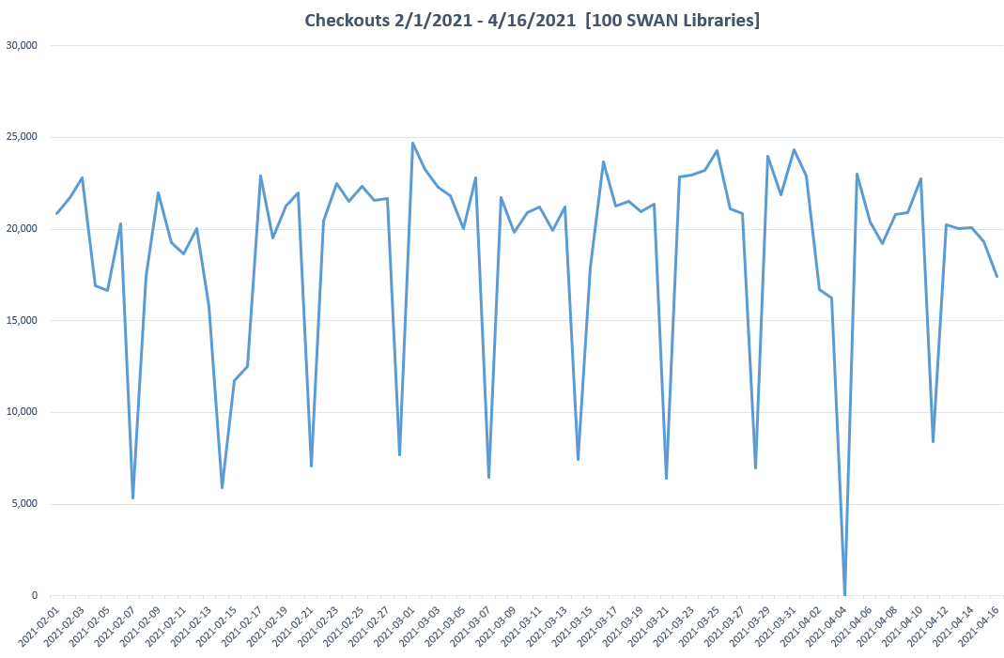
Steady since Feb 1, 2020
Nine of ten weeks, since Feb 2021, highest circulation day is Monday.
Little variation in circulation Monday – Saturday.
Notes:
Dawne

Slide 31
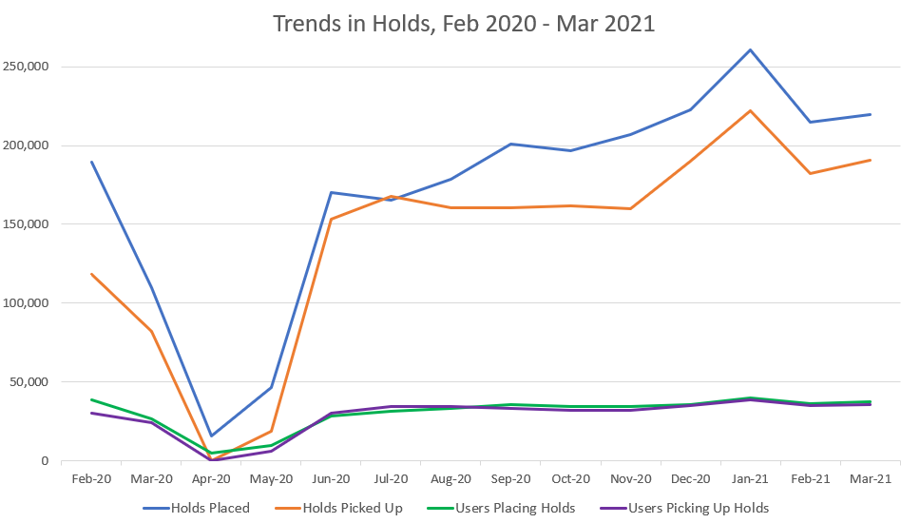
Trends in Holds, Feb 2020 – Mar 2021
Notes:
Dawne

Slide 32
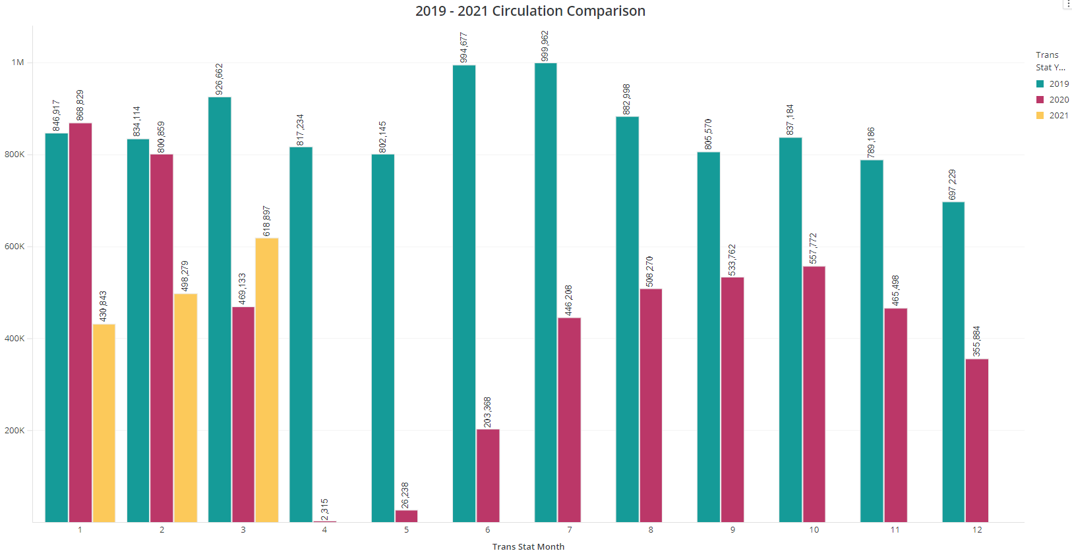
Prior Year Comparison
Notes:
Dawne

Slide 33
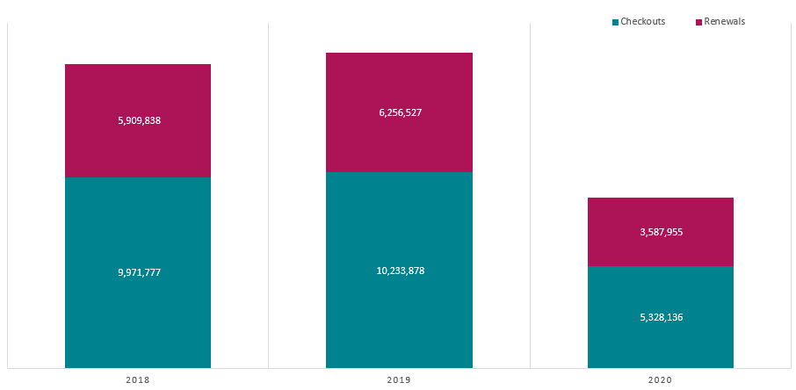
Checkouts vs Checkouts & Renewals
59% renewal
61% renewal
67% renewal

Slide 34
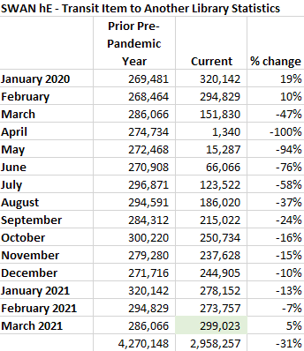
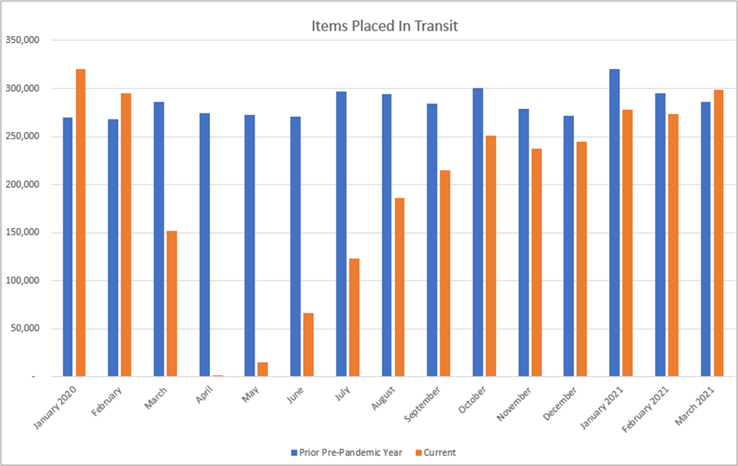
2019 vs 2020/2021 Circulation & Transits
Back to pre-pandemic transit volume.

Slide 35
Save the Date! ILL Boot Camp Go to L2 to register: https://librarylearning.org/event/2021-05-06/swan-ill-boot-camp-basics-worldshare-ill https://librarylearning.org/event/2021-05-27/swan-ill-boot-camp-borrowing-worldshare-ill https://librarylearning.org/event/2021-06-24/swan-ill-boot-camp-lending-worldshare-ill https://librarylearning.org/event/2021-07-01/swan-ill-boot-camp-policies
Notes:
Dawne

Slide 36
Save the Date! Directors’ Coffee Hour Go to L2 to register: https://librarylearning.org/event/2021-04-16/swan-directors-coffee-hour Library membership benefits Resource sharing Annual fees How SWAN Support works See SWAN Support: Meetings & Trainings » Trainings » Tutorials & Training Resources
Notes:
Dawne

Slide 37
In Case You Missed It... Aspen Member Update Q&A Recording
View the recording:
Meetings & Trainings > Tutorials & Training Resources
https://support.swanlibraries.net/tutorial/85801
Notes:
Tara

Slide 38
SWAN Board Election: 2 Seats July 1, 2021 Start 3-year term
Election Process Announced | March 4, 2021 (Quarterly)
Online Self-Nominations Accepted | April 5 – 30, 2021
Names of Candidates Released | May 3, 2021
Electronic Ballot | May 10 – May 31, 2021
Results Announced | June 1, 2021
Elected Candidates invited to June SWAN Board Meeting | June 18, 2021
Candidates’ Terms Begin | July 1, 2021
July Board Meeting | July 23, 2021
The SWAN Board is comprised of seven library directors/administrators elected at-large from the libraries in SWAN. Board meetings are held monthly on a Friday of each month at 9:30a.m.
Notes:
Dawne

Slide 39
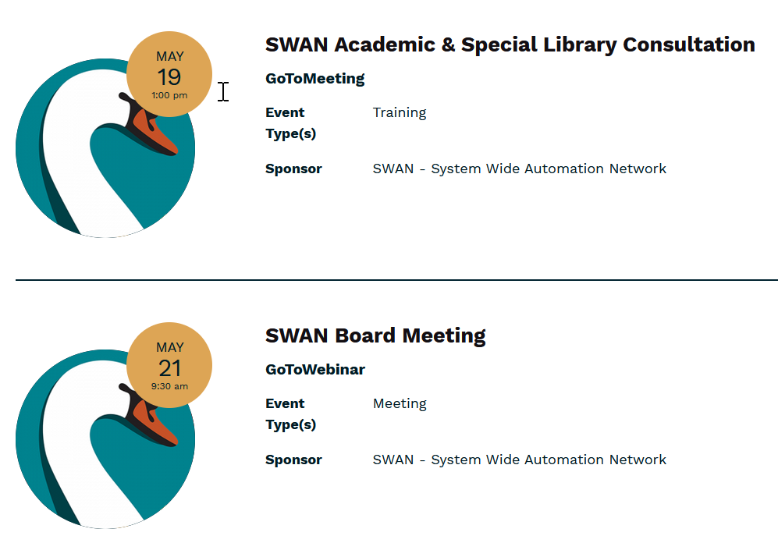
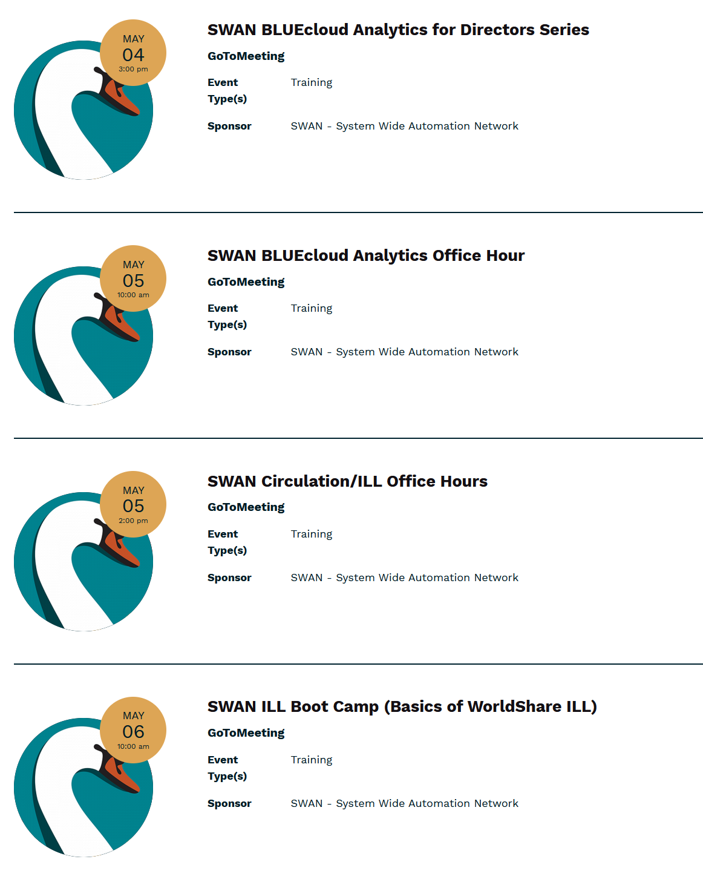
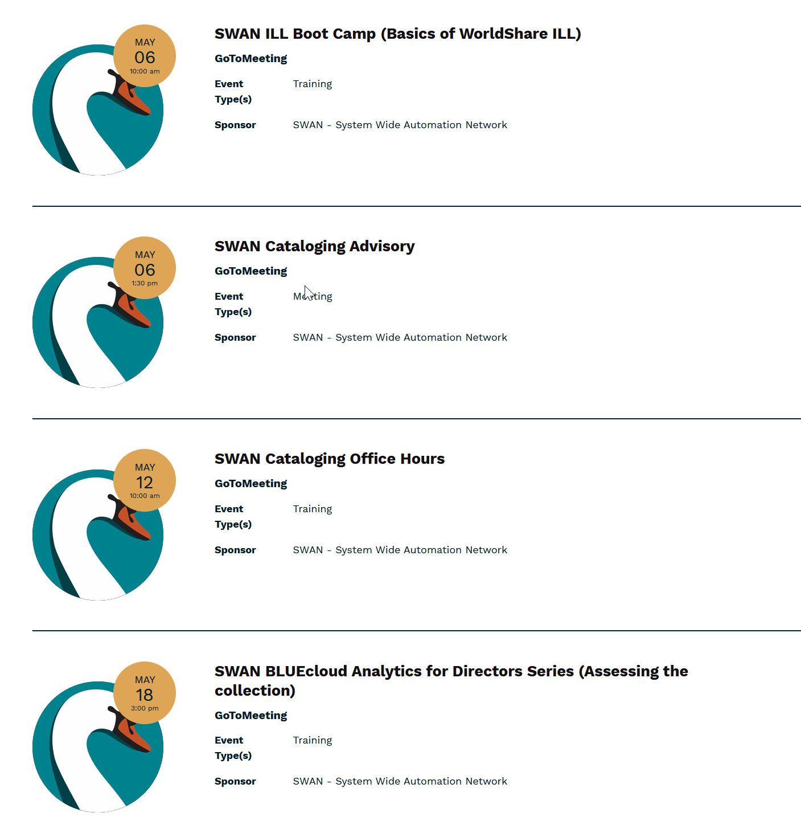
Other Upcoming Meetings
See SWAN’s events on L2
Notes:
Tara

Slide 40
Thank you!
Next Fireside Chat: May 25th– 11:00-12:00
https://librarylearning.org/event/2021-05-25/swan-members-fireside-chat

