Slide 1
SWAN Fireside Chat
May 25, 2021

Slide 2
Agenda
Post-pandemic return
CDC Guidelines, ILA statement on masking
Results for Questionnaire on Returning to post COVID policies
Grace period reset – June 1, 2021
Fine Free decisions and numbers
Processing fee
Project Updates & Happenings
BLUEcloud Mobile App – Self Checkout
SWAN Notice Dialer
Planning for Symphony 3.7.1 Upgrade
Patron record purge & NCOA
Pseudo Libraries
Diversity, Equity, and Inclusion in Metadata
Aspen
E-resources Update
Statistics
Upcoming Events & Meetings

Slide 3
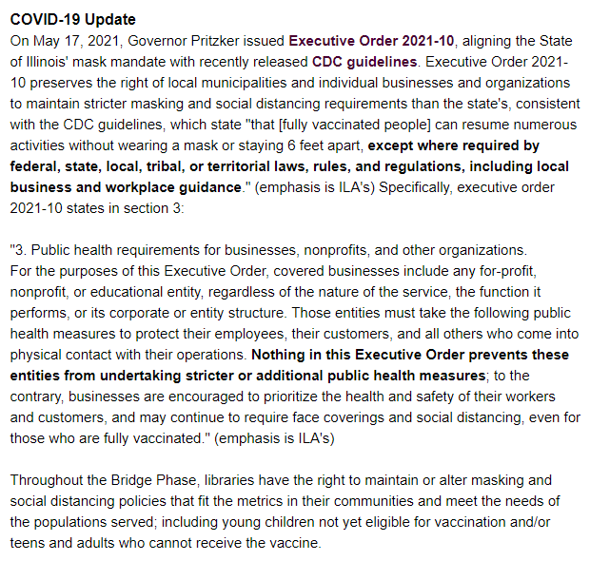
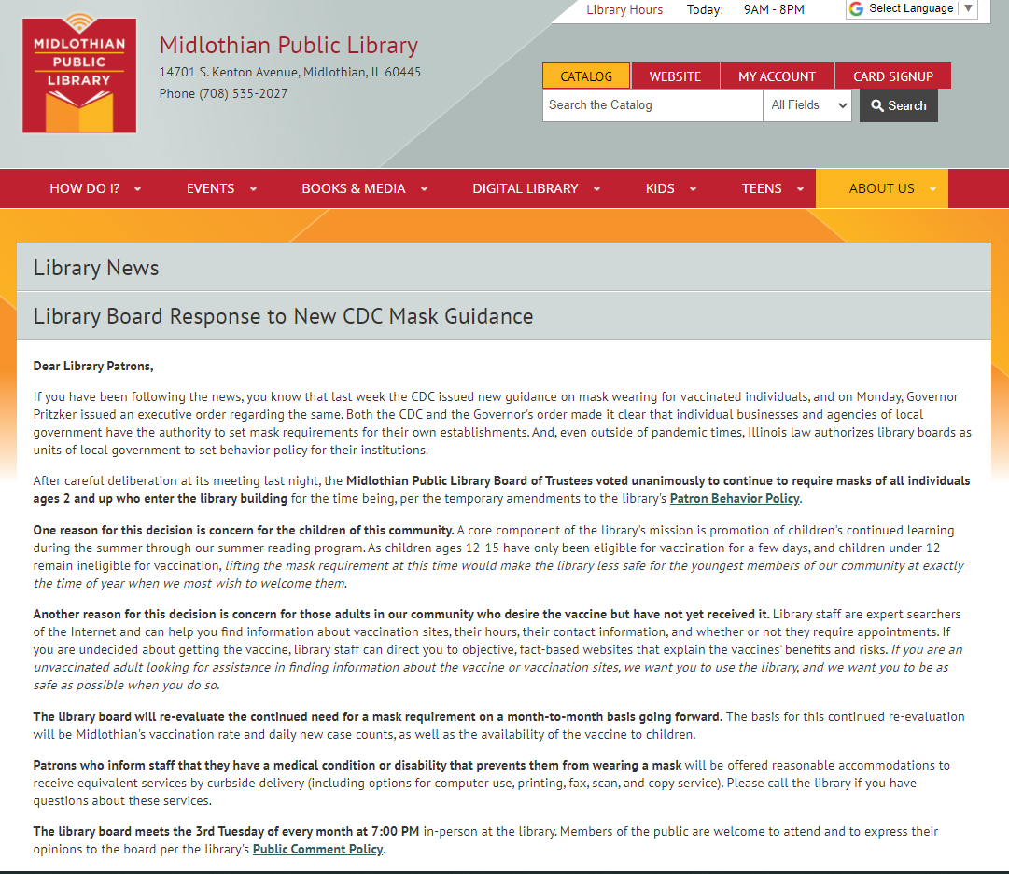
CDC Guidelines & ILA Alert
https://mailchi.mp/ila/ila-alert-news-from-the-illinois-library-association-736477

Slide 4
Polls – Library Masking Policy
Given the change in CDC guidelines, how is your library handling masking for both staff and the public?
We’ve got a series of 6 poll questions.
Notes:
Dawne

Slide 5
Returning to Post-COVID19: Questionnaire Results
28 libraries have responded
Please complete the survey: See News Post from 5/13 - https://support.swanlibraries.net/news/2021-05/86140
Responses help guide us in making recommendation to ease back into pre-pandemic practice and policies, as well as adjust based on current membership preferences

Slide 6
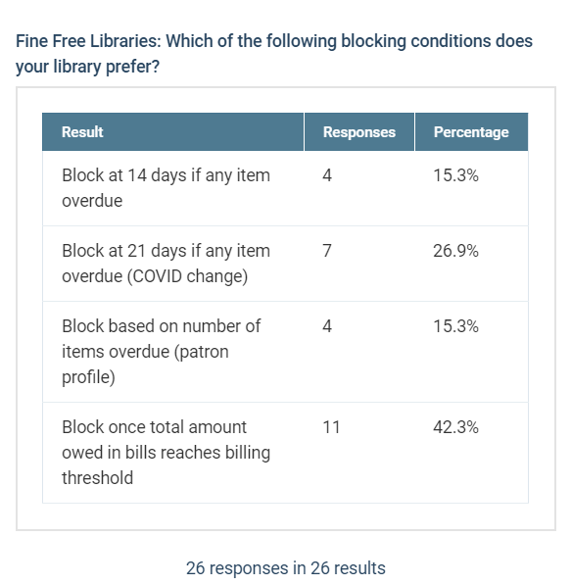
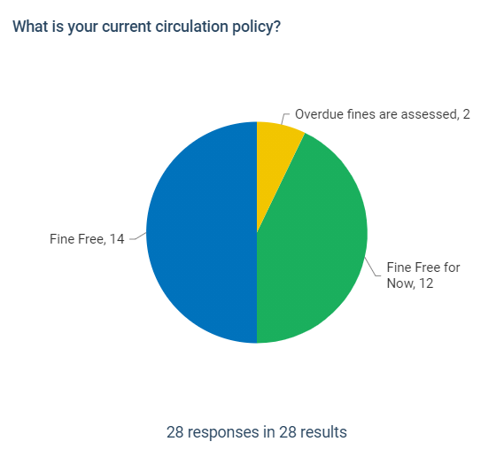

Slide 7
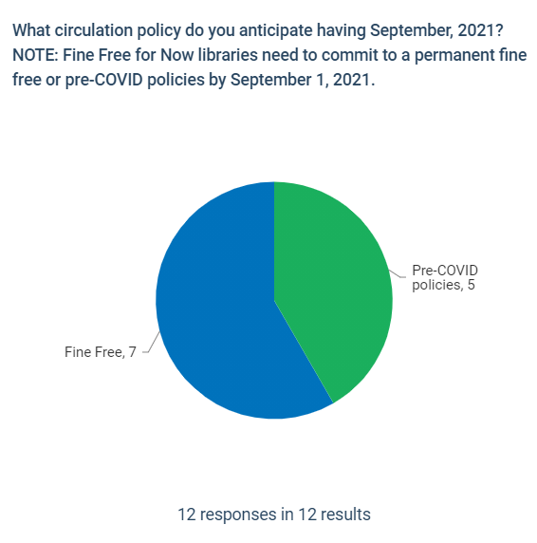
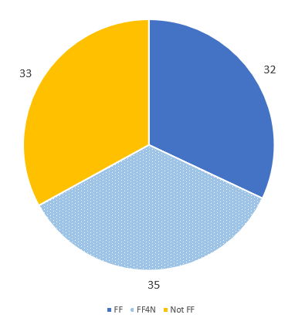
Current SWAN Library circulation policies

Slide 8
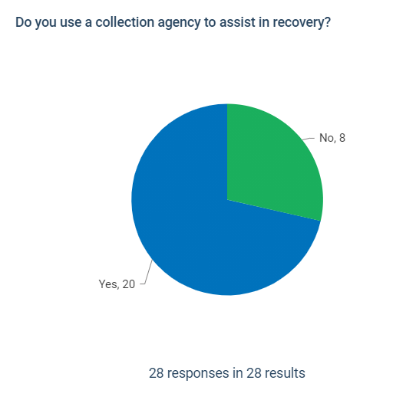
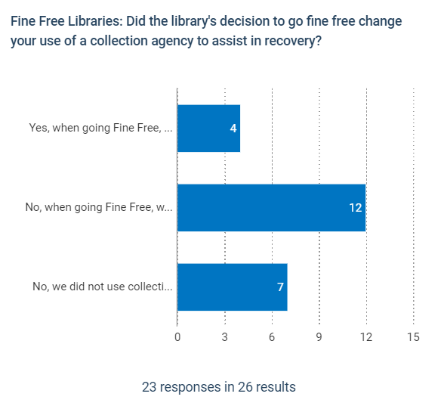

Slide 9
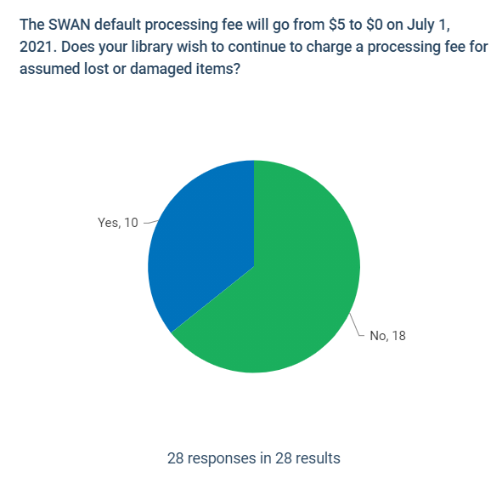

Slide 10
Grace Period
June 1, 2021
Modified in October 2020 to match quarantine periods
Fine accrual delayed for 7 days
0 day grace, delayed 7 days
3 day grace, delayed 8 days
System-wide global change will be reset to pre-covid 0 days/3 days grace on June 1st
Return to normal grace period and fine accrual
This Photo by Unknown Author is licensed under CC BY-NC
Notes:
Vickie

Slide 11
Processing Fees
July 1, 2021
Processing fee is assessed by checkout library for lost items
Default Price Policy is set by each library; if none, SWAN default is applied
Item price should be set for each item. BcAnalytics report – List items with no item price
See Support Site: Documentation > ILS Configuration > Item Configuration > Default Price
Default processing fee will be $0
This Photo by Unknown Author is licensed under CC BY-NC
Notes:
Dawne

Slide 12
Current Processing Fee Breakdown
18 libraries currently assess a processing fee - no change
30 libraries/agencies currently have processing fee of $0 – no change
56 currently have no entry in default price table; will change to $0 on July 1st unless your library submits a support ticket
If your library is not listed on the next slide and you want to retain the $5 processing fee, submit a support ticket requesting “Please set our library default price processing fee to $5.00”

Slide 13
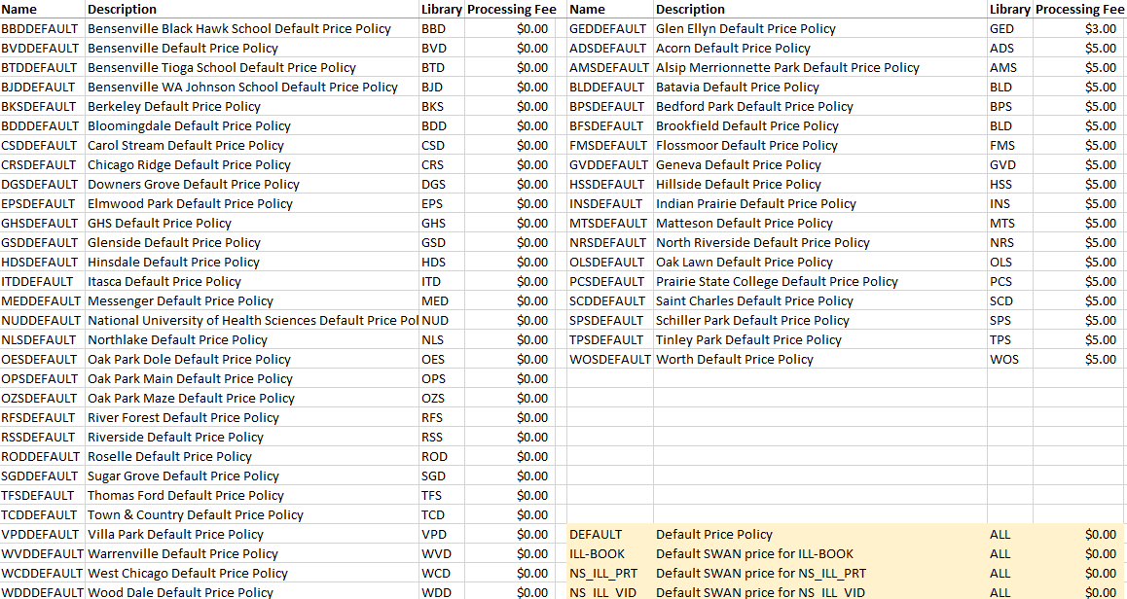

Slide 14
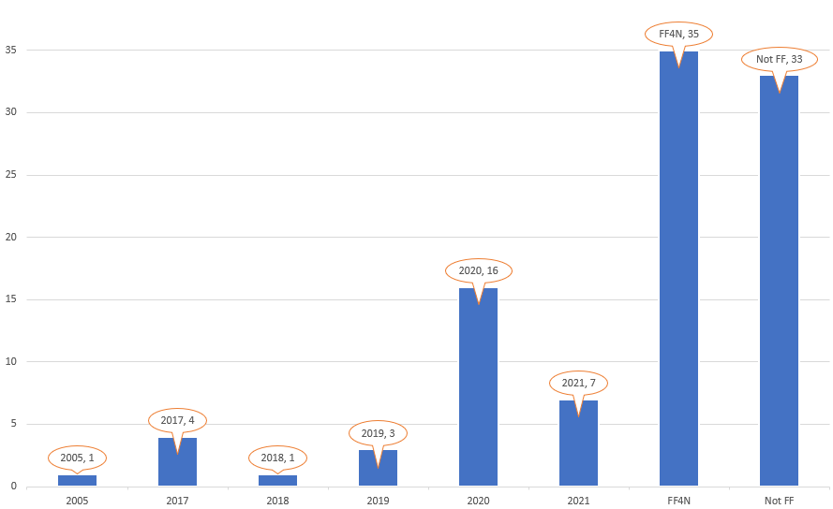
Fine Free Decisions & Numbers
32 libraries Fine Free
35 libraries Fine Free for Now
September 1, 2021
Return to pre-covid circ rules, or fine free permanently
This Photo by Unknown Author is licensed under CC BY-NC
Notes:
Dawne

Slide 15
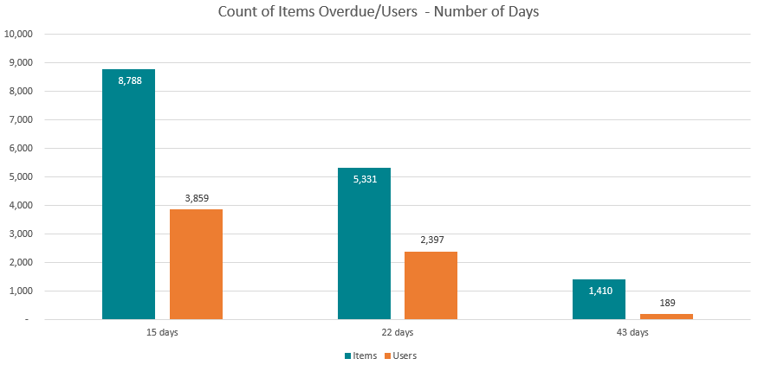
As of 5/24/2021 – Overdue Items/Users
2.28 Items/User
2.22 Items/User
7.46 Items/User

Slide 16
 | Patron Profile Limits | Nightly Overdue Time Period Block
Parameters | Billing threshold – items overdue 42 days are considered lost and added to bills Items Overdue – number of items that can be overdue (1 day) before record is blocked | Nightly job reviews any patrons with overdue items > 14 days checked out at your library; updates patron status to blocked
Patron Experience | Patron limit determines when account is blocked, regardless of which library they use If home library does not have overdue limits, the patron will not be blocked until meeting a bill threshold | Home library patron profile is checked for blocking, so other blocks may occur if profile has limits If home library does not block for overdues, patrons will not be blocked until 1 item becomes overdue for 14 days
Benefits | Home library patrons know limits and when to expect blocks to be applied Patrons can balance return of material to manage blocks | Assuming no limits are reached, patrons are given 2-weeks before account is blocked Only items > 14 days overdue are considered in nightly block update
Challenges | When limit is reached, patron is immediately blocked Block is not cleared until number of overdue items falls beneath the limit | Block is applied via a report run nightly, which may be updated to OK when the patron record is opened in WorkFlows. WorkFlows recalculates status when patron record is opened. This leads to staff confusion. Staff have to pay attention to Alerts and overdue dates/items.
Recommendation | Allow libraries to set bill threshold Move to a universal limit on overdue items allowed for patron account (not applied to in-house accounts) – 11 items | Use in addition to a universal overdue limit if library wishes to block even with 1 item overdue for more than 14 days.
Notes:
Dawne

Slide 17
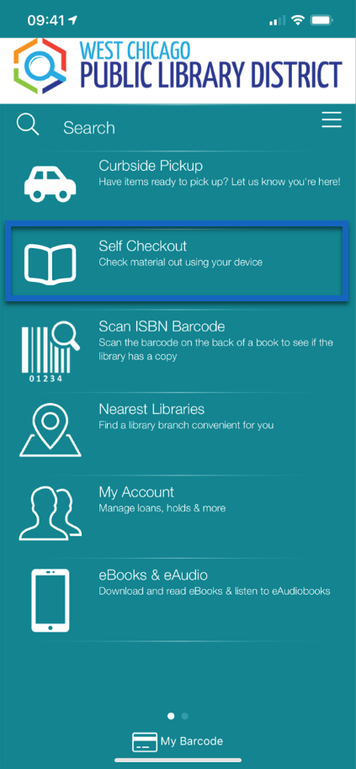
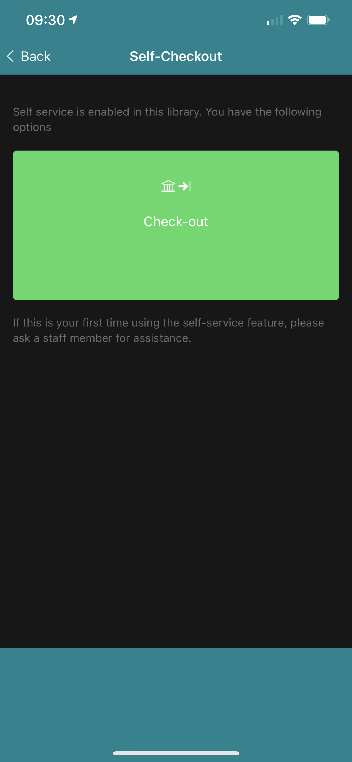
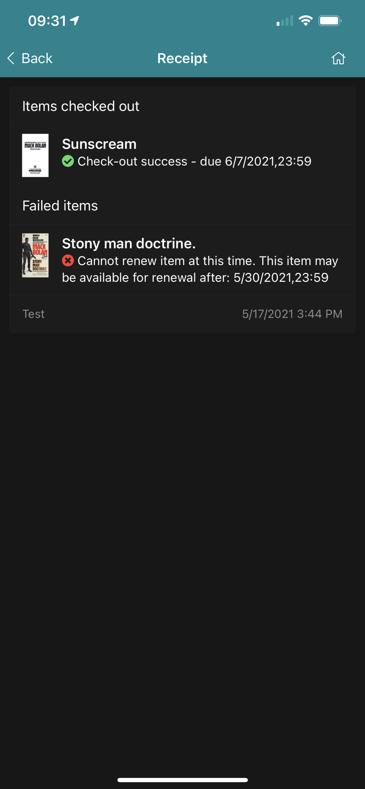
BLUEcloud Mobile App – Self Checkout
Add-on tool for BLUEcloud Mobile App allowing patrons to check out materials from within the boundaries of the library
Currently in pilot with West Chicago Public Library staff, soon to expand to West Chicago patrons
Following pilot, will become available for all interested libraries
Watch for news post/announcement
Requires use of location services on patron's mobile device
Determines if location is within library geo-fencing, based on latitude/longitude
Does not require use of beacon device
Notes:
Steven

Slide 18
SWAN Notice Dialer Pilot
Live TODAY (May 25th) for patrons with PHONE notice preference
Delivering 1st overdue notice (14 days), 1st hold notice
Full info, training video in news post
What you need to know:
Within the first month of the migration, please submit a help ticket to SWAN to let us know if you'd like to opt-in to have your library's main phone number displayed in the caller ID for your patrons. If you do not opt-in to this service, calls for your library will display SWAN's default toll-free number, 1-877-662-8190.
Anticipate daily emails detailing failed calls for the day from Unique's email address (messagebeefailednotificationexport@unique-mgmt.com). They’ll be sent to your [aaa]@notices.swanlibraries.net alias. Please follow-up with patrons as necessary. We also recommend whitelisting the @unique-mgmt.com email domain to ensure these emails are not blocked by spam filters.
Notes:
Steven

Slide 19
Support Site & OTRS Migration
Wed, April 28th
Migration completed April 28th
SWAN Support Site
SWAN Ticketing System
Verify that emails generated by these systems are not landing in your spam folders
This Photo by Unknown Author is licensed under CC BY-NC
Notes:
Steven

Slide 20
Symphony 3.7.1 Upgrade
Tentatively scheduled for early July
WorkFlows client updates will be required by mid-August
Formal announcement/news post coming soon
Changes coming to Manage Hold Shelf wizard
This and other changes will be detailed in an upcoming webinar
Notes:
Steven

Slide 21
Patron Record Purge & Bill Clean-up
What we heard:
Be more conservative in selection criteria
Provide reports to assist libraries in ongoing record review
Move to an ongoing process by Fall 2021
See:
News Post 5/17
SWAN Community Forums
June Quarterly Discussion
Target dates:
Begin August, 2021 with monthly clean-up
NCOA – Fall, 2021

Slide 22
Criteria Adjustments for Discussion
Concern | Adjustment
Last Activity Date (LAD) is before Expiration Date | Update LAD to “today” to reset prior to removal criteria review
OpenAthens and other services do not appear to be setting Last Activity Date consistently | Use Athens 1-year archive of barcodes to capture active barcodes in past year; update LAD to “today” to reset prior to removal criteria review
Bill removal criteria | Consider opt-out for libraries Ability for library to archive records for pursuance Discussion of $100 vs $200 threshold for > 10+yrs
Last Activity of 3 yrs seems aggressive given lost year or more due to pandemic | Start with 10+ year removal Work toward 5+ year removal by 1/1/2023
Edit of user address information does not update Last Activity Date | Symphony 3.7.1 settings can make this possible

Slide 23
Patron Record Purge
Purge criteria
Last Activity Date (LAD) prior to 1/1/2018 1/1/2011
Patron records flagged in the 2018 NCOA that have not been verified/updated with LAD prior to 1/1/2011
Bills paid via SWANPURGE
Bills associated with bad address/mail returned <=$200
LAD before 1/1/2011; bills $10.01-$200 (regardless of status)
LAD before 1/1/2018; bills <=$10 (regardless of status)
Notes:
Dawne

Slide 24
Timeline Targets
Jun-Jul 2021
Aug 2021
Sep 2021
Oct 2021
Jan 2022
Jan 2023
Update Last Activity Date
Review/remove bills
Allow library to review/update patron records
Move to 7+ years inactive criteria for selection
Start monthly removal of record 10+ yrs inactive
Start monthly reporting of records to remove
NCOA all remaining & geo-code active in last year records
Move to 5+ years inactive criteria for selection
Notes:
Vickie

Slide 25
Pseudo-libraries
DGS_L | Downers Grove Public Library Locker
GED_D | Glen Ellyn Public Library Drive-up Window
GVD_D | Geneva Public Library Drive-up Window
INS_D | Indian Prairie Public Library District Drive-up Window
OPS_LI | Oak Park Public Library Main Branch Indoor Locker
OPS_LO | Oak Park Public Library Main Branch Outdoor Locker
SCD_D | St. Charles Public Library District Drive-up Window
VPD_L | Villa Park Public Library Locker
8 Pseudo Libraries will be added in next month
Use first 3 characters of agency code for transit labels
Circulation/hold maps mirror home library
Notes:
Dawne

Slide 26
Drive-up window processing – staff experience
2
Checkout to patron
at drive-up window
1
Pull items from shelves
2
Check Onshelf Items
a
Print hold slip/wrapper
Place on hold shelf
1
3
b
From
XXX
Check in item
TO
XXX_D
Check in item
Print hold slip/wrapper
Place on drive-up hold shelf
c
Notes:
Dawne speaking:

Slide 27
Diversity, Equity, and Inclusion in Metadata
Task force to evaluate our catalog and ensure terms describing groups of people are modern, respectful, and granular.
Goals:
Evaluate LC subject headings and set up automated updating of problematic and outdated terms
Consider optional supplementary subject vocabularies to improve access to resources concerning groups not currently represented
Provide recommendations on improving visibility of diversity resources and Own Voices collections
Collect resources on performing diversity audits for interested members

Slide 28
Aspen Updates
This month, we have focused on performance and stability:
Added MARC record and e-resource indexes for all 100 catalogs – which drastically increased memory usage and index times
Decreased index size and run times by half
Added several checks to ensure if we have memory issues in the future, partial exports will not be processed
We're awaiting one last go-live feature: ProPay integration
Nightly Indexes

Slide 29
Spotlight on...Spotlights!
Aspen can generate book/item carousels that you can embed in your website.
You can use search filters or a manually created list to generate spotlights.
See them in action on the Nashville Public Library website.

Slide 30
Build a Better Library Website Boot Camp
Online course made possible in part by a 2020 award from the Catalyst Fund at LYRASIS.
Available through the WebJunction Course Catalog for free.
Covers design, project management, accessibility, and more
https://learn.webjunction.org/course/search.php?q=Build+a+Better+Library+Website+Boot+Camp

Slide 31
EBSCO Group Purchase
Database selections have been sent to RAILS – thanks everyone for a smooth process!
By July 1 start of the subscription we will:
Send a SWANcom with all database links
Update database links on the patron site
Update Article Search/EDS
Update EBSCO Admin
Notes:
Tara

Slide 32
Statistics
Note: These statistics and a few more are reported in the Monthly Operations Report, available online in the monthly Board packet, publicly available.
Notes:
Dawne

Slide 33
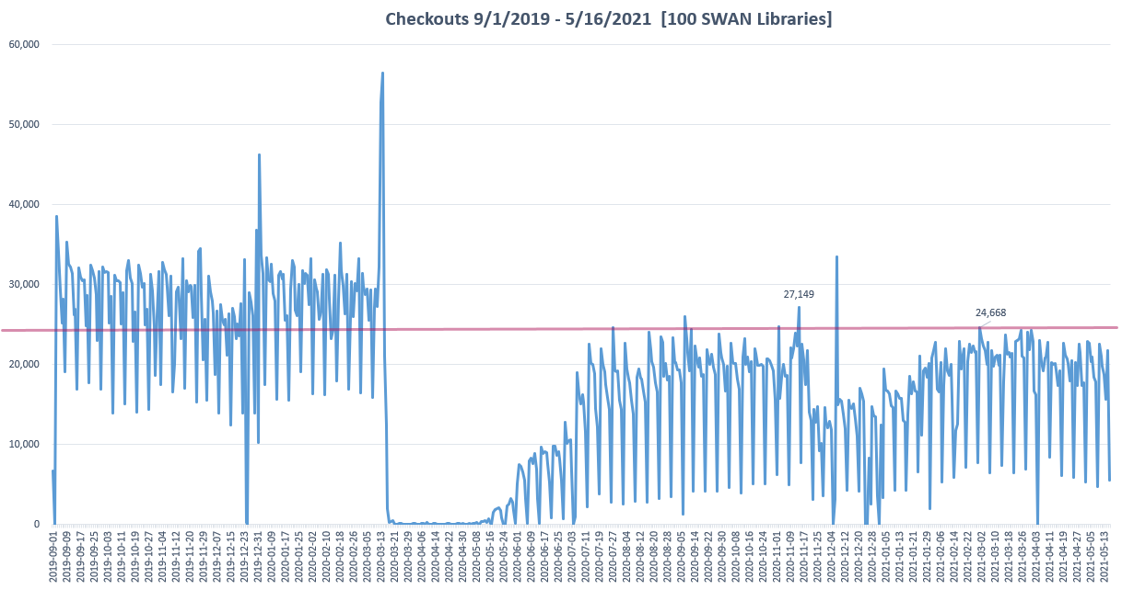
Notes:
Dawne

Slide 34
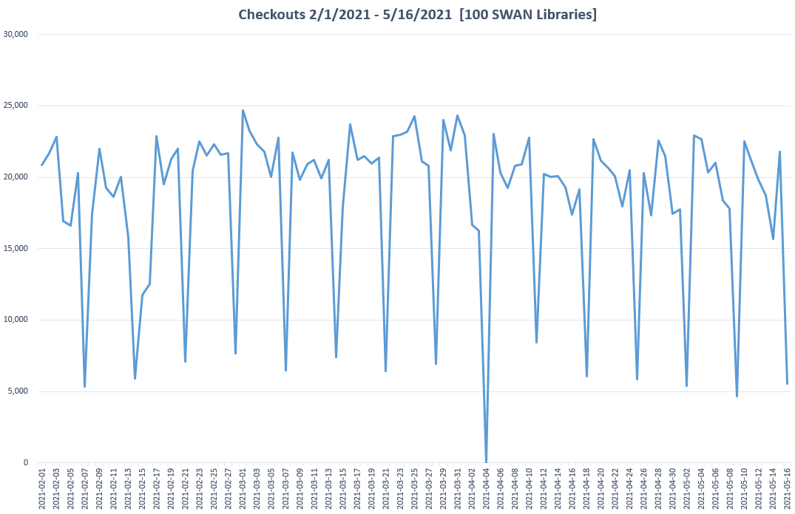
Steady since Feb 1, 2020
Mondays continue to trend as heaviest circulation.
Total circulation in May slightly down from April – not uncommon for annual pattern.
Notes:
Dawne

Slide 35
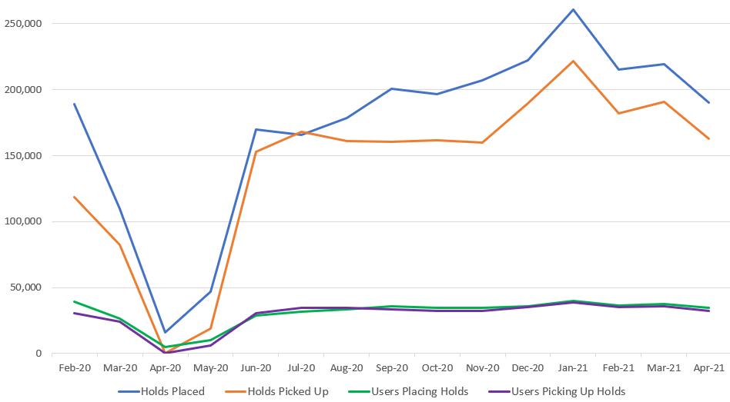
Trends in Holds, Feb 2020 – Apr 2021
Notes:
Dawne

Slide 36
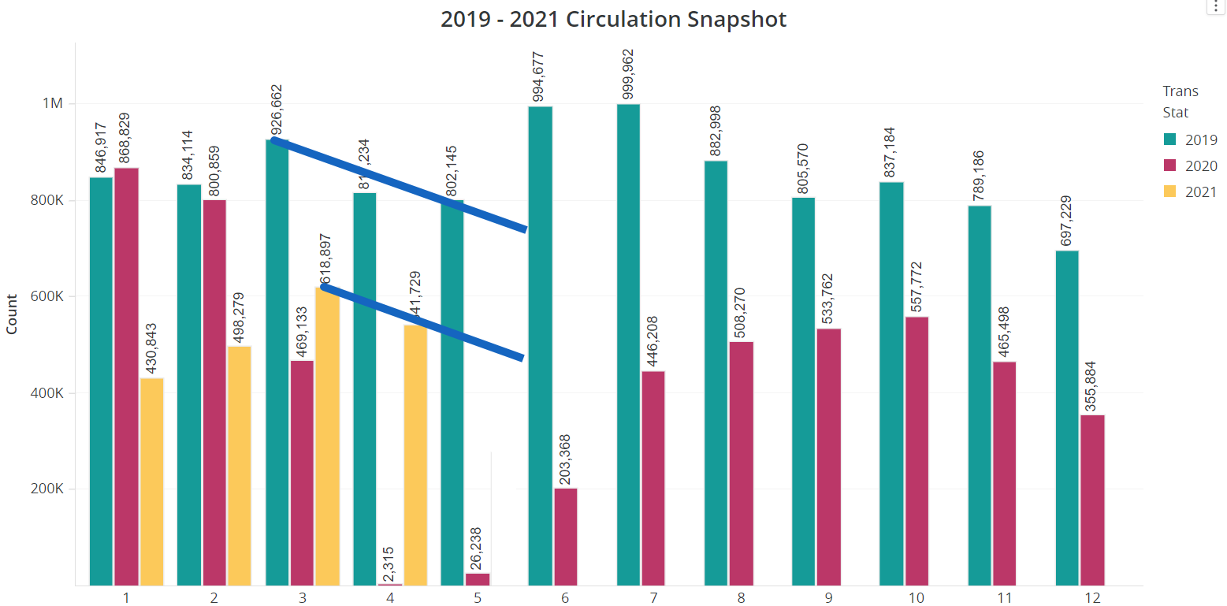
Prior Year Comparison
Notes:
Dawne

Slide 37
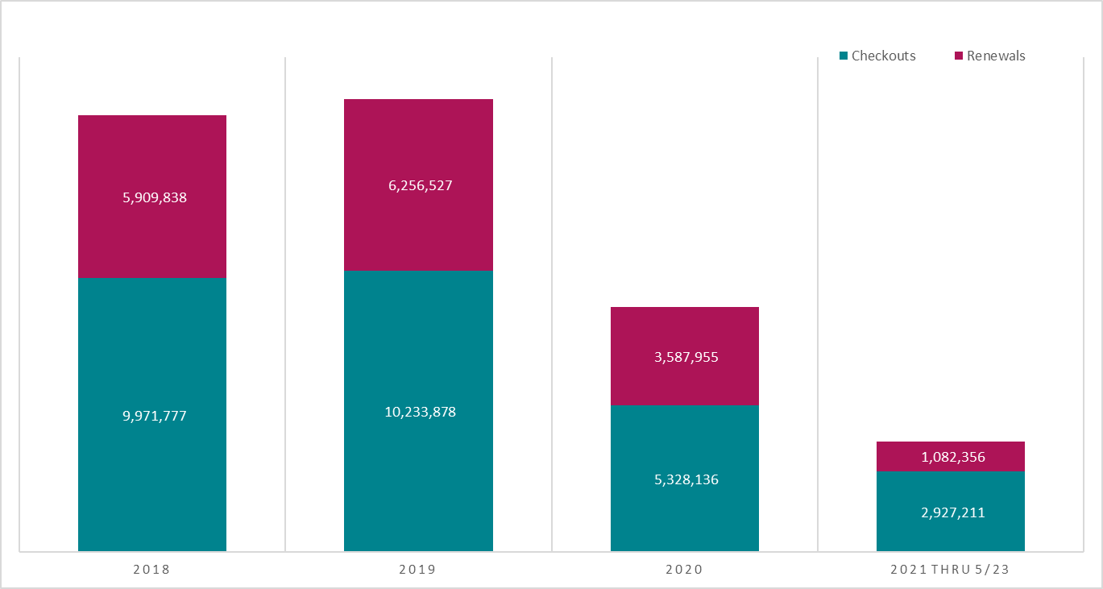
Checkouts vs Checkouts & Renewals
Not sure what this is telling us. Why such a dramatic drop in renewal percentage?
More popular materials that can’t be renewed?
61%
59%
59% renewal
61% renewal
67%
67% renewal
37%

Slide 38
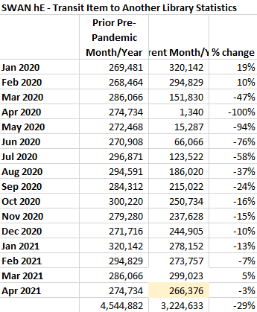
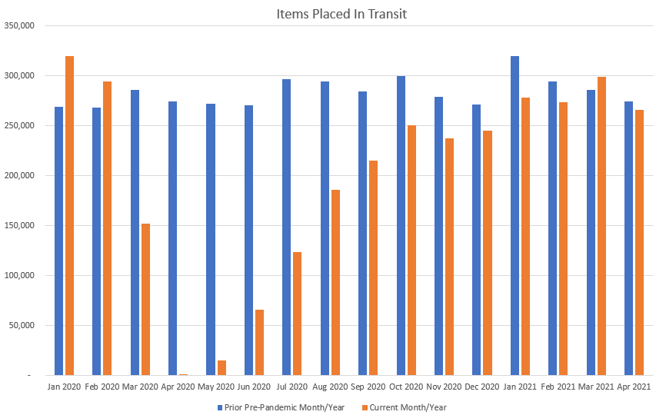
2019 vs 2020/2021 Circulation & Transits

Slide 39
SWAN Board Election: 2 Seats July 1, 2021 Start 3-year term
Election Process Announced | March 4, 2021 (Quarterly)
Online Self-Nominations Accepted | April 5 – 30, 2021
Names of Candidates Released | May 3, 2021
Electronic Ballot | May 10 – May 31, 2021
Results Announced | June 1, 2021
Elected Candidates invited to June SWAN Board Meeting | June 18, 2021
Candidates’ Terms Begin | July 1, 2021
July Board Meeting | July 23, 2021
The SWAN Board is comprised of seven library directors/administrators elected at-large from the libraries in SWAN. Board meetings are held monthly on a Friday of each month at 9:30a.m.
Notes:
Dawne

Slide 40
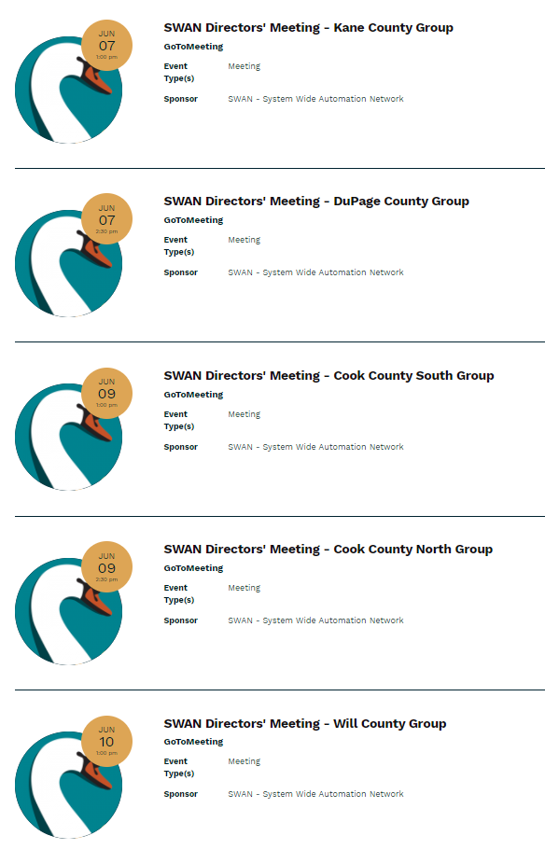
SWAN Directors’ Meetings
Library Ideas for ARPA Funding – 5 SWAN Hosted Brainstorming Events
See: News Post, May 18

Slide 41
Register on L2: June 11, 1-2 p.m. August 13, 1-2 p.m. October 15, 1-2 p.m. Library membership benefits Resource sharing Annual fees How SWAN Support works These sessions are informal and not recorded.
Directors’ Coffee Hour
Informal chance to talk with Aaron and fellow Library Directors
Notes:
Dawne

Slide 42
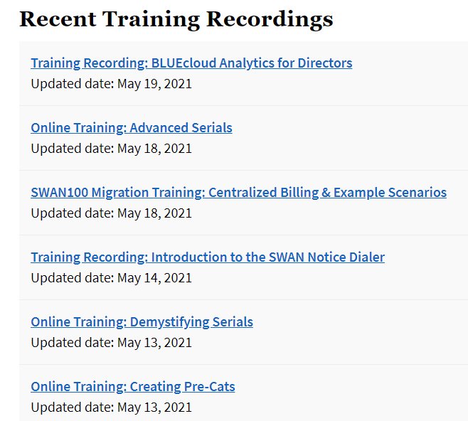
Interactive Staff Trainings
Meetings & Trainings>Tutorials & Training Resources
Advanced Serials online training released.
Notes:
Crystal

Slide 43
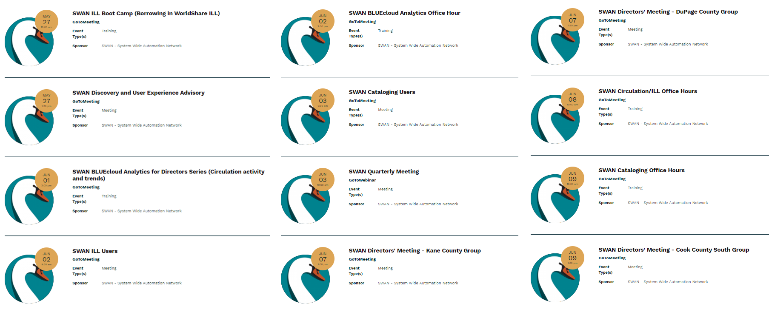
Other Upcoming Meetings
See SWAN’s events on L2
Notes:
Tara

Slide 44
Thank you!
Next Fireside Chat: June 29th – 11:00-12:00
https://librarylearning.org/event/2021-06-29/swan-members-fireside-chat
Register at GoToWebinar - https://attendee.gotowebinar.com/register/1230221980706466061

