Slide 1
SWAN Fireside Chat
August 31, 2021
Notes:
Scott

Slide 2
Agenda
Recap of September 1st Changes
Fine Free Update
Patron Record Purge
Pseudo Library Update
User Category Confusion & Clean-up
Diversity, Equity, Inclusion (DEI)
Aspen Update
E-Resources
Upcoming Events & Meetings
Notes:
Scott

Slide 3
Reminder for September 1st Policy Changes
Completed:
Elimination of print overdue notices – now only sent via text, voice message, or email (between 65-70% Fine Free)
Consolidation of hold pick-up notices and accommodation for pseudo-library hold pick-up notices (sent once a day around 2:00 PM)
Return to pre-pandemic notice wording
Return to pre-pandemic grace periods
Default SWAN processing fee set to $0, previous default was $5 (Libraries can request local processing fee charges.)
COVID related online catalog banners removed
Flexibility in blocking for Fine Free based on criteria of library choice
Scheduled:
Libraries Fine Free For Now – decide on pre-pandemic or Fine Free rules (September 1)
Reinstate 90-day removal of temporary patron records created through Online Patron Registration that have not been reviewed and updated/extended by home library (September1)
Please see our support site news post
Revert to pre-COVID hold pickup notices for all libraries
Remove COVID Outreach Circ Rule
Remove remaining temporary hold map adjustments
Overdue 1st notices return to 7 days (from 14)
Notes:
Dawne

Slide 4
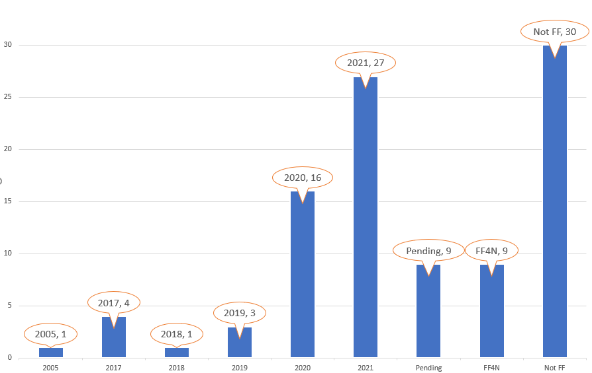
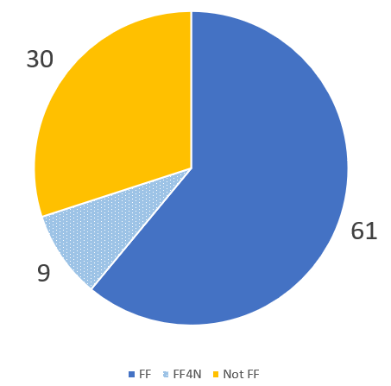
Fine Free Decisions & Numbers
September 1, 2021
Return to pre-covid circ rules, or fine free permanently
This Photo by Unknown Author is licensed under CC BY-NC
Notes:
Dawne - Vickie

Slide 5
Patron Record Purge: Monthly Report
1) Report link to History in BcAnalytics emailed 2nd of month
2) If desired, contact patrons and review
3) If retaining, update the patron record, verify Last Activity Date
15th of following month, remaining records meeting criteria are removed
Review the Monthly Patron Record Purge documentation
Notes:
Dawne

Slide 6
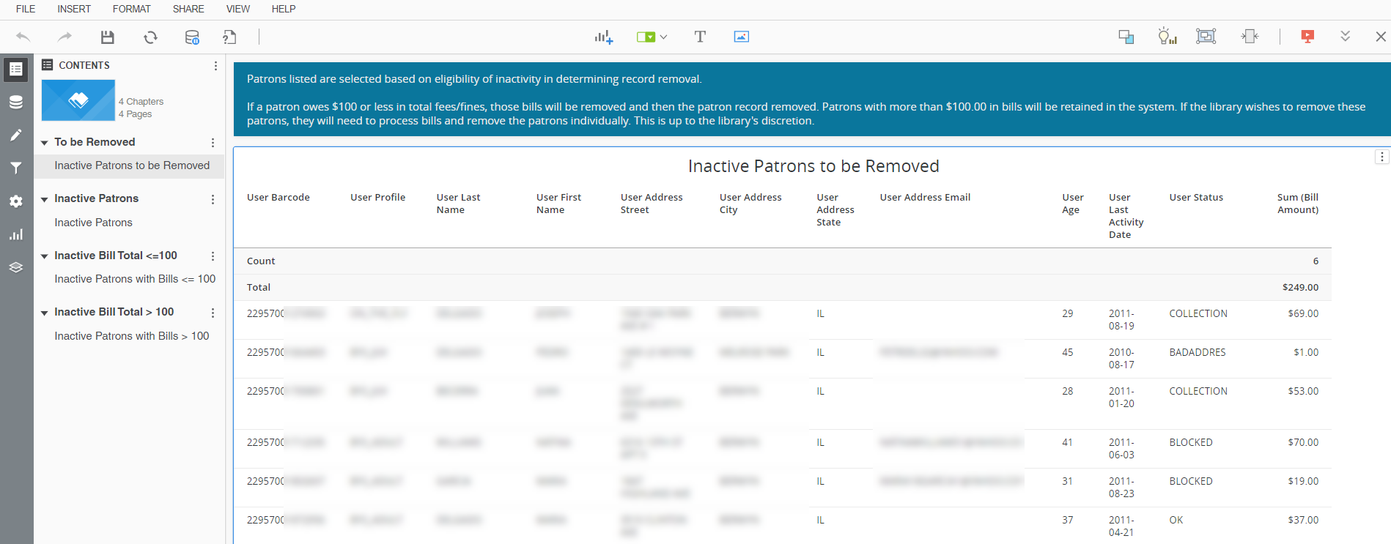
BLUEcloud Analytics – Inactive Patron Review
Monthly email with History List link to review (sent 2nd of month)
Notes:
Dawne

Slide 7
Patron Record Purge: Timeline Targets
Jun-Jul 2021
Aug 2021
Sep/Oct 2021
Fall 2021
Jan 2022
Jan 2023
Start monthly reporting and next month removal of record 10+ yrs inactive
Move to 7+ years inactive criteria for selection
Update Last Activity Date of Athens users
[COMPLETE]
[ON-TRACK]
[COMPLETE]
Initial removal of records with LAD before 1/1/2011
NCOA all remaining & geo-code active in last year records
Move to 5+ years inactive criteria for selection
Notes:
Dawne

Slide 8
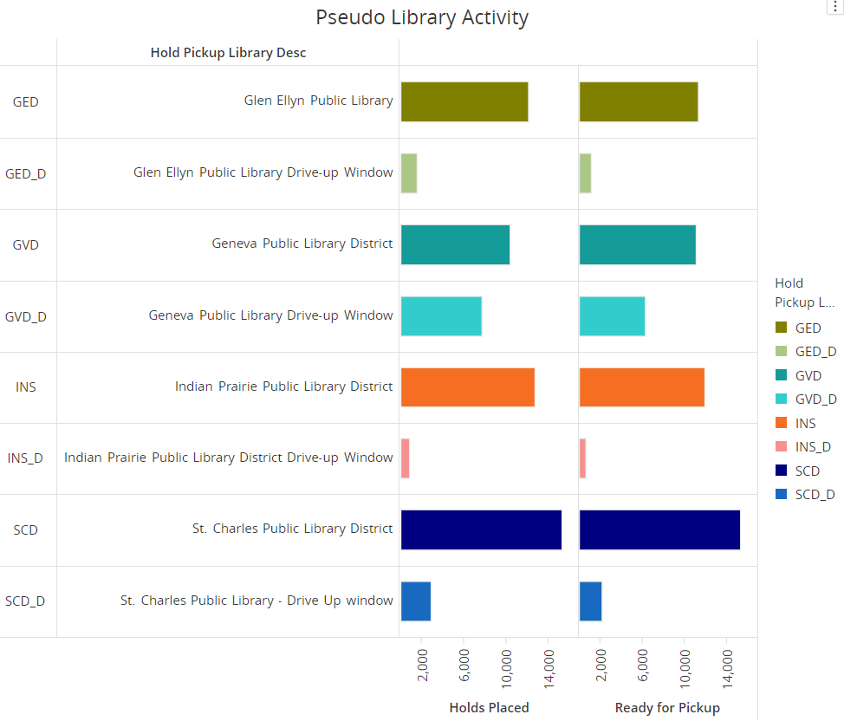
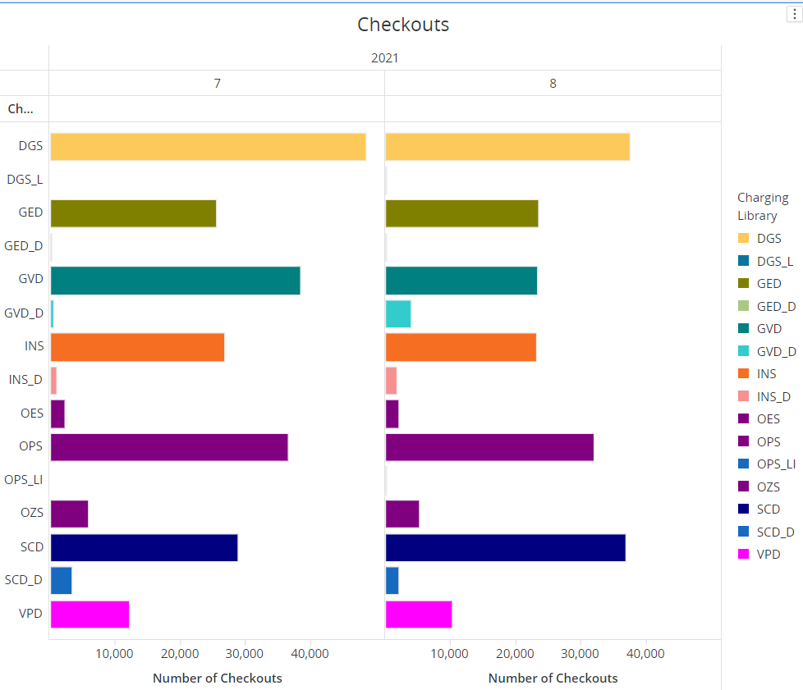
Pseudo Library Stats 7/1/2021-8/29/2021
Notes:
Dawne

Slide 9
User Category Confusion/Clean-Up
Pickup Preference (User Cat 11)
BOOK_DISC
CURBSIDE
DESK
DRIVEUP (replaced by Pseudo)
HOME_DEL
LOCKERS (replace by Pseudo)
OPEN
OUTREACH
XPRESS_CKO
Notice Preference
EMAIL
PHONE (only setting that notice logic follows)
TEXT
PRINTED (will be deprecated and replaced with MANUAL)
Notes:
Dawne

Slide 10
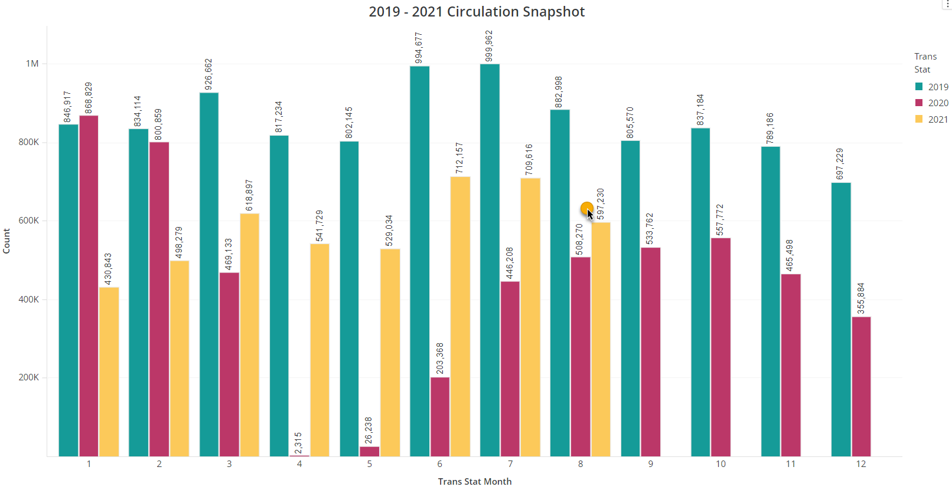
2019-2021 Circ Snapshot
Summer 2021 vs 2019
June 72% of circ
July 71% of circ
August 72% of circ
Notes:
Dawne

Slide 11
DEI Task Force Update
Subject headings will be updated to supplement the terms
Sexual minorities
Transsexual
Proposed adoption of Homosaurus subject vocabulary
Leadership:
Co-conveners: Scott Brandwein (SWAN), Rachel Fischer (CCS)
Administrative Support: Nincy George (RAILS)
Subject heading changes
Future networking group
Notes:
Scott

Slide 12
RAILS DEI in Metadata Networking Group
Group discussions, resource sharing, and consensus
Early meetings will focus on subject vocabulary
What are Illinois libraries are choosing to do?
Recommendations
Proposed first meeting date: Wednesday, 11/17, 1:00-2:30
Notes:
Scott

Slide 13
Aspen Rollout
Notes:
Tara

Slide 14
First Cohort Schedule
Date | What
August 30th, 2021 | Kickoff Meeting
Every other Monday, 10 a.m. | Aspen office hours
September 7th, 2021 11 a.m. | Aspen Admin Training: Themes & Library Settings
September 14th, 2021 11 a.m. | Aspen Admin Training: Browse categories, Spotlights, & Adding Covers
September 21st, 2021 11 a.m. | Aspen Admin Training: Placards & System Messages
October 5th, 2021 11 a.m. | Aspen Admin Training: Record Grouping
October 12th, 2021 11 a.m. | Aspen Admin Training: Purchase Suggestions
October 18th-29th, 2021 | Go live
Notes:
Tara

Slide 15
Second Cohort Schedule
Dates coming soon! For now, save these dates January - March:
Tuesdays at 11 a.m. for Aspen Admin trainings
Mondays at 10 a.m. for Aspen Office Hours
Notes:
Tara

Slide 16
Aspen 21.10 Release Highlights
Better handling of items checked out to generic users (for display, etc.)
Added item barcodes to checkouts in My Account
Using uniform titles to improve record grouping
ProPay (fines payment) integration *still testing
Notes:
Tara

Slide 17
Kanopy Update
Current and new SWAN subscribers will receive a 5% discount beginning September 1st.
If your library adds Kanopy over the next year, you could increase the discount to 10% for all libraries.
https://support.swanlibraries.net/news/2021-08/87475
Notes:
Robin

Slide 18
Webinar on Web Accessibility
September 21, 1:00 – 2:00 pm
Web Accessibility Fundamentals for Libraries presented by Deque and SWAN
https://librarylearning.org/event/2021-09-21/web-accessibility-fundamentals-libraries#main-content
Notes:
Robin

Slide 19
Beanstack Presentation – Info Sessions
Sept 14th 10:00 am
Sept 15th 1:30 pm
Notes:
Dawne

Slide 20
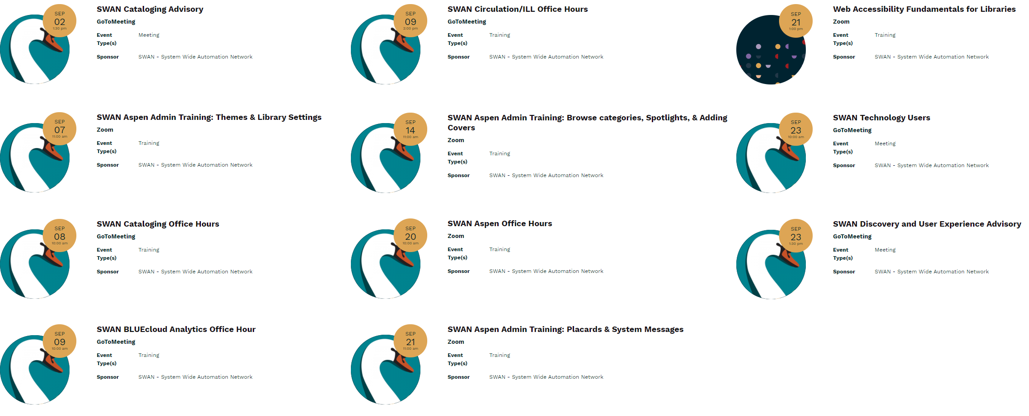
Other Upcoming Meetings
See SWAN’s events on L2
Notes:
Scott

Slide 21
Thank you!
Next Fireside Chat: September 28th – 11:00-12:00
Register at GoToWebinar:
https://attendee.gotowebinar.com/register/2610529087007235341
Notes:
Scott

