Slide 1
SWAN Fireside Chat
October 26, 2021
Notes:
Scott

Slide 2
Agenda
Sharing some stats
Circ Advisory Election
Reminder on Unusable Items
Aspen Rollout
Aspen Fines Payment
Aspen & Our Bibliographic Data
Accessibility Statement
RAILS DEI in Metadata Networking Group
SonicWall Hardware Replacements and Multi-Factor Authentication
Notes:
Scott

Slide 3
Processing Damaged & Unusable Items
Do not cancel Transit Pop-ups – follow on-screen instructions
If checking out to an in-house user or UNUSABLE_RB_ILL, forward item with a condition note to owning library.
Follow documentation for processing these items https://support.swanlibraries.net/documentation/64708

Slide 4
Aspen Rollout
Notes:
Tara

Slide 5
First Cohort Live!
In Week 1:
17 libraries went live – congratulations!
Compared to the previous week:
Aspen sessions increased 23%
Aspen users increased 21%
Aspen sessions make up about 30% of total sessions in both catalogs
You can monitor your library's Aspen and Enterprise statistics and compare usage through the Patron Use Report:
https://support.swanlibraries.net/documentation/70841
Notes:
Tara

Slide 6
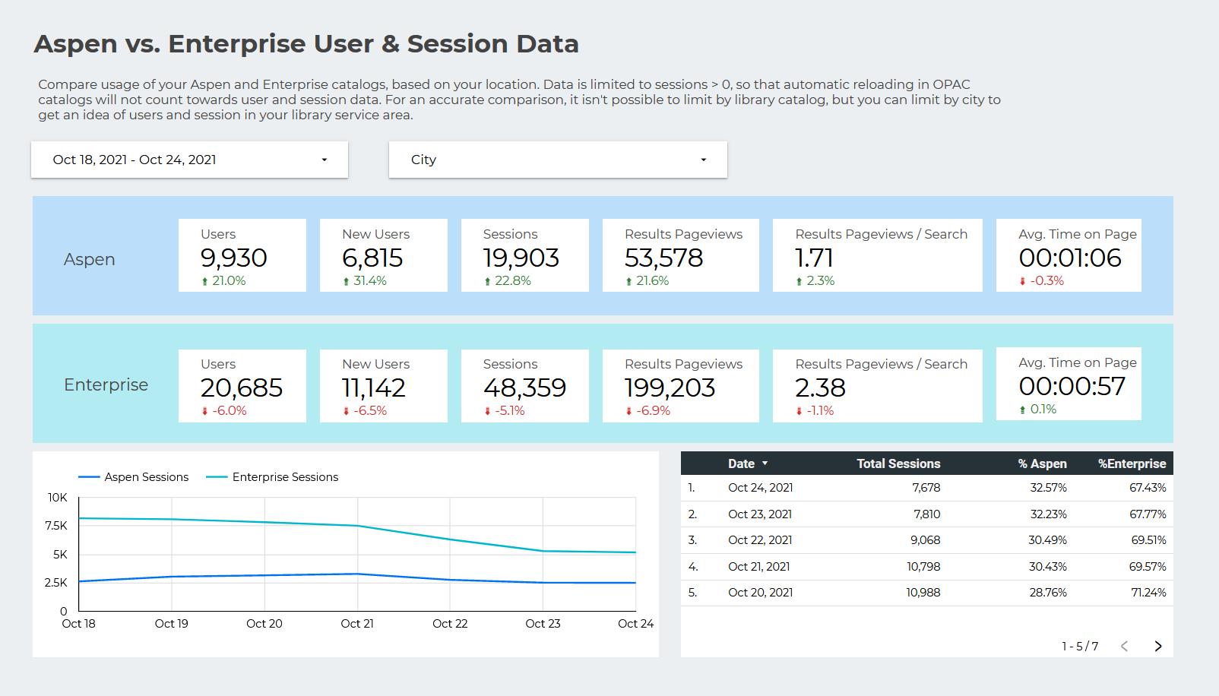

Slide 7
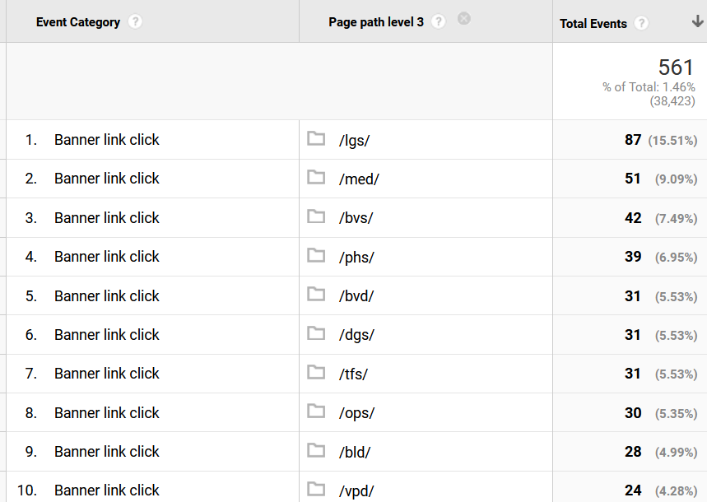
Your websites are the #1 driver of traffic to Aspen
Clicks on the Enterprise banner link to Aspen are very low.
Notes:
The top 5 libraries in this list don't have their websites pointing to Aspen yet. The Enterprise banners aren't getting a ton of clicks – this tells us it might be better to set one "soft launch" date for Cohort 2 and you can decide when you make the swaps on your website that will really get your patrons on Aspen.

Slide 8
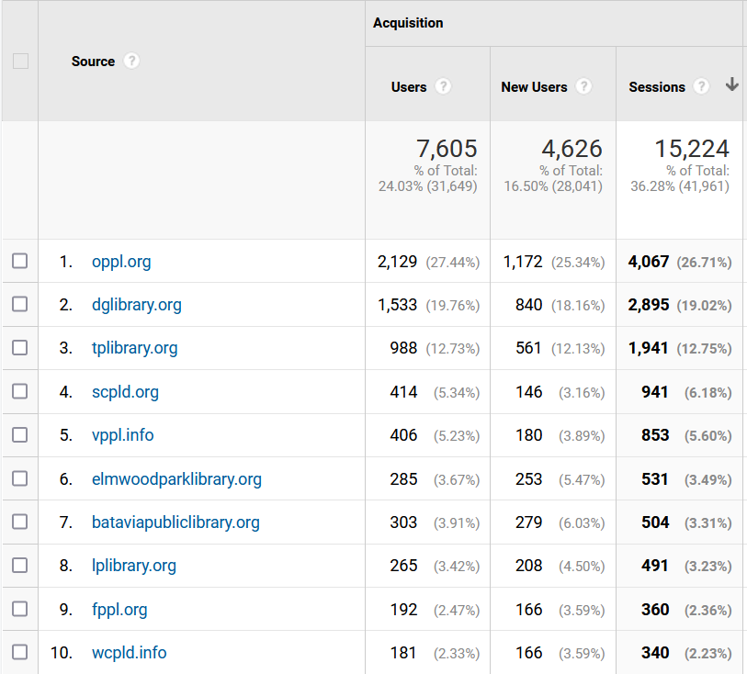
Your websites are the #1 driver of traffic to Aspen
Clicks on the Enterprise banner link to Aspen are very low.
Notes:
Referrals from your website are much higher.

Slide 9
Second Cohort Schedule
Date | What
January 10th, 2022 | Kickoff Meeting
Every other Monday, 10 a.m. | Aspen office hours
January 18th, 2022 11 a.m. | Aspen Admin Training: Themes & Library Settings
February 1st, 2022 11 a.m. | Aspen Admin Training: Browse categories, Spotlights, & Adding Covers
February 8th, 2022 11 a.m. | Aspen Admin Training: Placards & System Messages
February 15th, 2022 11 a.m. | Aspen Admin Training: Purchase Suggestions
March 1st, 2022 11 a.m. | Aspen Admin Training: Record Grouping
Week of March 7th, 2022 | Soft Launch
Notes:
Tara

Slide 10
Aspen Fines Payment Status
ProPay
Have been working with merchant account vendor for 6 months
Need new API keys for all libraries which requires a complete 2nd set of applications, activations, and accounts
PayPal
Created a SWAN PayPal account, set up in Aspen, & tested (took 2 weeks)
Libraries that currently use PayPal can work with us to turn on this payment in your Aspen catalog

Slide 11
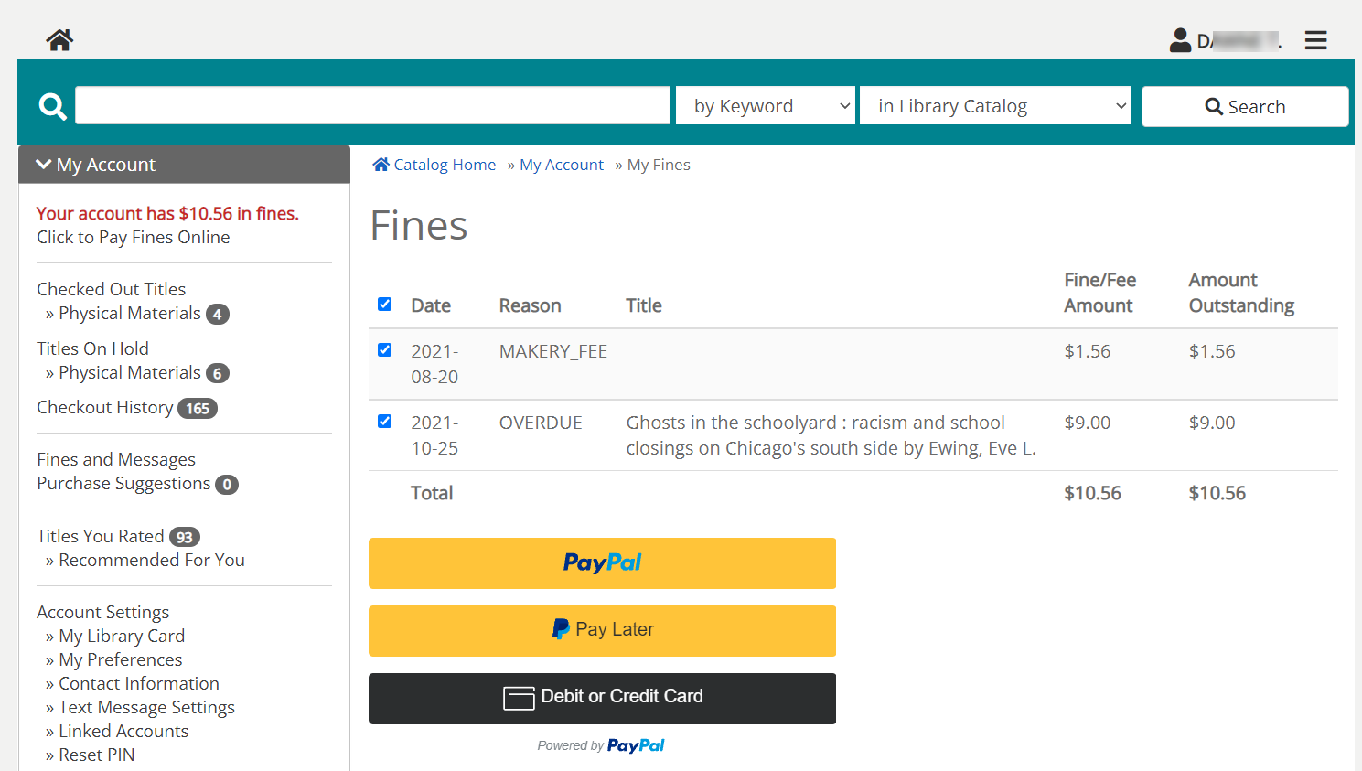
PayPal payment interface in Aspen
Patron can use their existing PayPal account and payment options -or-
Pay by credit or debit card

Slide 12
Fines Payment in Aspen
Thoughts on adding centralized PayPal and reconcile fines payments through Quarterly Billing?
Most payments are already reconciled through Quarterly Billing to properly account for item ownership and patron home library
Currently testing PayPal payments to ensure we can reconcile correctly
Enterprise and all other services using ProPay will be unaffected
Working to make the catalog "ILS neutral" and use payment methods that are more familiar to patrons

Slide 13
Polls
Please enter any thoughts related to online payment in the Q&A too.
What credit card options does your library currently support? (check all that apply)
Which of the following options would your library prefer for online payment processing in Aspen?
ProPay Online (Enterprise)
ProPay Card Swipes
Apple Pay and/or Google Pay
Square
PayPal
Centralize SWAN PayPal (quarterly reconciliation)
Library’s direct PayPal payment
We do not wish to take online payment-patrons pay in person
This Photo by Unknown Author is licensed under CC BY-SA-NC

Slide 14
Aspen & Our Bibliographic Data
Known Issues
Notes:
Scott

Slide 15
Audience and Fiction/Non-fiction
Heavy use of browse categories highlights some shortcomings in bibliographic data
Audience
Based on Item Category 2
Subject to human error and differing local practice
Fiction/Non-fiction
Vendor pre-cats often incorrect
SWAN developing a plan to tackle

Slide 16
Format
Aspen format analysis relies on markers not present in many pre-cat and local records
Enhancement request in place to recognize SWAN 590 format
Implementation timeline unknown

Slide 17
Aspen Office Hours
ASPEN
FREE
Every other Monday 10-11 AM
Bring your questions, let’s experiment and solve problems together.
November 1
November 15
November 29
This Photo by Unknown Author is licensed under CC BY

Slide 18
Accessibility Statement
https://support.swanlibraries.net/accessibility
Outlines plans to improve accessibility for patron and staff facing services
Includes resources for libraries
Commitment to put accessibility first in the catalog and e-resource group purchases
Be sure to contact SWAN first before purchasing any third-party catalog integrations
Notes:
Staff platform is the area that can use the most improvement, so we're looking forward to BLUEcloud staff as our primary staff tool.
We have resources on automated testing and VPATs, plus we'll post any recorded or online trainings conducted there.
Planning a training for 2022 on practical tips to use automated accessibility testing tools for your library websites.
We've been working to improve accessibility on patron facing resources for several years, but there are services like chat widgets that are embedded in the catalog and are not accessible. Going forward we won't add any new third-party integrations that don't meet accessibility standards, so be sure to contact us before you purchase if you want those embedded in your catalog. We want to work with you and the vendor to get accessibility improvements fixed or included in your contract, since the point of purchase is the most effective time to make a difference.

Slide 19
DEI in Metadata Networking Group
Notes:
Scott

Slide 20
DEI in Metadata Networking Group
A RAILS-sponsored networking group to discuss DEI issues as they relate to descriptive metadata
Early meetings will focus on subject analysis
Host topical discussions on specific issues related to marginalized groups and create a shared repository of knowledge and ideas
Co-chairs:
Scott Brandwein, SWAN
Rachel Fischer, CCS
Administrative Support:
Nincy George, RAILS

Slide 21
Kick-off Meeting
November 17th, 2021
Group goals and housekeeping
Discussion of current and past subject heading projects by SWAN, CCS, and attendees
Documentation review
Register on L2: https://librarylearning.org/event/2021-11-17/diversity-equity-and-inclusion-dei-metadata-networking-group-kick

Slide 22
SonicWall Hardware Replacements & MFA
Notes:
Scott

Slide 23
SonicWall Replacements
17 libraries with SWAN-managed SonicWalls that are End of Support (EOS)
Automatic TZ-470 replacements to be billed back to the library
November through January scheduling
Opting for Self-Maintainer? Email us ASAP!

Slide 24
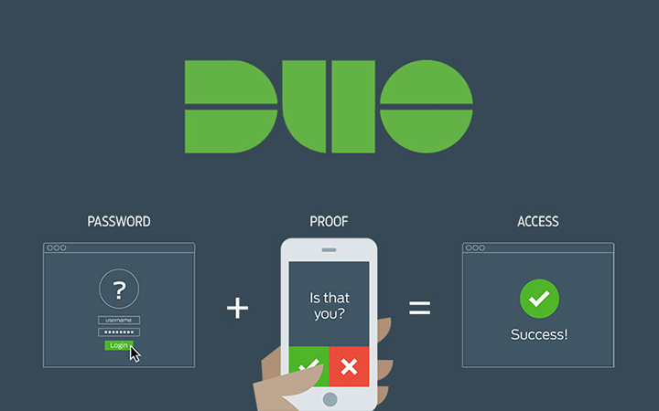
SonicWall Multi-Factor Authentication (MFA)
Duo has been configured on all SWAN-managed SonicWalls for SWAN administrative access.

Slide 25
Statistics & such
A look at some interesting numbers

Slide 26
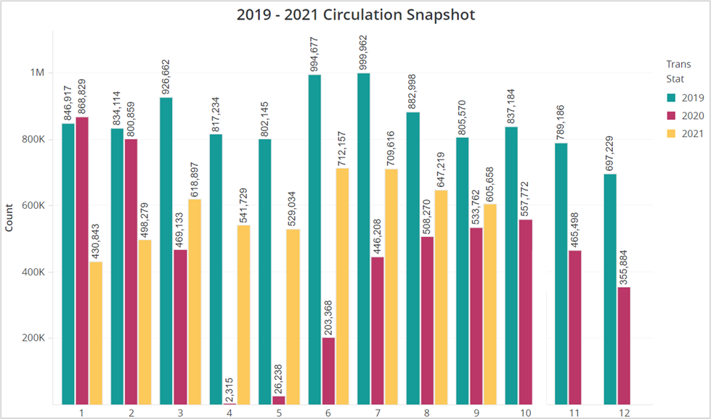
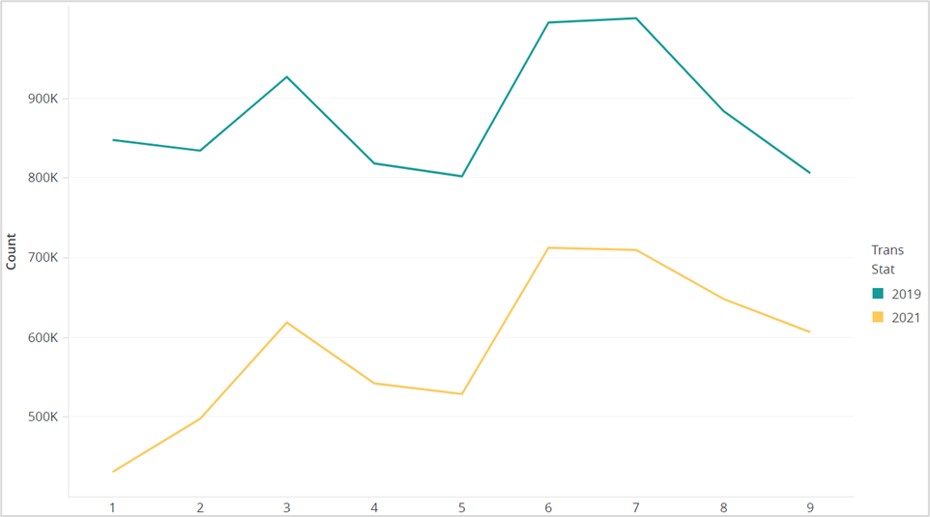
Circulation 2019 vs 2021 (also 2020)
09/19 vs 09/21 = 75%
08/19 vs 08/21 = 73%
07/19 vs 07/21 = 71%

Slide 27
Aspen Holds
15% of all holds placed in Sept – through Aspen
14% of all holds placed in August – through Aspen

Slide 28
Don’t forget to VOTE

Slide 29
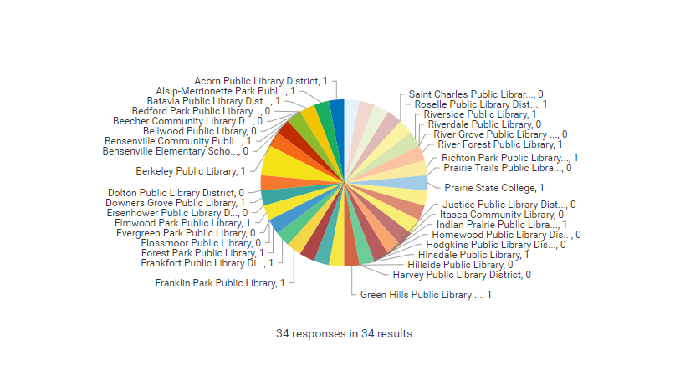
SWAN Circulation Advisory Election
Voting Deadline November 5th
5PM
The election for the SWAN Circulation Advisory Group is happening right now. Circulation managers should place their votes by
Thursday, November 5th by 5 PM.
Vote today!
One vote per library
This Photo by Unknown Author is licensed under CC BY-NC
Notes:
Dawne - Vickie

Slide 30
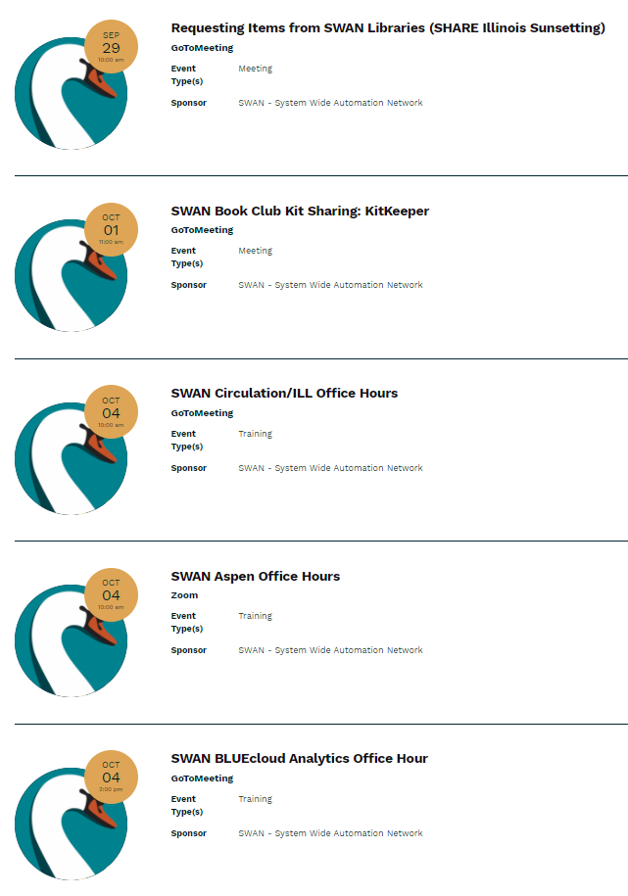
Other Upcoming Meetings
See SWAN’s events on L2
RFID Users – 10/28
E-Resource Advisory – 10/28
Cataloging Advisory – 11/4
Book Club Users – 11/10
Discovery and User Experience – 11/11
Circulation Advisory – 11/17
Board Meeting – 11/19
Monthly Office Hours
Circulation & ILL – 11/1
Aspen – 11/1; 11/15; 11/29
Cataloging – 11/3
BLUEcloud Analytics – 11/3
Academic & Special Library – 11/10
Notes:
Scott

Slide 31
Thank you!
Next Fireside Chat: November 30, 2021, 11:00 AM - Noon
Register at GoToWebinar: https://attendee.gotowebinar.com/register/3483027847531227917

