Slide 1
SWAN Fireside Chat
November 30, 2021
Notes:
Steven

Slide 2
Agenda
Item Due Dates
Sharing Some Stats
Collection Numbers
Aspen
Cohort 1 Feedback
Cohort 2 Update
Fines Payment
BLUEcloud Staff Pilot
Security Initiative
Sikich Risk Assessment
Password Management
SonicWall End-Of-Life Replacements
NCOA & Patron Purge
Notes:
Steven

Slide 3
Aspen Catalog
Notes:
Tara

Slide 4
Aspen Catalog: Cohort 1 Rollout Feedback
If you were in Cohort 1, please complete our feedback survey!
Your comments will help your colleagues in Cohort 2.
https://fs8.formsite.com/SWANServices/r8sti1sjrf/index.html
Notes:
Tara

Slide 5
Get ready Cohort 2!
January 10th is the kickoff! Be sure someone from your library is there.
Between now and then:
Directors should be sure you can access the Aspen Administration logins
Staff can start the Aspen trainings – it is never too early!
Save the dates for Aspen Administration trainings
Your logins are ready (thank you Dave!)
Notes:
Tara

Slide 6
Where can I find the Aspen logins?
Directors have access to these in the SWAN support site under: Documentation > Accounts & Logins > Workflows, SIP2, and Aspen Logins
Notes:
Tara

Slide 7
Who should have Aspen logins?
We’ll go over all of that in the kickoff meeting, but you can review the documentation at:
Documentation>Discovery> Beta Catalog> Administration & Permissions
Notes:
Tara

Slide 8
Second Cohort Schedule
Date | What
January 10th, 2022 | Kickoff Meeting
Every other Monday, 10 a.m. | Aspen office hours
January 18th, 2022 11 a.m. | Aspen Admin Training: Themes & Library Settings
January 31st, 2022 | Aspen Administrators should have completed the All Staff trainings
February 1st, 2022 11 a.m. | Aspen Admin Training: Browse categories, Spotlights, & Adding Covers
February 8th, 2022 11 a.m. | Aspen Admin Training: Placards & System Messages
February 15th, 2022 11 a.m. | Aspen Admin Training: Purchase Suggestions
March 1st, 2022 11 a.m. | Aspen Admin Training: Record Grouping
February 28th, 2022 | All staff should have completed the All Staff trainings
March 8th, 2022 | Soft Launch
Notes:
Tara

Slide 9
Fines Payment in Aspen
PayPal development is nearly complete – fines payment through PayPal will be available in Aspen by the end of the year.
You can use a centralized PayPal and SWAN will reconcile fines payments through Quarterly Billing OR you can use your own account.
Most payments are already reconciled through Quarterly Billing to properly account for item ownership and patron home library
Enterprise and all other services using ProPay will be unaffected
Working to make the catalog "ILS neutral" and use payment methods that are more familiar to patrons

Slide 10
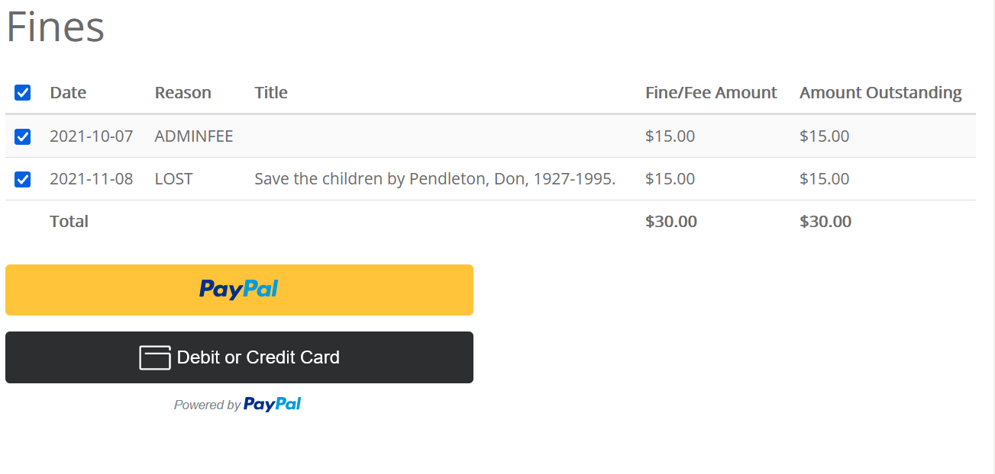
PayPal payment interface in Aspen
Patron can use their existing PayPal account and payment options -or-
Pay by credit or debit card
Notes:
Tara

Slide 11
BLUEcloud Staff Pilot
Notes:
Crystal, Dawne, Claudia, Sam

Slide 12
BLUEcloud Staff Pilot to Production (est.)
BLUEcloud Circ – Initial Test
BLUEcloud Cat – develop templates
BLUEcloud Circ – Expand access
BLUEcloud Acq – add new libraries
BLUEcloud Staff – transition some libraries to BLUEcloud “only”
Jan-Feb, 2022
Jan-Apr, 2022
BLUEcloud Acq/Cat – transition Symphony Acq/Cat
FY 23
Target by June, 2022
Nov-Dec 2021
FY 23 – second half
Indicates BLUEcloud updates, quarterly
SWAN will hold Member Update sessions after each release.
Notes:
Crystal, Dawne, Claudia, Sam

Slide 13
Security Initiative
Notes:
Steven

Slide 14
Sikich Risk Assessment
July – Sept 2021
Oct - Nov 2021 (Phase 1)
Nov - Dec 2021 (Phase 2)
Jan - Feb 2021 (Phase 3)
Feb - Mar 2022 (Phase 4)
TBD 2021
Receive/review Sikich proposal
Quarterly Membership presentation
Budget approval
Risk Analysis
Risk Management
[COMPLETE]
[ON-TRACK]
[COMPLETE]
Standards Development
Risk Identification
Risk Treatment
Notes:
Steven

Slide 15
Password Management
General Tips for Handling Logins
When you are provided a login to any SWAN service, you are responsible for the security and confidentiality of that login.
Do not share logins with other staff. All logins must be provided by a director or director-delegate supervisor.
Do not write logins on post-it or physical notes around your workstation. Use an encrypted password manager.
Do not email passwords, even if they are being sent to SWAN.
Notes:
Steven

Slide 16
Password Management Continued
Personalized account passwords
Always use strong passwords for SWAN credentials, utilizing the following:
A minimum of 8 characters
Uppercase and lowercase letters
At least one number (ex. 0-9)
At least one symbol (ex. !@#$%^&*-+)
Consider a passphrase:
ex. “That dog leapt over 12 fences!”
Support site documentation:
https://support.swanlibraries.net/documentation/89362
Password Management Best Practices:
January 11th at 11am
https://librarylearning.org/event/2022-01-11/swan-password-management-best-practices
Notes:
Steven

Slide 17
Reminder: SonicWall Replacements
Several libraries remaining with SWAN-managed SonicWalls that are End of Support (EOS)
You should have received two emails if your library is affected
Automatic TZ-470 replacements to be billed back to the library
December through January scheduling
Opting for Self-Maintainer? Email us ASAP!
Notes:
Steven

Slide 18
Patron Management Updates
Record management, NCOA, due date
Notes:
Dawne

Slide 19
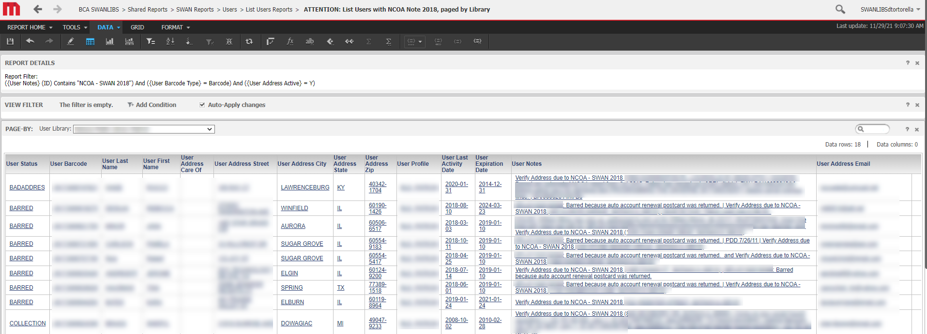
Final NCOA 2018 Clean-up
2,500 patron records remain
Libraries should review and update/remove records
See News Post from 11/29/21
Notes:
Dawne

Slide 20
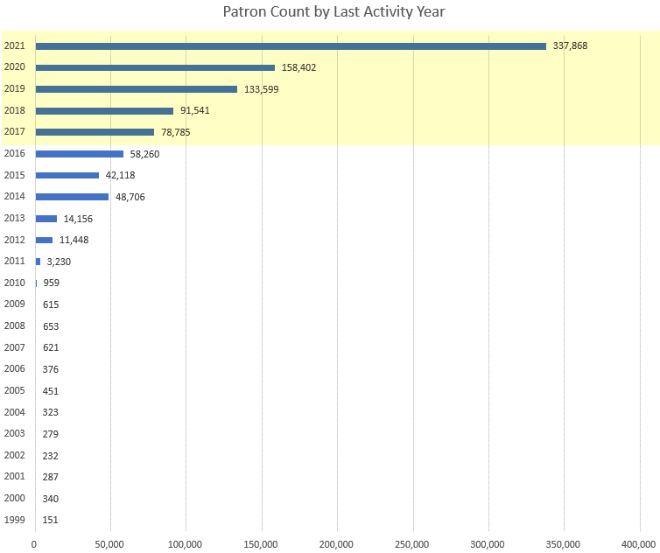
2021 NCOA
Names will be submitted in December to Unique
No blocking of accounts will occur until libraries have had a chance to review and remove notes (target April, 2022)
Geo-location codes will be added to patrons active within past 5 years.
~ 981,000 for Address Check
~ 800,000 for geo-location
Notes:
Dawne

Slide 21
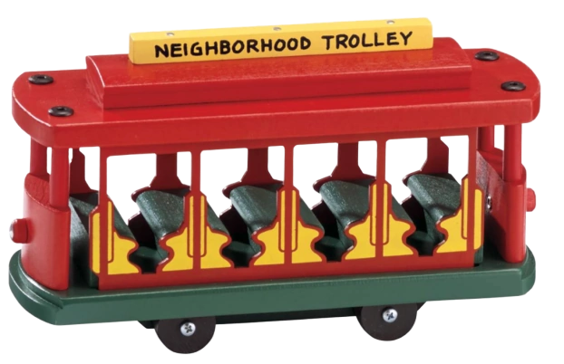
Reminder: Item Due Dates (not NEVER)
Due Date = NEVER should only be used for your own items Exceptions:
LOSS_RB_ILL, UNUSABLE_RB_ILL, MISSING
See: SWAN Reports > Circulation > List Circulation Reports > List Checkouts (Not My Item) Due Date NEVER
Set up consultation to review in-house account settings and policies
Notes:
Dawne

Slide 22
Statistics – a look at collection development during the pandemic
A look at some interesting numbers
Notes:
Dawne

Slide 23
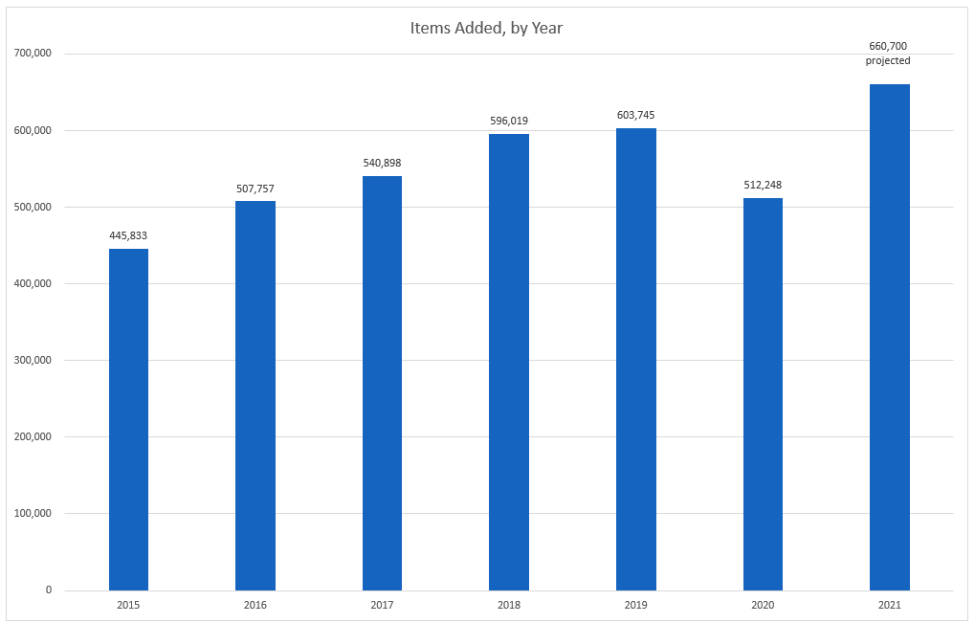
Items Added, by Year
2021 – projection based on 11 months
Consider discards, missing, losses, weeding - reducing items created in specific years over time
2021 appears to be compensating for 2020 decline
Notes:
Dawne

Slide 24
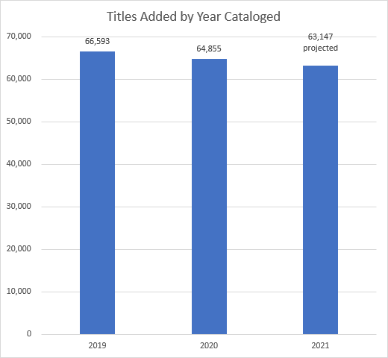
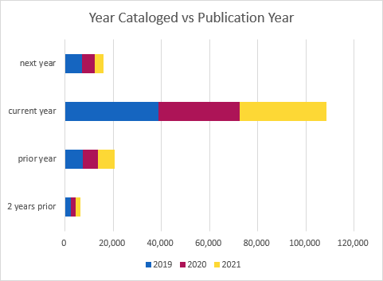
Titles, by Year Cataloged & Publication Year
Notes:
Dawne

Slide 25
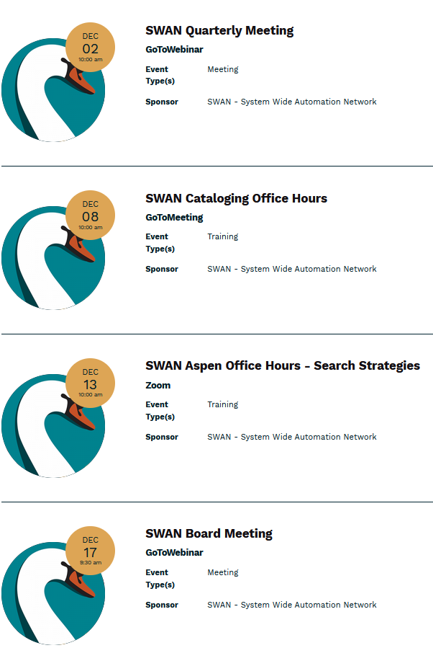
Other Upcoming Meetings
See SWAN’s events on L2
SWAN Quarterly – 12/2
Board Meeting – 12/17
Monthly Office Hours
Cataloging – 12/8
Aspen – 12/13 (Search Strategies)
Notes:
Steven

Slide 26
Thank you!
Fun & Top Ten lists! Bring your own to share.
Next Fireside Chat: December 28, 2021, 11:00 AM - Noon
Register at GoToWebinar: https://attendee.gotowebinar.com/register/5154755021862074636
Notes:
Steven

