Slide 1
SWAN Fireside Chat
February 22, 2022
Notes:
Steven

Slide 2
Agenda
Annual Rebuild & Offline
– April 17 (Tentative)
L2 Annual Update
Joining the SWAN Forums
Communicating Closures
Teacher Cards & Loan Policies
NCOA Results
Unique Referral Fee Increase
Damaged & Unusable Materials
Aspen Updates
Quarterly Meeting – March 3
2022 Meetings & Training
Notes:
Reindex: Steven
L2 Annual Update: Steven
Forums: Steven
Closures: Steven
Teacher Cards: Vickie
Internet Access Libs: Dawne
NCOA Results: Dave
Unique: Helen
Damaged & Unusable: Helen
Aspen Updates: Tara
Quarterly: Aaron?
2022 Meetings / Close: Steven

Slide 3
Annual Symphony Database Rebuild
Sunday, APRIL 17th
*Tentative* Sunday, April 17th, 2022 (Easter Sunday)
Downtime of WorkFlows and other services required throughout
Process will begin Saturday night after libraries close
Date/time to be confirmed at the Quarterly meeting
WorkFlows Offline required for open libraries on the 17th
Watch for the news post!
Impacted Services:
Enterprise & Aspen Catalog
*Intermittent* My Account functions (holds, payments, lists, etc)
*Intermittent* Inaccuracies of Item location and availability
Symphony WorkFlows
*Intermittent* External SIP2 & Web Services integrations (including external vendor subscriptions, digital materials access)
Internal SIP2 integrations for library self-checkout, AMH, and PC reservation
WorkFlows - Offline mode must be used for all checkouts
BLUEcloud Applications
BLUEcloud Analytics April 16/17th transactions - harvest will be delayed an extra day
BLUEcloud Mobile, MobileCirc, BLUEcloud Circ and Cataloging will be unavailable
Notes:
Steven

Slide 4
L2 Annual Update
Library Directors - Don’t forget to update your library’s Annual Certification in L2!
Required by the Illinois Administrative Code
Ensure all library staff are correctly listed
Due by March 31st!
https://librarylearning.org/annual-certification
L2 account is required for:
Accessing members-only content on SWAN support site
Approval of learning account registration

Slide 5
Joining the SWAN Forums
1. Ensure you’re associated with your library in L2 (see previous slide)
2. Email help@swanlibraries.net and request a login
3. Watch for the emailed invitation to join
We recommend including your library code in your username
Ex: DGS-JohnSmith
Get the most out of your SWAN Forums experience – join us for the upcoming office hours session! (March 17th)
https://librarylearning.org/event/2022-03-17/swan-how-improve-your-swan-community-forums-experience
Notes:
Steven

Slide 6
Communicating Closures to Patrons
Aspen Catalog Message Banners
https://support.swanlibraries.net/documentation/64894
System messages can be scheduled, posted, and modified at any time
Use this for any type of closure
Text / Email Blasts
https://support.swanlibraries.net/documentation/64894
Texts should be sent on a one-off, “manual message” basis to avoid spamming patrons
Emails should be sent using the library’s email campaign service, such as:
MailChimp
SendGrid
MailMan
Notes:
Steven

Slide 7
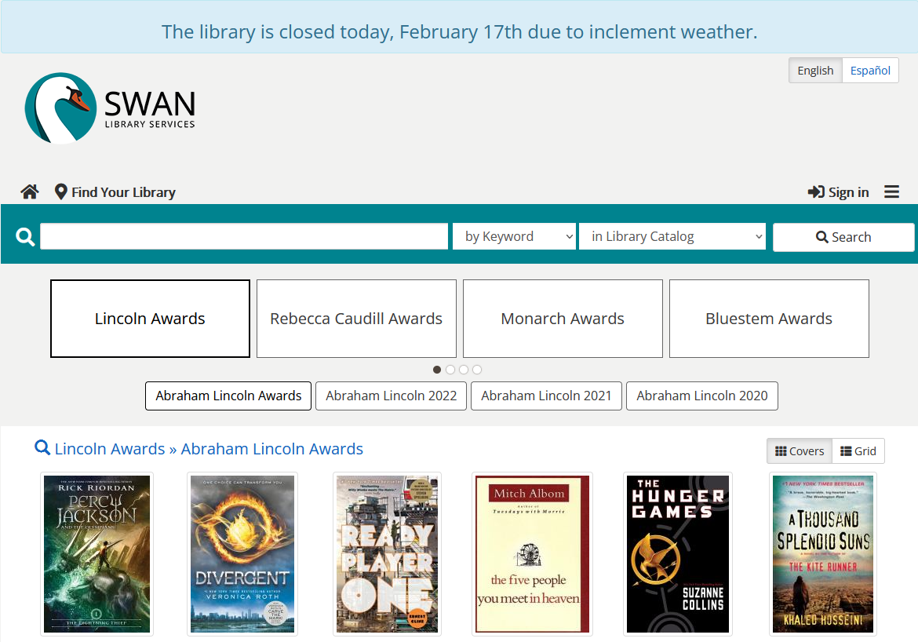
Communicating Closures to Patrons

Slide 8
Additional Pseudo Libraries
Agency Code | Route To | Description
DGS_L | DGS | Downers Grove Public Library Locker
GED_D | GED | Glen Ellyn Public Library Drive-up Window
GVD_D | GVD | Geneva Public Library Drive-up Window
INS_D | INS | Indian Prairie Public Library District Drive-up Window
LGS_D | LGS | La Grange Public Library Drive_up Window
MTS_L | MTS | Matteson Area Public Library Locker
NRS_L | NRS | North Riverside Public Library Locker
OPS_LI | OPS | Oak Park Public Library Main Branch Indoor Locker
OPS_LO | OPS | Oak Park Public Library Main Branch Outdoor Locker
SCD_D | SCD | St. Charles Public Library District Drive-up Window
SFS_LC | SFS | Stickney-Forest View Public Library Central Stickney Locker
SFS_LO | SFS | Stickney-Forest View Public Library District Locker
VPD_L | VPD | Villa Park Public Library Locker
Welcome our latest locker and drive-up libraries!
La Grange Drive-Up
Matteson Area Lockers
Stickney Forest-View Lockers
Notes:
Dawne

Slide 9
Teacher Cards & Loan Policies
Teacher Cards
Local public library decision on whether to issues Teacher Cards
Should not be issued without a pre-existing valid public library card record in SWAN
Formal Intergovernmental Agreement may supersede requirement for record in SWAN
System Wide User Profile
Checkout Limit = 200
Hold Limit = 50
Bill Threshold = $10
Expiration Date – August 15 20xx, will be updated annually - card can checkout at any SWAN library
Follows your local circulation rules – you can request a special rule
Notes:
Vickie

Slide 10
Patron Management: NCOA
National Change of Address
Notes:
Dave

Slide 11
NCOA Results
970,826 patron records submitted to UMS
COUNTY added to address
Address fields hidden in WF, visible in BCA:
GPS Latitude
GPS Longitude
Census Tract
Census Block
107,427 (11%) flagged as having moved
12,699 moved out of Illinois
New address written over existing address
Old address moved to note field with “NCOA 2021” message
User Cat 6 enabled and set to NCOA2021
NO status change!
Notes:
Dave

Slide 12
NCOA Recommended Next Steps
Review the documentation & reports: https://support.swanlibraries.net/documentation/66540
Purge records of patrons no longer in your service area
Submit a support ticket:
Bill forgiveness threshold
Criteria for geographic removal
Criteria for Last Activity Date
Update records of patrons still within your service area
Remove user notes associated with NCOA
Update User Category 6 to blank
Manually remove long-inactive patrons
Ensure they do not have outstanding activity
Review patrons that have moved from one SWAN library to yours
Welcome them to the area and invite them to your library!
Notes:
Steven

Slide 13
Patron Moves, By the Maps
Concentration of Patrons Who Have Moved
Notes:
Steven

Slide 14
Patron Moves, By the Maps
Concentration of WHERE patrons have moved since 2018 according to the United States Postal Service National Change of Address (NCOA)
Notes:
Steven

Slide 15
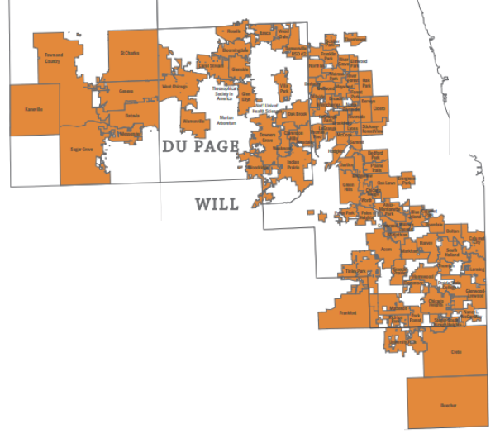
Patron Moves, By the Maps
Overlay of SWAN service area map shows the concentration of patrons moving within our SWAN library boundaries.
Notes:
Steven

Slide 16
Unique Management Services
Notes:
Helen

Slide 17
Unique - Numbers
Client Name (Top 10 ROI) | Cash | Material | Invoice | Asset ROI
Downers Grove Public Library | $1,261.64 | $4,107.15 | $171.40 | 31:1
St. Charles Public Library | $4,541.73 | $7,953.91 | $429.60 | 29:1
Glenside Public Library District | $461.00 | $1,955.00 | $98.45 | 25:1
La Grange Public Library | $5,350.23 | $3,803.94 | $393.80 | 23:1
Indian Prairie Public Library District | $3,761.62 | $3,608.54 | $435.90 | 17:1
Oak Park Public Library | $10,072.94 | $56,029.19 | $4,555.55 | 15:1
Berwyn Public Library | $1,647.60 | $4,134.15 | $429.60 | 13:1
Tinley Park Public Library | $3,994.60 | $4,777.44 | $689.15 | 13:1
South Holland Public Library | $848.05 | $3,229.75 | $340.10 | 12:1
Westmont Public Library | $2,123.03 | $4,434.06 | $537.00 | 12:1
Worth Public Library District | $263.95 | $734.90 | $80.55 | 12:1
Client Name (Bottom 10 ROI) | Cash | Material | Invoice | Asset ROI
Calumet City Public Library | $1,405.70 | $3,095.29 | $1,020.30 | 4:1
Chicago Ridge Public Library | $906.30 | $2,211.78 | $733.90 | 4:1
Green Hills Public Library District | $3,986.30 | $3,528.24 | $1,852.65 | 4:1
Melrose Park Public Library | $777.07 | $1,626.58 | $581.75 | 4:1
Steger-South Chicago Heights Library District | $1,044.77 | $1,178.56 | $563.85 | 4:1
West Chicago Public Library District | $2,256.03 | $1,603.98 | $966.60 | 4:1
Chicago Heights Free Public Library | $553.20 | $1,172.99 | $617.55 | 3:1
Hodgkins Public Library District | $436.90 | $779.50 | $384.85 | 3:1
Justice Public Library | $432.93 | $917.98 | $456.45 | 3:1
Lyons Public Library | $618.60 | $566.00 | $393.80 | 3:1
Markham Public Library | $415.90 | $1,013.00 | $447.50 | 3:1
Placement fee increasing from $8.95 to $9.85 effective April 1st
Most libraries assess a $10 Referral Fee
ROI for SWAN libraries range from 3:1 to 31:1
Open a ticket if you would like your Referral Fee modified
Notes:
Helen

Slide 18
Cash and Material Recovery by Library
Cash and Material Recovery by Library
Notes:
Helen

Slide 19
Damaged & Unusable Materials
Detailed instructions and definitions can be found on the support site
Wear should be expected and will naturally result from normal use.
Communicate with counterparts to coordinate processing
Notes:
Helen

Slide 20
Aspen Catalog
Notes:
Tara

Slide 21
Soft Launch is Tuesday March 8th!
Banner on your Enterprise catalog
List copying available in Enterprise to copy lists to Aspen

Slide 22
Additional Key Dates
24 Apr.
Redirect catalog.swanlibraries.net to Aspen
30 Apr.
Enterprise contract ends

Slide 23
Videos & How-Tos for Patrons
https://swanlibraries.net/using-the-new-catalog/

Slide 24
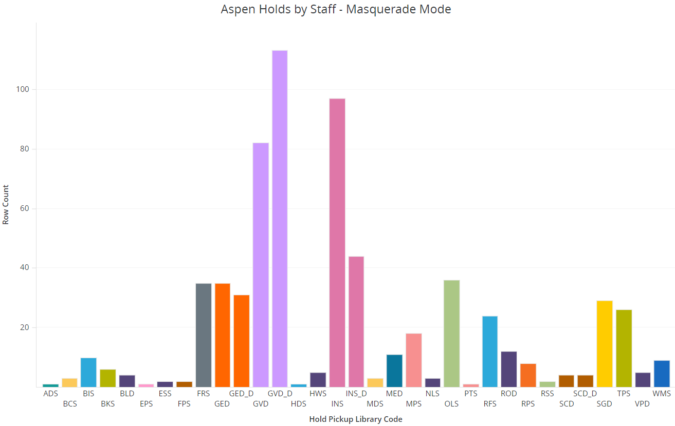
Who’s using masquerade mode?
Data for the month of February 2022

Slide 25
SWAN Quarterly Meeting
Thursday, March 3rd
10:00am – 12:00pm
Budget approval
Live vote during meeting
Aspen Discovery final countdown
Presentation on SWAN pilot with Baker & Taylor rental collection
https://librarylearning.org/event/2022-03-03/swan-quarterly-meeting
Notes:
Aaron

Slide 26
Other Upcoming Meetings
See SWAN’s events on L2
Quarterly – 3/3
Board Meeting – 3/18
Monthly Office Hours
BLUEcloud Staff – 2/23
Circulation/ILL/Outreach - 3/2
Aspen – 3/7
Cataloging – 3/8
Analytics – 3/9
Circulation & Hold Map – 3/16
Aspen (Search Strategies) - 3/21
BLUEcloud Staff – 3/23
Technology Update – 3/24
OCLC Training on L2
WorldShare ILL Borrowing – 2/22
WorldShare ILL Lending – 2/24
Introduction to OCLC Interlibrary Loan – 3/15
User Groups:
E-Resource Advisory – 2/24
Book Club Users – 3/9
Circulation Advisory – 3/16
Trainings
SWAN ILL Bootcamp – 2/24
IPLAR Stats – 2/28
Aspen Admin: Record Grouping – 3/1
SWAN Generic Accounts – 3/3
SWAN Community Forums – 3/17
SWAN ILL Bootcamp – 3/22
Notes:
Steven

Slide 27
Thank you!
Next Fireside Chat: March 29th, 11:00 AM - Noon
Register at GoToWebinar: https://attendee.gotowebinar.com/register/1955742433521239054
Notes:
Steven

