Slide 1
SWAN Technology Update
March 24th, 2022
Notes:
Steven Schlewitt, SWAN IT & Systems Support Manager

Slide 2
Agenda
Housekeeping
Uptime report
Scheduled rebuild & offline
Enterprise OPAC retirement
VPN agreements
IT contractors
Security initiative / risk assessment
How Do We Do That?
Windows 11 rollout
Open Forum

Slide 3
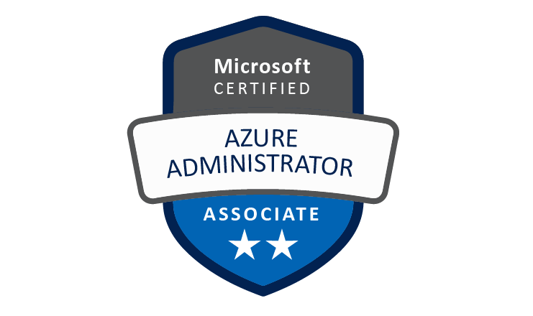
Congratulations, Ian Nosek!
SWAN’s Microsoft Azure
Certified Administrator!

Slide 4
System Uptime Report
September 1st 2021 – March 20th 2022

Slide 5
WorkFlows/Symphony Server Outage Tracking: September 1st through March 20th
Date | Approx Time | Time Elapsed (Min) | System | Planned? | Library Hours? | Reason
10/17/2021 | 20:37 | 10 | Symphony | Yes | No | Planned system patching.
12/30/2021 | 22:34 | 10 | Symphony | Yes | No | Planned system patching.
1/23/2022 | 18:49 | 5 | Symphony | Yes | No | Planned system patching.
3/20/2022 | 19:06 | 20 | Symphony | Yes | No | Planned system patching.

Slide 6
Enterprise Catalog, Aspen Catalog, and Web Services (OPAC Services) Outage Tracking: September 1st through March 20th
Date | Approx Time | Time Elapsed (Min) | System | Planned? | Library Hours? | Reason
10/6/2021 | 2:15 | 45 | Web Services | Yes | No | Web Services 6.2.1 Upgrade
10/17/2021 | 20:37 | 10 | Web Services | Yes | No | Planned system patching.
11/21/2021 | 20:32 | 5 | Aspen Discovery | Yes | No | Planned system patching.
1/15/2022 | 11:05 | 5 | Aspen Discovery | No | Yes | Aspen server slowness relating to CPU spikes. Suspected to be runaway harvest process affecting MySQL.
1/15/2022 | 11:05 | 5 | Aspen Discovery | No | Yes | Aspen server restart following persistent CPU load spikes throughout the morning.
1/23/2022 | 18:38 | 5 | Aspen Discovery | Yes | No | Planned system patching.
2/4/2022 | 2:30 | 5 | Aspen Discovery | No | Yes | Aspen server restart following persistent CPU load spikes throughout the morning.
3/20/2022 | 19:06 | 20 | Web Services | Yes | No | Planned system patching.

Slide 7
Other Notable Outages: September 1st through March 20th
Date | Approx Time | Time Elapsed (Min) | System | Planned? | Library Hours? | Reason
No measurable outages during this period. |  |  |  |  |  | No measurable outages during this period
Notes:
Coming Soon: tracking of BLUEcloud Central. BLUEcloud Analytics

Slide 8
Uptime Tracking
Quarterly Uptime | WorkFlows/Symphony | OPAC Services | Other Services | Combined
Q1 2021 | 100.00% | 100.00% | 98.04% | 98.04%
Q2 2021 | 99.99% | 99.87% | 99.85% | 99.71%
Q3 2021 | 99.81% | 99.99% | 100.00% | 99.81%
Q4 2021 | 99.98% | 99.95% | 100.00% | 99.94%
Q1 2022 | 99.98% | 99.97% | 100.00% | 99.94%

Slide 9
Notable Critical Vulnerabilities Patched
Dec. 2021
Log4Shell (CVE-2021-44228) in December 2021
Zero-day vulnerability in common Java logging framework, Log4j
CVSS severity of 10/10
Jan. 2022
Polkit Privilege Escalation (CVE-2021-4034) in January 2022
Unprivileged users can run commands at a higher level
CVSS severity of 7.8/10

Slide 10
Annual Symphony Database Rebuild
Sunday, APRIL 17th
Sunday, April 17th, 2022 (Easter Sunday)
Downtime of WorkFlows and other services required throughout
Process will begin Saturday night after libraries close
WorkFlows Offline required for open libraries on the 17th
Complete details in the news post
Impacted Services:
Enterprise & Aspen Catalog
*Intermittent* My Account functions (holds, payments, lists, etc)
*Intermittent* Inaccuracies of Item location and availability
Symphony WorkFlows
*Intermittent* External SIP2 & Web Services integrations (including external vendor subscriptions, digital materials access)
Internal SIP2 integrations for library self-checkout, AMH, and PC reservation
WorkFlows - Offline mode must be used for all checkouts
BLUEcloud Applications
BLUEcloud Analytics April 16/17th transactions - harvest will be delayed an extra day
BLUEcloud Mobile, MobileCirc, BLUEcloud Circ and Cataloging will be unavailable
Notes:
Steven

Slide 11
24 Apr.
Redirect catalog.swanlibraries.net to Aspen
30 Apr.
Enterprise contract ends
Aspen
Key Dates

Slide 12
Sunday, APRIL 24th
Catalog.swanlibraries.net addresses will automatically redirect
Example: catalog.swanlibraries.net/dgs redirects to dgs.swanlibraries.net
Ensure you are not using swanlibs.ent.sirsi.net
These addresses are SirsiDynix-owned and will not redirect
Aspen
Enterprise OPAC Retirement

Slide 13
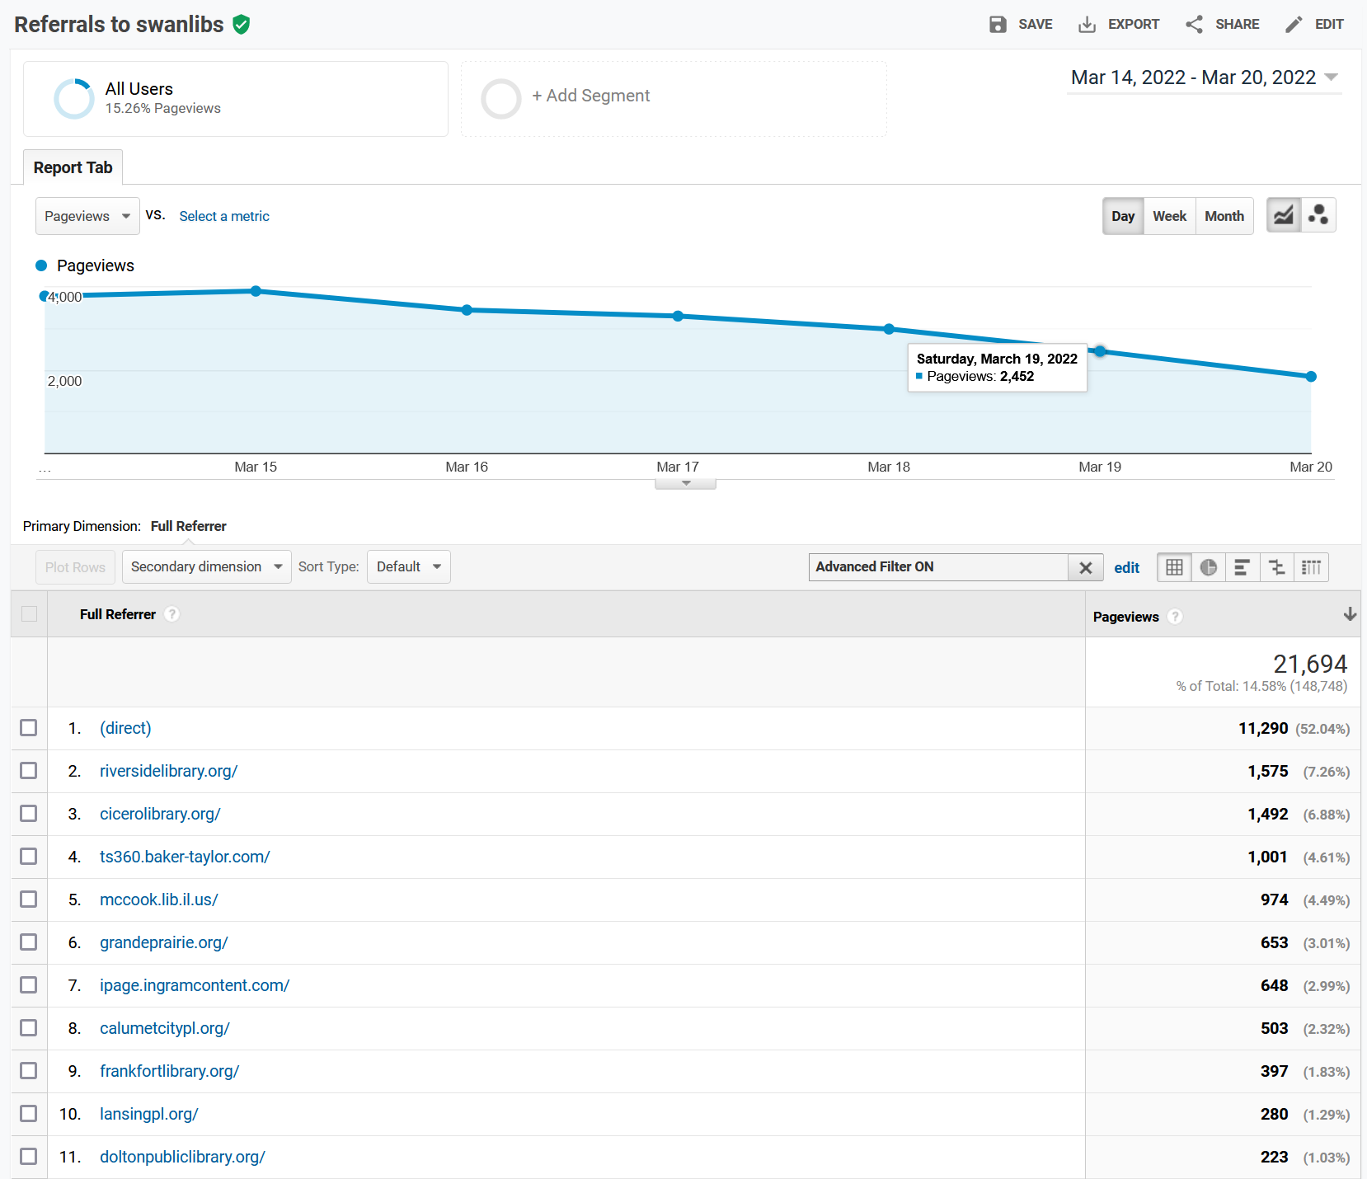
Referrals to swanlibs.ent.sirsi.net
We're seeing these drop which is great! This URL will break, with no redirect, April 30th.

Slide 14
SWAN-Managed VPN Agreements
When making changes to internal/external networking
Changing addressing of wireless network
Changing addressing of staff network
Segmenting networks
Introducing a new staff network
Changing an internet service provider (ISP)
Cancelling an ISP
When changing external-facing hardware
ISP is swapping out the modem
Always contact SWAN at least 48 hours in advance when pursuing an internal or external change
Contact SWAN at least one week in advance if requesting a consultation or site visit
When to contact SWAN

Slide 15
Library Contractors
Contact SWAN via help@swanlibraries.net
ALWAYS CC the library director or associated administrator
Provide at least 48 hours notice prior to significant changes
Coordinate consultations with at least one week notice

Slide 16
Multi-Factor Authentication
DUO MFA now used on all SWAN-managed SonicWall hardware
Implemented Q4 2021

Slide 17
SWAN Security Initiative
Information Security Risk Assessment

Slide 18
OVERVIEW
What is the Sikich Risk Assessment?
Assessment of SWAN’s risk management policies and security practices compared to the NIST SP 800-171 framework
What is NIST SP 800-171 and why should we follow it?
National Institute of Standards and Technology Special Publication 800-171
Industry-established requirements protects “controlled, unclassified information”
Ensures SWAN complies with an industry-recognized set of policies for data handling, system security and configuration
For comparison, SirsiDynix follows NIST SP 800-53, a similar framework
Risk and Authorization Management Program (RAMP) is becoming common practice at state level, emphasizing the necessity of SWAN having a framework like NIST 800-171
Current cost to remediate a breach is typically $150 per record, posing significant financial risk without a guiding framework
SWAN database consists of approximately 1-million patron records
18

Slide 19
CYBERSECURITY Summarized
Identify
Inventory assets, risks and vulnerabilities
Protect
Access control, system hardening, vulnerability remediation, firewalls
Detect
Events, anomalies, security analytics
Respond
Forensics, containment, eradication
Recover
Backups, disaster recovery, restoration

Slide 20
CONCLUSIONS
SWAN Take-Aways
Convert the INFORMAL to FORMAL
Have practices and procedures reviewed by an outside expert
Establish baseline policies
Create formal process documentation to follow consistently
Audit server/network configurations regularly
Leverage system logging, security alerting

Slide 21
Associated Projects
Sikich Risk & Cybersecurity Assessment
Sikich interview and assessment process
NIST SP 800-171 policy, process drafting
Establish Incident Response Team (IRT)
Audit servers/networks against SWAN-NIST policies
Monthly Patron Purges / 2021 NCOA
Regular email phishing training for SWAN staff
SonicWall Firewall Updates
Multi-Factor Authentication for SWAN servers and SonicWalls
SonicWall hardware replacements, 2021
New SonicWall self-maintainer libraries
System Monitoring Tools
Zabbix System Monitoring to replace Cacti
Investigation of Azure/M365 subscription security tools
Investigation of Managed Detection and Response (MDR) security alerting services
R&D of membership-wide directory services and single sign-on (SSO)
SirsiDynix BLUEcloud Pilot
SirsiDynix audit of Symphony policies, roles and permissions
Review SWAN 3rd party vendor integrations
Eliminate unsecured SIP2 integrations
Audit vendor agreements
Education & Partnerships
Outreach to library community partners to brainstorm cybersecurity
Education push to member libraries at SWAN events

Slide 22
How is Your Library Handling Cybersecurity?
Does your library have cybersecurity insurance?
Do you practice phishing campaigns?
Do you utilize any sort of external system monitoring?
Does your library practice principal of least privilege (PoLP)?
Does your library minimize handling of patron data?
How does your library vet 3rd party vendors?
Do you require PINs at self-checkout stations?
Open Discussion

Slide 23
ICYMI
Password Management Best Practices

Slide 24
How Do We Do That?
Windows 11 Migration

Slide 25
Initial Testing and Pilot Phase
Installed Windows 11 as ‘Windows Insider’ in September 2021
Initial compatibility testing with WorkFlows and other critical software
“What to expect” presentation at February staff meeting
Pilot group was selected and went live by end of February
Windows 11 “Office Hour” was scheduled for feedback/comments
25

Slide 26
Staff Deployment Phase and Beyond
Staff handled their own upgrade via Windows Update
Upgrade assistance was offered to staff; most did not require assistance
All staff was live on Windows 11 by March 18
Another Windows 11 “Office Hour” was scheduled for following week
Using Windows 11 Teams Channel to keep staff updated on patches
26

Slide 27
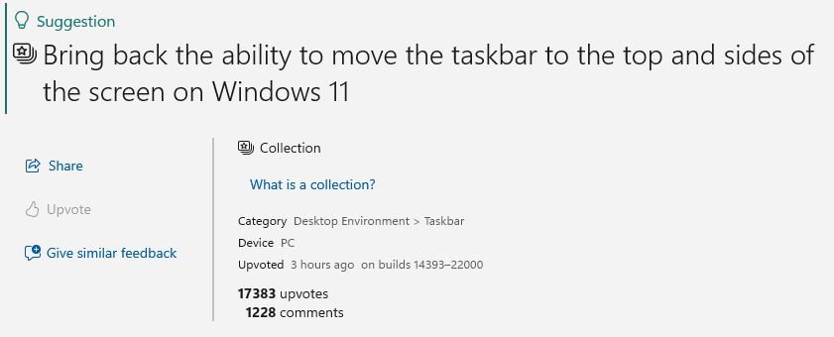
Observations and Staff Experience
Windows 11 is largely compatible with all applications
Improved synchronization with OneDrive and SharePoint
Contextual menu and Taskbar streamlined
Most of the bugs encountered were due to unapplied patches
Using Microsoft’s Feedback Hub to search and upvote enhancement requests
27

Slide 28
Windows 11
How many of you have deployed Windows 11?
What has been your experience rolling it out to staff, to patrons?
What incompatibilities and frustrations have you encountered?
Open Discussion

Slide 29
Windows Version Support
Microsoft EOS for Windows 7 – January 2020
This includes your self-checkout and PC reservation workstations!
SWAN supports the following operating systems:
Windows 8
Windows 10
Windows 11
MacOS (latest)
Notes:
Microsoft ended support for Windows 7 in January of 2020. https://www.microsoft.com/en-us/microsoft-365/windows/end-of-windows-7-support The OS no longer receives essential vulnerability patches to ensure the security of your library and SWAN. For that reason, and because of the recent rash of ransomware outbreaks, we have discontinued support for Windows 7 in the latest WorkFlows installer. I would urge you to migrate affected PCs to Windows 10 as soon as possible to mitigate the risks to the library. Looking over a few articles (https://www.tomshardware.com/reviews/get-windows-10-free-or-cheap,5717.html), it looks like you might still be able to upgrade for free if you’re not already receiving licensing from a volume reseller.

Slide 30
Open Forum Discussion
Future RFID implementations?
New installations of Self-Checkout or AMH?
System upgrades?

Slide 31
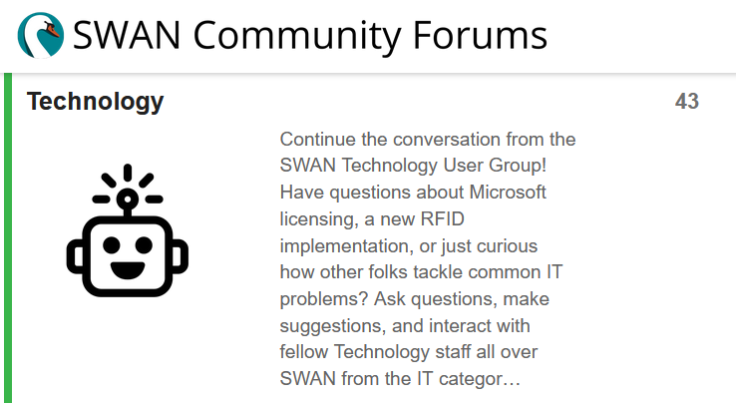
Continue the Discussion
SWAN Community Forums / Technology
Need help getting started?
How to improve your SWAN Community Forums Experience

Slide 32
Upcoming Meetings
SWAN Fireside Chat
Tuesday, March 29th, 11am
SWAN RFID Users Group
Thursday, April 28th, 10am
SWAN Technology Update
Thursday, September 22nd, 10am

Slide 33
Questions & Follow-Up
Send questions to our online ticketing system at help@swanlibraries.net
Visit the SWAN Support Site for access to recorded sessions. https://support.swanlibraries.net
Submit a request for additional training topics. Help > Request Forms > Request Training or Consultation

