Slide 1
SWAN Fireside Chat
June 28, 2022
Notes:
Steven

Slide 2
Agenda
SWAN Expo 2022 – August 19th
Vendor Integrations
Baker & Taylor EDI issue recap
Non-resident users under 18
SMS Text Report by Library
Monthly patron review – 9 years inactive
Recruiting Activity
New WorldCat – August
EBSCO database subscription update
Aspen Tip of the Month Masquerade Mode
Member Engagement
SWAN Passport Idea
User Group Recap
Online Learning Update
L2 Employee Verification
Moving to Zoom
Upcoming Meetings & Training

Slide 3
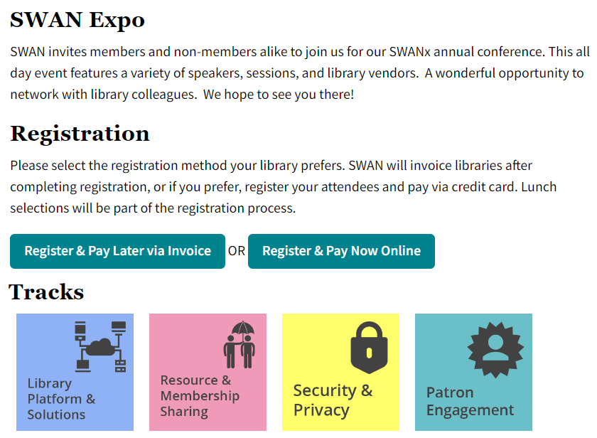
SWAN Expo 2022 – August 19, 2022
Update on member user groups
Highlighting use of the SWAN library services platform
Network with colleagues
Cost: $30, includes lunch
Space limited to 300
Raffle
No vendor tables

Slide 4
Update on registration
108 registered attendees
24 libraries
Approximately 20 staff members from SWAN libraries participating in sessions
Lunch options:
Turkey breast and swiss cheese wrap
Grilled veggie wrap
Santa Fe Salad w/grilled chicken
Greek Salad

Slide 5
3rd Party Vendor Integrations

Slide 6
Work with SWAN – early & often
Contact SWAN as soon as you are considering a 3rd party vendor that requires integration with our ILS
See 3rd Party Vendors & Integrations
RFID solutions must be consortium-aware (involve us early in discussion/evaluation)
New integrations must use secure connections
Vendors must sign Vendor Access Policy before connections are established
Connection methods supported:
SirsiDynix Web Services API
OpenAthens
TLS-SIP2
Fall 2022, we will be working with OverDrive to secure connections via TLS-SIP2

Slide 7
Baker & Taylor EDI Issue Recap
A recap on recent struggles with EDI functionality
Notes:
Vickie

Slide 8
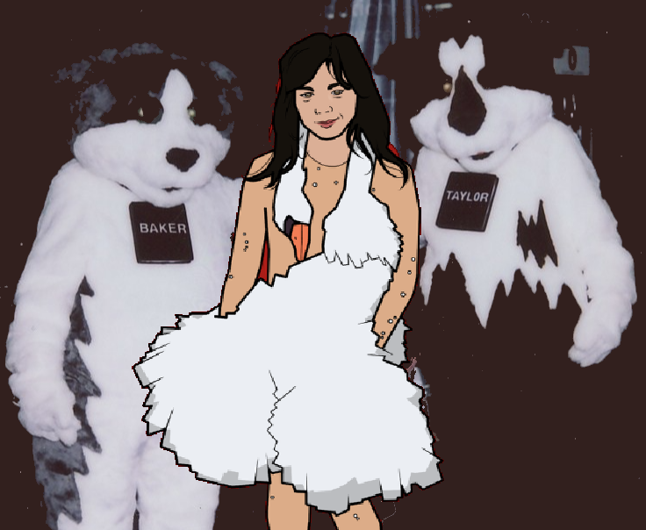
B&T EDI Issues
Thanks Vickie for your work on behalf of SWAN Libraries with Baker & Taylor for the past 2 weeks!
Problem identified on June 15th
Known Issue tracks progress
Will not close known issue until we have caught up with pending EDI transfers
Source of problem: B&T upgraded their ftp server and settings were incompatible with previous configuration
Rudy identified B&T misconfiguration on 6/23 – sent them instructions on how to fix
B&T appears to have made this change afternoon of 6/27
Vickie tested repeatedly with B&T for 2 weeks
Currently scheduling reports to prioritize libraries with FY end June

Slide 9
Non-resident Users Under 18
Public Act 102-0843
Notes:
Crystal

Slide 10
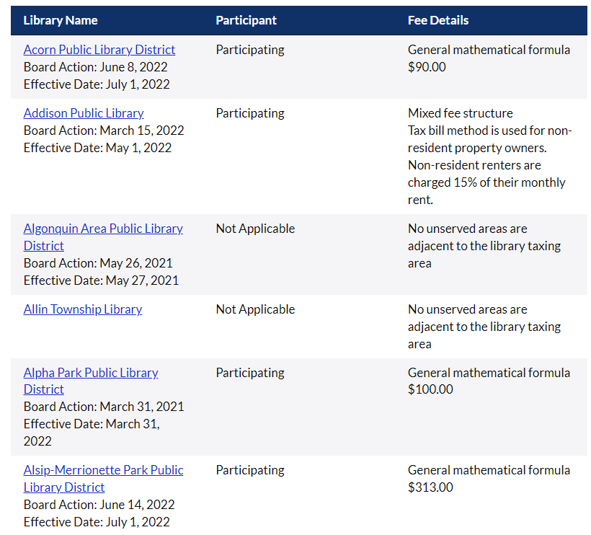
Helpful Resources
RAILS Nonresident Page
Public Library Nonresident Card Participation (List of all libraries and their fee details)
Library Service Areas Map
Notes:
Hello Everyone, this topic came up in a users group meeting recently and so I wanted to provide some resources for everyone.
The Illinois General Assembly recently enacted Public Act 102-0843, which includes a provision authorizing library boards to waive nonresident fees for persons under 18 years old if they choose.
On the RAILS site https://www.railslibraries.info/services/nonresident-services . There are a couple of links on this page you can visit: this first one here shows what libraries charge for their non-resident cards. If you have not updated this in a while, it’s a good time to take a look and see if you need to update anything. https://www.railslibraries.info/services/nonresident-cards
If you would like to look at your area and see if there are unserved areas, you can look up an address to check whether it’s served by a public library
https://idor.maps.arcgis.com/apps/webappviewer/index.html?id=9a731308e2aa4899af4a4eb1e6626db1

Slide 11
SMS Text Report by Library

Slide 12
Processing your SirsiDynix SMS Report
https://support.swanlibraries.net/documentation/91175
Sent daily to library’s aliased xxx@swanlibraries.net email
Review all ERROR details listed in the Detail Report – Errors Only tab to review errors and contact patron
Note the message type (Hold or Overdue or Manual)

Slide 13
Monthly Patron Review – 9-Years Inactive
Notes:
Dave

Slide 14
61 libraries fewer than 100 patrons matching criteria
28 libraries greater than 100 patrons matching criteria
July reports will use 9+ year inactive criteria
Libraries have 6 weeks to review
Total number across SWAN eligible = 11,414

Slide 15
IPLAR Patron Counts
Monthly patron records are removed from the system that have been inactive for 10 years. Starting in August 2022, the period will be 9 years.
Through NCOA and ongoing removal of inactive patron accounts, you may have noticed a reduction in your count of registered patrons from prior years.
IPLAR Note: Files should have been purged within the past three (3) years.
This occurs monthly automatically.
You can note the following as an explanation on your IPLAR form:
We have moved to a monthly removal process for inactive accounts to protect patron privacy. Also, we ran a National Change of Address verification to remove out-of-district patrons in December 2021. These actions have resulted in a reduction in total resident card count.

Slide 16
New WorldCat & WorldShare ILL Stats

Slide 17
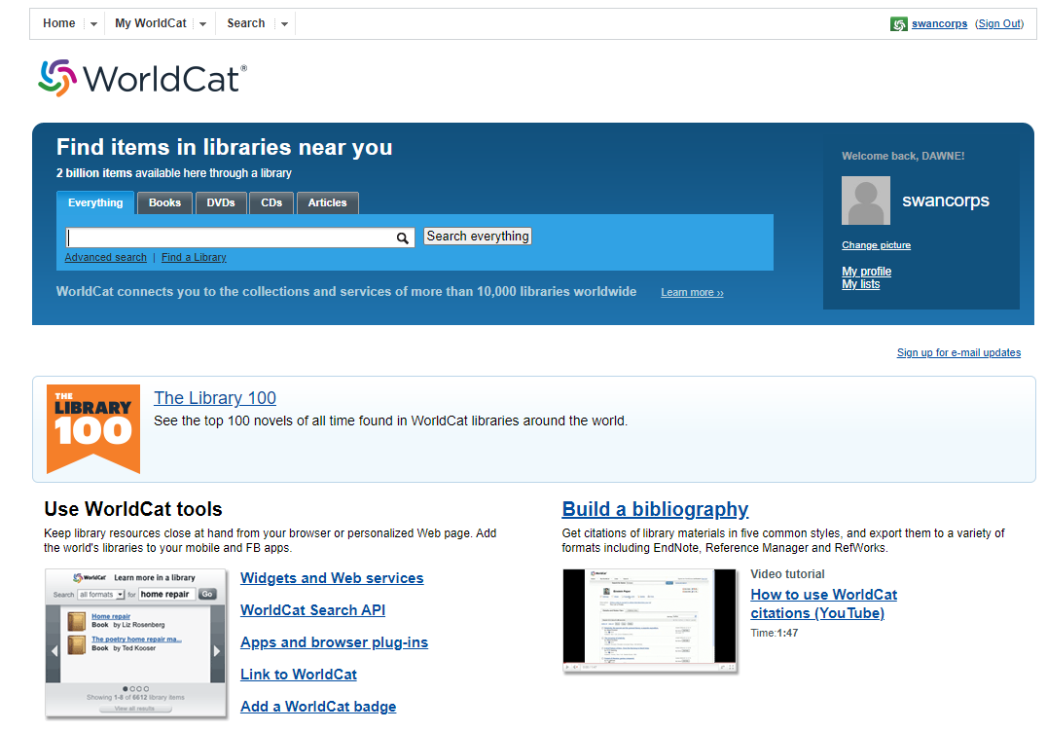
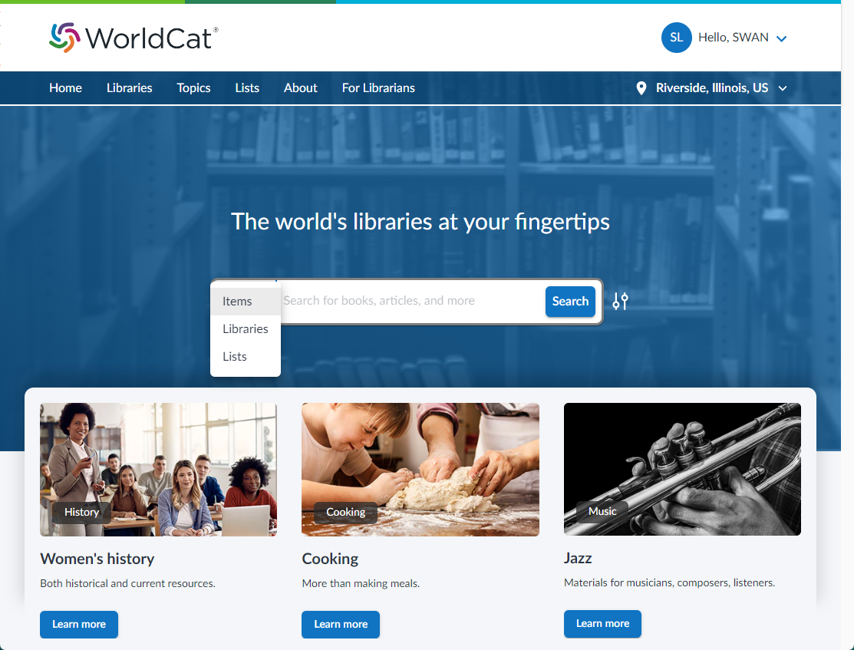
New WorldCat (August 2022)
Look for webinar announcements later this summer. SWAN staff will provide front-line training, support, and config.
Impact on SWAN Libraries
Library card sign-up link
Feature lists and topics of interest
Not a replacement or in competition with Aspen
Links to our Aspen catalog on all holdings
WorldCat Discovery will continue as gateway for ILL requests

Slide 18
WorldShare ILL Activity by State, May 2022
Illinois led the country in both lending and borrowing
Illinois is a net-lender
So far in 2022, Illinois filled most requests within own state (so far 79,420)
OCLC WorldShare ILL is, by far, the most used resource sharing platform in Illinois
Statistics provided by OCLC - See: https://www.oclc.org/community/discussions/interlibrary_loan.topic.html/oclc_ill_activitybystate-LfEe.en.html

Slide 19
Recruiting activity

Slide 20
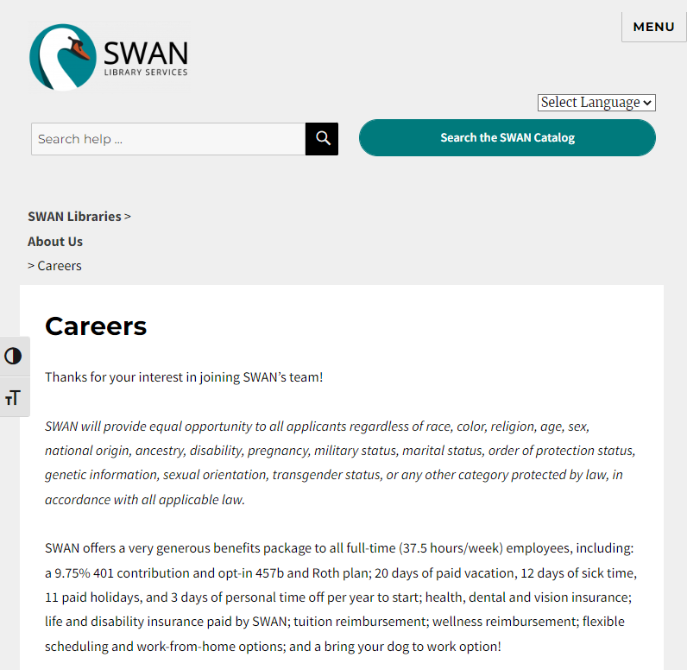
Available Positions at SWAN
Information Technology & Systems Support Manager
E-Resources Consultant
Search is expected to being this week. See SWAN’s Career Page swanlibraries.net/about-us/careers

Slide 21
E-Resources

Slide 22
EBSCO database subscription 2022/2023
New database links are available!
See the patron site or SWAN support site for URLs
Update database links on your websites
If your library didn't change your subscription, you don't need to do anything.

Slide 23
Aspen
Notes:
Tara

Slide 24
Aspen Tip of the Month
If you haven't tried out masquerade mode yet, it is great!
No need to switch between the catalog and WorkFlows
Great for a dual-monitor public service desk
You see what the patron sees – place in queue, frozen holds, ratings, linked accounts, and more
Start exploring masquerade mode!
Notes:
Search results display grouped records, which could have dozens of standard numbers attached. To grab an ISBN, just click into an individual record, and ISBN is at the top of the page.
Tara

Slide 25
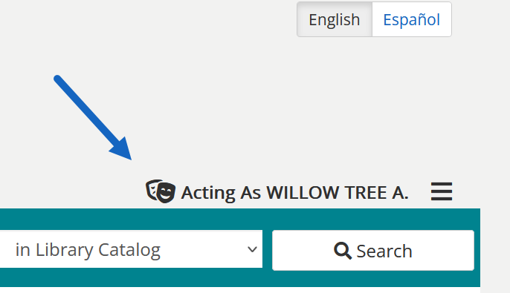
How to use masquerade mode
Get the OPACREF login from your director
Account > Masquerade
Scan the patron barcode

Slide 26
Member Engagement

Slide 27
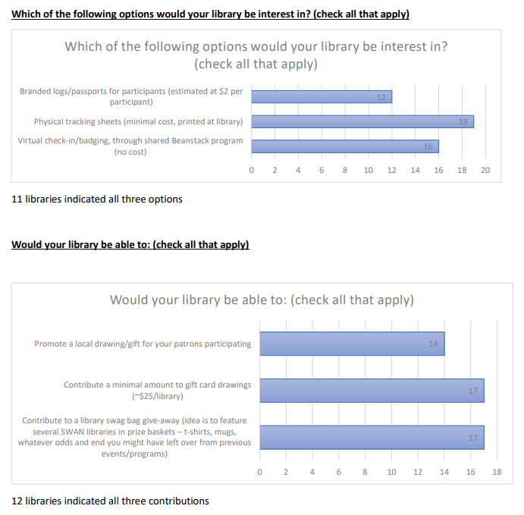
SWAN Passport Idea/Survey
Pgs. 41-44 of June Board Packet
22/26 responding libraries are interested in participating
Need more time to plan
Facilitate discussion with libraries interested
Needs to be member library driven/led
Need 3-4 month lead time for marketing & promotion

Slide 28
User Groups/Meetings: Recap
SWAN Quarterly Meeting 6/2
Board Elections
Performance Metrics
Library Cards for Non-Residents
Passport Idea
SWAN Online Learning Update
Circulation Users 6/15
Update on Daily SMS Report
Non-Resident Cards
Placing Holds in Aspen
ILL Users 6/1
Article Exchange
New WorldCat
OCLC Community Resources
E-Resource Advisory 6/23
Announcement – Thanks and congrats to Robin
RAILS VPAT
Hoopla & OverDrive collections

Slide 29
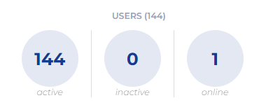
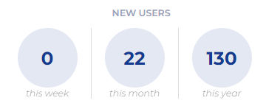
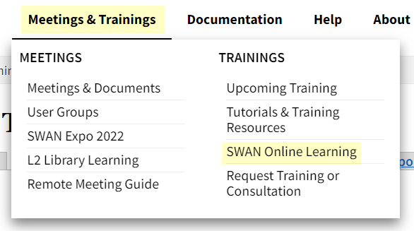
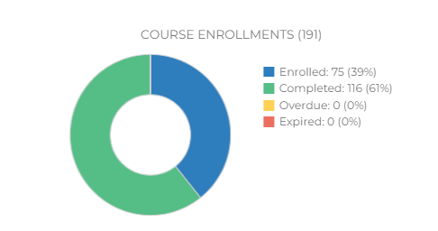
Online Learning Update
https://support.swanlibraries.net/meetings-trainings/swan-online-learning
9 courses in the catalog
Look for new course in July on WorkFlows Searching

Slide 30
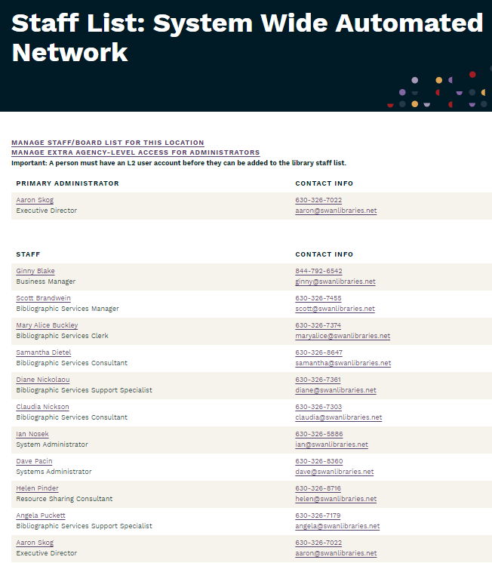
L2 Reminder – Verify Employees
We rely on L2 to verify employees
L2 is required to access:
SWAN Support Site members-only content
Login to OTRS ticketing
SWAN Forums (verify before account invite)
SWAN Online Learning
Creation of BLUEcloud accounts
Don’t forget, a Library Director can designate an L2 delegate to help with managing staff accounts. HR or Department Heads are great backups!

Slide 31
Moving to Zoom – August 2022
Starting August 2022 – all SWAN meetings will transition to Zoom instead of GoToMeeting
Check L2 listings and SWAN support site for updated meeting links
Will have new links in place by mid-June
NOTE: Recorded meetings in Zoom will include participant video displays. This is a change from GoToMeeting which will be announced to members as we move to Zoom recordings.

Slide 32
Other Upcoming Meetings
See SWAN’s events on L2
SWAN Board Meeting – 7/15
Monthly Office Hours
Circ/ILL/Outreach – 7/6
Aspen – 7/11
Cataloging – 7/12
BLUEcloud Analytics – 7/13
Circulation & Hold Map – 7/20
DEI in Metadata – 7/22
User Groups:
Book Club Users – 7/13 – Planned for Geneva Public Library on-site!
Cataloging Advisory – 7/14
Circulation Advisory – 7/20
DUX Advisory – 7/21
Office hours are free-form, without an agenda. Bring your questions, ideas you’d like to share, and request demonstrations of how to perform functions/tasks.
Notes:
Scott

Slide 33
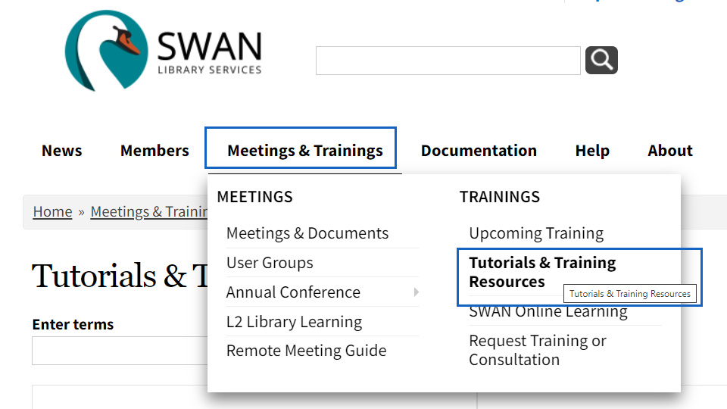
Recent webinar recordings available
Getting Started with Accessibility Testing
EDS New User Interface
Track Reading with Beanstack
New Self-Paced Training: Patron Account Blocks & Notes

Slide 34
Thank you!
Next Fireside Chat: July 26, 11:00 AM - Noon
Register at GoToWebinar:
https://register.gotowebinar.com/register/116435402112460813
Notes:
Scott

