Slide 1
SWAN Fireside Chat
October 25, 2022

Slide 2
Agenda
Staff announcements
MessageBee proposal
Learning management system
Support Site updates
BLUEcloud Circulation
Platform news
BLUEcloud Analytics accounts
SWAN support tips and tricks
Circulation Advisory update
Cataloging groups
Item type consolidation update
Serial data cleanup
Aspen formats
Aspen tip of the month
New webinars posted
User group survey results
Upcoming meetings, training, announcements
Quarterly meeting Dec 1st

Slide 3
SWAN 2022
Executive Director: Aaron Skog
Business Manager:
Ginny Blake
Bibliographic Services Manager: Scott Brandwein
Bibliographic Services Specialist: Angela Puckett
Bibliographic Services Specialist: Diane Nickolaou
Bibliographic Services Clerk (PT) : Mary Alice Buckley
Information Technology & Systems Support Manager: Ian Nosek
Systems Engineer: Rudy Host
Systems Administrator: Dave Pacin
Consultant – Bibliographic Services: Claudia Nickson
User Experience Manager: Tara Wood
Assistant Director: Dawne Tortorella
Finance: Contracted services -Lauterbach
Contracted Support: Outsourced Notice Printing Unique Management
Consultant – Electronic Resources: Olivia Montolin
Bibliographic Services Specialist (PT): Sue Stupar
Consultant:- Bibliographic Services: Samantha Dietel
Systems Administrator: Michael Szarmach
Consultant - ITSS: Vickie Totton
Systems Administrator: Ahren Sievers
HR: Contract services with HR Source
Consultant - UX: Crystal Vela
Consultant – Resource Sharing: Helen Pinder

Slide 4
Welcome Ahren!
Ahren Sievers joined SWAN this month as the IT & System Support System Administrator
Scott Brandwein, Assistant Director
Ian Nosek, IT & System Support Manager
Olivia Montolin, Electronic Resource Consultant
Posting soon for SWAN Bibliographic Services Manager

Slide 5
MessageBee proposal
Presentations to date
Quarterly 9/1
DUX 9/22
Technology Users 9/22
Fireside 9/27
Committee of the Whole (COW) 10/4
Next steps
Quarterly 12/1
Seeking approval for one-time funds & amending the current budget for expenses through June 30, 2023

Slide 6
MessageBee approval process (in progress)
Presentation to Board
SWAN Quarterly Presentation to Membership
Vote at SWAN Quarterly
July, 2022
September 1, 2022
December 1, 2022
COW meeting
October 4, 2022

Slide 7
Training & Support updates
Crystal Vela, UX Consultant
Helen Pinder, Resource Sharing Consultant
Vickie Totton, IT & System Support Consultant

Slide 8
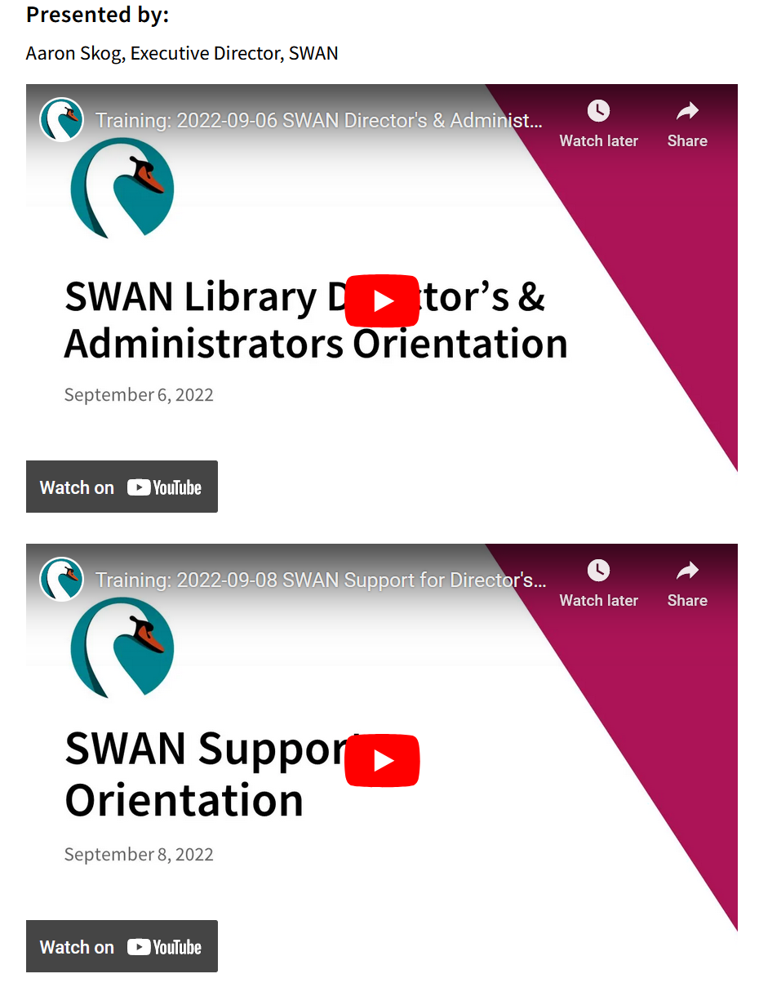
New Webinars Posted
Directors' orientation part 1 & part 2
Non-Resident Card Webinar
Notes:
Crystal Non-Resident Webinar was held on Monday October 17th. If you were unable to make it, you can review the webinar at your convenience.

Slide 9
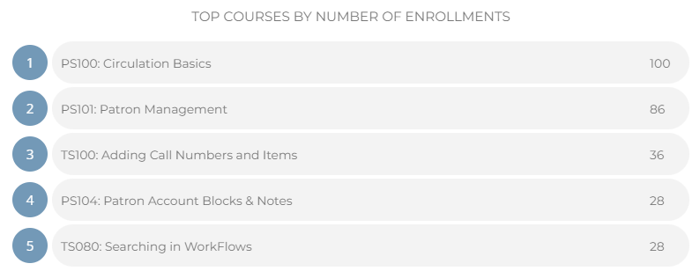
Learning Management System
10 courses in Circulation and Technical Services
210 users
246 courses completed
*Your information needs to be up-to-date in L2 before we approve your account.
Notes:
Crystal

Slide 10
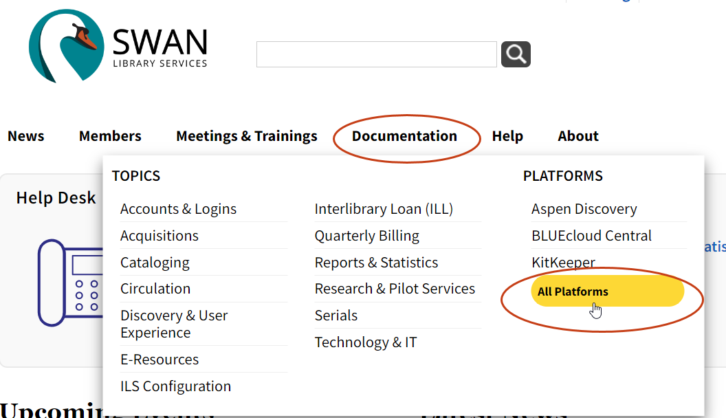
Exciting Platform News
Beanstack
Current and upcoming challenges posted
Beanstack-hosted training & recordings
SWAN's Beanstack available to all readers
KitKeeper
Moved to Supported Platforms
Detailed guidance and standards
Borrow KitKeeper content even without a collection of your own
Notes:
Helen

Slide 11
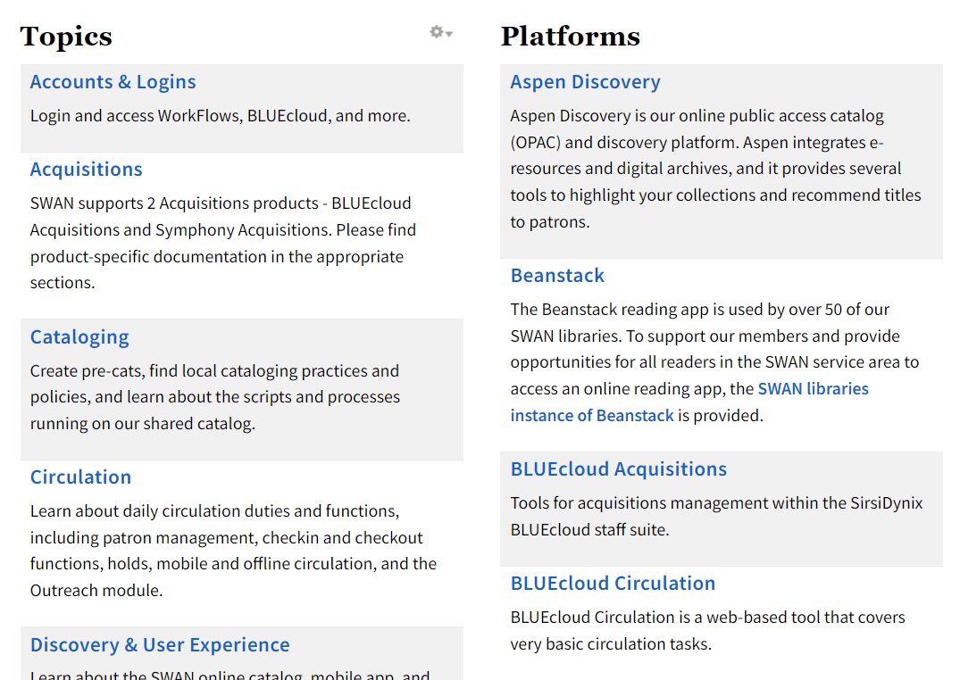
Support Site Documentation Update
You can now browse documentation by topic (e.g., Circulation) or by the platform (e.g., Aspen.
Landing pages for documentation and topics will also link you to trainings and ways to get involved.
Notes:
Crystal

Slide 12
Support Site Documentation Update
New landing pages for platforms and topics show you:
Related training
User groups and forums
Open issues (platforms)
Notes:
Crystal

Slide 13
BLUEcloud Analytics Personal Accounts
BLUEcloud Analytics Accounts are maintained by SirsiDynix - not SWAN
Shared library member accounts allow better communication within the library and troubleshooting with SWAN

Slide 14
Staff Changes Onboarding & Offboarding New Checklists!
Vickie Totton, IT & System Support Consultant

Slide 15
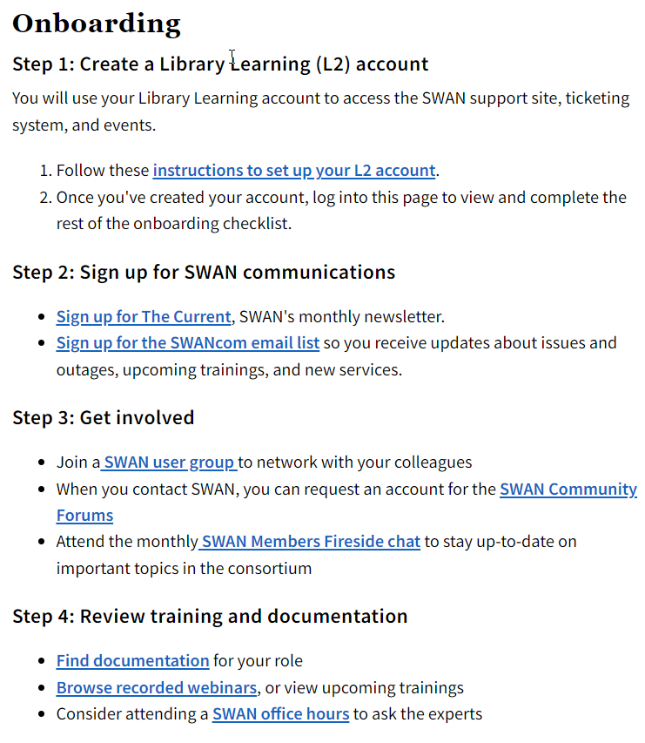
Staff Changes Onboarding & Offboarding
Use the new checklists available on the SWAN Support Site to make sure new staff have access and outgoing staff access is cleared

Slide 16
SWAN Support Tips & Tricks
Using the OTRS Help Desk | SWAN Library Services (swanlibraries.net)
Once you are seeing Company Tickets, you can:
Select tickets currently open, closed, or all (in both states or other states such as merged)
Sort by state (closed, merged, etc.)
Sort by age, which is displayed as days-hours-minutes depending

Slide 17
Library services platform updates
Sam Dietel, Bibliographic Services Consultant
Crystal Vela, UX Consultant
Scott Brandwein, Bibliographic Services Manager
Claudia Nickson, Bibliographic Services Consultant

Slide 18
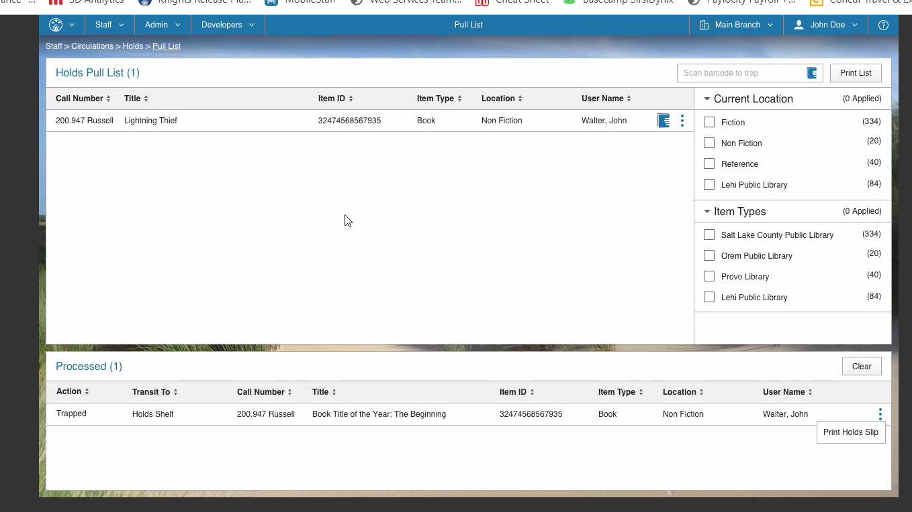
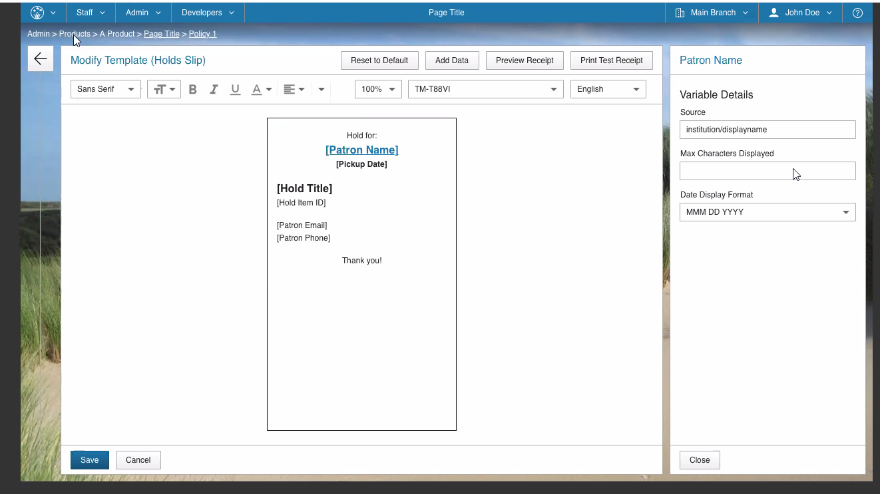
BLUEcloud Circulation - in development
Printing
Silent printing
Printing templates
Easy interface
Multiple printers supported as well as network printers
Holds Pull List actions
Checking out item without checking in behavior

Slide 19
Symphony Item Type Consolidation Update
All SWAN Item Types consolidated into 5 format groups:
Print
Video
Audio
Equipment/Device
Library of Things
Send a ticket to help@swanlibraries.net to request a consultation!

Slide 20
Serials Clean-up Project
Serials prior to 01/01/2020
Retention policy
Check out to DISCARD user
2,989 serials items checked out to DISCARD
10 libraries
MARC holdings and controls were removed
What you can do:
Run or request serials reports of older serials
Revise your retention policy
Delete MARC holdings and controls
Check them out to your DISCARD user

Slide 21
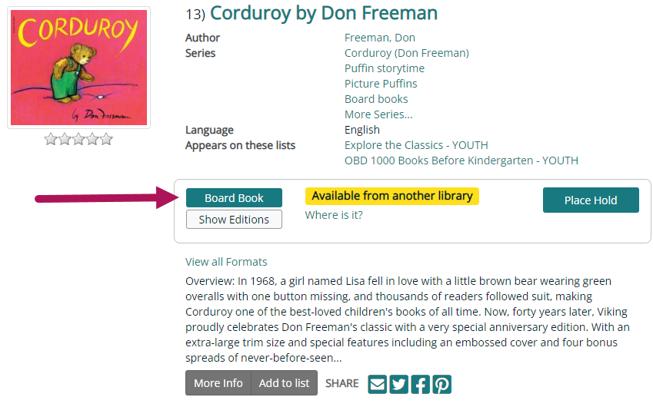
Aspen Formats
The 22.10.00 release added support for the following formats:
Playaway formats
Pop-up books
Board books
4K Blu-ray
Update is a work in progress! Further refinement to come.
https://bywatersolutions.com/news/aspen-discovery-announces-22-10-00-release-notes

Slide 22
Aspen Tip of the Month: Keep up with Aspen releases
Aspen releases go live every month and introduce new features and bug fixes.
We track releases and everything relevant for SWAN libraries in our News section: https://support.swanlibraries.net/news/aspen

Slide 23
User groups & upcoming events
Scott Brandwein, Bibliographic Services Manager
Crystal Vela, UX Consultant
Aaron Skog, Executive Director

Slide 24
Join the Cataloging Think Tank!
Cataloging Advisory
DEI Working Group
Quarterly meetings
Discuss cataloging policy and strategy
Adapt practice to changing discovery layer
Cataloging Library status not required
Bi-monthly (but irregular) meetings
Discuss issues of representation in the SWAN catalog
Update bibliographic description to respectful, modern and accessible terminology
Cataloging knowledge not required
Notes:
Scott

Slide 25
Circulation Advisory Group
Circulation Advisory Group
9-member advisory group
Meet quarterly
Advisory Group members serve two-year terms on a rotating basis.
Members are self-nominated & elected if necessary
New Group Members ​
​
Emily Foster, Itasca​
Latricia Thompson, Downers Grove​
Parish Turner, Bensenville​
Stephanie DeYoung, Batavia

Slide 26
User Group Interest Survey
Results & Recommendations

Slide 27
User Group Interest Survey Results
34 responses from 27 libraries
Nineteen of the 34 respondents (56%) currently participate in SWAN groups

Slide 28
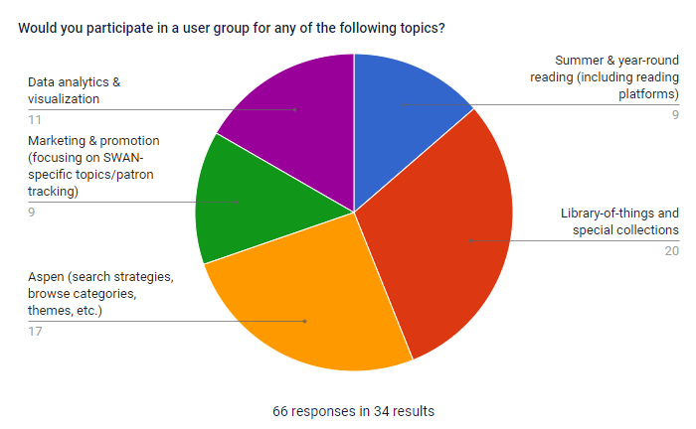
User Group Interest Survey Results
66 from 34 respondents shows some would participate in more than one topic

Slide 29
User Group Interest Survey Results
Only 2 of the identified topics have library volunteering to chair the new user group
Aspen
Library of things

Slide 30
User Group Interest Survey Results
Recommendations for 2023
Focused panel discussion on Library of Things (multiple topics, centered on a day of discussion)
Marketing & promotion – promote RAILS and other library groups addressing the topic; expanded office hours and workshops if SWAN membership approves MessageBee (focused on the tool, rather than the overarching topic)
Data analytics & visualization – workshop offerings
Summer & year-round reading – special online forum discussion, facilitate a “get-together” as requested, no formal users group

Slide 31
Upcoming meetings
See SWAN’s events on L2
Monthly Office Hours
Sunsetting BLUEcloud Analytics personal accounts – 10/28 & 11/2
Cataloging - 11/2
Circulation/ILL/Outreach - 11/2
Aspen – 11/7
BLUEcloud Analytics 11/9
Circulation & Hold map –11/16
BLUEcloud Staff (Acq, Cat, Circ) 11/23
OCLC: WorldShare ILL Borrowing-10/26
RFID Users – 10/27
OCLC: WorldShare Lending – 10/27
E-Resources Advisory – 10/27
Director's Coffee Hour – 10/31
Book Club Users - 11/9
Circulation Advisory – 11/ 16
DUX Advisory –11/17
Office hours are free-form, without an agenda. Bring your questions, ideas you’d like to share, and request demonstrations of how to perform functions/tasks.

Slide 32
SWAN Quarterly Meeting
Thursday, December 1st
10:00 a.m. – 12: 00 p.m.
Oak Brook Public Library
Voting to amend budget
Live-stream, but only in-person attendees can vote (per OMA)

Slide 33
The End
Join us for the next SWAN Membership Fireside on Tuesday, November 29th ^{11:00 a.m. - noon}
^{See L2 for Zoom details}

