Slide 1
SWAN RFID User’s Group
April 27, 2023

Slide 2
Agenda
Welcome and introductions
New Co-Chair
New RFID Implementations / Vendor Updates in SWAN Libraries
COSUGI Update
LGS Survey of Check-Ins in 2022
RFID Support Site Page
Symphony RFID pad support vs. StaffConnect LINK vs. StaffConnect CIRC
Participation in the SWAN Forums
Open Discussion
Next meeting: November 2, 2023

Slide 3
New RFID Implementations/Vendor Updates
Gabe Oppenheim, La Grange Park Public Library District
Christine Karns, Bloomingdale Public Library
Yesennia Ruiz & Jim Berg, Linda Sokol Francis Brookfield Library
Jeannette Hess, Berwyn Public Library

Slide 4
LPPLD and Envisionware
A Match Made in Heaven?

Slide 5
A (very) brief history
RFID has been live since January 2017
Hardware includes 5 pads for staff, 4 self-check kiosks, and security gates
Tagging collection took staff approximately 2 months
Once all staff were trained, the process was relatively simple

Slide 6
Early problems
Staff pads were problematic for the first few years.(Restart RFID service, reinstall drivers/software, etc., call for support, rinse and repeat.)
Most issues resolved with newer versions of software/pad support integrated into WorkFlows, and toroid cores (ferrites) added to both ends of USB cables.

Slide 7
Non-RFID related problems
We've had issues with self-check hardware (printer problems and a failed screen)
Database for people counters built into security gates corrupts itself on a regular basis
User difficulty with non-RFID ILL materials at self-checks is an ongoing struggle

Slide 8
Our friend Envisionware
Envisionware is generally responsive to support requests
Hardware replacements (e.g., new screen) take longer, but. . . SuPpLy ChAiN iSsUeS

Slide 9
New RFID Implementations/Vendor Updates
Gabe Oppenheim, La Grange Park Public Library District
Christine Karns, Bloomingdale Public Library
Yesennia Ruiz & Jim Berg, Linda Sokol Francis Brookfield Library
Jeannette Hess, Berwyn Public Library

Slide 15
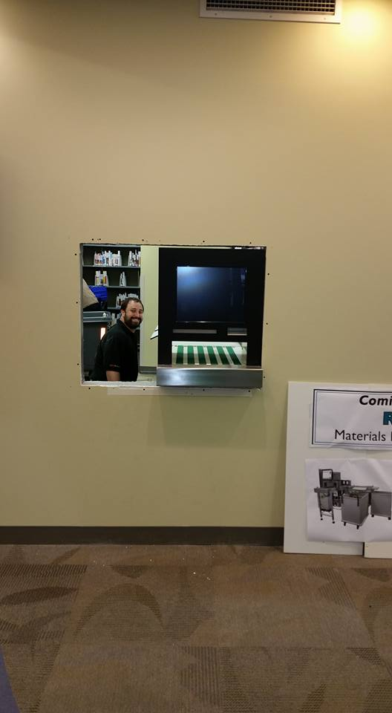

Slide 18
New RFID Implementations/Vendor Updates
Gabe Oppenheim, La Grange Park Public Library District
Christine Karns, Bloomingdale Public Library
Yesennia Ruiz & Jim Berg, Linda Sokol Francis Brookfield Library
Jeannette Hess, Berwyn Public Library

Slide 19
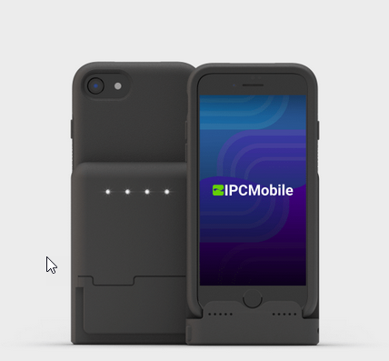
COSUGI Update
BLUECloud Circulation: Full Speed Ahead (Carla Clark)
BLUECloud Circulation is now compatible with FE Technologies and Bibliotheca RFID systems
MobileStaff: Takin’ It To The Stacks
MobileStaff Roadmap:
Working to support QuantumPay Connected
Experimenting with adding support for built-in NFC
Notes:
QuantumPay Connected
The QPC family of devices allows mobile workers to extend the capabilities of their iPhones® and iPads® into a powerful point-of-sale solution. Stable and secure passthrough connectivity via MFI certified Lightning® connector ensures a transaction is never missed. The QPC family of devices offers support for magnetic stripe, EMV contactless card payment technologies with a 2D barcode scanner option.

Slide 20
LGS Survey of Check-Ins in 2022
LGS Check-Ins of items from SWAN RFID Libraries | 143,474 | 78%
LGS Check-Ins of items from SWAN non-RFID Libraries | 21,955 | 12%
Other | 18,996 | 10%
Total | 184,425 | 100%

Slide 21
RFID Support Site
https://support.swanlibraries.net/documentation/88053
Downloadable Spreadsheet with detailed member library information
SWAN Standard – Defined
Generic RFP forthcoming

Slide 22
WorkFlows with 3M/Bibliotheca Libraries
Symphony RFID pad support
vs.
StaffConnect LINK
vs.
StaffConnect CIRC

Slide 23
SWAN Forums
Keep the discussion going: https://forums.swanlibraries.net/
Joining and accessing the forums
Open Discussion

Slide 24
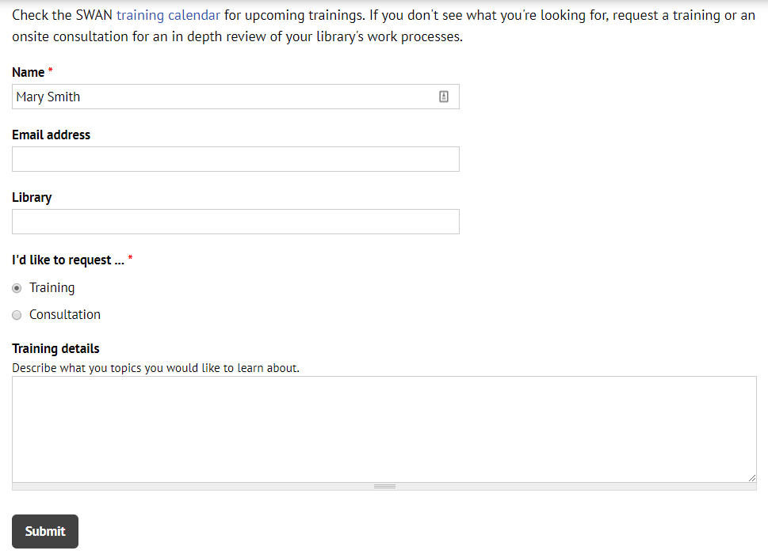
Questions & Follow-up
Send questions to our online ticketing system at help@swanlibraries.net
Visit the SWAN Support Site for access to recorded sessions. https://support.swanlibraries.net
Submit a request for additional training topics. Help > Request Forms > Request Training or Consultation
Notes:
If you have questions, please contact SWAN via our online ticketing system. Also, SWAN training sessions, documentation, and resources are available from the SWAN Support Site.
You can submit a request for additional training through our online form.

