Slide 1
SWAN Library Presentation
Reaching Everyone, Everywhere

Slide 2
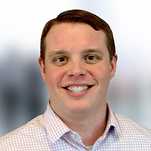
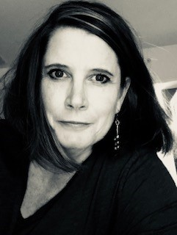
Your Bibliotheca Team
Mason Humphrey
VP of Sales, West
St Paul, MN
Kristi Sampson
Account Executive
Chicago, IL
Matt Bellamy
President of Americas
Minneapolis, MN

Slide 3
we work to make our beliefs reality by​ imagining and creating tools that​ pack a punch for libraries and patrons​

Slide 4
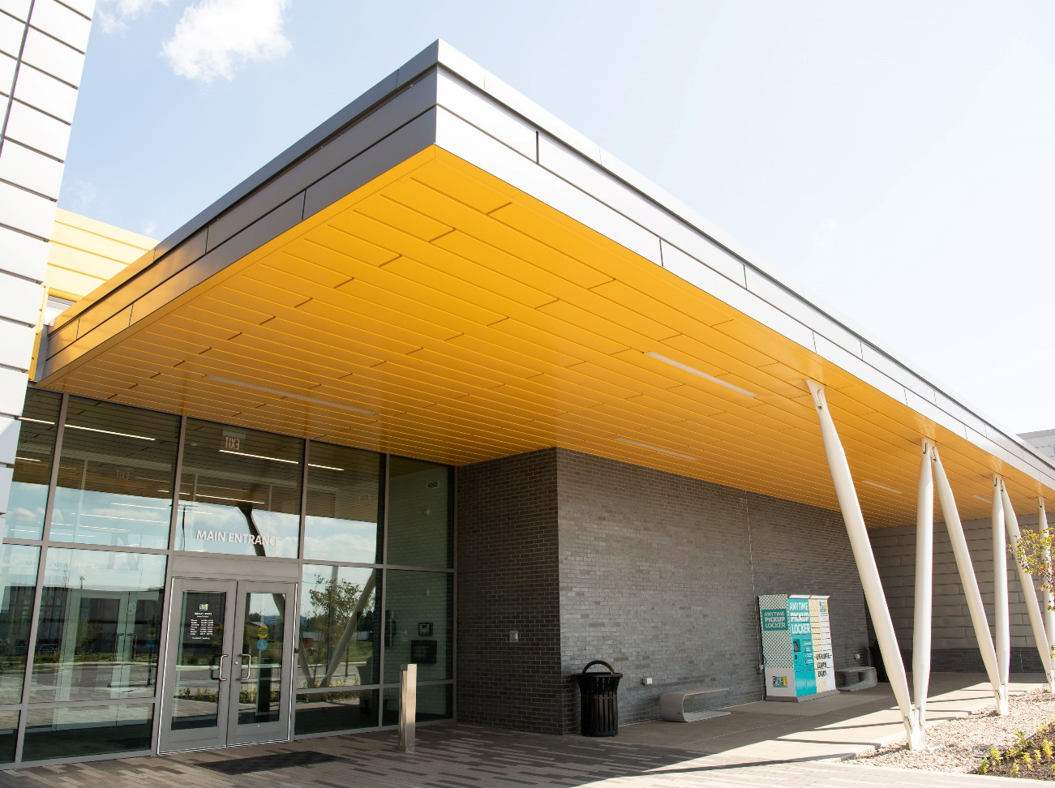
we serve
libraries across the globe,​ from enormous cities to rural outposts​ and everything in-between​

Slide 5
we make
physical and digital library experiences, both in-house and remote,​ intuitive and culturally inclusive​​

Slide 6
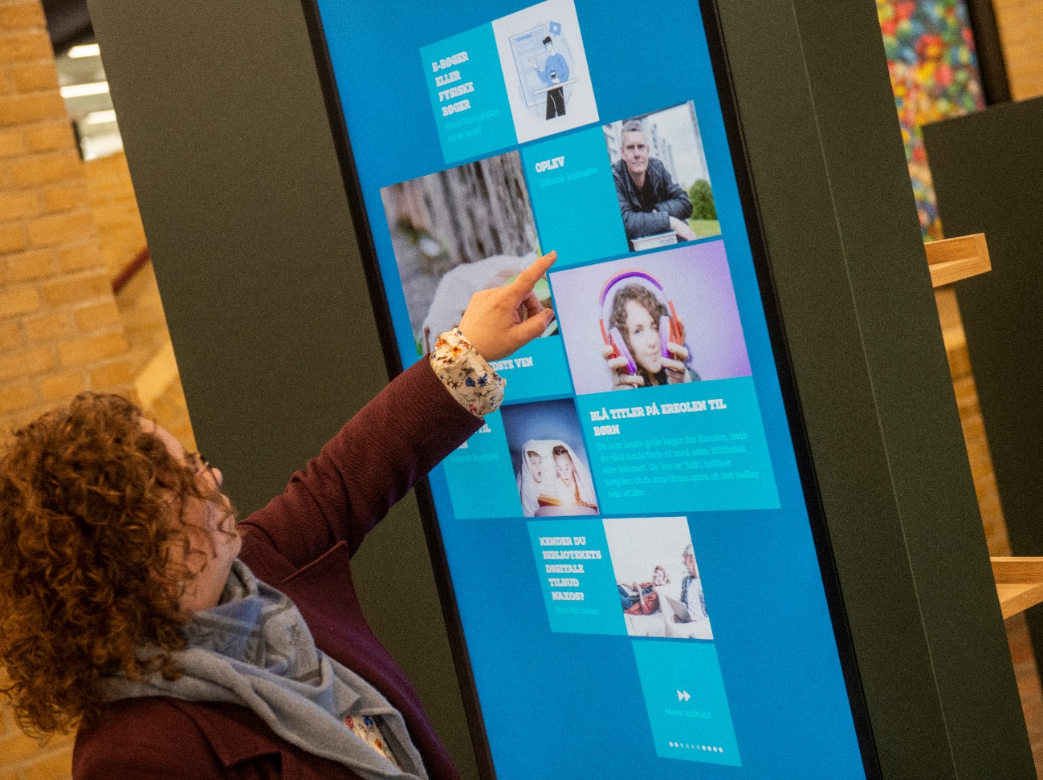
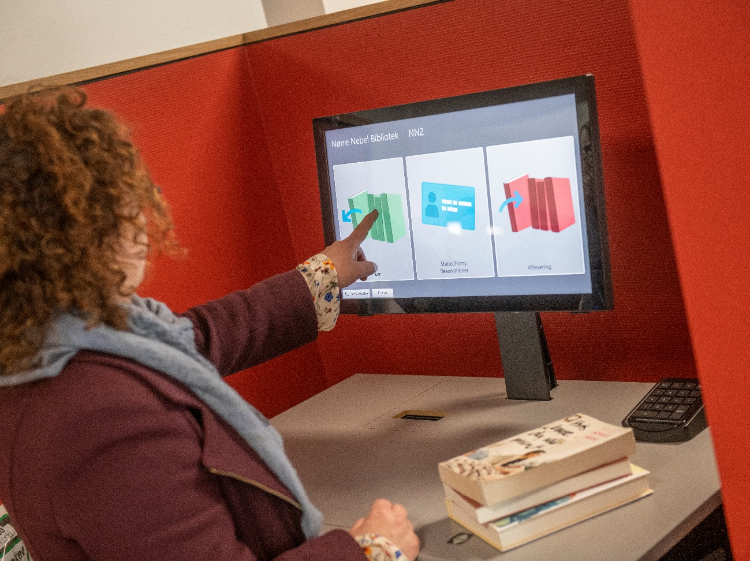
we stand for unparalleled equity,​ easy access for the marginalized,​ privacy and freedom of information​​

Slide 7
we care about reducing energy consumption and accomplishing smaller, faster,​ quieter, greener

Slide 8
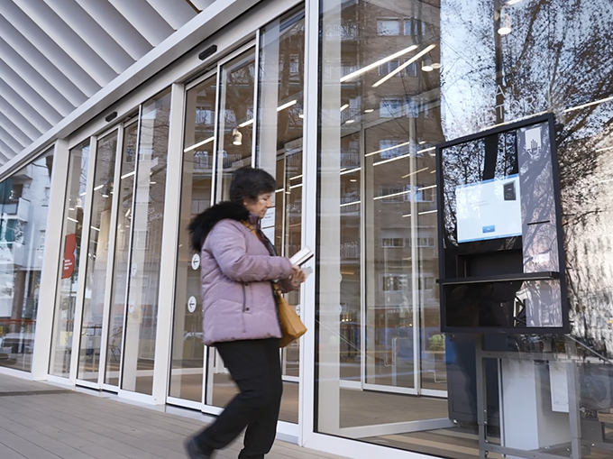
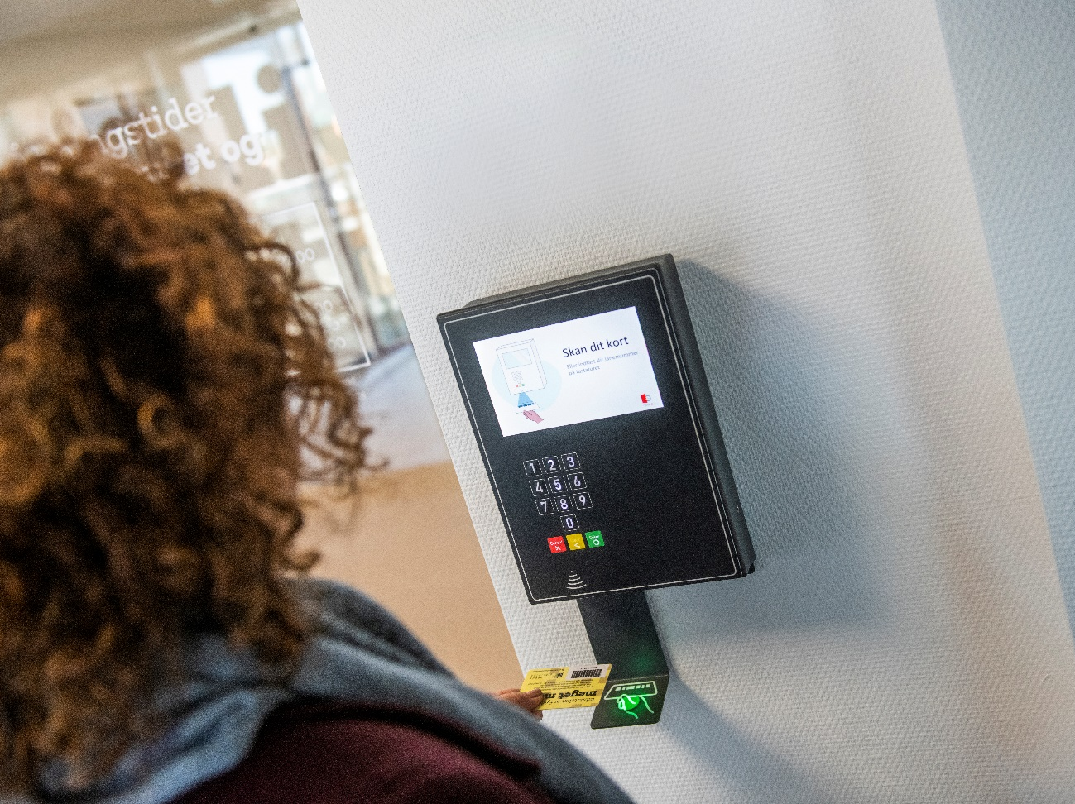
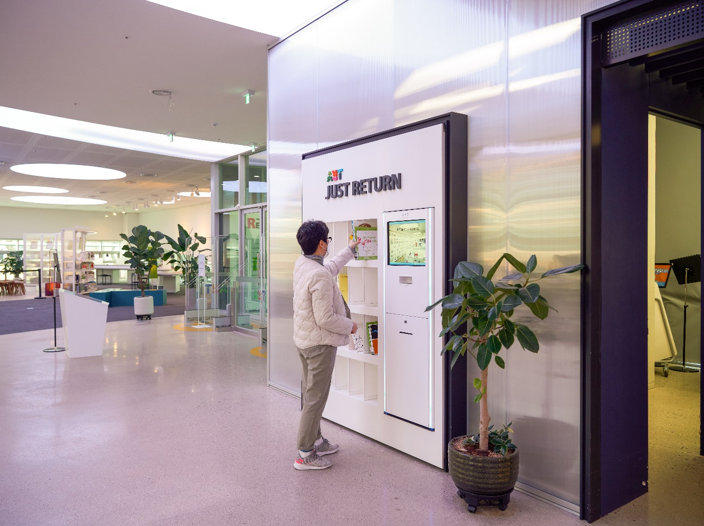
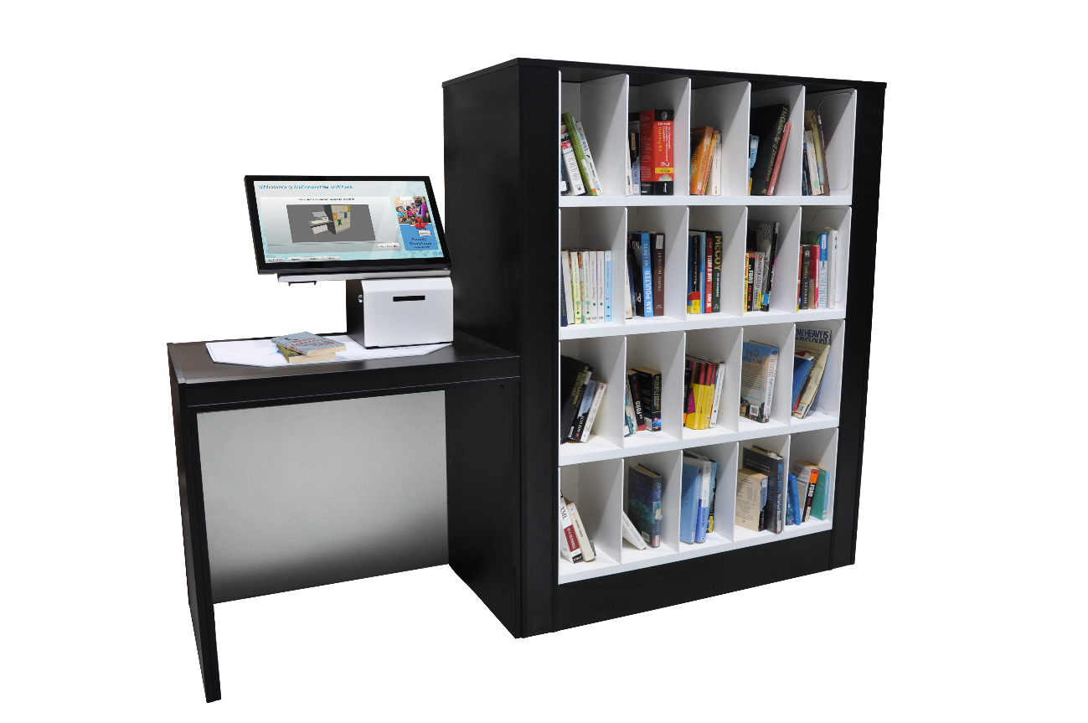
we’re all about radical options to​ ​ increase hours​ increase access​ increase circulation​ increase awareness​

Slide 9
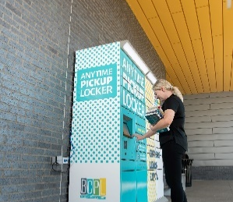
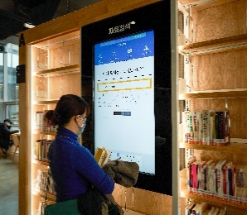
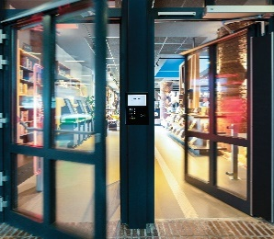
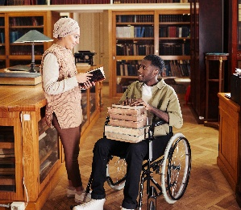
we believe in​
outreach​
sustainability​
diversity​
access​
community​
equity​
literacy​
inclusion​

