Slide 1


Swan RFID Presentation

Slide 2
About EnvisionWare
Founded in 1998 and built on 25 years of dedication to innovation and customer satisfaction
Employees are librarians, former library staff and library-focused people who share a common vision:
To help public libraries deliver better and more efficient public services
Over 12,000 public libraries served
Customer service-focused organization.
Customer satisfaction is our number one goal.
Notes:
EnvisionWare manages one of the most comprehensive service systems in North America. EnvisionWare consultants and field engineers are strategically located around the United States with some service locations housed in leading library systems. In addition to EnvisionWare personnel, a field technician force is at the ready to deliver rapid onsite technical response.

Slide 3
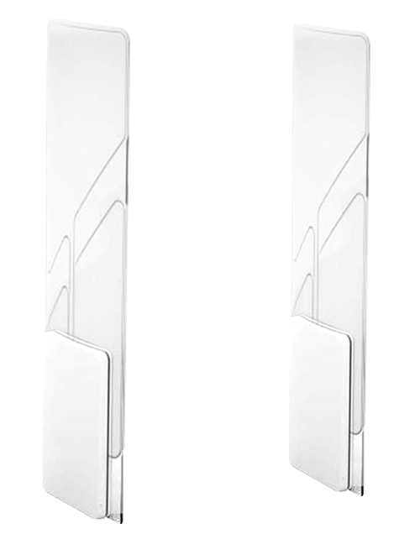
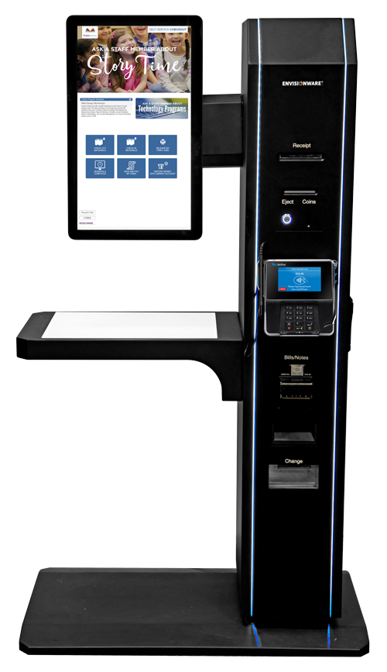
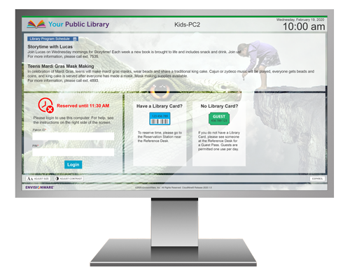
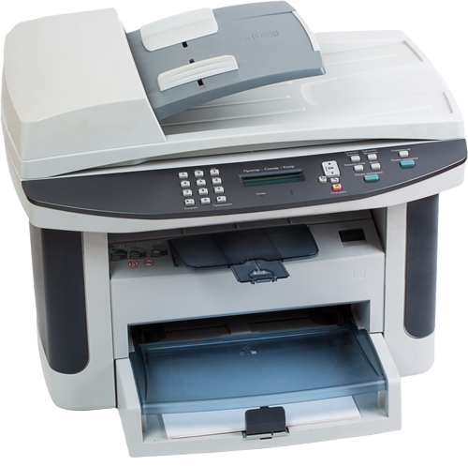
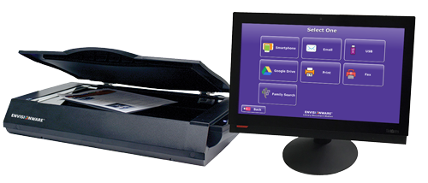
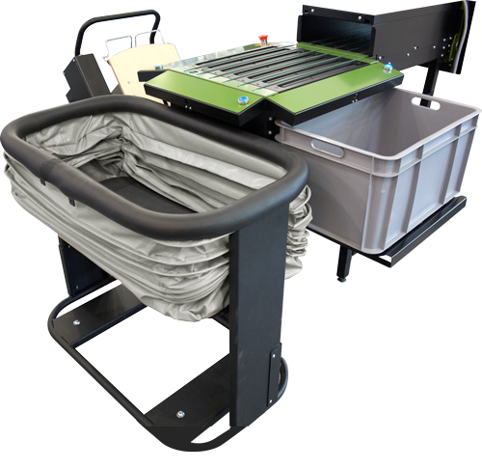
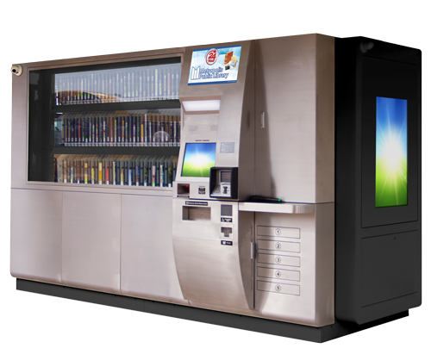
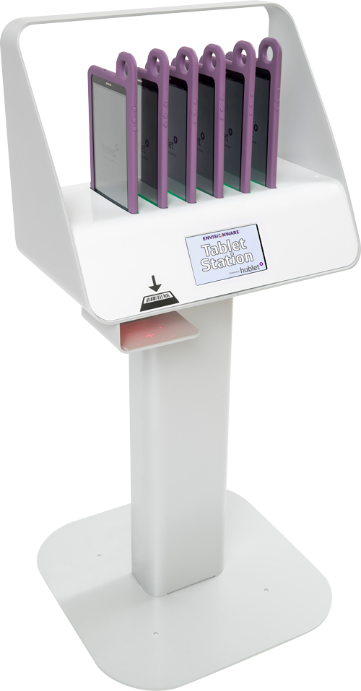
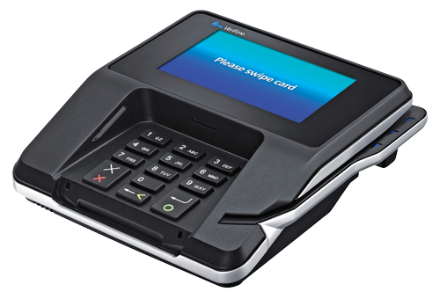


Enriching Public Libraries Inside and Out
Computer Access and Reservation Control
Print
Management
Scanning,
Copying and
Faxing
RFID
Solutions
Self-Service
Checkout
Automated
Materials
Handling
24-Hour
Library
Payment
Solutions
Tablet Station
Analytics
Utility
Applications
Notes:
Service organization built to deliver ongoing support for this full range of solutions
Most comprehensive solutions for public library self-service
Tie seamlessly together
Single vendor
Vendor partnership with ILS partner

Slide 4
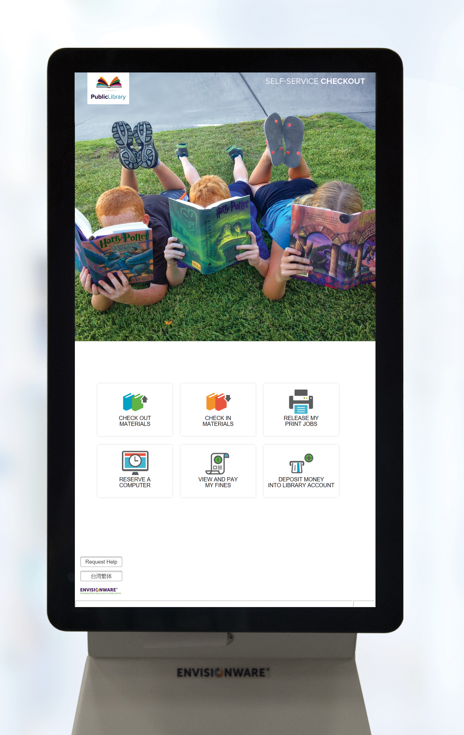
EnvisionWare OneStop™
Customizable and Intuitive
Use with your hardware or ours
Customize your workflow
Dynamic language switching
Cost Effective and Efficient
Integrates with PC Reservation® , Copy Payment Manager, and LPT:One™
Integrates with EnvisionWare®
eCommerce Services™ for fines
Branch Manager™ adds email receipts
and alerts
Use with barcode and/or RFID technology

Slide 5
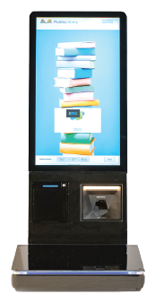
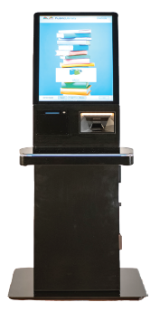
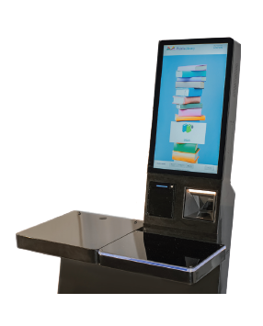
OneStop™ Self-Service Circulation Solutions
X25 Countertops
X25 Kiosk

Slide 6

Plano Public Library
Innovative new Project – Current Customer but new RFP
Replacing all new Sorters
All New Self-checks
Preventative Maintenance Trips for all solutions

Slide 7
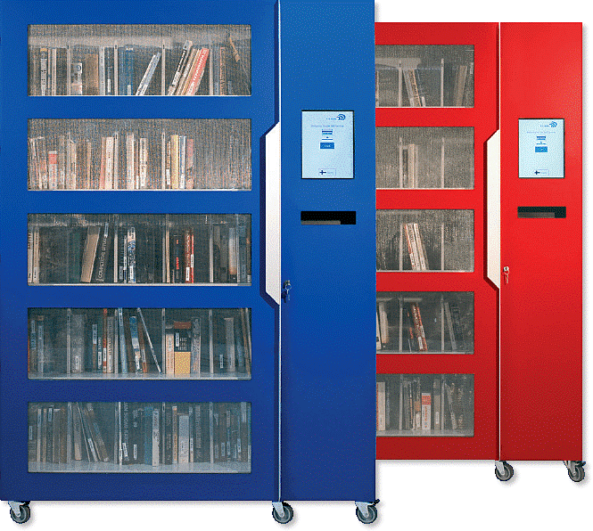
Kent District Library
Innovative RFP, Show us the best of Everything
46 Bin Central Sorter
After site visits went from branch systems to central sorter
Lib-Cabinet

Slide 8
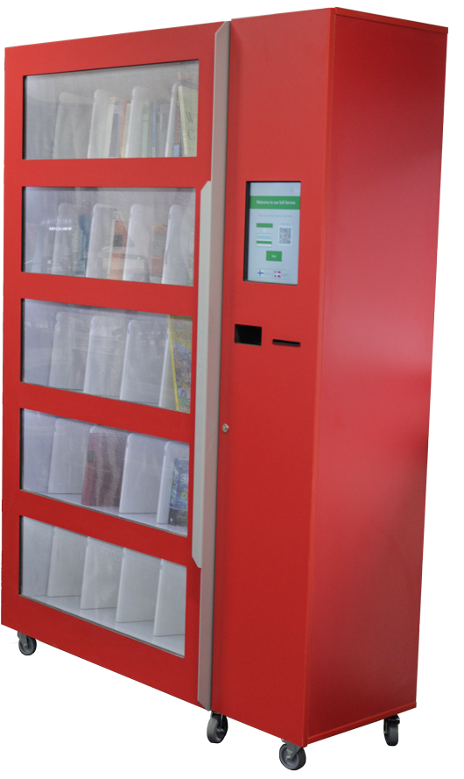
      Libcabinet™
    Operational efficiency, accessibility, inventory management, staffing constraints
  Can be placed in any location – uncomplicated lending and return process – 24/7 access
  Conventional operating hours can sometimes act as barriers – limiting patrons from accessing resources at their convenience
  Real-time inventory, intuitive user experience, cost efficient
  Modern features – smartphone ID
  Very large capacity 200+ items
  Multiple color options and/or custom wraps

Slide 9
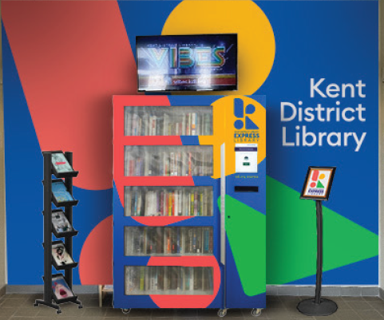
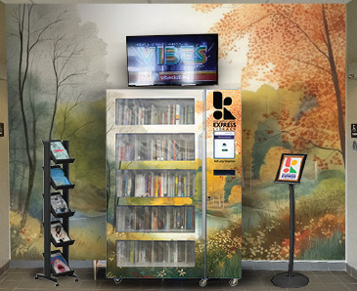
Kent District Library – Make it your own
Innovative RFP, Show us the best of Everything
46 Bin Central Sorter
After site visits went from branch systems to central sorter
Lib-Cabinet

Slide 10
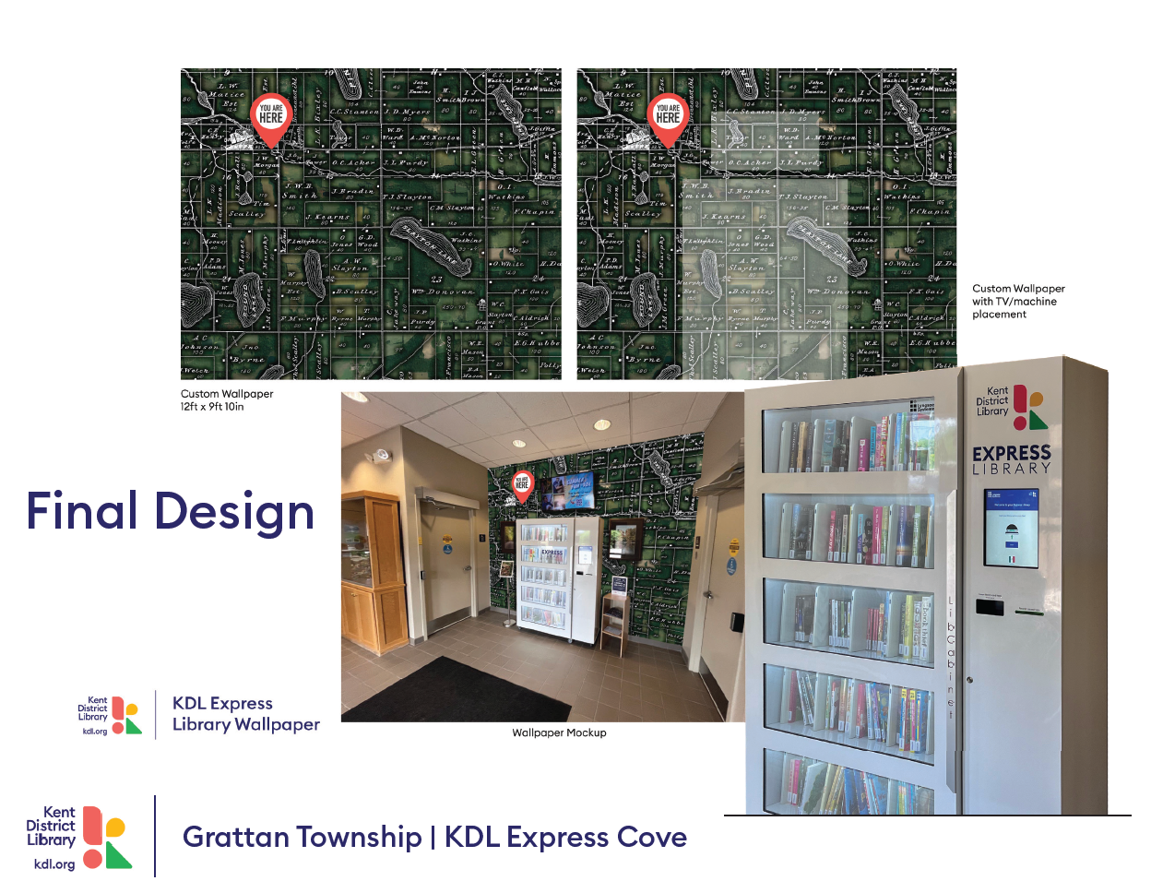
Kent District Library – Make it your own
Innovative RFP, Show us the best of Everything
46 Bin Central Sorter
After site visits went from branch systems to central sorter
Lib-Cabinet

Slide 11
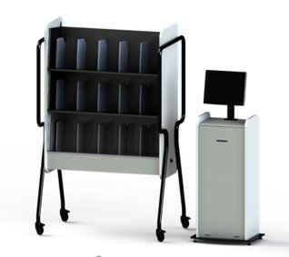
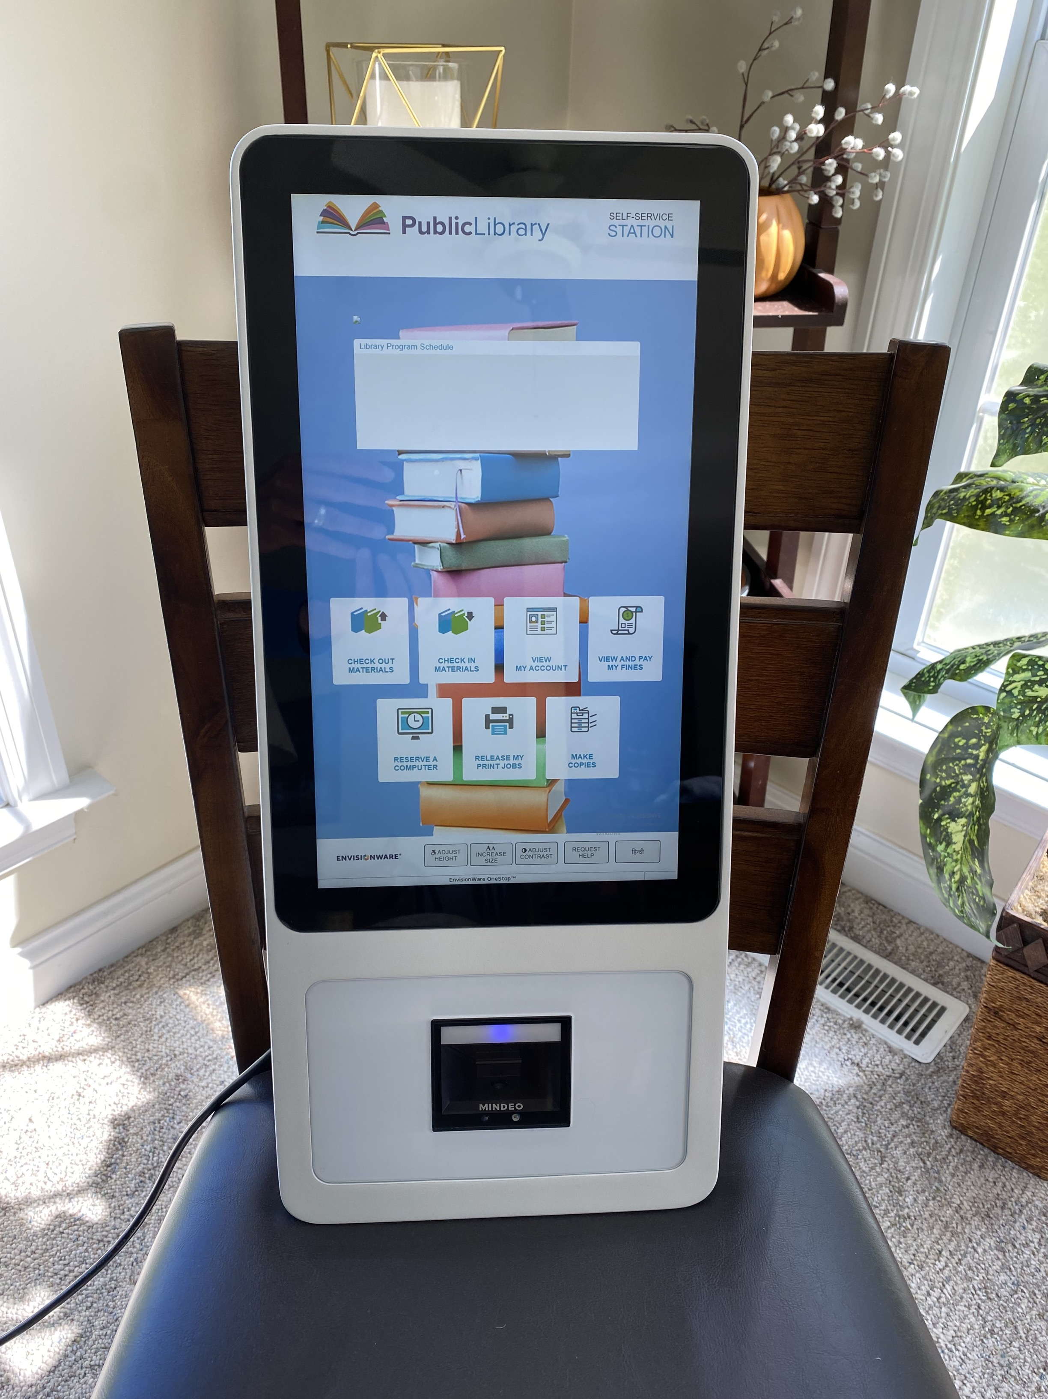
Smart Shelves – Wall Mounted Self-Checks
Innovative RFP, Show us the best of Everything
46 Bin Central Sorter
After site visits went from branch systems to central sorter
Lib-Cabinet

Slide 12
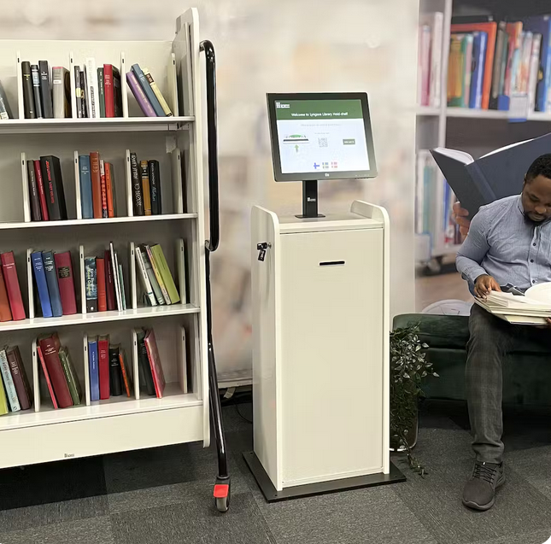
      Intelligent hold shelf™
  Real-time inventory management
  Accessibility and privacy – streamlined process minimizes physical interactions
  Convenient notification system
  Paperless – removes the need for hold slips
  Integrated holds functions transform the lending process
  Real-time inventory – seamless integration with the SIP protocol for updates on every item

Slide 13
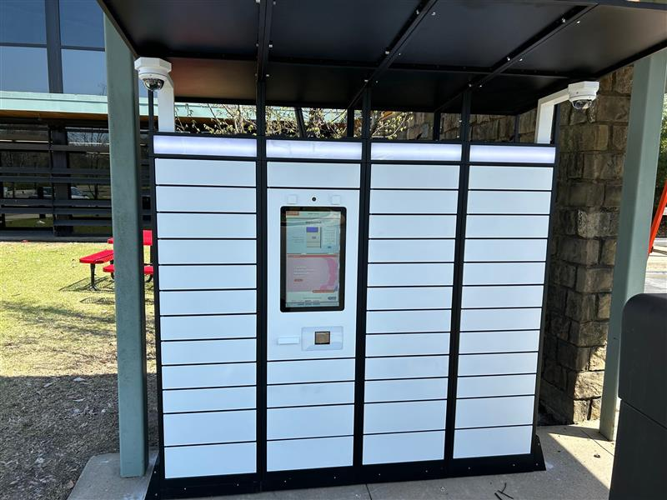
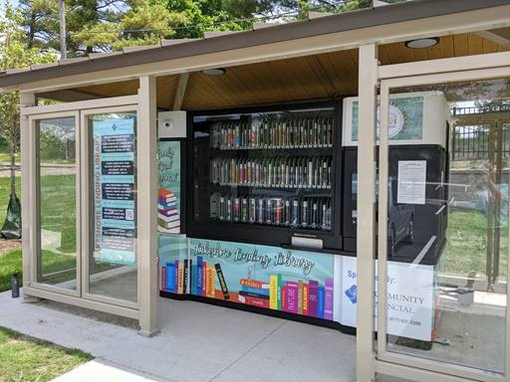
Holds Lockers – 24 Hour Library
Innovative RFP, Show us the best of Everything
46 Bin Central Sorter
After site visits went from branch systems to central sorter
Lib-Cabinet

Slide 14
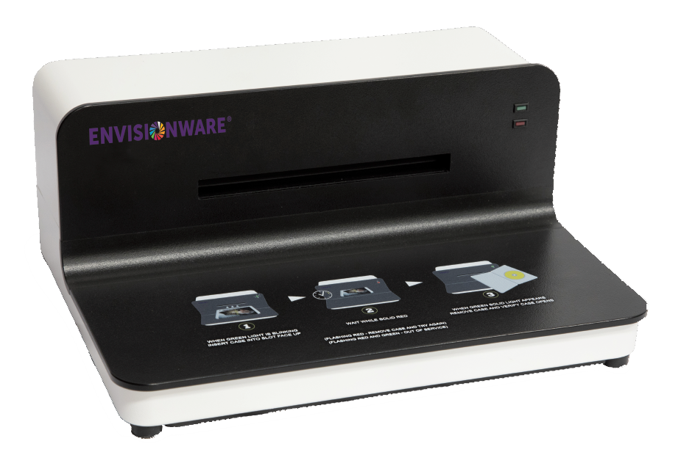
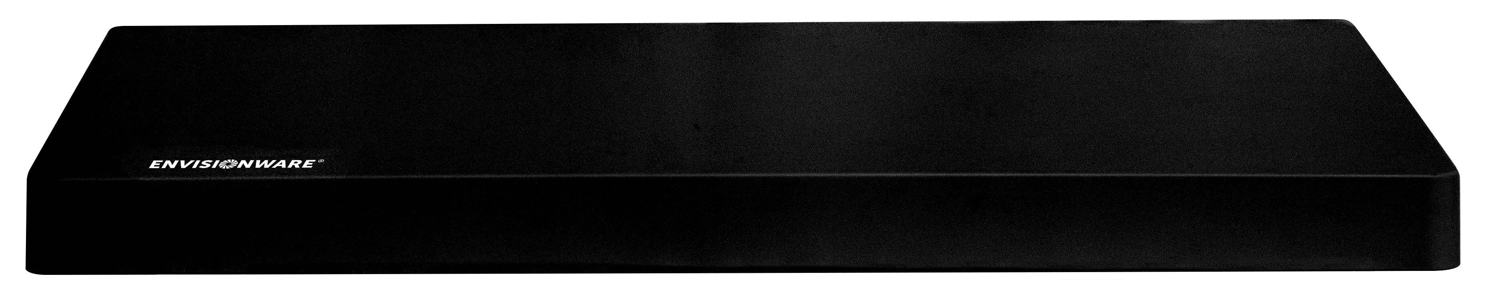
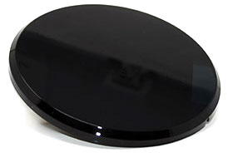
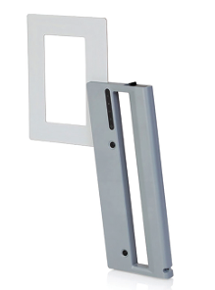
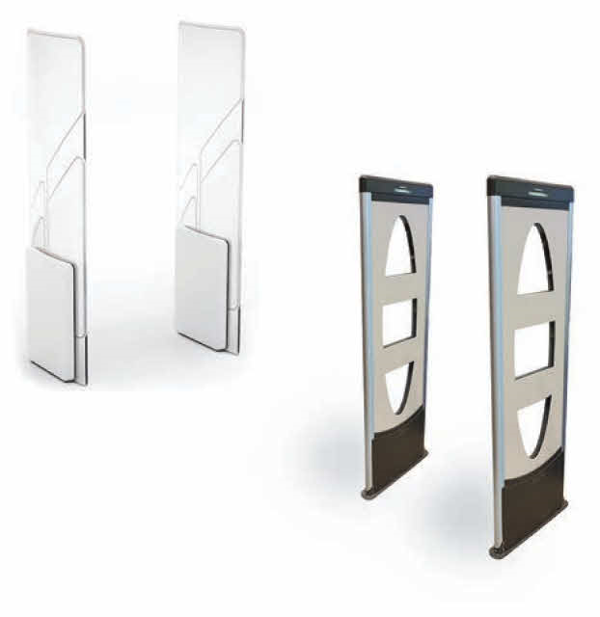
EnvisionWare RFID Solutions
Deskpad Readers
Disc Readers
EnvisionWare® Media Case Controller (EMC2)™
Check out and unlock in 1 step
Unlock Clear-Vu One-Time™ and Playaways®
Inventory Wand
RFID Security

Slide 15

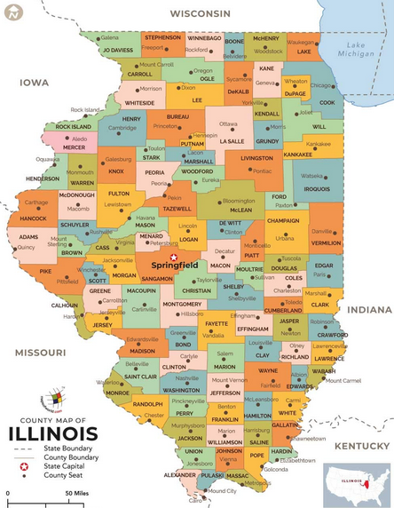














Over 100 Libraries Currently in Illinois are current EnvisionWare customers, Over 250 locations

Slide 16

Why EnvisionWare & Lyngsoe
Company focused on service, Public Libraries
Broad, integrated product line
Close relationships with other vendor partners
Control over development (hardware and software)
Oversee manufacturing of most hardware
Implementation by EnvisionWare staff
Predictable customer experience
Notes:
Predictable: Can’t guarantee the future but maintenance has not been raised on products
*NOTE: Clarify implementation and manufacturing with Lyngsoe

