Slide 1
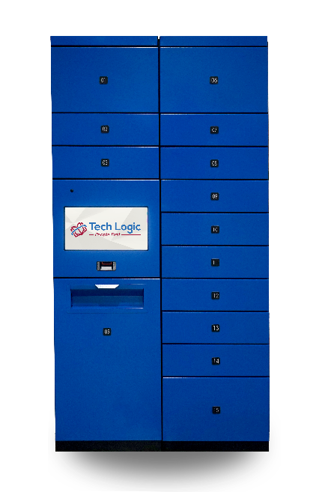
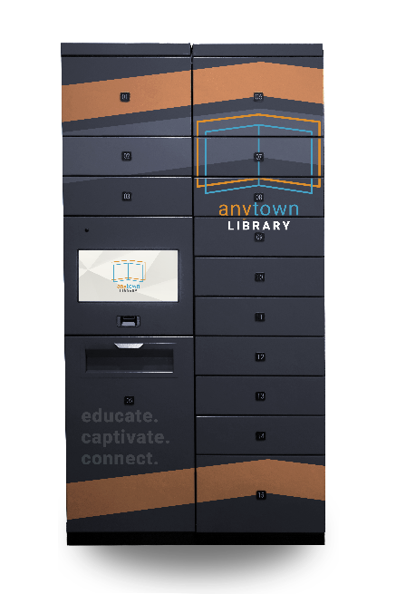
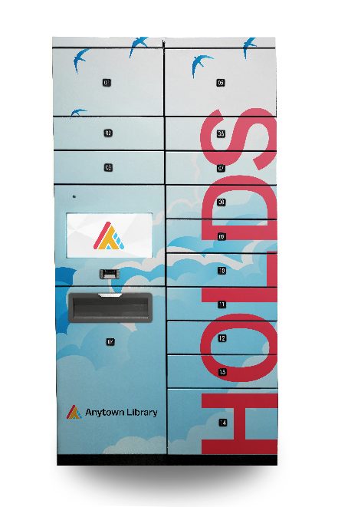
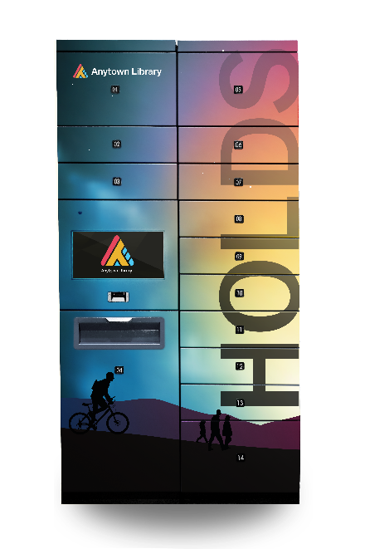
Streamline Holds Pickup with selfCIRC LOCKER
Notes:
A holds pickup locker will streamline your curbside pickup and can also expand your reach across the community.
selfCIRC LOCKER offers a secure and efficient connection point between your library and your patrons.
Here to share about our holds pickup lockers and, also, at the end, share some tips and tricks for ensuring you get the most out of your locker investment.

Slide 2
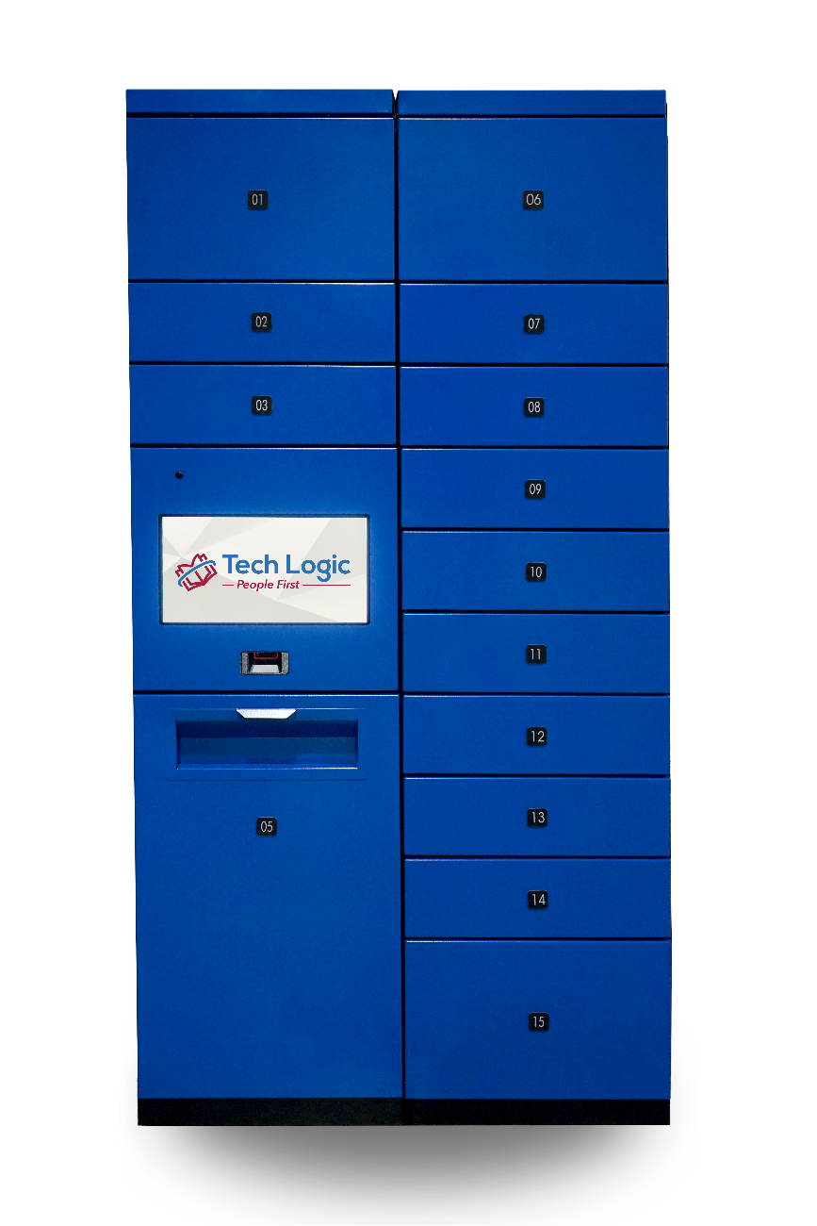
selfCIRC LOCKER
ILS Integrated
Our lockers work within your ILS holds pickup workflow. Ask us how!
Inside and Outside
Powder-coated steel, IP67 touchscreen, optional exterior awning
Web-Based Control
Manage lockers from any PC or tablet with access to the library network

Slide 3
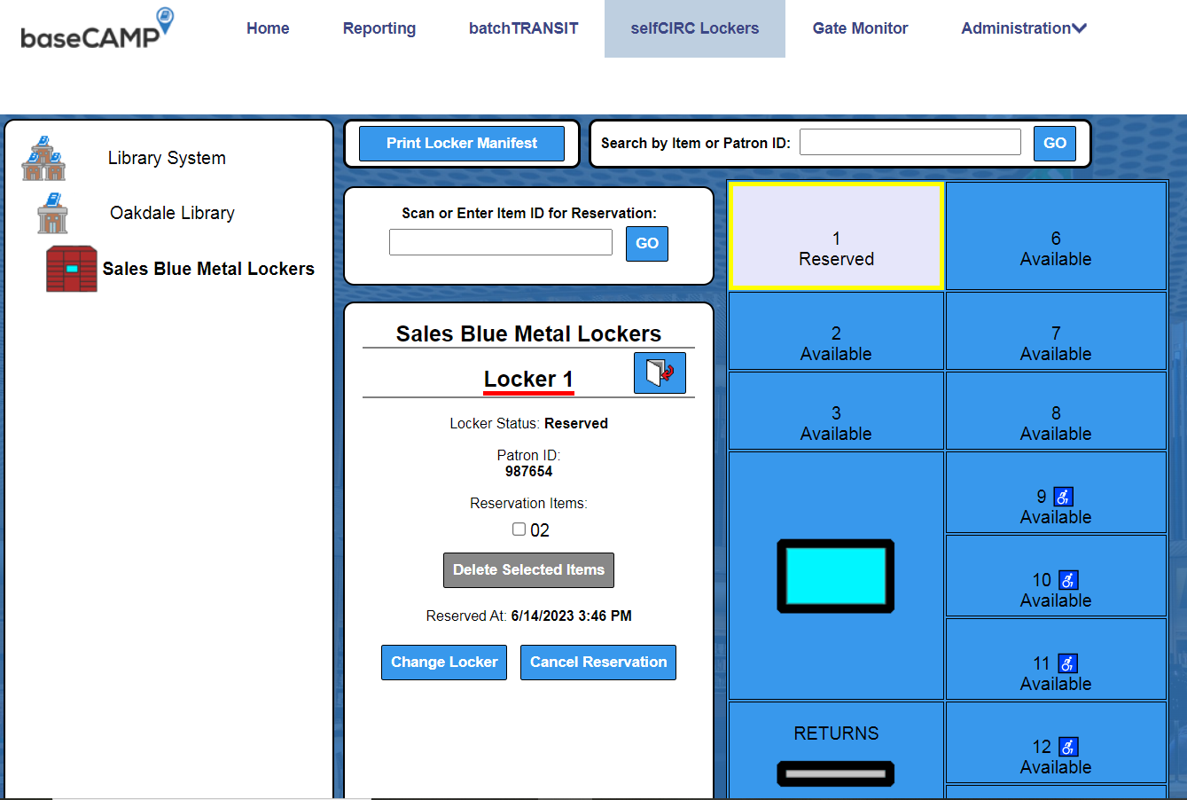
selfCIRC LOCKER
Intuitive Management, Streamlined Fulfillment
Tech Logic’s software integrates with the ILS, making it EASY for library staff to fulfill hold requests.
Step 1 — Hold Placement
Step 2 — Hold Processing
Step 3 — Hold Transit
Step 4 — Hold Pickup
Notes:
Step 1—Hold Placement. A patron reserves one or more hold items through the catalog and selects the locker as their pickup location.
Step 2—Hold Processing. A staff member scans the hold items into baseCAMP. baseCAMP assigns the hold items to an available locker space. The ILS notes that the hold items are in a transit status.
Step 3—Hold Transit. A staff member prints a manifest showing which hold items go to which locker space (including entry codes). The staff member uses each entry code to place hold items. Once the hold items are placed, the ILS notifies the patron that their hold items are available for pickup.
Step 4—Hold Pickup. The patron uses their library card to open the locker space that contains their hold items. Once the patron retrieves their hold items from the locker, the ILS checks out the items to the patron.

Slide 4
selfCIRC LOCKER
Step 1: Choose Your Console
Every selfCIRC LOCKER kiosk requires one CC-1 or CC-2 control console
Each CC-1 or CC-2 control console can support up to 144 locker reservation spaces and include the following:
A-size and B-size lockers with tamper-proof doors
Touchscreen (PCAP, waterproof, outdoor-approved
Windows IoT Enterprise LTSC
2-D barcode imager for print or digital (e.g. cell phones)
Security camera (if the library decides to enable)
Returns bin (CC-2 only)
CC-1
CC-2

Slide 5
selfCIRC LOCKER
Step 2: Add Locker-Only Consoles As Needed
Tech Logic can install additional LO-1 and LO-2 consoles onto the library’s selfCIRC LOCKER kiosks at any time, to fit the library’s evolving needs and strategies.
LO-1 and LO-2 consoles include the following:
A-size and B-size lockers with tamper-proof doors
C-size lockers with tamper-proof doors (LO-2 only)
LO-1
LO-2

Slide 6
selfCIRC LOCKER
Step 3: Personalize Your Lockers
Showcase your library’s personality, build engagement throughout your community, and raise awareness for your services
A selection of various standard paint colors are already included with our lockers.
Or, we can apply custom colors or vinyl wrapping according to your custom design (quoted).

Slide 7
We’d love to talk with you!
Mike Heitzman, Sr. Solution Specialist, Tech Logic
mheitzman@tech-logic.com | 651-208-9504
www.tech-logic.com/download-product-catalog

