Slide 1
SWAN RFID Users Group
La Grange Public Library
April 25, 2024

Slide 2
Agenda
Welcome and Introductions
COSUGI 2024 Update
Open Discussion
Next meeting: October 24, 2024
SWAN Forums
Library Lockers and Drive-Up Windows
SWAN Support Site – RFID
SWAN RFID Library Updates

Slide 3
COSUGI 2024 Update
Carla Clark included RFID integration in the BLUECloud Circulation initiatives for 2024-2025.
Session: BC Circulation: A Day in the Life. COSUGI Reconnect 2024 (March 7, 2024).

Slide 4
SWAN RFID Library Updates
New installations, procedures, equipment

Slide 5
Library Lockers and Drive-Up Windows
Description | Agency Code | Route To | RFID?
Bloomingdale Public Library Locker | BDD_L | BDD | Y
Bensenville Public Library Locker | BVD_L | BVD | N
Downers Grove Public Library Locker | DGS_L | DGS | Y
Glen Ellyn Public Library Drive-up Window | GED_D | GED | N
Geneva Public Library Drive-up Window | GVD_D | GVD | Y
Indian Prairie Public Library District Drive-up Window | INS_D | INS | N
La Grange Public Library Drive_up Window | LGS_D | LGS | Y
Matteson Area Public Library Locker | MTS_L | MTS | Y
North Riverside Public Library Locker | NRS_L | NRS | N
Oak Park Public Library Main Branch Indoor Locker | OPS_LI | OPS | Y
Oak Park Public Library Main Branch Outdoor Locker | OPS_LO | OPS | Y
Park Forest Public Library Drive-up Window | PFS_D | PFS | N
St. Charles Public Library District Drive-up Window | SCD_D | SCD | Y
Stickney-Forest View Public Library Central Stickney Locker | SFS_LC | SFS | N
Stickney-Forest View Public Library District Locker | SFS_LO | SFS | N
Villa Park Public Library Locker | VPD_L | VPD | N

Slide 6
By the Numbers
21 of the 100 SWAN Libraries have an RFID system:
4 SWAN RFID Libraries have Indoor or Outdoor Lockers (BDD, DGS, MTS, OPS)
3 SWAN RFID Libraries have a Drive-Up window (GVD, LGS, SCD). OLS is in the process of building a Drive-Up window.

Slide 7
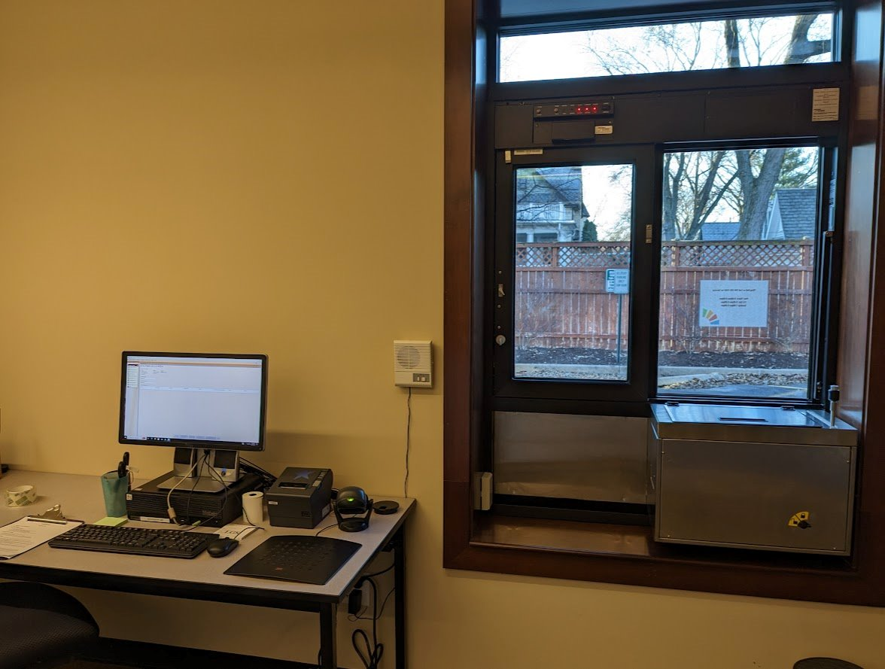
La Grange Public Library
Purchased 3M RFID system with security gates and four 3M Self-checks (2014).
RFID system activated upon migration to SirsiDynix WorkFlows (2015).
Purchased a Bibliotheca SelfCheck 500 (2021).
Installed Pick Up Window (2023).

Slide 8
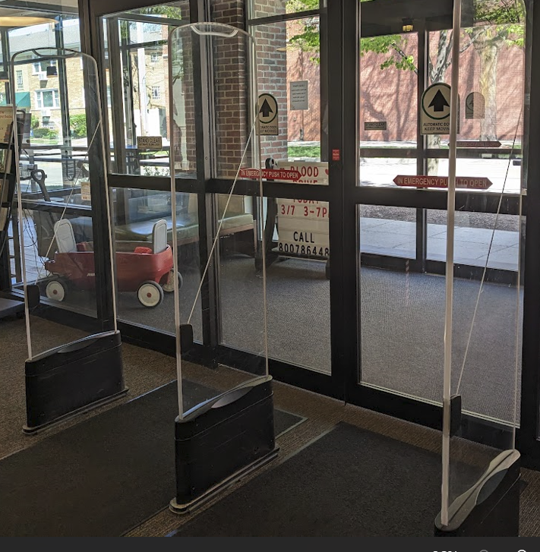
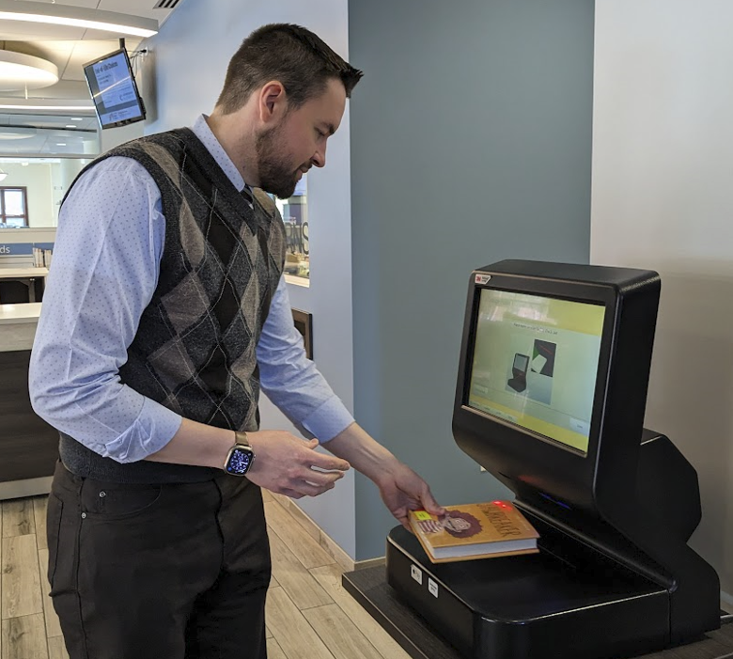
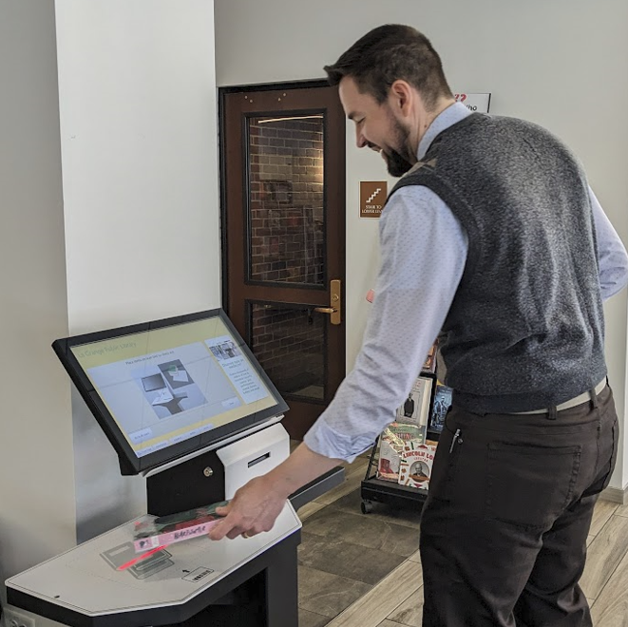
La Grange Public Library Tour
3M Self-Check
Security Gates
Bibliotheca SelfCheck 500

Slide 9
SWAN Support Site - RFID
https://support.swanlibraries.net/documentation/88053

Slide 10
SWAN Forums
https://forums.swanlibraries.net/
Keep the discussion going
Joining and accessing the forums
Open Discussion

Slide 11
Questions?
Next SWAN RFID Users Group Meeting:
October 24, 2024
Ahren Sievers ahren@swanlibraries.net Rebecca Bartlett rebecca@lagrangelibrary.org

