Slide 1
SWAN Acquisitions and Cataloging Users
May 09, 2024

Slide 2
Agenda
Updates from LACONI TSS Acquisition
Order Cards
Brief Record and On-the-Fly Item Creation and Maintenance
SWAN Support Site Revamp
Pre-Cat Libraries Expectations
Duplicate records (Paw Prints, Penworthy, Follettbound...)
New SWAN Self-Paced Course
SWAN Symphony Upgrade to 4.1
Vinyl records
Open Discussion
Next meeting: September 12th, 2024-9:30 a.m.

Slide 3
Technical Services Section Acquisitions Roundup 2024
Ingram is innovating with AI AutoStore Cube Storage.
They offer a leasing program and Ingram Express for "Need it Now " to compete with Amazon-flat fee, free shipping, small fuel surcharge ($3 or $6).
Ingram has a print-on-demand that prints 75,000/100,000 books a day!
Coming soon: a premium service called iCurate, a $2,100 value but is free! It is powered by actual librarians.
This service would ship standing orders on the 1st of each month for Adult, Teen and Youth.
Midwest Tape is committed to providing physical A/V media.
Midwest Tape has real people customer service agents.
Offering electronic EDI ordering, invoicing and seamless order/data integration.
Midwest Tape Return Program offers free replacements of cases, artwork and materials for up to one year.
Coming soon: My Cart will offer live streaming tv.

Slide 4
Children's Plus, Inc.
Baker & Taylor
CPI will be undergoing a rebranding in August 2024 to Libraria.
EDI compatible-Quick click
Free Collection Development Service
Monthly/Seasonal Lists
They also offer cataloging and processing.
Curt Leppert thanked attendees for their patience through COVID and the two cyber-attacks.
B&T has partnered with Library Ideas to be the exclusive publisher of VOX books. There are over 700 titles with a 12% discount through 6/30/2024.
Unprocessed VOX books will begin shipping on 5/15/2024 and pre-processed ones will ship on 6/1/2024.
Brodart
Has partnered with Library IQ
Offering a system that will show how well an item will circ in your library.

Slide 5
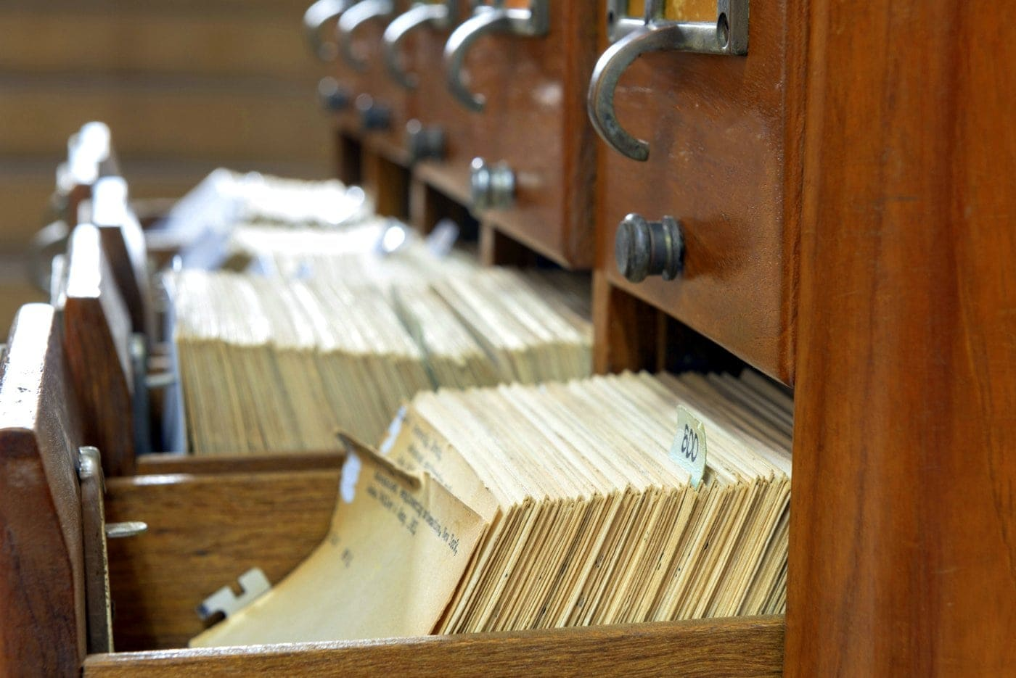
Order Cards
Does anyone use some other method instead of order cards?
If so, what system/method do you use?

Slide 6
Brief Record and On-the-Fly Item Creation and Maintenance
Use the "Add Brief Title" wizard instead of the Helper in the Charge/Checkout Wizard.
Place a copy-level hold so when the item returns it can be fully cataloged.

Slide 7
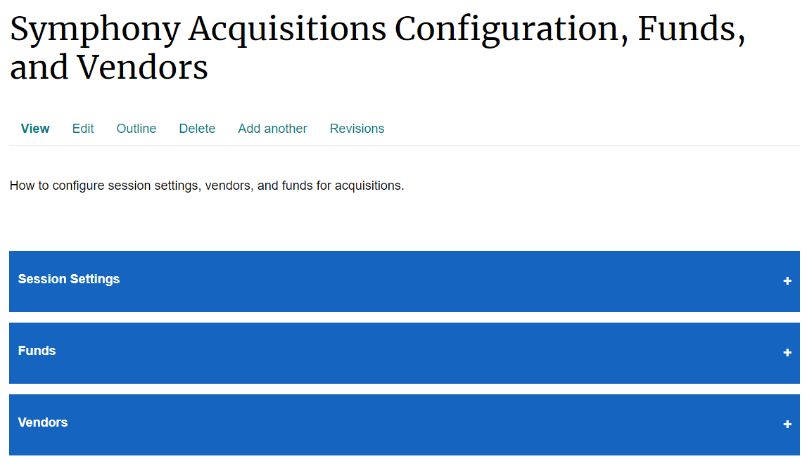
SWAN Support Site Revamp: Acquisitions and Cataloging Documentation Updates
Some documentation has been corrected, expanded, or made more concise.
You may notice some new display options with accordions.
SWAN conducts a support site documentation review yearly.
Remember that the support site is a living document, so it is updated constantly throughout the year.
Click around and explore!

Slide 8
Pre-Cat Libraries Expectations

Slide 9
Perform an ISBN/UPC search AND a title search before adding a new pre-cat.
Whenever possible, report duplicate records via the ticket system.

Slide 10
3) Ensure the pre-cat has the required MARC tags:
020 or 024 (ISBN or UPC)
100 (author)
245 (title)
250 (edition statement, when applicable)
264 (publication place, publisher, date of publication)
300 (physical description: number of pages or discs)
590 (format)
946 (signature: library 3-letter code, your initials, YYYYMMDD)
977 PRE-CAT

Slide 11
Duplicate records with children's materials
As mentioned before, ALWAYS do a title search in addition to searching by UPC number, especially when it comes to children's materials.
We combine ISBNs for Paw Prints, Follettbound, Penworthy, and other imprints into one record.
Recommended reading: When to Input a New Record.

Slide 12
New self-paced course
19 courses in Circulation and Technical Services
To access:
https://support.swanlibraries.net/meetings-trainings/swan-online-learning
Register in L2 before requesting access to the courses.

Slide 13
Symphony 4.1 upgrade
Scheduled overnight Monday, June 17th
SirsiDynix will begin upgrade process around 11PM June 17th
During the upgrade window (2-3h) WebServices/SIP2 will be offline
No access to My Account in Aspen | E-Resources | SIP2
Go-Live Tuesday, June 18th
SWAN does not anticipate any library staff disruption or required use of Offline Mode
Upon receiving All-Clear from SWAN, member libraries may access WorkFlows Tuesday morning, June 18
Watch SWANcom for updates!

Slide 14
Open Discussion

Slide 15
The Team
ACUG CO-CHAIRS
Mark your calendars now! Next meeting is Thursday, September 12, 2024!!!
Susana Leyva- Palos Heights Public Library
sleyva@phlibrary.org
Head of Technical Services
MaryKellie Marquez- Warrenville Public Library District
marykellie@warrenville.com
Acquisitions and Cataloging Manager
SWAN
Samantha Dietel
samantha@swanlibraries.net
Consultant, Bibliographic Services
Claudia Nickson
claudia@swanlibraries.net
Consultant, Bibliographic Services
Vickie Totton
vickie@swanlibraries.net
Consultant, Information Technology Systems & Support
Cynthia Romanowski
cynthia@swanlibraries.net
Bibliographic Services Manager

