Slide 1
SWAN Fireside Chat
June 25, 2024

Slide 2
Agenda
Symphony 4.1 Debrief
Independence Day Rebuild
Project updates
Hold map revamp
SWAN Expo
Aspen/LiDA update
E-Resource update
Resource sharing update
User Groups
ILL Recap
Engagement Poll
Zoom Consultation Update
Communications & upcoming meetings

Slide 3
Symphony 4.1 Debrief

Slide 4
Symphony Upgrade Review
Timeline of Events – Monday 6/17-18
10:17pm – SirsiDynix tech began the upgrade process after confirmation of successful backup.
Est. install time: 1-3hrs
12:04am – SirsiDynix communicated that the upgrade was taking longer than expected, but we opted to give it more time.
4:08am - Decision was made to terminate the installation after SirsiDynix determined that the upgrade process had hung—logs were no longer updating.
5:55am - SWAN restored Production from backup and the server returned to full 3.7.1 functionality.

Slide 5
Symphony Upgrade Review
What now?
Working with SirsiDynix to determine the cause
(similar issues did not occur on Test)
Waiting to be assigned a new upgrade date
SWAN has been promised to receive priority scheduling
Make sure to subscribe to SWANcom

Slide 6
Installing/downgrading WorkFlows
If your library has not already upgraded to WorkFlows 4.1; please refrain
Installation packages for WorkFlows 4.1 will remain on the Support Site
Installation packages for WorkFlows 3.7.1 are available by request via help ticket
WorkFlows 4.1’s new support for Item Category 6 causes issues when editing an item record on Symphony 3.7.1
Client/Server mismatch pop-up message at startup
Clients are not required to be updated prior to server upgrade
New features unavailable until client is and server version matches
Client/Server mismatch errors to be expected until after go-live

Slide 7
What’s happening?
Rebuilding the Authority and Authority Thesauri indexes
Starting Wednesday evening – July 3
Regularly scheduled Symphony Reports may be delayed on Independence Day (7/4)
In preparation:
Loading authority records from MARCIVE
Important notes:
Aspen catalog will still be available
No Cataloging during the Rebuilds
No BlueCloud Acq/Cat during Rebuilds
Independence Day
Authority Reindexing

Slide 8
Project Updates

Slide 9
Reminder: Symphony Hold Map Update
We will update the hold map July 16th
Why? To fix a loophole in hold queue and placement
If your user placed a hold at a station library other than yours (Aspen instance or staff logged into WorkFlows) AND
The item type was restricted to your users only in the hold map THEN
Your item would not fill that patron hold until it was no longer restricted This typically affected new items.
We will update the hold map so this loophole will no longer exist
Libraries do not need to do anything, and this will be seamless. All Hold Map rules and restrictions will remain the same but holds will no longer be impacted by which Aspen instance or "station library" was used to place that hold.

Slide 10
SWAN Expo
Registration open!
https://support.swanlibraries.net/expo
The full session schedule will include roundtables, workshops, and presentations - we will announce the full schedule soon!
Workshops and presentations
Aspen for library staff
BLUEcloud Analytics
Circulation best practices
Collection management: weeding, storage, renovation
MobileStaff hands-on
Navigating copyright
Power searching in Symphony
RAILS delivery
WorldCat Discovery
Roundtables
Mindfulness and self care
Staff development and team building
Difficult service scenarios
Save the date! August 23rd

Slide 11
Aspen Update

Slide 12
New minimum requirements for LiDA
Users may need to update their devices to continue using the app.
The app stores will display updated minimum compatibility starting 6/26.
iOS users may experience app crashing if they are not on a compatible version of iOS
IOS 16 or higher
Android 12 or higher

Slide 13
LiDA Scan-and-Go Pilot
Pilot is currently on pause, awaiting development to fix how checkout library is recorded in the app
In the interim, we're working on clearer error messaging for expected errors (items already checked out, items that can't be checked out, etc.)
Scan-and-go is the self check feature in the Aspen LiDA app

Slide 14
New accessible browse category display
"Netflix" like display has a better user experience for anyone using the keyboard or assistive devices to browse the home page.
Available after the release, 6/26 in the Theme settings

Slide 15
Electronic Resources Update

Slide 16
Sideloading expansion
Sideloading adds MARC records directly into Aspen
Records to not appear in Workflows
Sideloading is handled by SWAN and records must meet certain criteria to be added in Aspen
Vendors supported:
Kanopy
Flipster
Creativebug
Tumblebooks
To get these records added to your library catalog, please open a request to: help@swanlibraries.net

Slide 17
New EBSCO package
SWAN all-inclusive package
RAILS EBSCO Flagship package
57 libraries total
51 libraries total
Not enough interest to make cost appropriate
Package includes:
ConsumerReports.org
NoveList Plus / NoveList K-8 Plus
Choice of 6 additional databases
Estimated pricing was based on 84-96 libraries

Slide 18
Resource Sharing Update

Slide 19
Schedule your WorldShare ILL audit today!
Check for standard practice
Explore opportunities for process improvements
Review/cleanup user accounts
Customize deflections
https://scheduler.zoom.us/helen-pinder/ill_audit

Slide 20
User Groups Recap
Recordings of group meetings on the SWAN support site: https://support.swanlibraries.net/meetings-trainings/meeting-documents

Slide 21
ILL Users
Topics included
ILL and Copyright questions for SWAN Expo session
Reluctant lender scenarios
Auto deflection of non-US loan requests
ILL Audits
Next meeting: October 2nd at 9:30
https://librarylearning.org/event/2024-10-02/swan-ill-users

Slide 22
User Group Engagement Poll

Slide 23
Communications & Upcoming Meetings

Slide 24
Zoom Consultations
Speak directly with SWAN staff on a variety of topics.
Now featuring BLUEcloud Analytics consultations.

Slide 25
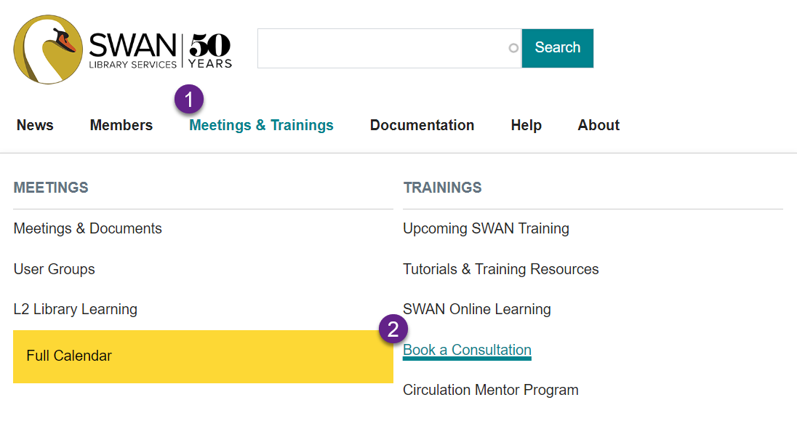

Slide 26
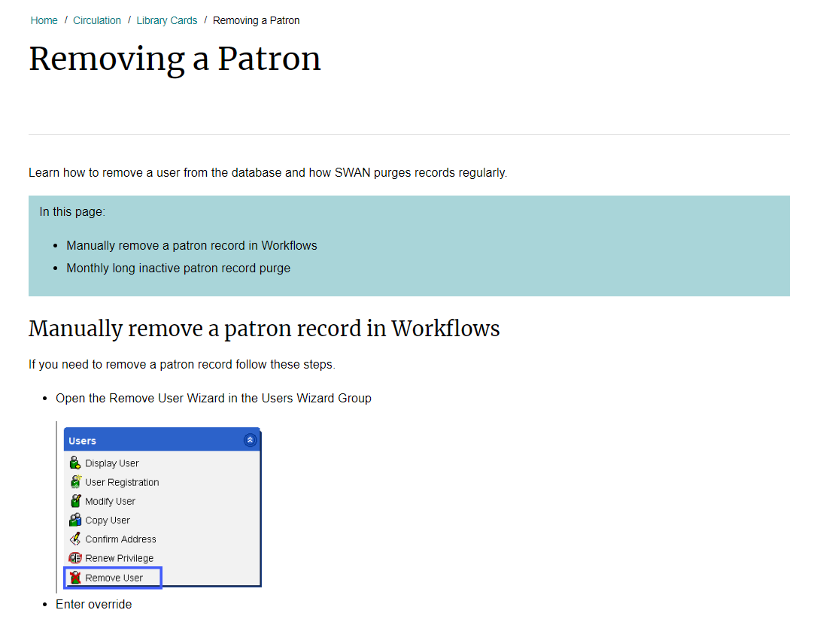
Updated Documentation
Removing a Patron

Slide 27
Upcoming meetings
Circ Users (6/26)
E-Resource Advisory (6/27)
Aspen Users (7/9)
Book Club Users (7/10)
Cataloging Advisory (7/11)
IPLAR Office Hours (7/16)
Circulation Advisory (7/17)
ILL/Circ/Quarterly Billing Office Hours (7/18)
SWAN Board Meeting (7/19)
Register now for 2024 user groups, governance meetings, and office hours! On L2 and the SWAN Support Site: support.swanlibraries.net/calendar
This year all registration is through Zoom. Register to receive email reminders.

Slide 28
See you at the next Fireside!
July 30, 2024
See L2 for details.

