Slide 1
SWAN RFID Users Group
Linda Sokol Francis Brookfield Library
October 24, 2024

Slide 2
Agenda
Welcome and Introductions
ILA and SD Connections Update
Open Discussion/Library Tour
SWAN Forums
SWAN Support Site – RFID
SWAN RFID Libraries and AMH
2023-2024 Projects
WorkFlows 4.1 Update

Slide 3
Welcome and Introductions
Co-Chairs:
Ahren Sievers, Systems Administrator, SWAN Library Services
Rebecca Bartlett, Access Services Manager, La Grange Public Library
Members: SWAN RFID libraries and SWAN libraries interested in implementing RFID

Slide 4
Illinois Library Association Conference (October 8-10, 2024)
Bibliotheca
Murphy Security Solutions
SelfCheck 3000
CloudCheck Tablet
RemoteLocker
Open+
DLA Inventory Wand
D-Tech HoldIT
D-Tech X-Plorer Self-Check

Slide 5
SirsiDynix Connections (October 22-24, 2024)
BLUECloud Accelerate Roadmap - Berit Nelson), Chief Product Officer, SirsiDynix
BLUECloud Circulation: Are We There Yet? - Carla Clark, Product Manager, SirsiDynix
Participant question: Is there any progress on RFID integration for Bibliotheca libraries?
Answer: SirsiDynix developers have completed enhanced RFID integration with RFID vendor FE Tech. They are currently working with Bibliotheca, which has already achieved RFID integration with Symphony Web. There is not yet a standard for RFID integration with a web-based product like BLUECloud Circulation versus a client-based product like WorkFlows.

Slide 6
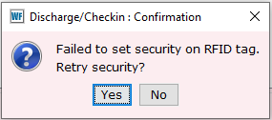
WorkFlows 4.1 Update
WorkFlows 4.0 introduced a bug for some users of RFID equipment.
WorkFlows 4.1 added the checkbox 'RFID Tag Security Enabled' as a workaround to this bug so that users wouldn't be interrupted while checking out materials.
Workaround: use the go-between software provided by RFID vendor (e.g. StaffLink)
4.2 will introduce an RFID Security Status wizard
Will allow users to change the security bit setting of RFID-enabled items.

Slide 7
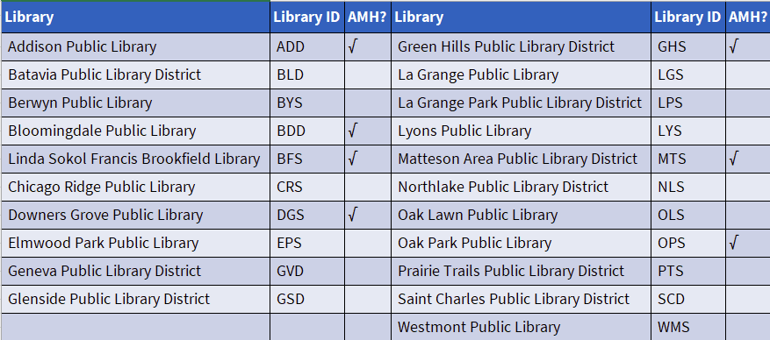
SWAN RFID Libraries and AMH
Of 21 SWAN RFID Libraries, 7 have an Automatic Materials Handler (AMH).
AMH vendors are 3M/Bibliotheca, D-Tech, Lyngsoe and TechLogic.

Slide 8
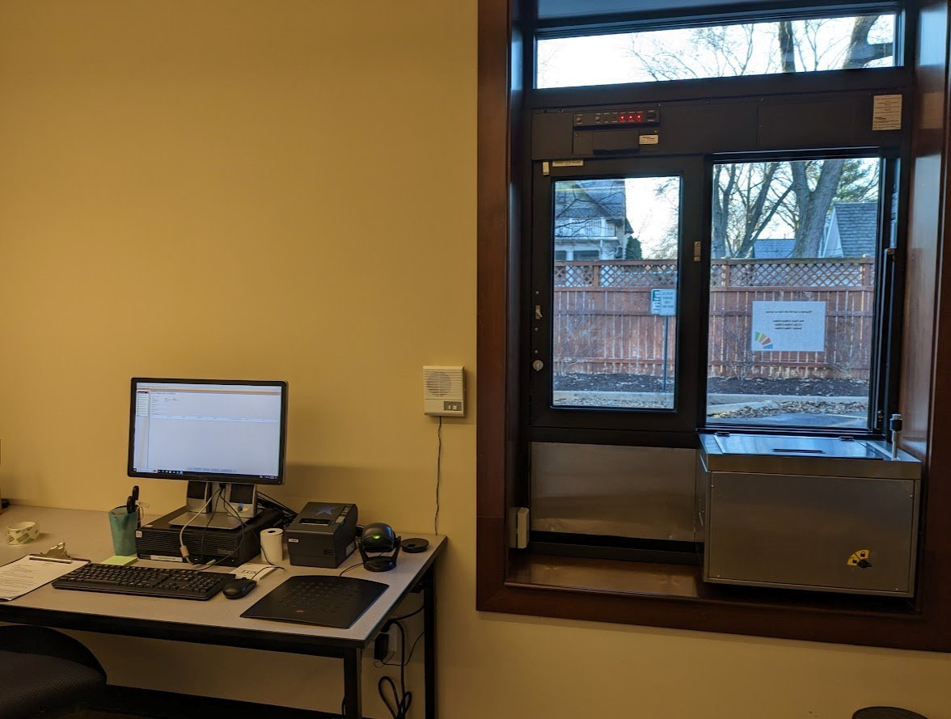
2023-2024 Projects
Hosted a virtual Vendor Fair for five RFID companies to showcase products and services (November 2023)
Visited the La Grange Public Library to see the new Pick Up window (April 2024).
Created a list of SWAN RFID libraries with drive up windows and lockers (April 2024).

Slide 9
SWAN Support Site - RFID
https://support.swanlibraries.net/documentation/88053

Slide 10
SWAN Forums
https://forums.swanlibraries.net/
Keep the discussion going
Joining and accessing the forums
Open Discussion/Library Tour

Slide 11
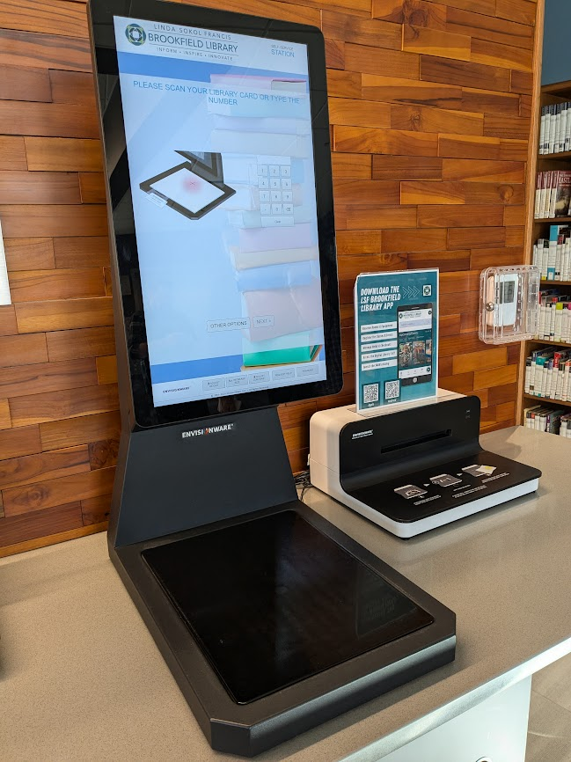
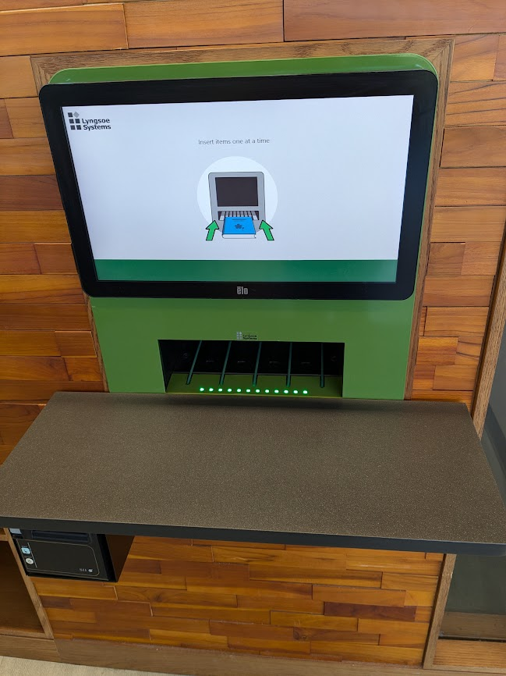
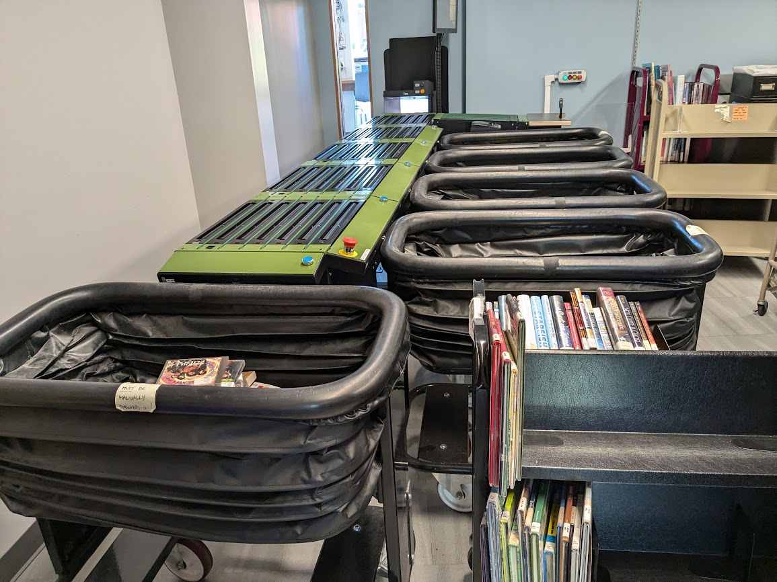
Envisionware RFID system at Linda Sokol Francis Brookfield Library
5-Bin AMH
Self-Check and DVD Unlocker
Book Return

Slide 12
Questions?
Ahren Sievers ahren@swanlibraries.net Rebecca Bartlett rebecca@lagrangelibrary.org

