Slide 1
Requesting Items from SWAN Libraries
September 29, 2021
Notes:
This workshop is a jump start for requesting items from SWAN libraries in OCLC WorldShare ILL. Since SHARE Illinois will sunset at end of October, 2021, SWAN libraries want to help other non-SWAN libraries make requests through WorldShare ILL.

Slide 2
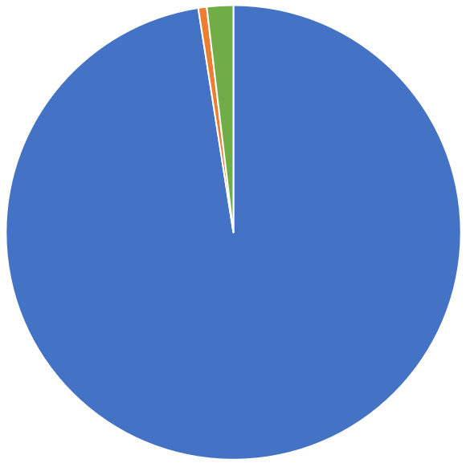
How We Share Resources
FY19 – 3,078,944 transits (ILL transactions - material travels to another library)
Within SWAN 3,000,954 (97.5%)
Borrow outside of SWAN 20,304 (0.6%)
Lend outside of SWAN 57,686 (1.9%)
Missing in Transit 1,518 (<0.05%) or less than 1 in every 2,000 items

Slide 3
SHARE Illinois
https://shareillinois.info/
NOTE: RAILS announced in July 2021, that SHARE Illinois will sunset at end of October 2021.

Slide 4
So how can you request items from SWAN libraries?
OCLC WorldShare ILL
Create Custom Holdings Group of SWAN Libraries (and other consortia)
Create Custom Holdings Path
Use Custom Holdings Path when making ILL request

Slide 5
To build Custom Holding Groups by consortium
Verify that your OCLC symbol is correctly identified in your library’s L2 information.
Choose catalog under dropdown
Click Apply
Then copy and paste codes into OCLC Create Custom Holding Groups interface
Notes:
For Academic libraries, a good list to create is the I-Share libraries. Select Library Type = Academic and Catalog = I-Share

Slide 7
Building OCLC Custom Holding Group for SWAN Libraries
Use RAILS OCLC Custom Holdings Group Generator and search by catalog https://www.railslibraries.info/services/oclc_groups
Select Catalog = SWAN
Apply for list of SWAN Libraries
Copy the returned list of OCLC symbols

Slide 8
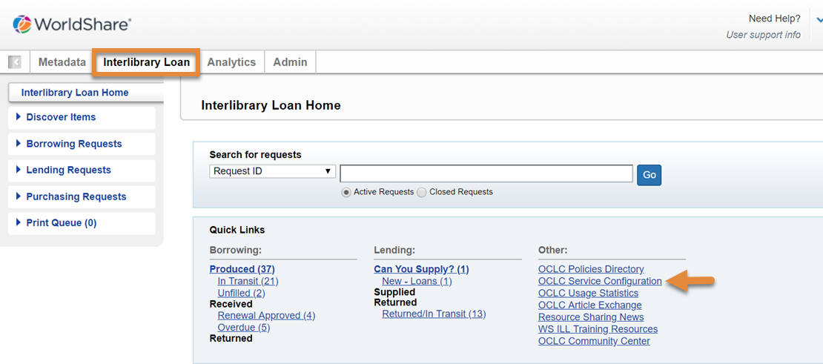
Finding the Custom Holdings Group interface – Service Configuration

Slide 9
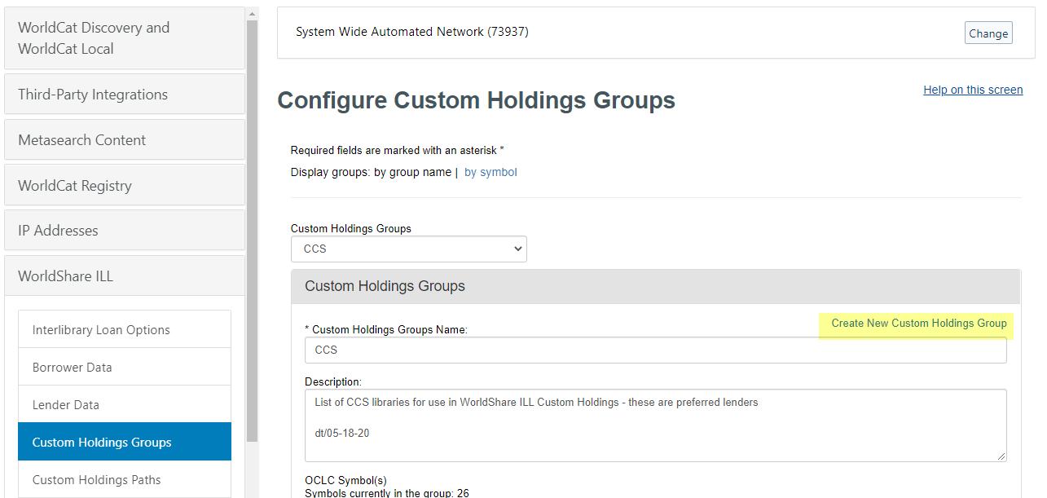
Create New Custom Holdings Group

Slide 10
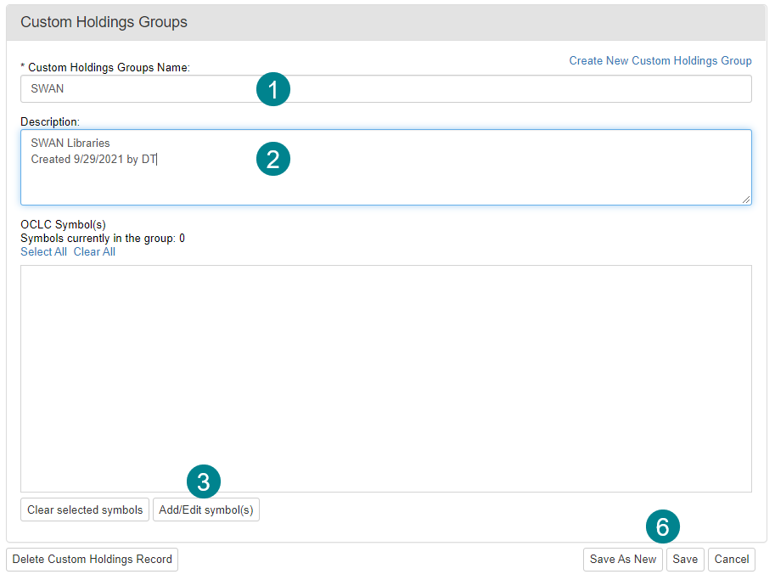
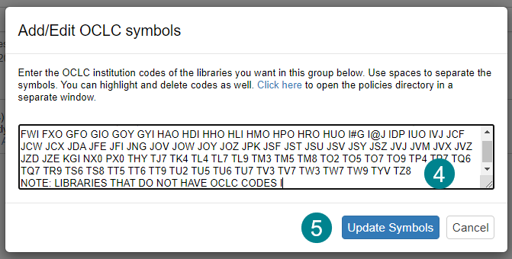
Create a group
Enter Custom Holdings Group Name
Enter Description, include data added/edited and person
Add/Edit symbols (copied from RAILS OCLC lookup tool)
Paste in symbols
Update Symbols
Save As New or Save (if editing existing)

Slide 11
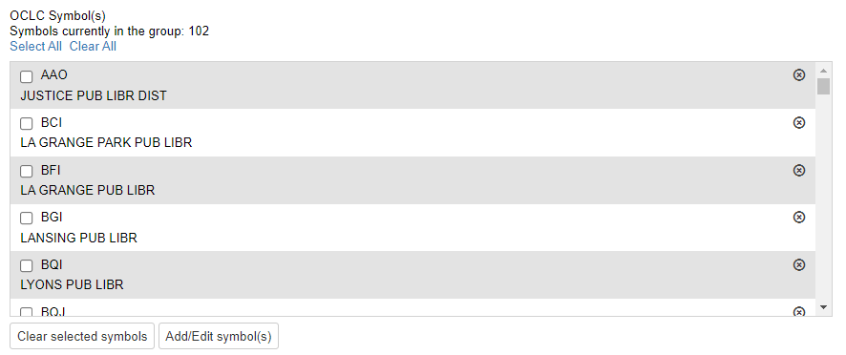
Symbol/Library List in Group
Once added, symbols expand to show libraries for additional reference and checking.

Slide 12
Create multiple groups
Create a group for all the shared catalogs in Illinois
CCS
Pinnacle
PrairieCat
RSA
I-Share/CARLI
SHARE – Heartland
Create state-wide groups
Subject focused
Preferred Lenders
Delinquent Borrowing Libraries
Libraries can be defined in multiple groups. For example, National University of Health Sciences OCLC symbol might be added to all these groups:
SWAN
Illinois
Academic
Health

Slide 13
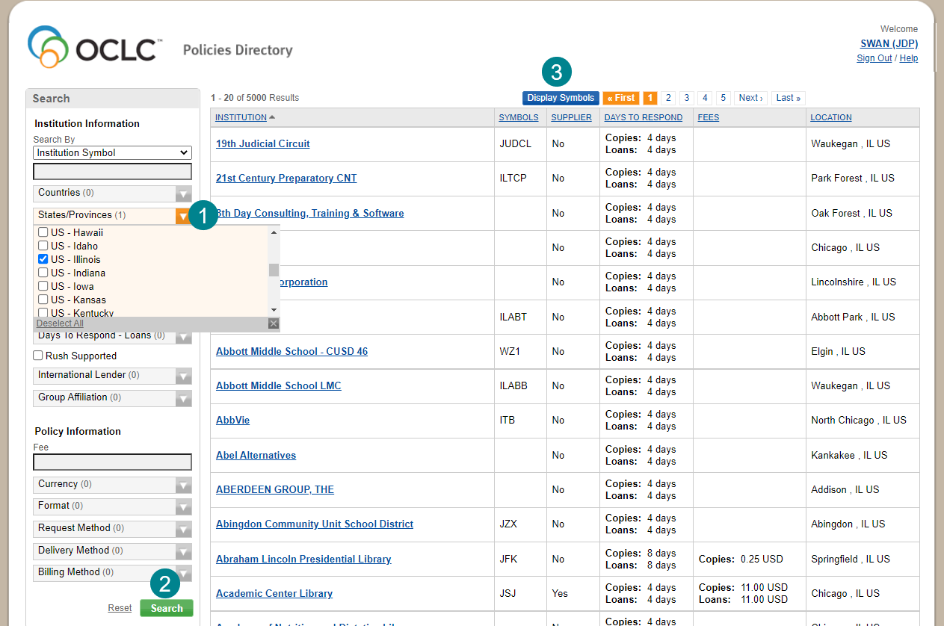
Using OCLC Policies Directory for Library Search
Libraries in Illinois:
State/Province – select US – Illinois
Search
Display Symbols

Slide 14
Copy/Paste Symbols between Tools
Copy all symbols (these will be used to create the custom group – Illinois)

Slide 15
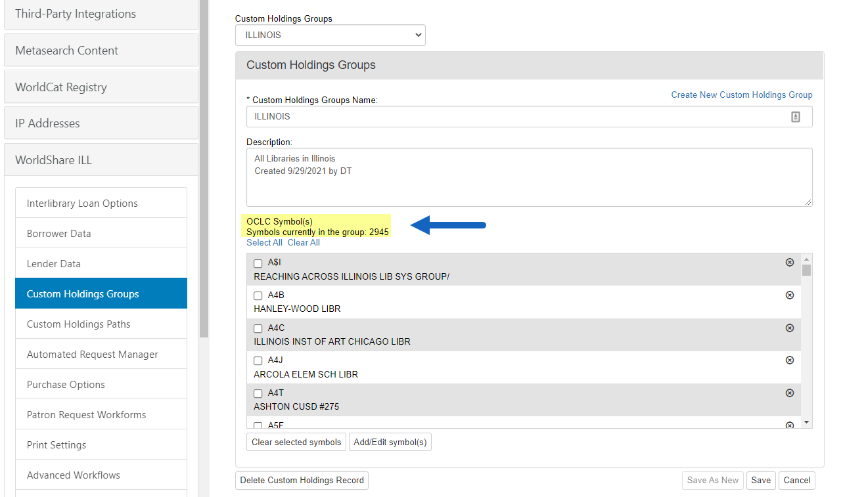
Creating Illinois Group ~3,000
Verify at least once per year
A group this large will take a few seconds to save – look for success message

Slide 16
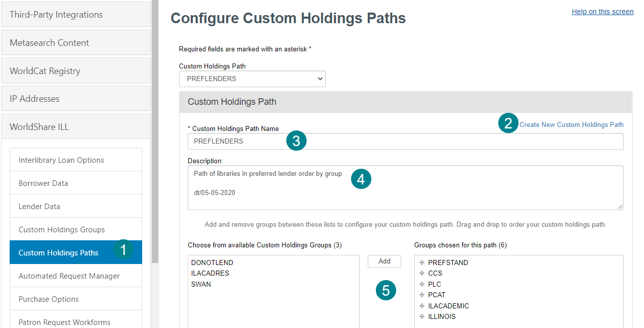
Create Custom Holdings Path (priority list of your groups)
Service Configuration – Custom Holdings Paths
Create New
Name the Path
Description (remember date/initials)
Move groups into priority order

Slide 17
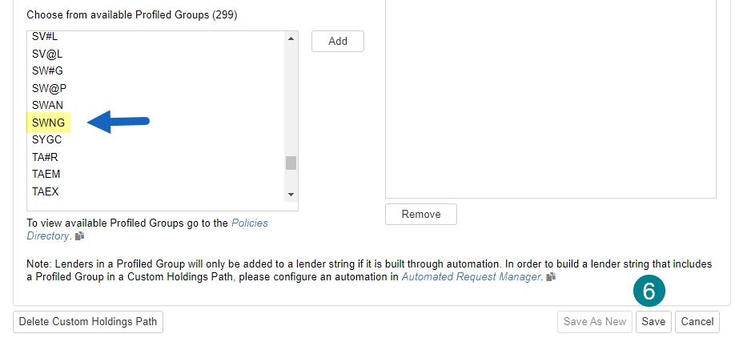
Custom Holdings Path –Profiled Groups
Save
Note: in the case of SWAN, you can use our profiled group BUT IT IS SWNG, NOT SWAN. Not all consortia have been profiled.

Slide 18
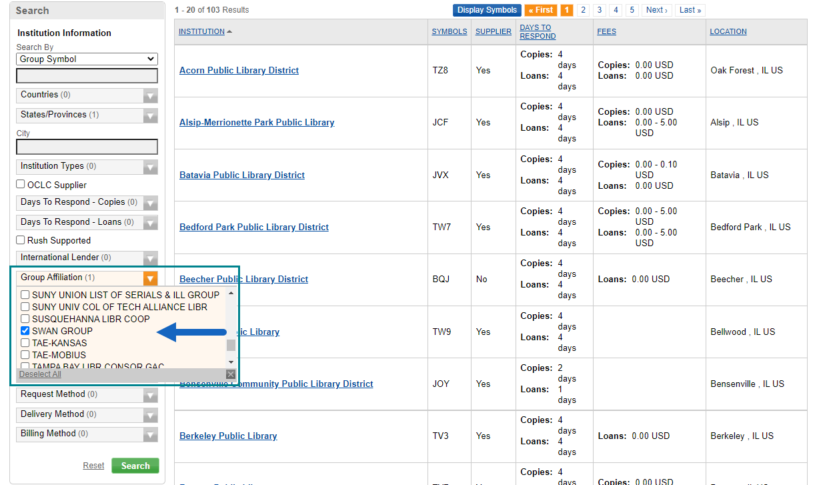
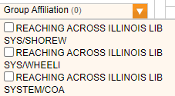
Search for Group Affiliation in Policies Directory
While Group Affiliation is a great shortcut, not all consortia or groups in Illinois have maintained their membership. Beware!

Slide 19
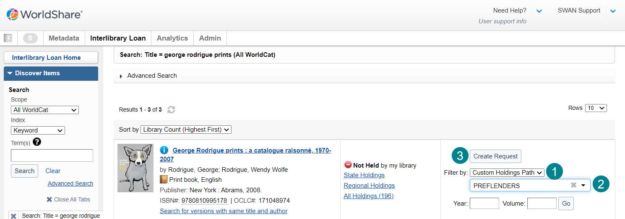
Create Request in WorldShare ILL
Filter by: Custom Holdings Path
Select the desired path
Create Request

Slide 20
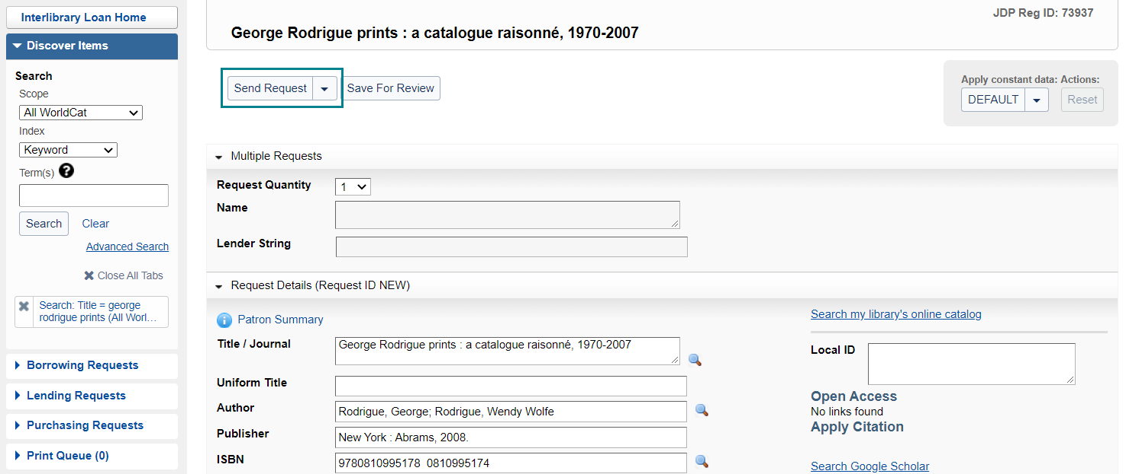
Send Request
By the way – Did you know you can request multiple copies to facilitate book club requests? It will set up multiple lender strings.

Slide 21
Resources from OCLC
WorldShare Interlibrary Loan Documentation https://help.oclc.org/Resource_Sharing/WorldShare_Interlibrary_Loan?sl=en
Custom Holdings Groups https://help.oclc.org/Resource_Sharing/WorldShare_Interlibrary_Loan/Service_Configuration_Settings/040Custom_Holdings_Groups
Custom Holdings Paths https://help.oclc.org/Resource_Sharing/WorldShare_Interlibrary_Loan/Service_Configuration_Settings/050Custom_Holdings_Paths
Create and edit requests https://help.oclc.org/Resource_Sharing/WorldShare_Interlibrary_Loan/Borrowing_Requests/Create_and_edit_requests

Slide 22
Questions?
We will provide a recording of this session to our consortium colleagues and attendees
Find a colleague in another Illinois consortium to help test your holdings groups/paths
Our ILL Boot Camp Training series is available to all, although tailored to SWAN libraries https://support.swanlibraries.net/training/87282

